Slide 1
Duel Problem

Slide 2
Dual Problem of an LPP
Given a LPP (called the primal problem), we shall associate another LPP called the dual problem of the original (primal) problem.

Slide 3
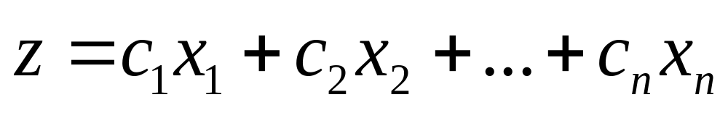
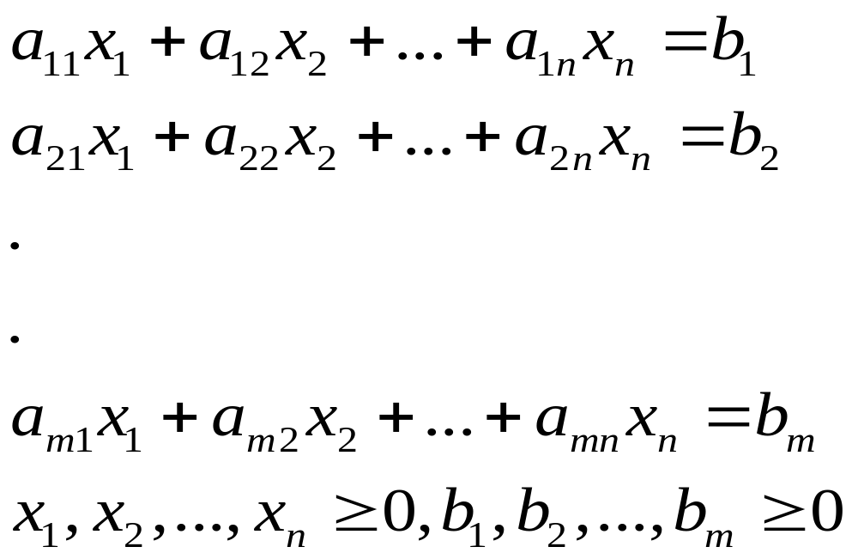
Definition of the dual problem
Given the primal problem (in standard form)
Maximize
subject to

Slide 4
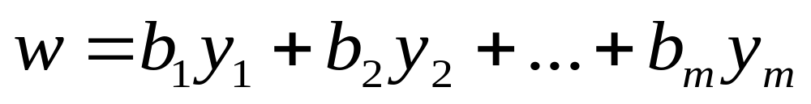
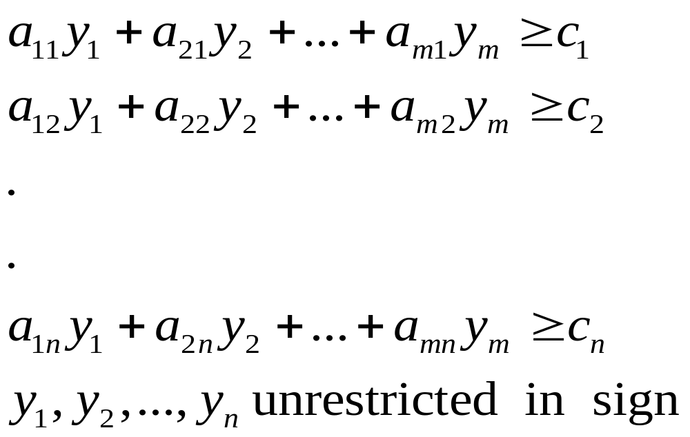
the dual problem is the LPP
Minimize
subject to

Slide 5

If the primal problem (in standard form) is
Minimize
subject to

Slide 6
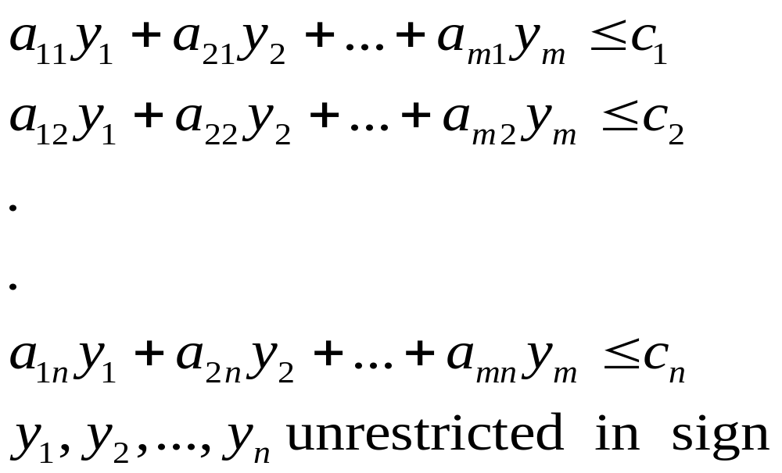
Then the dual problem is the LPP
Maximize
subject to

Slide 7
We thus note the following:
1. In the dual, there are as many (decision) variables as there are constraints in the primal.
We usually say y_{i} is the dual variable associated with the ith constraint of the primal.
2. There are as many constraints in the dual as there are variables in the primal.

Slide 8
3. If the primal is maximization then the dual is minimization and all constraints are ≥
If the primal is minimization then the dual is maximization and all constraints are ≤
In the primal, all variables are ≥ 0 while in the dual all the variables are unrestricted in sign.

Slide 9
5. The objective function coefficients c_{j} of the primal are the RHS constants of the dual constraints.
6. The RHS constants b_{i} of the primal constraints are the objective function coefficients of the dual.
7. The coefficient matrix of the constraints of the dual is the transpose of the coefficient matrix of the constraints of the primal.

Slide 10
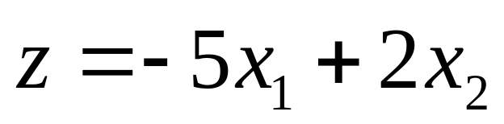
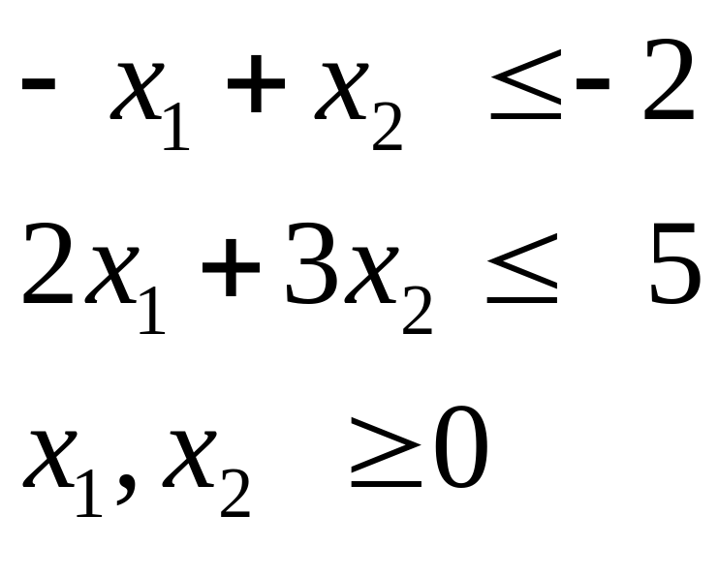
Write the dual of the LPP
Maximize
subject to

Slide 11
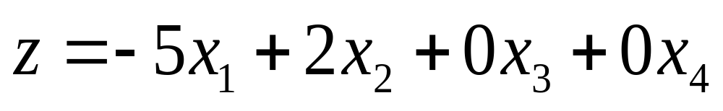
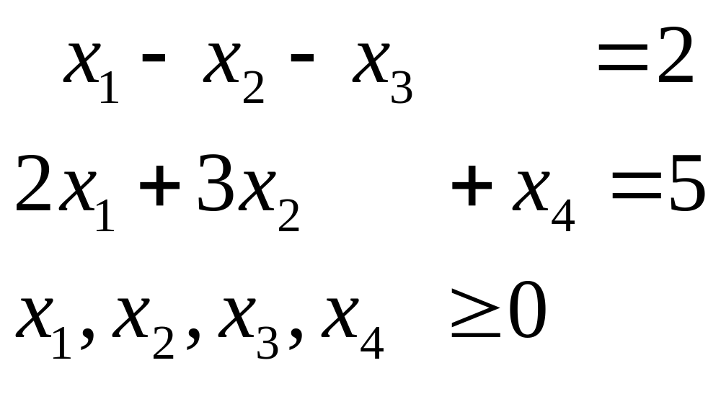
Thus the primal in the standard form is:
Maximize
subject to

Slide 12
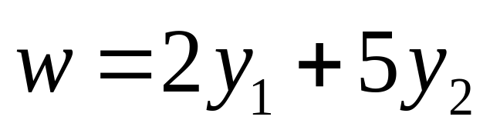
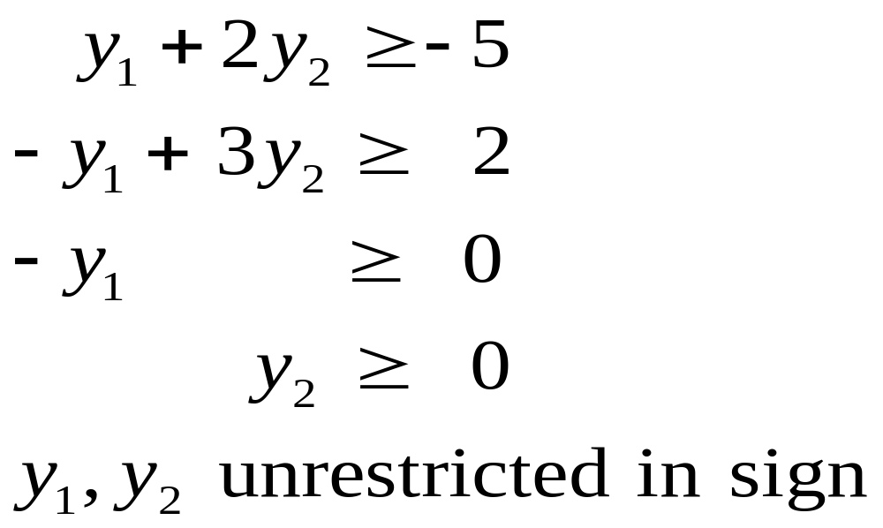
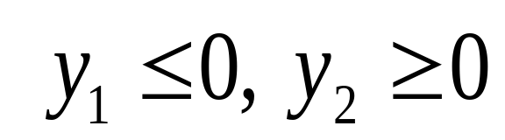
Hence the dual is:
Minimize
subject to

Slide 13
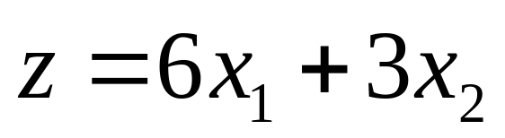
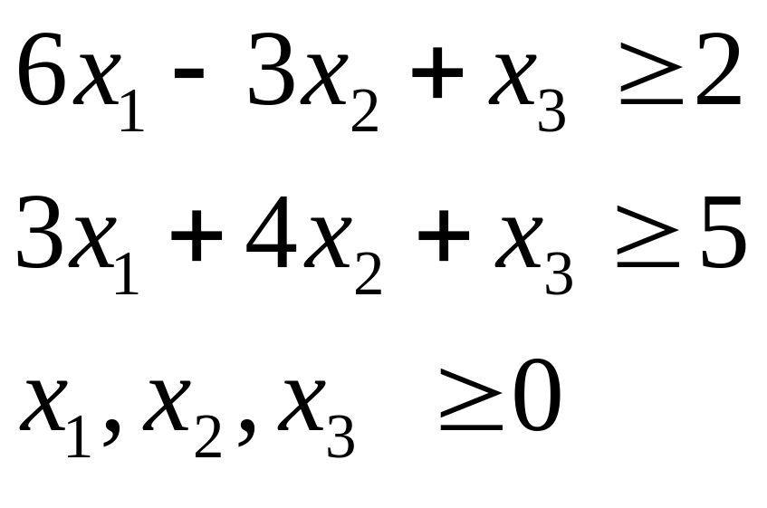
Write the dual of the LPP
Minimize
subject to

Slide 14
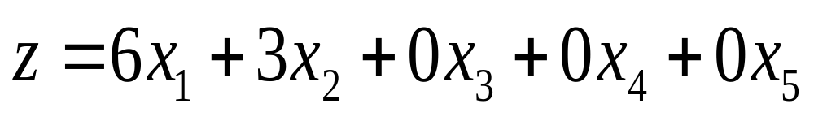
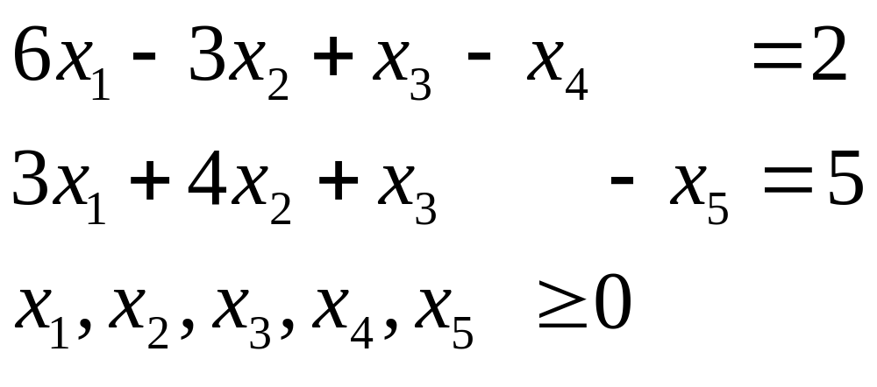
Thus the primal in the standard form is:
Minimize
subject to

Slide 15
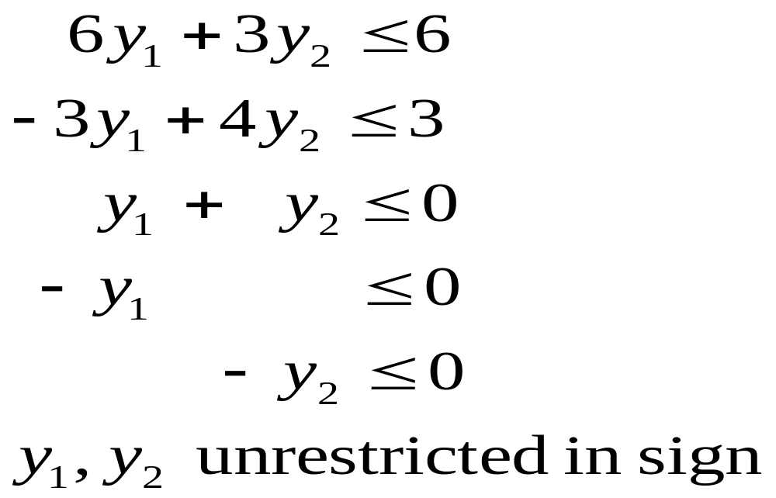
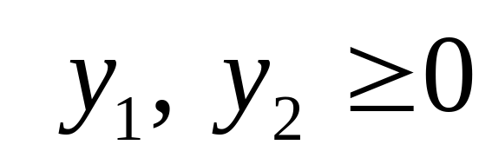
Hence the dual is:
Maximize
subject to

Slide 16
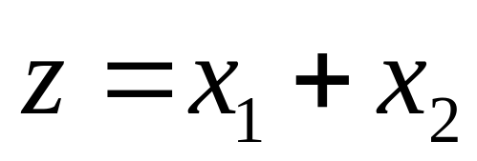
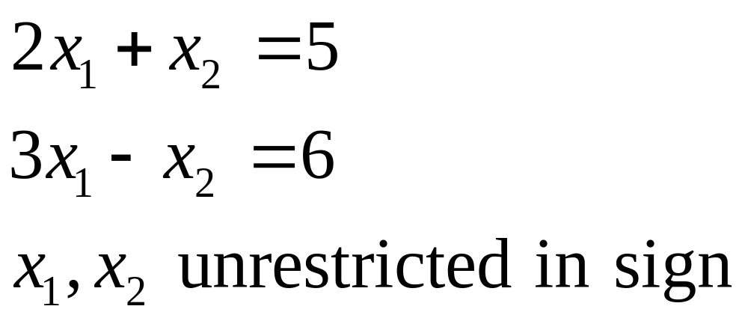
Write the dual of the LPP
Maximize
subject to

Slide 17
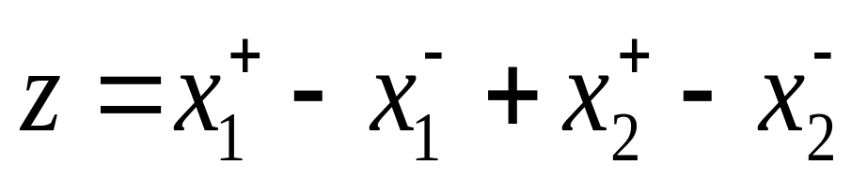
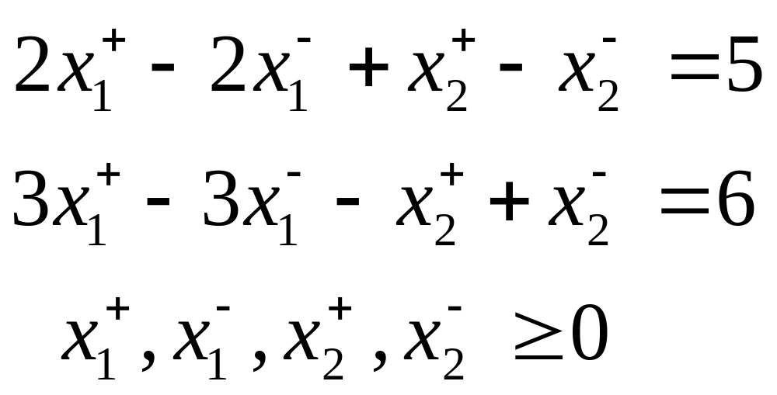
Thus the primal in the standard form is:
Maximize
subject to

Slide 18
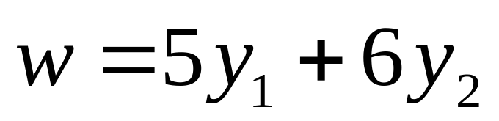
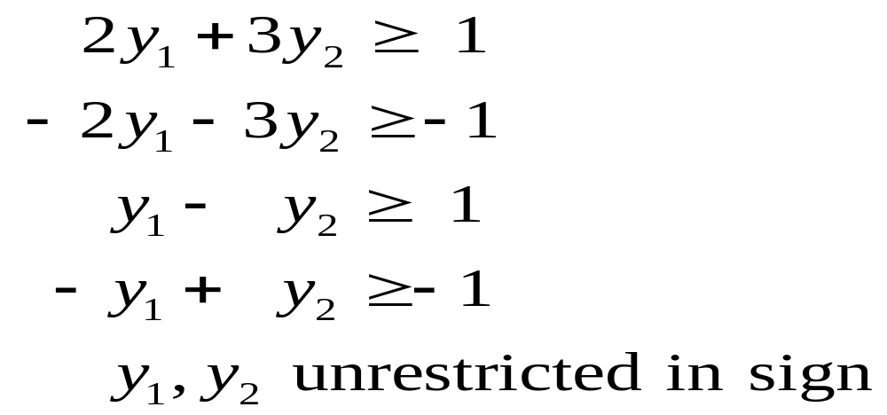
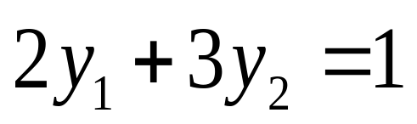
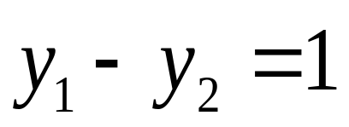
Hence the dual is:
Minimize
subject to

Slide 19
From the above examples we get the following SOB rules for writing the dual:
Label Maximization Minimization
Constraints Variables
Sensible ≤ form ≥ 0
Odd = form unrestricted
Bizarre ≥ form ≤ 0
Variables Constraints
Sensible ≥ 0 ≥ form
Odd unrestricted = form
Bizarre ≤ 0 ≤ form

