Slide 1
SQL Logistics Analytics
Queries + Result Tables + Visual Placeholders

Slide 2
Step 1: Remove Duplicate Orders
📌 Query:
SELECT Order_ID, COUNT(*) AS countFROM flipkart_ordersGROUP BY Order_IDHAVING COUNT(*) > 1;
📊 Result: Zero

Slide 3
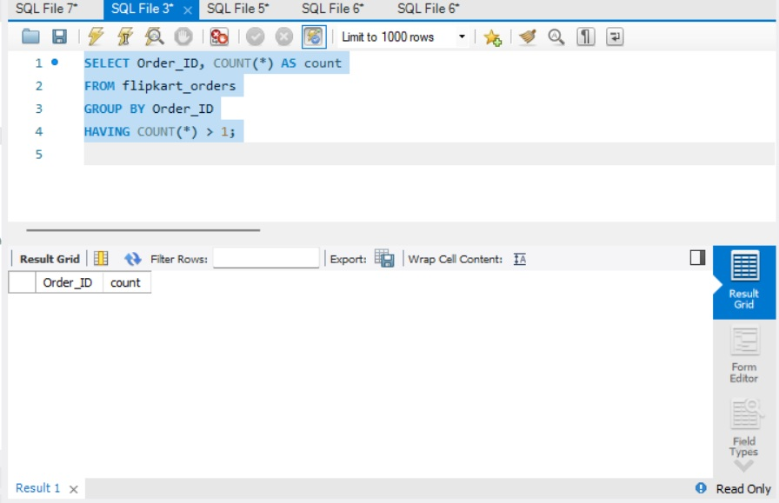
Screenshot of Step:1

Slide 4
Step 2: Count Null Traffic Delay
📌 Query:
SELECT COUNT(*) AS Null_Count
FROM flipkart_shipmenttracking
WHERE Traffic_Delay_Min IS NULL;
📊 Result: Zero

Slide 5
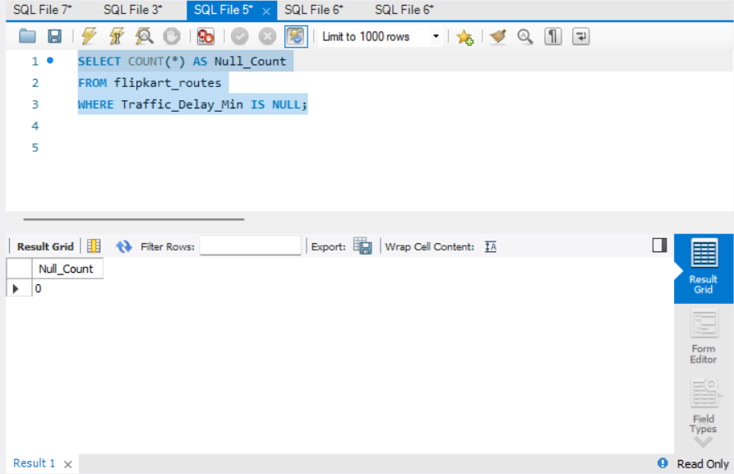
Screenshot of Step:2

Slide 6
Step 3: Check Date Format
📌 Query:
SELECT Order_Date, Expected_Delivery_Date, Delivery_Date
FROM flipkart_orders
LIMIT 10;
📊 Result: Dates are already in YYY-MM-DD Format

Slide 7
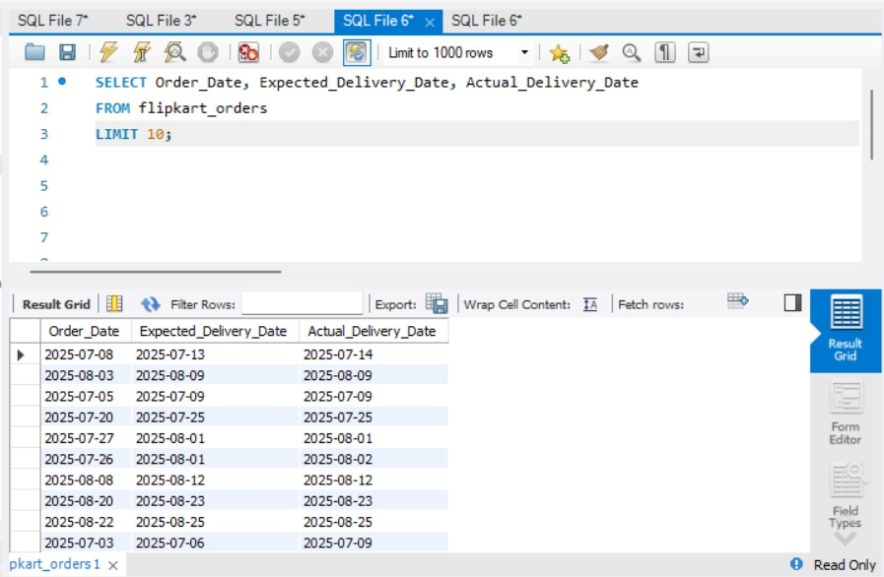
Screenshot of Step:3

Slide 8
Step 4: Incorrect Delivery Dates Check
📌 Query:
SELECT *
FROM flipkart_orders
WHERE Delivery_Date < Order_Date;
📊 Result: Zero

Slide 9
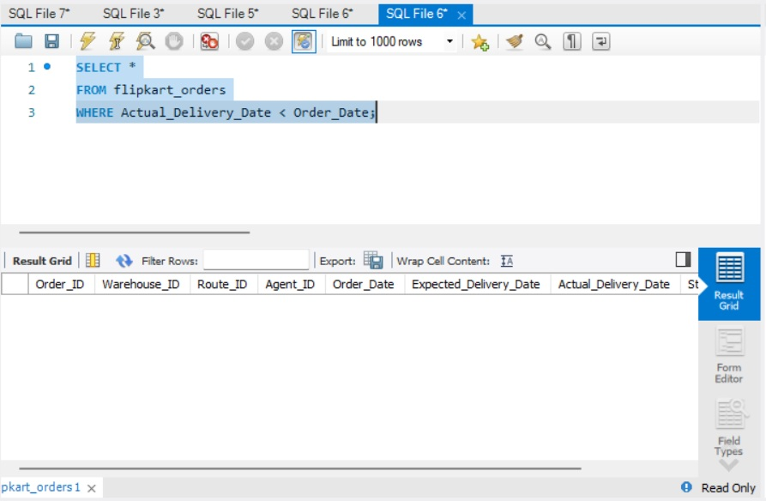
Screenshot of Step:4

Slide 10
Task Summary
✔ Duplicate orders removed
✔ Null delays handled
✔ Date formats standardized
✔ Validation checks completed

