Slide 1
Flipkart Delivery Delay Analysis
Task 2 – SQL Project
Orders, Routes & Warehouse-wise Delay Insights

Slide 2
Task 2 Objectives
Calculate delivery delay in days for each order using order dates.
Identify top 10 delayed routes based on average delay days.
Rank all orders by delay within each warehouse using window functions.

Slide 3
Query 1: Delivery Delay Per Order
The query below computes the delay in days by comparing actual and expected delivery dates.
SELECT Order_ID,
Order_Date,
Expected_Delivery_Date,
Actual_Delivery_Date,
DATEDIFF(Actual_Delivery_Date, Expected_Delivery_Date)
AS Delivery_Delay_Days
FROM flipkart_orders;

Slide 4
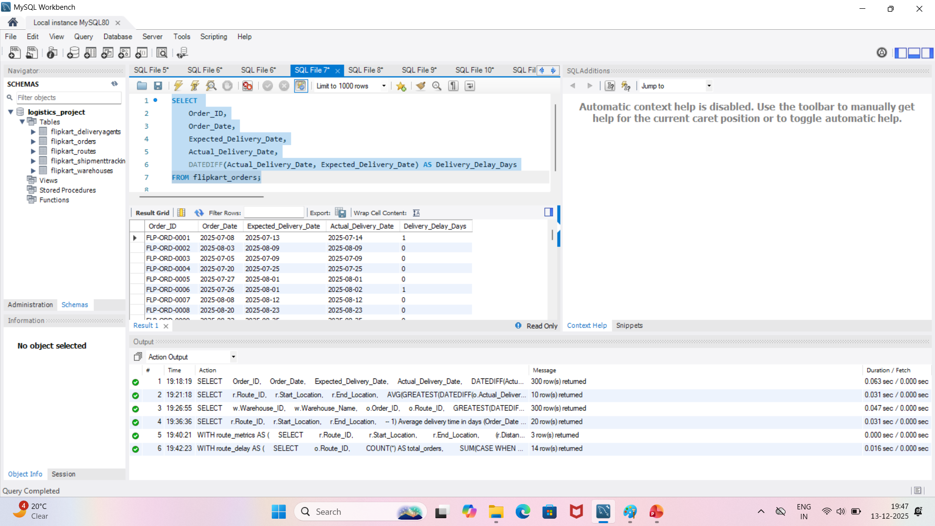
Query 1: Screenshot of Delivery Delay Per Order

Slide 5
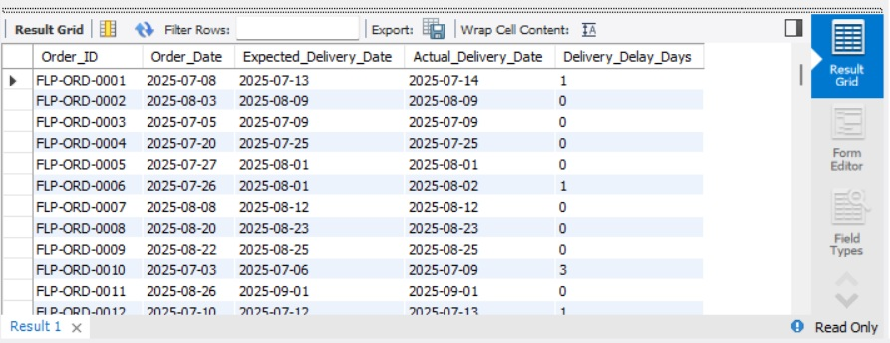
Result Sample: Delivery Delay Per Order
Sample of calculated delay days for few orders:

Slide 6
Query 2: Top 10 Delayed Routes
This query joins orders with routes and calculates average delay per route.
SELECT r.Route_ID,
r.Start_Location,
r.End_Location,
AVG(GREATEST(DATEDIFF(o.Actual_Delivery_Date, o.Expected_Delivery_Date),0)) AS Avg_Delay_Days
FROM flipkart_orders o
JOIN flipkart_routes r
ON o.Route_ID = r.Route_IDGROUP BY r.Route_ID, r.Start_Location, r.End_Location
ORDER BY Avg_Delay_Days DESC
LIMIT 10;

Slide 7
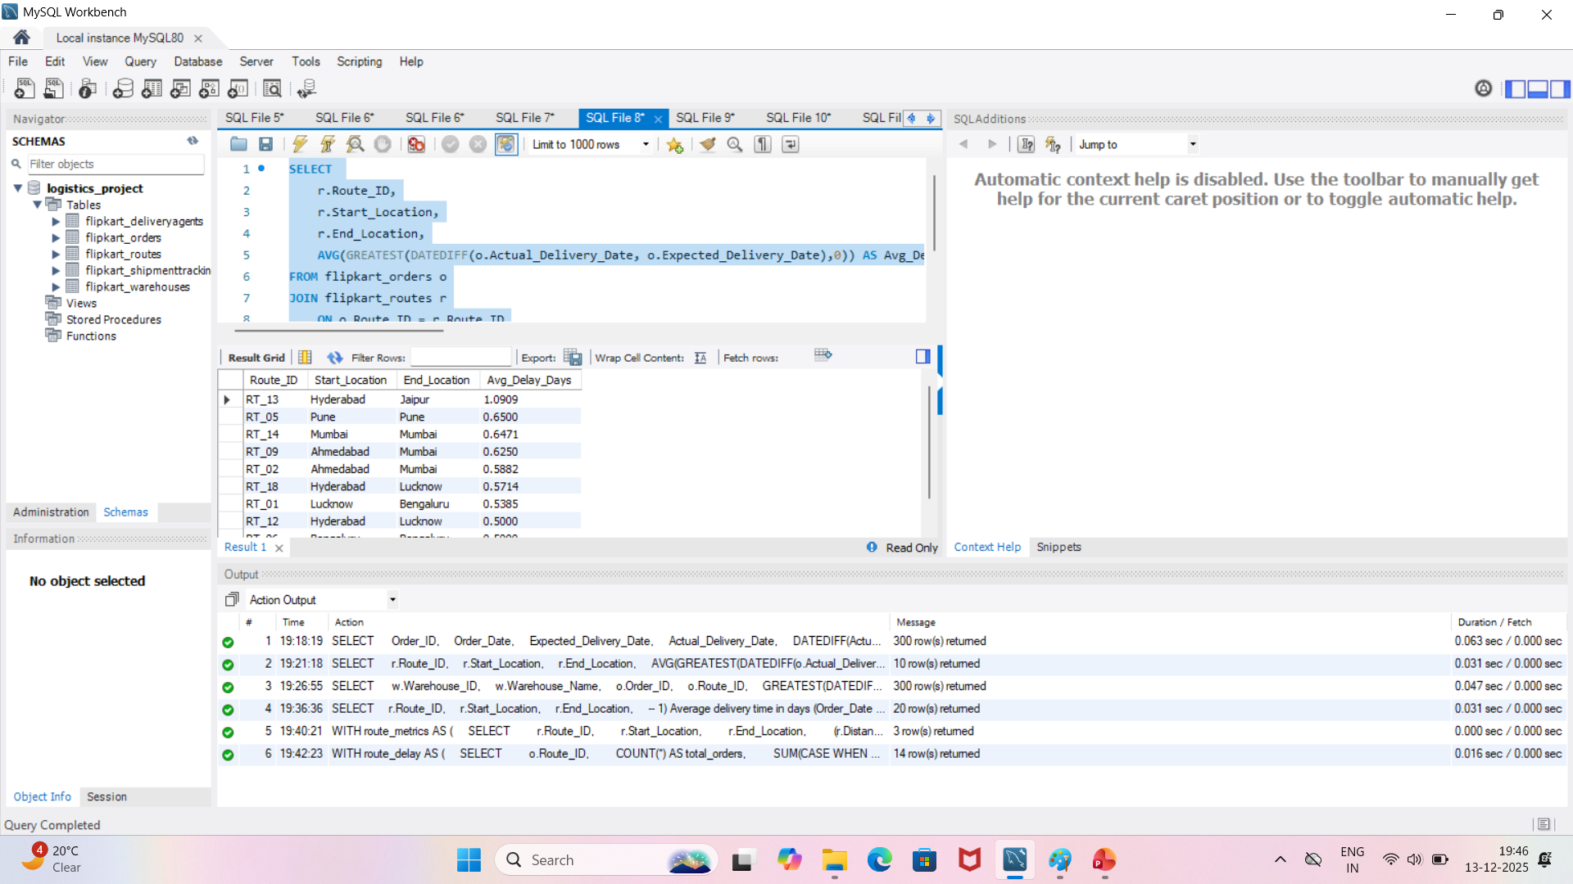
Query 2: Screenshot of Top 10 Delayed Routes

Slide 8
Result: Top 10 Delayed Routes
Example summary of the most delayed routes by average delay days:

Slide 9
Query 3: Rank Orders Within Each Warehouse
Window function ranks orders by delay days inside each warehouse.
SELECT
w.Warehouse_ID,
w.Warehouse_Name,
o.Order_ID,
o.Route_ID,
GREATEST(DATEDIFF(o.Actual_Delivery_Date, o.Expected_Delivery_Date), 0) AS Delivery_Delay_Days,
RANK() OVER (
PARTITION BY w.Warehouse_ID
ORDER BY GREATEST(DATEDIFF(o.Actual_Delivery_Date, o.Expected_Delivery_Date), 0) DESC
) AS Delay_Rank_In_Warehouse
FROM flipkart_orders oJOIN flipkart_warehouses w ON o.Warehouse_ID = w.Warehouse_ID;

Slide 10
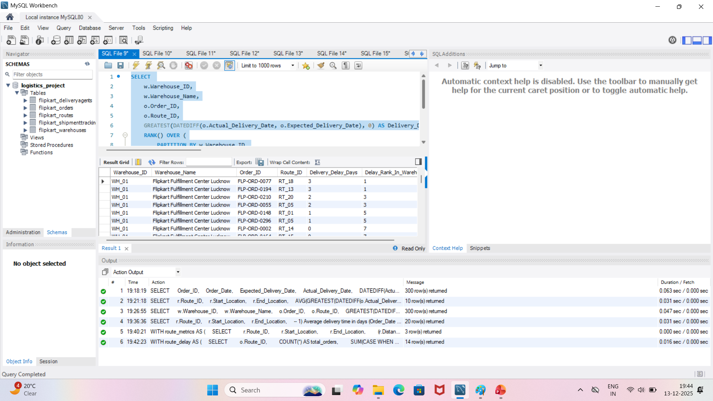
Query 3: Screenshot of Rank Orders Within Each Warehouse

Slide 11
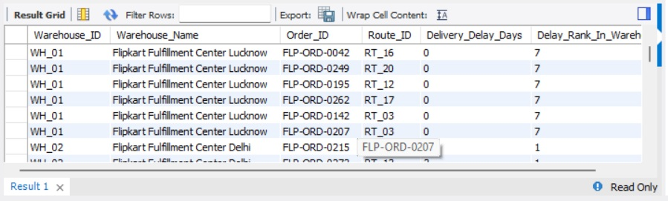
Result Sample: Warehouse-wise Ranking
Example ranking of delayed orders within a warehouse:

Slide 12
Key Findings-
Delay days can be monitored at order level using simple date differences.
Top delayed routes (e.g., RT_14, RT_11) should be reviewed for process or route optimization.
Warehouse-wise ranking helps identify critical delayed orders to prioritize.

