Slide 1
Task 3: Route Optimization Insights
Analyzing delivery time, traffic delays, and efficiency ratios for all 20 routes
Avg Delivery Time: Order_Date to Actual_Delivery_Date (in days)
Traffic Delay: Average delay minutes from route master data
Efficiency Ratio: Distance_KM ÷ Average_Travel_Time_Min
Delay Rate: Percentage of orders delivered after expected date

Slide 2
Query1: Route-Level Metrics Calculation
Core SQL query to extract all 4 route metrics from orders and routes data:
SELECT r.Route_ID, r.Start_Location, r.End_Location,
AVG(DATEDIFF(o.Actual_Delivery_Date, o.Order_Date)) AS avg_delivery_time_days,
r.Traffic_Delay_Min AS avg_traffic_delay_min,
(r.Distance_KM * 1.0 / r.Average_Travel_Time_Min) AS distance_time_efficiency,
AVG(DATEDIFF(o.Actual_Delivery_Date, o.Expected_Delivery_Date)) AS avg_delay_days,
SUM(CASE WHEN DATEDIFF(o.Actual_Delivery_Date, o.Expected_Delivery_Date) > 0 THEN 1 ELSE 0 END) * 100.0
/ COUNT(*) AS delayed_pct
FROM flipkart_orders AS o
JOIN flipkart_routes AS r ON o.Route_ID = r.Route_ID
GROUP BY r.Route_ID, r.Start_Location, r.End_Location, r.Distance_KM, r.Average_Travel_Time_Min, r.Traffic_Delay_Min;

Slide 3
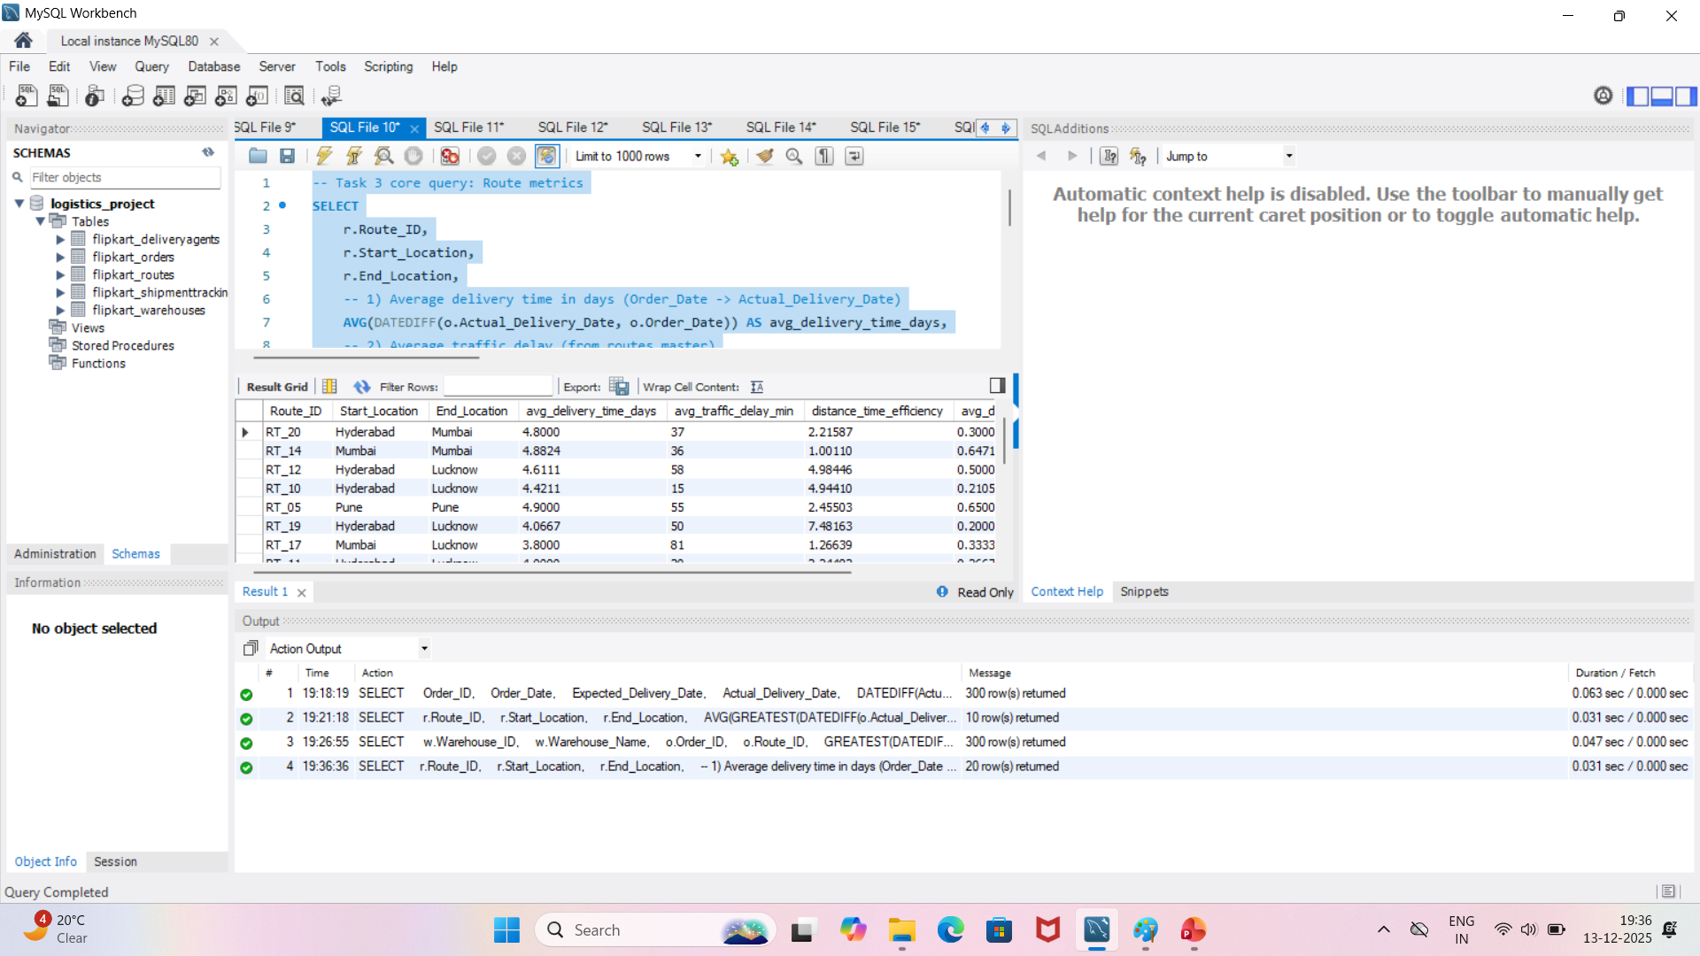
Query1: Screenshot of Route-Level Metrics Calculation

Slide 4
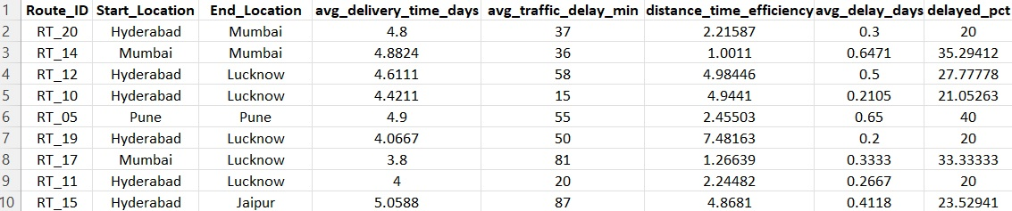
Results: Route Metrics Explained
Sample output showing all 4 metrics for top-performing and problem routes:
Key: Higher efficiency ratio = better performance. Delayed % should be <10% for optimal routes.

Slide 5
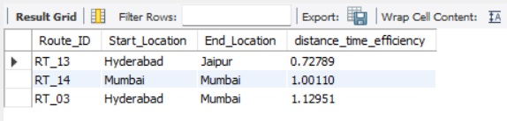
❌Query2: Top 3 Routes with WORST Efficiency
Lower efficiency ratio = slower route (km per minute is low)

Slide 6
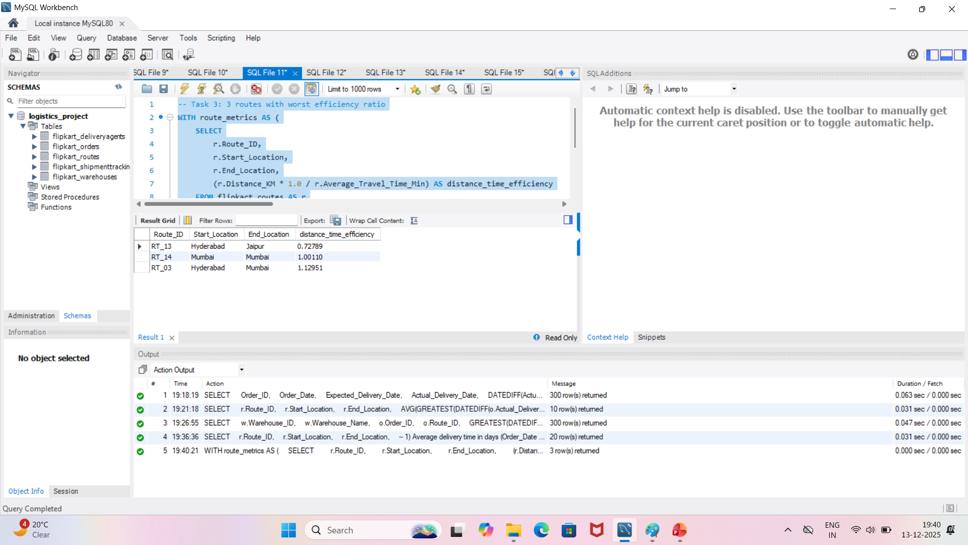
Query2: Screenshot of Top 3 Routes with worst efficiency

Slide 7
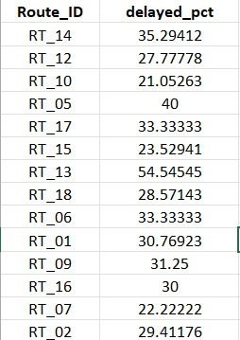
📊Query 3: Routes with >20% Delayed Shipments
14 routes exceed 20% delay threshold (should be <10% for best practice)
Finding: 70% of routes fail to meet acceptable delay targets

Slide 8
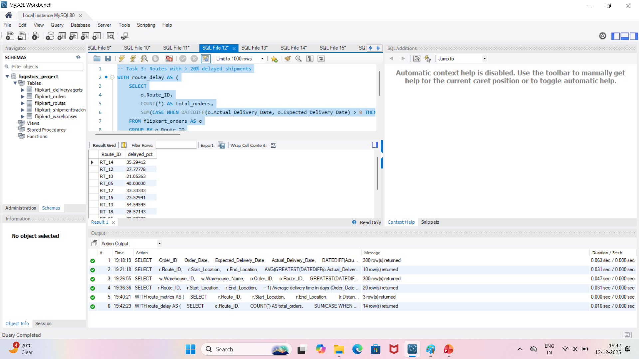
Query 3: Screenshot of Routes with >20% Delayed Shipments

Slide 9
🚨 CRITICAL FINDING: RT_13 & RT_14
These 2 routes have BOTH worst efficiency AND highest delay rates
RT_13: Hyderabad → Jaipur
Efficiency: 0.728 km/min (WORST)
Delay Rate: 54.55% (HIGHEST)
Avg Travel Time: 1481 min
RT_14: Mumbai → Mumbai
Efficiency: 1.001 km/min (2nd WORST)
Delay Rate: 35.29% (2nd HIGHEST)
Traffic Delay: 36 min avg

Slide 10
✅ Optimization Recommendations
Priority 1 - RT_13 (Hyderabad → Jaipur): Re-route via intermediate hubs. Split into RT_13A and RT_13B. Current 1481-min travel time is excessive.
Priority 2 - RT_14 (Mumbai → Mumbai): Local route delays suggest traffic congestion. Implement time-window adjustments (early morning/late evening deliveries).
Priority 3 - RT_05 (Pune → Pune): 40% delay rate on local route. Increase agent count or use multiple delivery slots.
High-Traffic Routes: RT_15 (87 min delay), RT_08 (90 min delay), RT_17 (81 min delay) → Allocate more resources or adjust time windows.
Best Performers: RT_19 (7.48 km/min), RT_12 (4.98), RT_10 (4.94) → Use as templates for optimization.

Slide 11
📈 Implementation Action Plan
Week 1: Conduct root cause analysis for RT_13 and RT_14 (traffic, logistics, agent issues)
Week 2-3: Implement route re-design for top 3 critical routes
Week 4: Monitor KPIs and measure improvement in delay rates
Target Goal: Reduce overall delayed shipments from 70% routes to <15% within 30 days

Slide 12
Summary & Key Takeaways
✅ Task 2: Calculated delivery delays and identified warehouse-wise rankings
✅ Task 3: Analyzed route efficiency and discovered critical bottlenecks
🎯 Recommendation: Focus on RT_13, RT_14, and RT_05 for immediate optimization
📊 Expected Impact: 20-30% improvement in on-time delivery rates

