Slide 1
Warehouse Performance Analysis
Task 4 – Flipkart SQL Project
Processing Time, Delays & On-Time Delivery Metrics

Slide 2
Task 4 Objectives
Find top 3 warehouses with highest average processing time.
Calculate total vs. delayed shipments for each warehouse.
Identify bottleneck warehouses using CTEs (processing time > global average).
Rank warehouses based on on-time delivery percentage using window functions.

Slide 3
Query 4.1: Top 3 Warehouses by Processing Time
The query below calculates average processing time (Order_Date to Actual_Delivery_Date) for each warehouse.
SELECT Warehouse_ID,
AVG(DATEDIFF(Actual_Delivery_Date, Order_Date)) AS avg_processing_days
FROM flipkart_orders
GROUP BY Warehouse_ID
ORDER BY avg_processing_days DESC LIMIT 3;
Result:
WH_02: 5.30 days (SLOWEST)
WH_10: 4.83 days (SLOW)
WH_06: 4.74 days (SLOW)

Slide 4
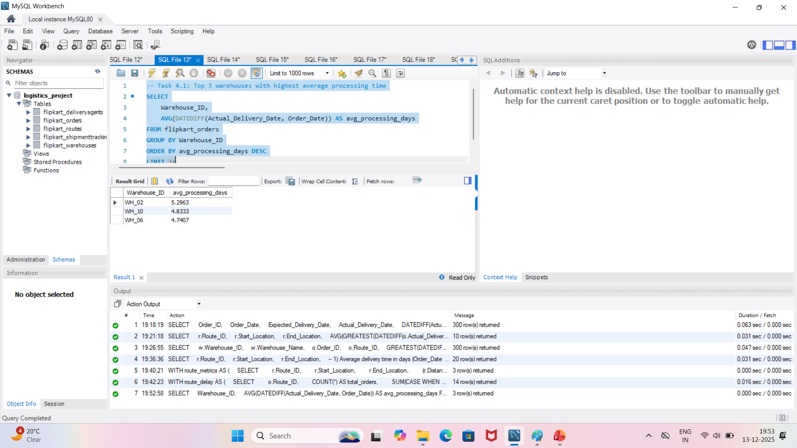
Query 4.1: Screenshot of Top 3 Warehouses by Processing Time

Slide 5
Query 4.2: Total vs Delayed Shipments
This query calculates the percentage of delayed shipments (Actual > Expected) for each warehouse.
SELECT Warehouse_ID, COUNT(*) AS total_shipments,
SUM(CASE WHEN DATEDIFF(Actual_Delivery_Date,
Expected_Delivery_Date) > 0 THEN 1 ELSE 0 END) AS delayed_shipments,
ROUND(SUM(...)*100.0/COUNT(*), 2) AS delay_percentage
FROM flipkart_orders
GROUP BY Warehouse_ID
ORDER BY delay_percentage DESC;
Result (Top 3 Most Delayed):
WH_10: 36.67% delayed (11 of 30)
WH_03: 36.00% delayed (9 of 25)
WH_02: 33.33% delayed (9 of 27)

Slide 6
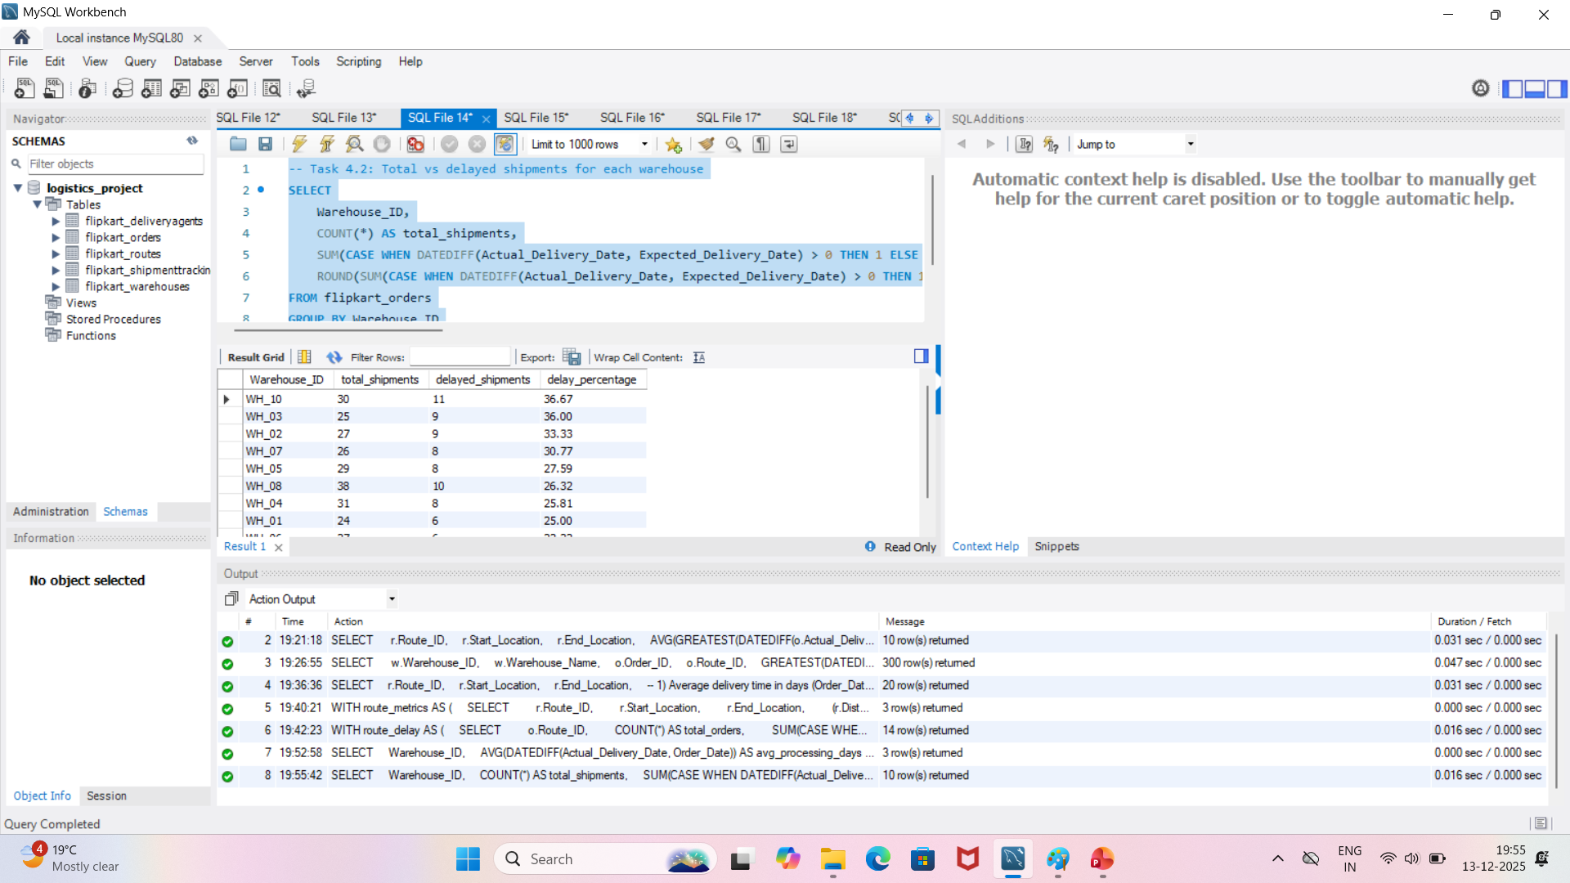
Query 4.2: Screenshot of Total vs Delayed Shipments

Slide 7
Query 4.3: Bottleneck Warehouses (CTE)
Common Table Expression identifies warehouses with processing time exceeding the global average (4.51 days).
WITH warehouse_processing AS (
SELECT Warehouse_ID, AVG(DATEDIFF(Actual_Delivery_Date, Order_Date)) AS avg_processing_days,
COUNT(*) AS total_orders
FROM flipkart_orders GROUP BY Warehouse_ID),
global_avg AS (
SELECT AVG(DATEDIFF(Actual_Delivery_Date, Order_Date)) AS global_avg_processing FROM flipkart_orders)
SELECT wp.Warehouse_ID, wp.avg_processing_days, ga.global_avg_processing,
ROUND((wp.avg_processing_days - ga.global_avg_processing), 2) AS days_above_average
FROM warehouse_processing wp CROSS JOIN global_avg ga
WHERE wp.avg_processing_days > ga.global_avg_processing;
Result (4 Bottleneck Warehouses):
WH_02: 5.30 days (+0.79 above average)
WH_10: 4.83 days (+0.33 above average)
WH_06: 4.74 days (+0.23 above average)
WH_05: 4.69 days (+0.18 above average)

Slide 8
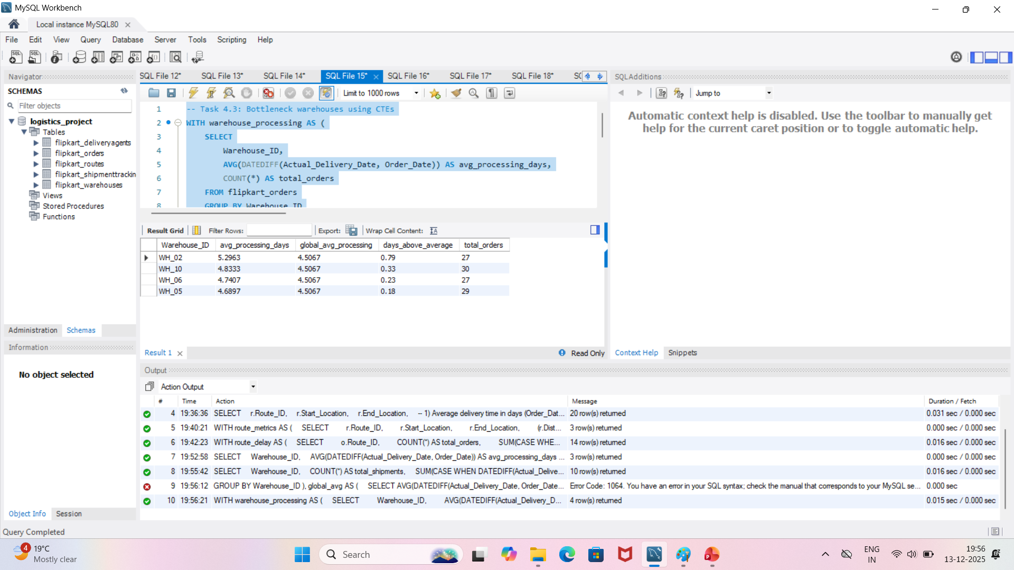
Query 4.3: Screenshot of Bottleneck Warehouses (CTE)

Slide 9
Query 4.4: On-Time Delivery Ranking (Window Function)
RANK() OVER clause assigns ranking to warehouses based on on-time delivery percentage (Actual ≤ Expected).
SELECT Warehouse_ID, COUNT(*) AS total_orders,
SUM(CASE WHEN DATEDIFF(Actual_Delivery_Date, Expected_Delivery_Date) ≤ 0 THEN 1 ELSE 0 END) AS on_time_orders,
ROUND(SUM(...)*100.0/COUNT(*), 2) AS on_time_percentage,
RANK() OVER (ORDER BY on_time_percentage DESC) AS on_time_rank
FROM flipkart_orders
GROUP BY Warehouse_ID
ORDER BY on_time_percentage DESC;
Result (Top & Bottom 5 Warehouses):
Rank 1: WH_09 - 83.72% on-time (36/43 orders)
Rank 2: WH_06 - 77.78% on-time (21/27 orders)
... (Ranks 3-9)
Rank 10: WH_10 - 63.33% on-time (19/30 orders)

Slide 10
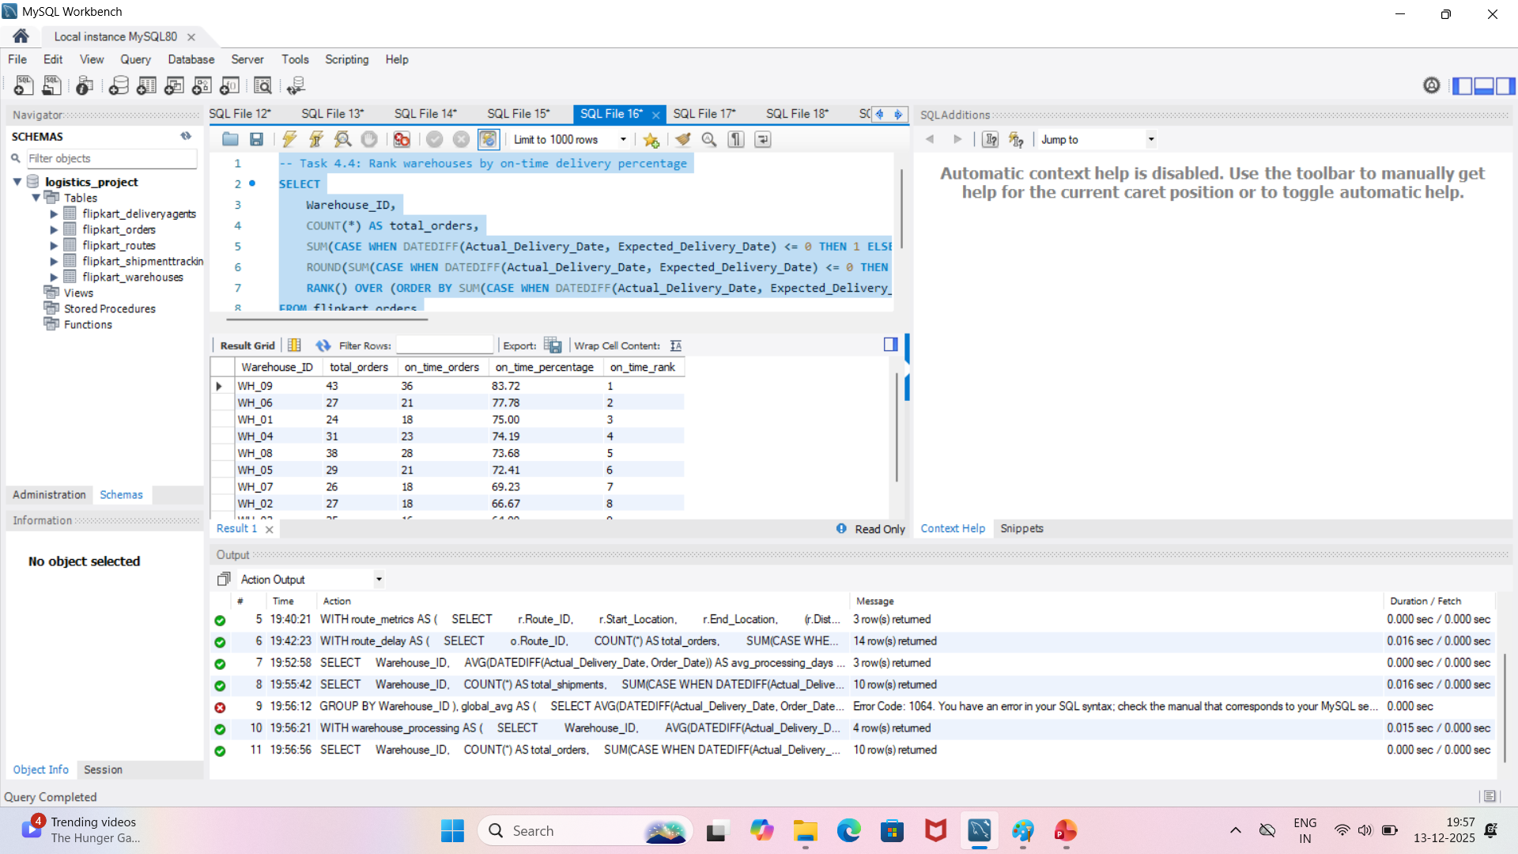
Query 4.4: Screenshot of On-Time Delivery Ranking (Window Function)

Slide 11
🔍 Key Findings & Patterns
❌ Problem Warehouse (WH_02): 5.30 days processing, 33.33% delays, 66.67% on-time (Rank 8)
⚠️ At-Risk Warehouse (WH_10): 4.83 days processing, 36.67% delays, 63.33% on-time (Rank 10)
✅ Best Performer (WH_09): 43 orders, only 16.28% delays, 83.72% on-time (Rank 1)

Slide 12
💡 Warehouse Optimization Recommendations
Priority 1 - WH_02 (CRITICAL): Reduce 5.30 to 4.51 days. Audit inventory management, staffing, and order processing workflow.
Priority 2 - WH_10 (HIGH): Address 36.67% delay rate. Implement time-window adjustments and increase delivery agents.
Priority 3 - WH_03: 36% delays. Review order-to-dispatch process for bottlenecks.
Best Practice Template: Use WH_09 process model (83.72% on-time) as benchmark for others.
Global Target: Reduce bottleneck warehouses from 4 to 0 within 30 days. Achieve >80% on-time for all warehouses.

Slide 13
📋 4-Week Implementation Plan
Week 1: Root cause analysis for WH_02, WH_10, WH_03 (inventory, staffing, equipment)
Week 2-3: Implement process improvements (staff retraining, workflow optimization, tech upgrades)
Week 4: Monitor KPIs and measure improvement in processing time and on-time delivery %
Target: All warehouses processing time < 4.51 days, on-time delivery > 80%

Slide 14
Summary & Next Steps
✅ Identified 3 slowest warehouses (WH_02, WH_10, WH_06)
✅ Found 4 bottleneck warehouses exceeding global average (4.51 days)
✅ Ranked all warehouses by on-time delivery (WH_09: 83.72%, WH_10: 63.33%)
🎯 Priority Action: Focus on WH_02 & WH_10 for immediate performance improvement

