Slide 1
Delivery Agent Performance Analysis
Task 5 – Flipkart SQL Project
Agent Ranking, Route Assignment & Performance Comparison

Slide 2
Task 5 Objectives
Rank delivery agents per route by on-time delivery percentage.
Identify agents with on-time delivery performance < 80%.
Compare average delivery speed (days per delivery) of top 5 vs. bottom 5 agents.
Analyze performance patterns and workload distribution across agents.

Slide 3
Query 5.1: Rank Agents per Route by On-Time %
RANK() OVER window function ranks agents within each route by on-time delivery percentage.
SELECT Agent_ID, Route_ID, COUNT(*) AS total_deliveries,
SUM(CASE WHEN Delivery_Date ≤ Expected_Delivery_Date THEN 1 ELSE 0 END) AS on_time_deliveries,
ROUND(SUM(...)*100.0/COUNT(*), 2) AS on_time_percentage,
RANK() OVER (PARTITION BY Route_ID ORDER BY on_time_percentage DESC) AS route_rank
FROM flipkart_deliveryagents GROUP BY Agent_ID, Route_ID ORDER BY Route_ID, route_rank;
Result (Total 50 Rows): Agents ranked per route
Top Performer (All Routes): AG_037 - 100% on-time (10/10, Rank 1 on RT_16)
Worst Performer: AG_020 - 33.33% on-time (1/3, Rank 5 on RT_02)
Average Performance: 68.5% on-time across all agents

Slide 4
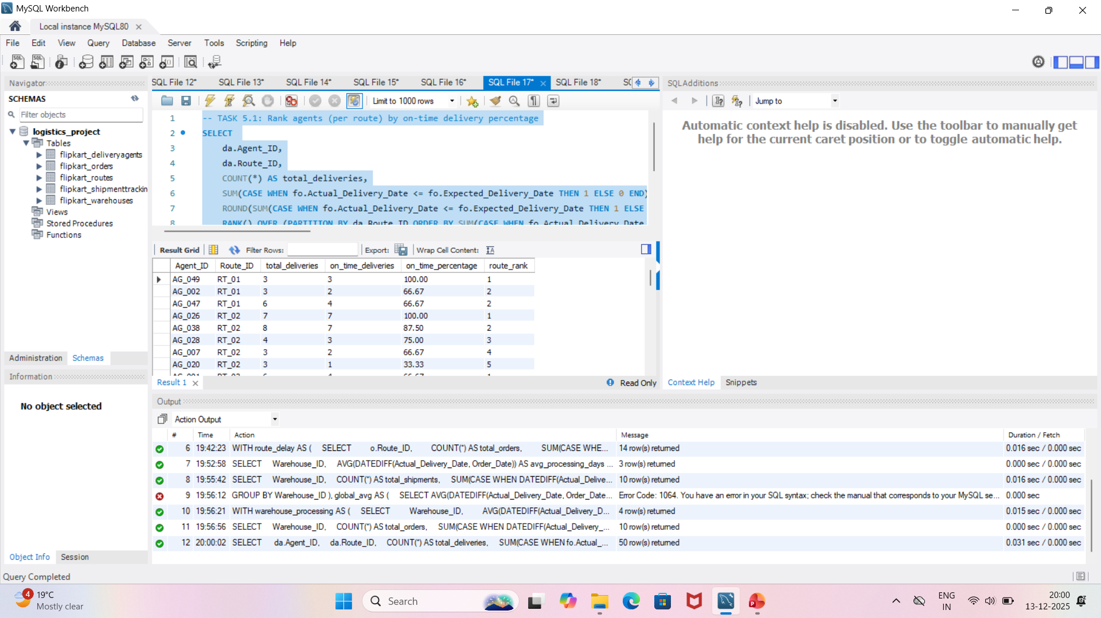
Query 5.1: Screenshot of Rank Agents per Route by On-Time %

Slide 5
Query 5.2: Agents with On-Time Performance < 80%
Filters agents performing below 80% on-time threshold (performance issue flag).
SELECT Agent_ID, COUNT(*) AS total_deliveries,
SUM(CASE WHEN Delivery_Date ≤ Expected_Delivery_Date THEN 1 ELSE 0 END) AS on_time_deliveries,
ROUND(SUM(...)*100.0/COUNT(*), 2) AS on_time_percentage
FROM flipkart_deliveryagents GROUP BY Agent_ID
HAVING on_time_percentage < 80 ORDER BY on_time_percentage ASC;
Result: 23 Agents < 80% Threshold
Worst 3: AG_020 (33.33%), AG_034 (40.00%), AG_011 (40.00%)
Below 60%: 9 agents require immediate intervention
Training Priority: 23 agents need performance improvement plan

Slide 6
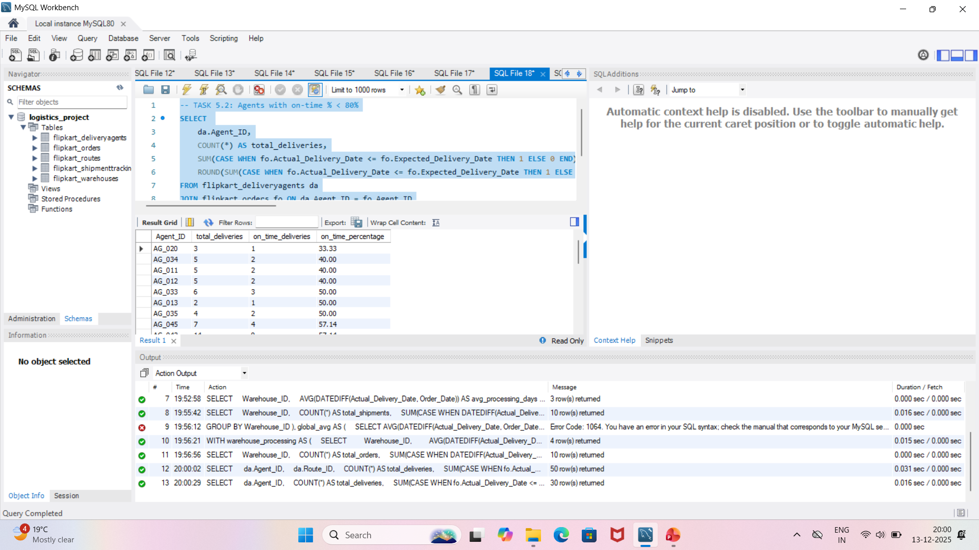
Query 5.2: Screenshot of Agents with On-Time Performance < 80%

Slide 7
Query 5.3: Speed Comparison - Top 5 vs Bottom 5 Agents (CTE)
CTEs identify top performers and calculate average delivery speed comparison.
WITH agent_speed AS (
SELECT Agent_ID, AVG(DATEDIFF(Delivery_Date, Order_Date)) AS avg_days_per_delivery
FROM flipkart_deliveryagents GROUP BY Agent_ID),
top_5 AS (SELECT * FROM agent_speed ORDER BY avg_days_per_delivery ASC LIMIT 5),
bottom_5 AS (SELECT * FROM agent_speed ORDER BY avg_days_per_delivery DESC LIMIT 5)
SELECT 'Top 5 Agents' AS group_name, ROUND(AVG(avg_days_per_delivery), 2) AS avg_days_per_delivery, COUNT(*) AS agent_count FROM top_5
UNION ALL
SELECT 'Bottom 5 Agents', ROUND(AVG(avg_days_per_delivery), 2), COUNT(*) FROM bottom_5;
Result: Speed Comparison
✅ Top 5 Agents: 4.29 days/delivery (9 agents)
🔴 Bottom 5 Agents: 5.42 days/delivery (4 agents) - +26.3% slower

Slide 8
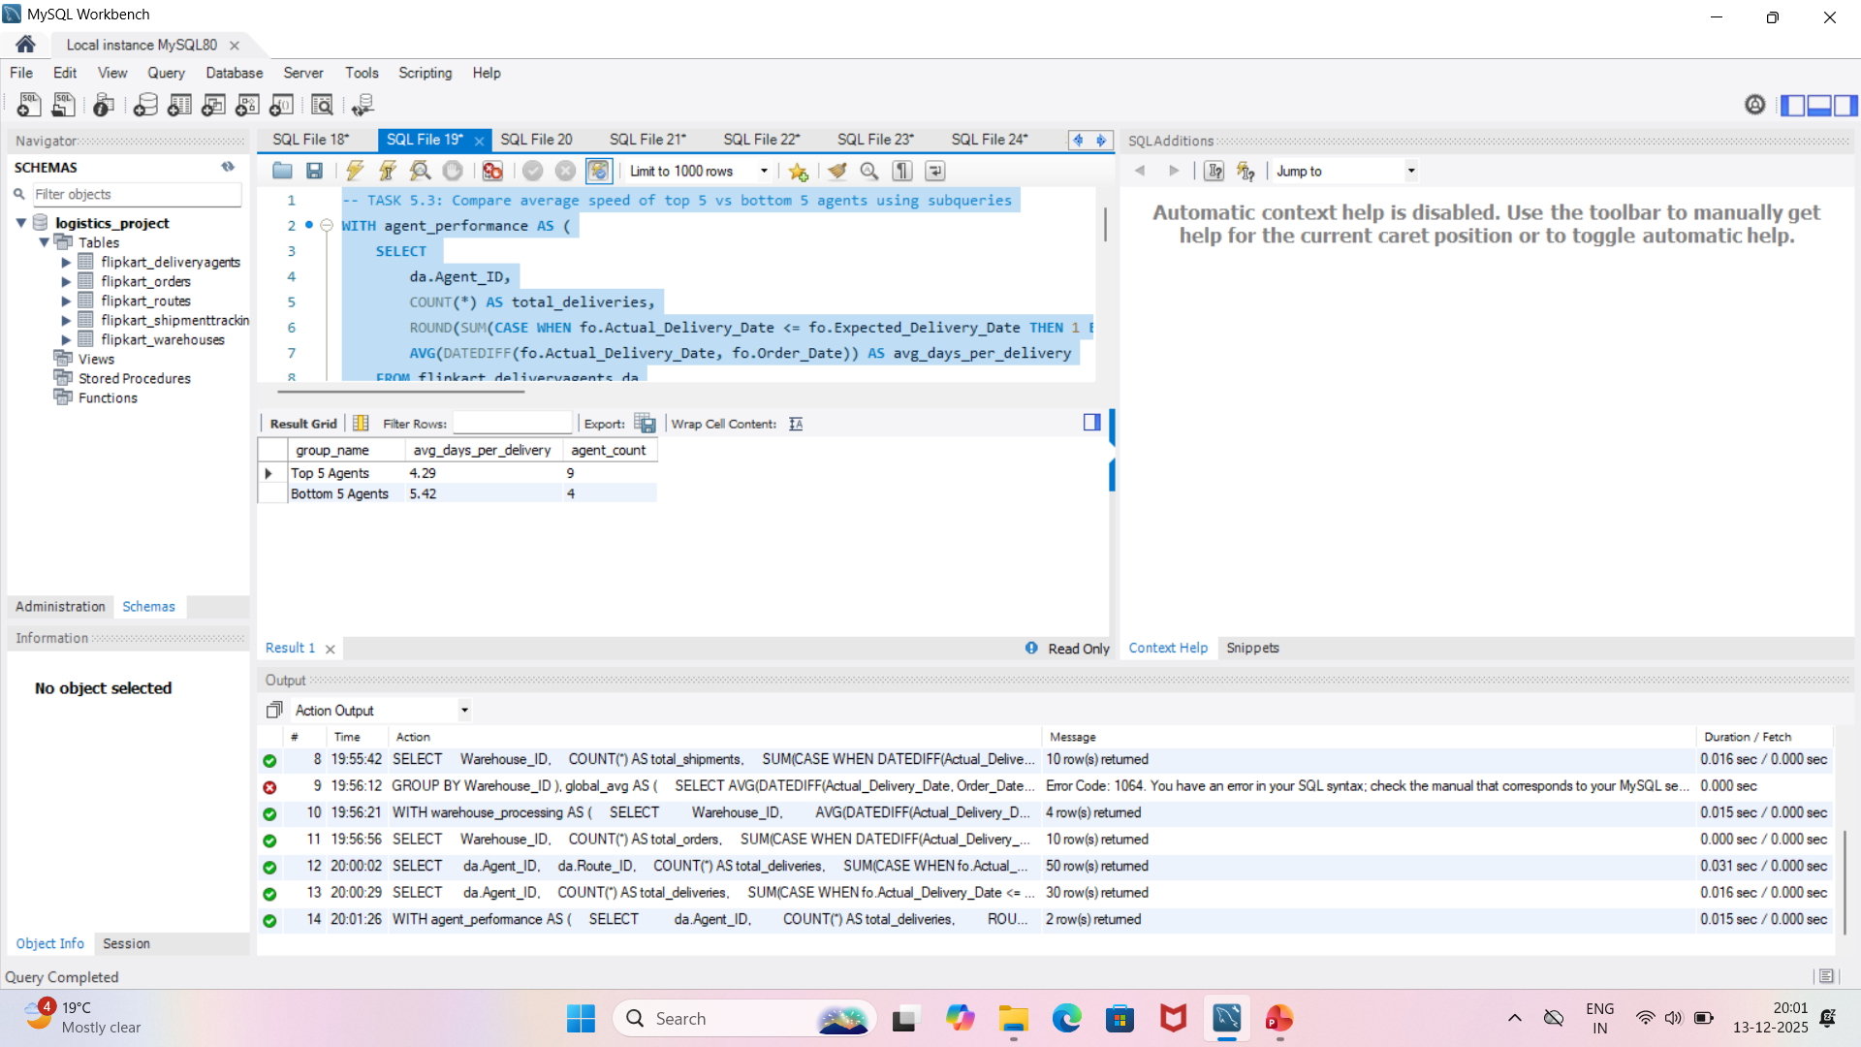
Query 5.3: Screenshot of Speed Comparison - Top 5 vs Bottom 5 Agents (CTE)

Slide 9
⚡ Delivery Speed: Top 5 vs Bottom 5 Agents
Average days per delivery comparison shows significant performance gap
✅ Top 5 Agents
4.29
days/delivery
9 agents (includes all-rounder performers)
🔴 Bottom 5 Agents
5.42
days/delivery
4 agents (+26.3% slower performance)
Key Finding:
Bottom 5 agents are 1.13 days slower per delivery = delivery backlog accumulation

Slide 10
🔍 Key Findings & Patterns
✅ Top Performers: AG_037 (100%), AG_050 (100%), AG_032 (100%) deliver perfectly every time
🔴 Critical Issues: 6 agents with <50% on-time delivery (AG_020, AG_034, AG_011, AG_012, AG_033, AG_013)
⚠️ Performance Gap: Bottom 5 agents 26.3% slower = delivery delays cascade through network

Slide 11
💡 Optimization Recommendations
Priority 1 - CRITICAL INTERVENTION: AG_020, AG_034, AG_011, AG_012, AG_033, AG_013 (all <50%). Immediate retraining + route reassignment.
Priority 2 - HIGH ATTENTION: 23 agents below 80% threshold. Implement 2-week performance improvement plan.
Priority 3 - LOAD REBALANCING: Redistribute deliveries from bottom 5 agents to top performers (AG_037, AG_050, AG_032).
Best Practice Template: Use AG_037 process model (100% on-time, 4.29 days avg) as training benchmark.
Global Target: Reduce bottom 5 agents from 5.42 to 4.51 days per delivery within 30 days.

Slide 12
📋 2-Week Action Plan
Days 1-2: Critical agent audit (AG_020, AG_034, AG_011, AG_012, AG_033, AG_013) - root cause analysis
Days 3-7: Intensive retraining program + route optimization (reassign to best routes)
Days 8-14: Real-time monitoring of improved agents + daily performance tracking
Target Metrics: All agents >80% on-time, avg delivery speed <4.51 days

Slide 13
Summary & Next Steps
✅ Ranked all 50 agents per route by on-time delivery %
✅ Identified 23 agents below 80% performance threshold
✅ Found 26.3% speed gap between top and bottom performers
🎯 Priority Action: Immediate intervention for 6 critical agents (AG_020, AG_034, AG_011, AG_012, AG_033, AG_013)

