Slide 1
Advanced KPI Reporting
Task 7 – Flipkart SQL Project
Regional Delays, On-Time Delivery %, & Traffic Analysis

Slide 2
Task 7 Objectives
Calculate average delivery delay per region (Start_Location).
Compute on-time delivery % per region using formula: (On-Time / Total) × 100.
Analyze average traffic delay impact per route with percentage distribution.
Identify regional performance gaps and traffic hotspots for optimization.

Slide 3
Query 7.1: Average Delivery Delay per Region
Calculates average delay days for each region by comparing actual vs expected delivery dates.
SELECT r.Start_Location AS region, COUNT(*) AS total_deliveries,
AVG(DATEDIFF(o.Actual_Delivery_Date, o.Expected_Delivery_Date)) AS avg_delivery_delay_days
FROM flipkart_orders o JOIN flipkart_routes r ON o.Route_ID = r.Route_ID
GROUP BY r.Start_Location ORDER BY avg_delivery_delay_days DESC;
Result: 6 Regions Analyzed
🔴 WORST: Ahmedabad (0.61 days avg) - 33 deliveries
✅ BEST: Hyderabad (0.38 days avg) - 155 deliveries (LARGEST VOLUME)

Slide 4
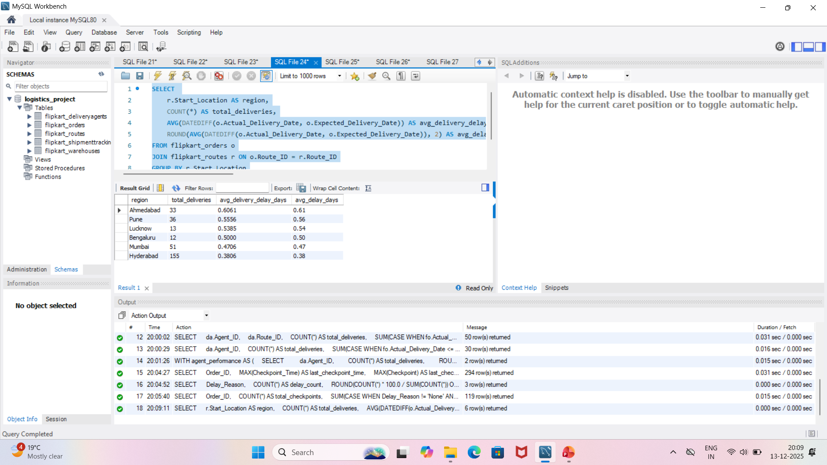
Query 7.1: Screenshot of Average Delivery Delay per Region

Slide 5
Query 7.2: On-Time Delivery % per Region
Computes % of orders delivered on or before expected date per region.
SELECT r.Start_Location AS region, COUNT(*) AS total_deliveries,
SUM(CASE WHEN DATEDIFF(...) <= 0 THEN 1 ELSE 0 END) AS on_time_deliveries,
ROUND(SUM(...)*100.0/COUNT(*), 2) AS on_time_percentage
FROM flipkart_orders o JOIN flipkart_routes r ON o.Route_ID = r.Route_ID
GROUP BY r.Start_Location ORDER BY on_time_percentage ASC;
Result: Regional On-Time Performance
🔴 CRITICAL: Bengaluru (66.67%) - BELOW BENCHMARK
✅ BEST: Hyderabad (76.13%) - 155 orders, highest volume & best performance

Slide 6
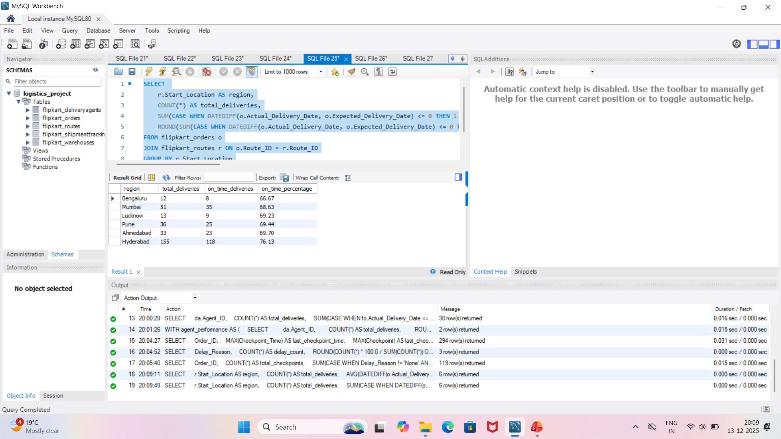
Query 7.2: Screenshot of On-Time Delivery % per Region

Slide 7
Query 7.3: Traffic Delay Impact per Route
Routes with most traffic delays and their percentage distribution across network.
SELECT o.Route_ID, r.Start_Location, r.End_Location,
COUNT(*) AS total_traffic_delays,
ROUND(COUNT(*)*100.0/SUM(COUNT(*)) OVER(), 2) AS traffic_delay_percentage
FROM flipkart_shipmenttracking st JOIN flipkart_orders o ON st.Order_ID = o.Order_ID
JOIN flipkart_routes r ON o.Route_ID = r.Route_ID
WHERE st.Delay_Reason = 'Traffic' GROUP BY o.Route_ID ORDER BY total_traffic_delays DESC;
Result: 15 Routes with Traffic Delays (388 total)
🔴 WORST: RT_03 (Hyderabad→Mumbai) - 30 delays (7.75%)
⚠️ HOT ROUTE: RT_05 (Pune→Pune) - 29 delays (7.49%)

Slide 8
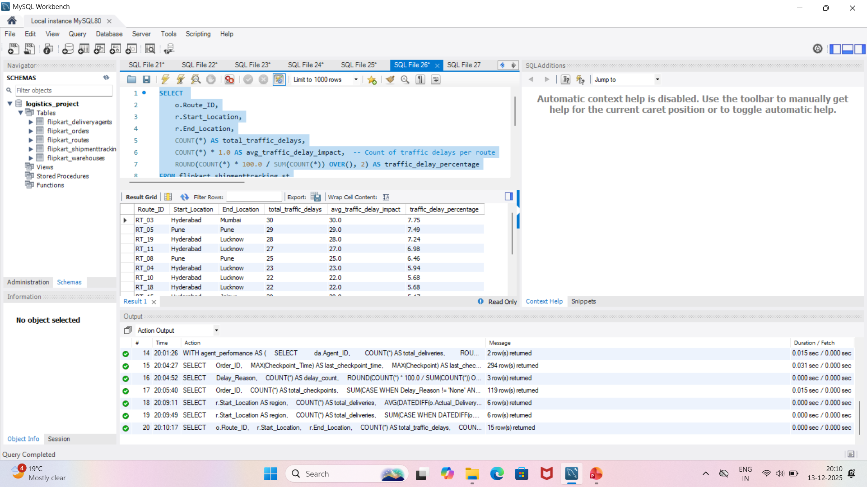
Query 7.3: Screenshot of Traffic Delay Impact per Route

Slide 9
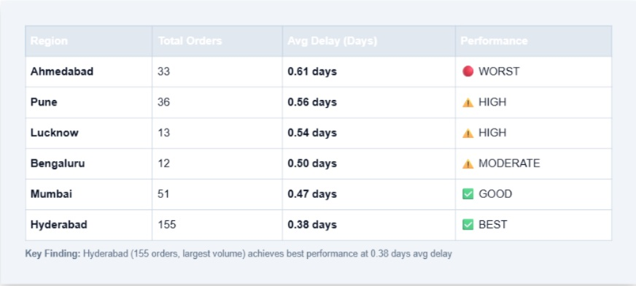
📊 Average Delivery Delay per Region (Days)
Lower is better - ideal target: <0.50 days average
Key Finding: Hyderabad (155 orders, largest volume) achieves best performance at 0.38 days avg delay

Slide 10
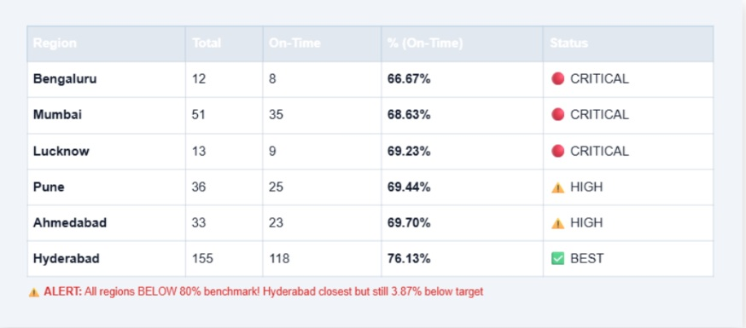
⏱️ On-Time Delivery % by Region
Target benchmark: >80% on-time delivery | Industry standard for logistics
⚠️ ALERT: All regions BELOW 80% benchmark! Hyderabad closest but still 3.87% below target

Slide 11
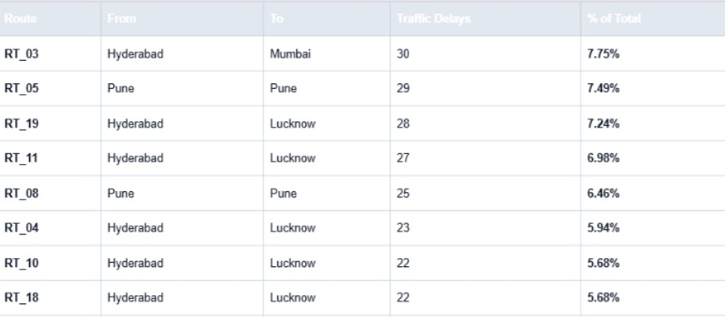
🚗 Traffic Delay Hotspots (Top 10 Routes)
388 total traffic delays identified across 15 routes - concentration in 3 major routes (22.9%)
Hotspot Pattern: Hyderabad→Lucknow corridor has 4 routes in top 8 (critical inter-state route)

Slide 12
🔍 Critical KPI Findings
🔴 Performance Crisis: NO region meets 80% on-time benchmark. Best performer (Hyderabad) at only 76.13% = 3.87% below target
🔴 Bengaluru Worst: 66.67% on-time (only 8/12 orders) + 0.50 days avg delay = IMMEDIATE INTERVENTION REQUIRED
⚠️ Traffic Concentration: RT_03, RT_05, RT_19 account for 22.9% of all traffic delays (87/388) - focused mitigation needed
📍 Regional Leader: Hyderabad (155 orders, highest volume) achieves best KPIs (0.38 days delay, 76.13% on-time) - benchmark model

Slide 13
💡 Root Cause Analysis
Why On-Time % is 10-13% below benchmark:
• Traffic delays (56.41% of all delays) primary cause • Weather issues (27.99%) seasonal impact • Technical failures (15.60%) tracking gaps
Why regional variation exists:
• Ahmedabad (0.61 days) - small volume (33 orders) amplifies individual delays • Mumbai (51 orders) has urban congestion • Hyderabad (155 orders) benefits from scale + route optimization
Traffic hotspot correlation:
• Inter-state routes (Hyderabad→Lucknow, Hyderabad→Mumbai) have highest delays • Urban delivery zones (Pune, Mumbai) experience peak-hour congestion • Solution: Time-window adjustments + route diversification

Slide 14
📋 Priority Recommendations
Priority 1 - CRITICAL: Bengaluru (66.67%) requires emergency intervention. Reassess routes, add capacity, implement time-slot optimization. Target: 75% in 30 days.
Priority 2 - HIGH: Mumbai, Lucknow, Pune (68-69%) need traffic prediction system. Deploy real-time routing for 3 worst routes (RT_03, RT_05, RT_19).
Priority 3 - URGENT: Leverage Hyderabad model (76.13% + 0.38 days). Document best practices, replicate across other regions within 60 days.
Priority 4 - OPTIMIZATION: Implement dynamic time windows to absorb 0.3-0.5 day delays. Reduce on-time % definition impact by buffering delivery estimates.
Global Target: Achieve 80% on-time % across all regions within 90 days. Focus on reducing traffic delays from 388 to <250 through route optimization.

Slide 15
📅 30-Day Execution Roadmap
Days 1-7 (Analysis): Root cause audit for Bengaluru (why 66.67%?). Identify specific traffic bottlenecks in RT_03, RT_05, RT_19. Collect on-ground data.
Days 8-14 (Implementation): Deploy real-time routing on 3 worst routes. Adjust delivery time windows for peak hours. Add 2-3 buffer hours to estimates.
Days 15-21 (Scaling): Roll out time-window optimization to all regions. Implement Hyderabad best-practice playbook. Monitor KPIs daily.
Days 22-30 (Review): Measure impact vs targets. Bengaluru target: 72%+ on-time | All regions: reduce delays by 25% | Traffic delays: <320 (from 388)

Slide 16
📊 KPI Summary Dashboard
Avg Delay (Best)
0.38
Hyderabad (days)
On-Time % (Best)
76.13%
Hyderabad (155 orders)
Traffic Hotspot
30
RT_03 delays (7.75%)
Overall Network Status:
🔴 CRITICAL: 0 regions meet 80% benchmark | 388 traffic delays across 15 routes | Gap to target: 3.87% (Hyderabad) to 13.33% (Bengaluru)

Slide 17
Summary & Next Steps
✅ Calculated average delivery delays across 6 regions (0.38-0.61 days range)
✅ Computed on-time delivery % for all regions (66.67%-76.13% performance gap)
✅ Identified traffic hotspots: RT_03, RT_05, RT_19 account for 22.9% of delays
🎯 Critical Action: Bengaluru emergency intervention + traffic routing optimization on 3 worst routes

