Slide 1
CCMS STREET LIGHT SYSTEM
Presented By:
Electric&Moriarty

Slide 2
About
Single centralized nodes
multiple senders, one receiver
underlying architecture: peer-to-peer radio frequency communication.

Slide 3
Problems
Fault detection in a CCMS network for a particular node is near to impossible.
High installation cost for wired transmission
Application of predictive analysis algorithms, though cost effective aren’t efficient.

Slide 4
Solution
Node to node
Radio Frequency
Hopping of data over a dynamic array of street light

Slide 5
Why RF?
Superiority over wired networks
Modularity
Reparability

Slide 6
Cost Analysis
Components Required | Cost of components
RF Transreceivers | Rs.7.00
Transformer | Rs.2.00
Capacitors | Rs.0.50
Bridge Rectifier | Rs.0.50
Shielding Cost | Rs.3.00
Total | Rs.13.00

Slide 7
Shielding Parameters:
Metallic sheets made of metal or ferrite materials
Solenoids and Coils
Capacitors, ferrules and grounded wired to minimize EMI noise.
Magnetic materials used to draw emi into magnetic fields.
Superconducting materials that expel magnetic fields

Slide 8
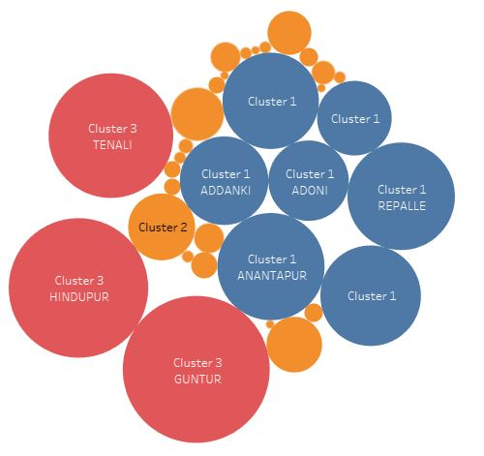
PREDICTIVE ANALYSIS
K-means clustering was performed for state Uttar Pradesh according to ULBname. Guntur has most number of complaints registered, thus we need to maximize our resources over that region.

