Slide 1
CRaSH
Portal Team

Slide 2

Agenda
Introduction to CRaSH
Deployment and connection
Using the CRaSH command
Develop the CRaSH commands yourself.

Slide 3
Introduction to CRaSH

Slide 4
What's CRaSH ?
A shell for JCR that bundled as a war file to deploy in eXo portal 2.5.x or Gatein
Allow remote connection to a server and perform various operations
Test JCR queries
CRaSH was written in Java and Groovy
CRaSH project hosted on Google Code under LGPL
(http://code.google.com/p/crsh/)
Current version : 1.0.0 – beta10

Slide 5
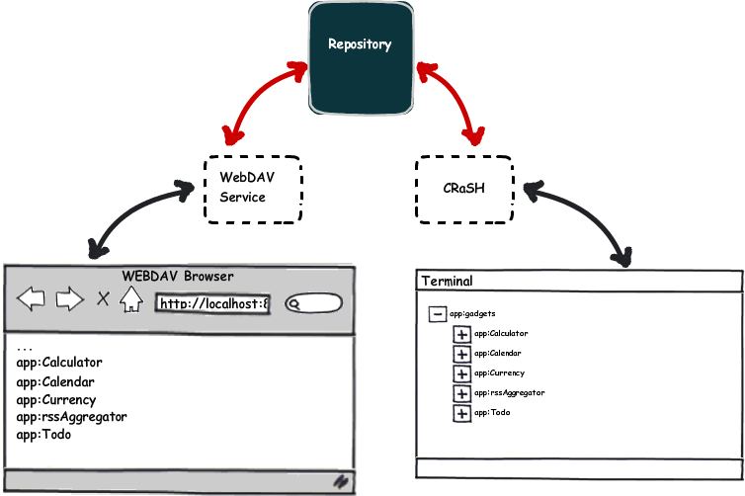
What's CRaSH ?

Slide 6
Deployment and connection

Slide 7
Deployment
Copy crash.war into server eXo Portal 2.5.x or Gatein
CraSH.war will be deployed in server running
CraSH.war could be built from source code or download from hosted site

Slide 8
Connect to CRaSH
We use telnet or SSH to connect on port 5000 (with telnet) and 2000 (with SSH)
telnet localhost 5000
Trying ::1...
Connected to localhost.
Escape character is '^]'.
CRaSH 1.0.0-beta11-SNAPSHOT (http://crsh.googlecode.com)
Welcome to exo!
It is Wed Sep 08 15:55:56 ICT 2010 now.
%

Slide 9
Using the CraSH commands

Slide 10
CraSH commands
CraSH provide some commands to access JCR from shell
  Connect to a repository
  Listing the content of a node
  Changing the current node
  Printing the current node
  Copying a node
  Removing a node
  .....

Slide 11
Introduce useful commands
Demo some commands with gatein

Slide 12
Develop the CRaSH command yourself

Slide 13
How to develop a command
The shell command is based on the Groovy language
Use args4j project to inject the options and arguments on the command class
Each command has a corresponding Groovy file in /WEB-INF/groovy/commands

Slide 14
CRaSH components
Telnet
SSH
Connectors
Shell
Engine
JCR
Connector
SCP
Command
Args4j
Groovy

Slide 15
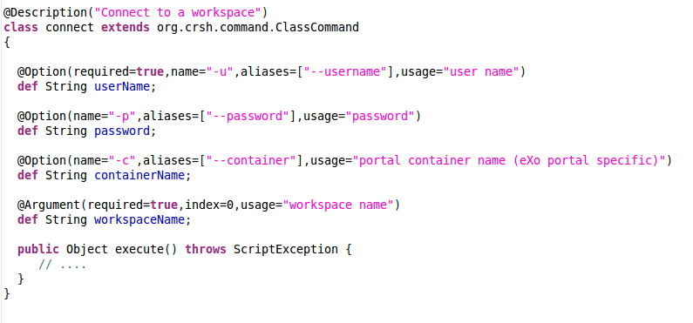
How to develop a command
ClassCommand
_________________
execute() : Object
connect
___________________
execute() : Object
connect.groovy file

Slide 16
How to develop a command
CRaSH provides some useful functions:
assertConnected() checks that the user is connected
getCurrentNode() returns the current node
setCurrentNode(Node node) updates the current node
findNodeByPath() returns a node based on the provided path
formatValue(Value value) formats a JCR value into a suite text value
formatPropertyValue(Property property) format a JCR property value into a suite text value

Slide 17
Reference:
http://code.google.com/p/crsh/
http://wiki-int.exoplatform.org/display/exoproducts/CRaSH+utility+scripts
https://args4j.dev.java.net/
http://groovy.codehaus.org/
Q & A

