Slide 1
Using CASA to Simulate Interferometer Observations
Nuria Marcelino
North American ALMA Science Center

Slide 2

Simulating Interferometer Data
Take a model image and simulate how it would look if observed by ALMA or the JVLA.
Other arrays (e.g., SMA, CARMA, etc.) also included
Explore the effects of:
Number of antennas
Antenna configuration
Length of observation
Thermal noise
Phase noise
Functionality included in CASA via tasks simobserve and simanalyze (nee simdata).
CASAguides includes several walkthroughs: http://casaguides.nrao.edu/index.php?title=Simulating_Observations_in_CASA
Notes:
--When planning interferometer observations it is useful to simulate how your source would look like as observed by ALMA or the JVLA.
--And explore the output of the instrument under a variety of conditions such as…
--CASA tasks simobserve and simanalyze, can be used to simulate visibilities and clean and analyze the output images. In versions previous to 3.3., the functionality of both tasks was contained in a single task named simdata.
--The CASAguides website contains several examples on how to simulate observations

Slide 3
Basic Simulation Workflow
In CASA…
Model Sky Distribution
(FITS, image, components)
simobserve
Simulated Measurement Set
(calibrated u-v data)
simanalyze
Simulated Image
& Analysis Plots Comparing “Observed”/original image
Notes:
The basic simulation workflow in CASA is as follow:
--by using a model of the sky brightness distribution of your source,
--simobserve will predict the visibilities as measured by ALMA or the JVLA,
--i.e. a measurement set
--then, simanalyze will produce a cleaned image of the simulated visibilities,
--and other diagnostic plots to compare the resulting image with the input model

Slide 4
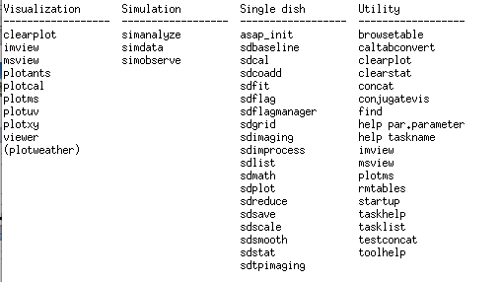
Simulation Tasks
simobserve simulates interferometric (and single dish)observations of a source.
simanalyze images and analyzes these simulations.
“tasklist” output
Notes:
These two tasks, and the previous simdata, are listed under simulation when getting the list of tasks in CASA using “tasklist”

Slide 5
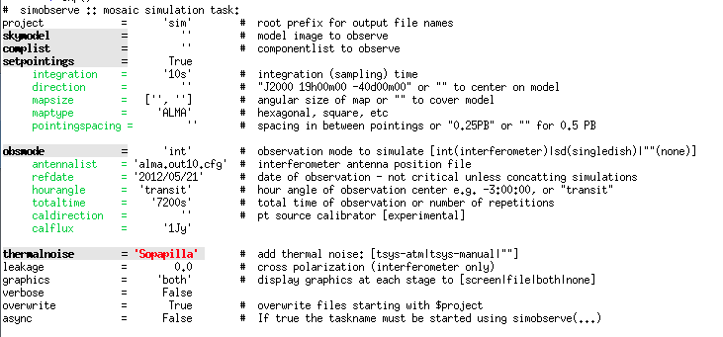
simobserve
simulates interferometer observations of a source.
“inp simobserve” output
Notes:
--simobserve simulates interferometer observations of a source and obtain the “measured” visibilities.
--the figure shows the list of input parameters for this task, as seen when you type “inp simobserve” in CASA

Slide 6
CASA Refresher
inp shows parameter names
Expandable parameter (currently NOT expanded)
Expandable parameter (currently expanded)
Notes:
Those parameters with grey background are expandable,
and when set to “true”, or depending on the value, will show its different options

Slide 7
CASA Refresher
inp shows current value (change, e.g., by project = “myproj”)
Invalid Value
Notes:
The column in the middle show the current values for all parameters.
Red text means the current value is not valid.

Slide 8
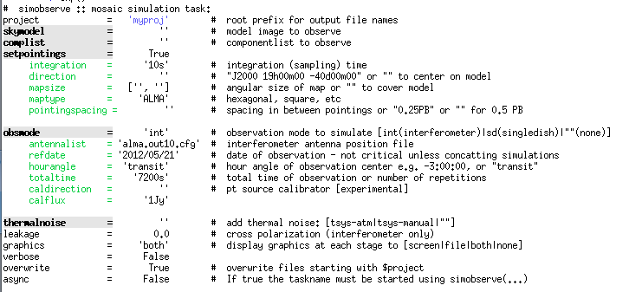
CASA Refresher
inp shows current value (change, e.g., by project = “myproj”)
Valid Value
Default Value
Notes:
Values can be modified by typing e.g. project=‘myproj’
If the value you entered is a valid one, it will be shown in blue
To make a difference from the default ones in black

Slide 9
CASA Refresher
inp shows brief description
Notes:
The right column shows a short description for each parameter

Slide 10
CASA Refresher
When all parameters are set, execute with “go simobserve”
If you get stuck:
Type “tasklist” to see all tasks
Type “help taskname” to get help on taskname
Type “default taskname” to set the default inputs
Type “inp” to review the inputs of the current task
Ask!
Notes:
Once you have set all the parameters according to your source and observation details, you can execute the task by typing “go simobserve”
Whenever you find any problem, you can
--see all list of tasks with “tasklist”
--get a more detailed information about the task with “help”
--reset a task to its default values with “default”
--and review your current values with “inp’, in particular before running the task
--and ask, today during the tutorial or through the helpdesk anytime

Slide 11
Basic Simulation Workflow
In CASA…
Model Sky Distribution
(FITS, image, components)
simobserve
Simulated Measurement Set
(calibrated u-v data)
simanalyze
Simulated Image
& Analysis Plots Comparing “Observed”/original image
Notes:
Okay, back to simobserve….

Slide 12
What Defines a Simulation?
Model Sky Distribution (Required)
What does the sky really look like in your field?
Telescope (Required)
Number of Antennas, Configuration, Diameter
Observation (Required)
Integration time, scan length, pointing centers
Corruption
(Optional)
Thermal noise, phase noise, polarization leakage
Notes:
What defines a simulation? We need…
--a model of the sky distribution of your source
--information on the instrument
--observation parameters
--you can also corrupt your data with noise, to make your simulations more realistic
All this required information on the simulation, can be introduced in simobserve as parameters…..

Slide 13
simobserve
Model sky distribution as FITS file or “component list”
Model Sky Distribution (Required)
What does the sky really look like in your field?

Slide 14
simobserve
Telescope via configuration file.
Telescope (Required)
Number of Antennas, Configuration, Diameters

Slide 15
simobserve
Observations defined via setpointings and obsmode
Observation (Required)
Integration time, scan length, pointing centers

Slide 16
simobserve
Corruption with thermalnoise & toolkit
Corruption
(Optional)
Thermal noise, phase noise, polarization leakage

Slide 17
simobserve
Model sky distribution as FITS file or “component list”
Model Sky Distribution (Required)
What does the sky really look like in your field?
Notes:
The model can be introduced as a FITS file (an image), or defined by a list of components.

Slide 18
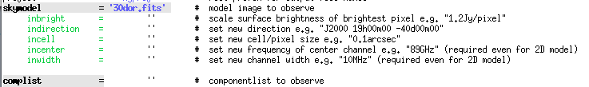
Input Sky Model
Model sky distribution as FITS file. simobserve needs:
Coordinates
Brightness units
Pixel scale (angular and spectral)
Stokes axis (optional)
These may be specified in your FITS header or supplied/over-written by simobserve.
Notes:
If you introduce your model as a FITS file, simobserve needs to know…
Which may be in the header or overwritten using the inputs of skymodel

Slide 19
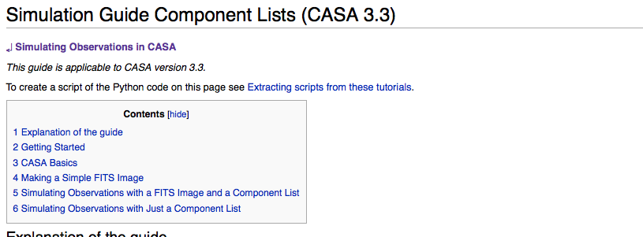
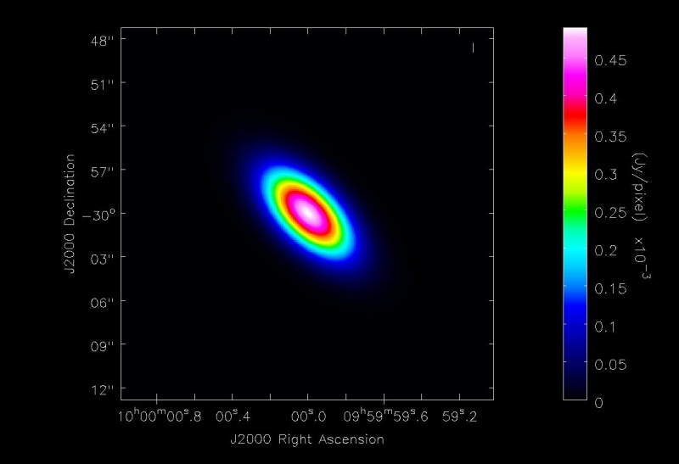
Input Sky Model
Alternatively, supply a Gaussian “component list.”
Example at: http://casaguides.nrao.edu/index.php?title=Simulation_Guide_Component_Lists_(CASA_3.3)
Notes:
Or you can supply a text file with a component list to model the sky distribution of your source.
In the CASAguides you can find examples on how to create such component list.
It can be a single gaussian flux distribution component, like the one shown in the figure,
Or several point sources.

Slide 20
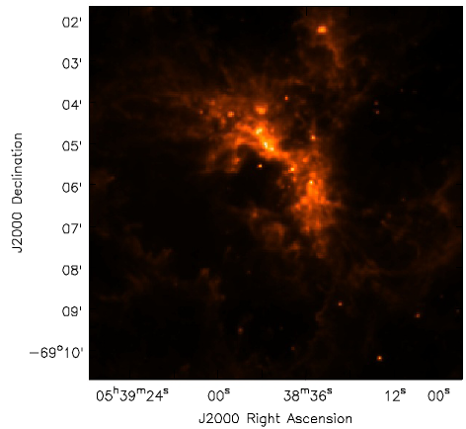
Simple Example
Simulate observing 1mm dust continuum in a 30-Doradus (LMC)-like region at the distance of M31/M33 (800 kpc).
We have a near-IR image of 30 Doradus, will need to:
Scale the brightness and observing frequency
Adjust the pixel scale (move it from 50-800 kpc)
Set a new position
Define the observations integration time, telescope, etc.
Our Model
30 Doradus in the LMC
8 μm (credit: SAGE collaboration)
Notes:
To illustrate how to do a simulation in CASA, let’s go through a simple example:
--we are going to simulate 1mm dust continuum ALMA observations of a star-forming region like 30 Doradus but at a distance of M31/M33
--as the model image, we are going to use a near-IR image of 30 Doradus, therefore we will make some modifications to the model, such as…
And also define the observing strategy.
This example is in one of the CASAguides and you can go through it later in the hands-on…

Slide 21
Simple Example
inbright = “0.6mJy/pixel” Requires spectral model/other knowledge to estimate (Science!)
Indirection = “J2000 10h00m00s -40d00m00s”
incell=“0.15arcsec” native cell size = 2.3”, moving from 50 kpc➔800 kpc scale by 50/800
incenter=“230GHz”, inwidth=“2GHz” Need to supply observing frequency & bandwidth (here 1mm dust continuum)
Notes:
Once we introduce the name of the FITS file, we can see the expanded optional parameters:
--we scale the brightness of the source using “inbright’. This requires some knowledge about the source or the use of models to estimate this number
--we’ll set the new position of the source in the sky, with “indirection”
--incell will adjust the pixel size, to mimic the new distance of the source
--we also need to change the observing frequency and the bandwidth
Note that none of these will change in your original FITS, only to simobserve know which values to use instead of the ones in the header.

Slide 22

Simple Example
inbright = “0.6mJy/pixel” Requires spectral model/other knowledge to estimate (Science!)
Indirection = “J2000 10h00m00s -40d00m00s”
incell=“0.15arcsec” native cell size = 2.3”, moving from 50 kpc➔800 kpc scale by 50/800
incenter=“230GHz”, inwidth=“2GHz” Need to supply observing frequency & bandwidth (here 1mm dust continuum)
Notes:
Now, we type inp simobserve again to see if the new parameters we entered are valid (in blue)

Slide 23
simobserve
Telescope via configuration file.
Telescope (Required)
Number of Antennas, Configuration, Diameter
Notes:
The telescope info is entered as a text file in “antennalist’.

Slide 24
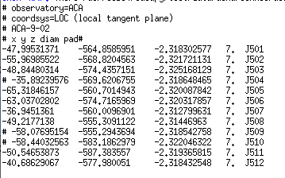
Configuration Files
Define telescope array for simobserve.
Config Files in CASA Already
ALMA, JVLA, CARMA, SMA, etc.
Example Config File: ALMA Cycle 1 ACA
x y z diameter name
Notes:
This file defines the array configuration.
CASA contains already configuration files for different telescopes, such as…
For ALMA, you can find different files for Cycle 0 and 1, full ALMA, and also ACA configurations.
They are text files, this figure shows an example for the ACA configuration for Cycle 1:
it contains the position (x,y,z) and diameter of the antennas (7m in this case), and the name of the pad where the antenna is located.

Slide 25
Configuration Files
Pick an intermediate-extent full-ALMA configuration
Notes:
For our example, we’ll pick up one intermediate-extent full ALMA configuration

Slide 26
simobserve
Observations defined via setpointings and obsmode
Observation (Required)
Integration time, scan length, pointing centers
Notes:
Observation details are specified with the parameters “setpointings” and “obsmode”

Slide 27

setpointings
setpointings dictates field, integration time, mosaic
integration sets data averaging (and field visit) time here averaging 600s (10m) ensures a quick initial execution
direction sets field or map center
mapsize, maptype, pointingspacing define a mosaic By default it will cover the model, here that means a 9-point mosaic
Notes:
With “setpointings” we define the field, integration time and mosaic details
--integration is the time interval for each integration and data point, i.e. data averaging and field visit. We change the default 10sec to 10min in order to make the simulation faster. For your science case, you may want to do first a quick simulation, to be sure simobserve runs without problems, and then decrease the integration time to a more realistic one for the final run and get a more accurate simulation.
--direction will set the field or map center. If blank, will use that specified in the model
--mapsize, maptype and pointingspacing define the mosaic. Here we’ll leave the default values which
Mapsize=[‘’,’’], will cover automatically the size of the input model
Maptype=ALMA, tells simobserve to use the same hexagonal algorithm used by the OT
Poinitngspacing=‘’, automatically sets the pointings to be half the primary beam apart (nyquist sampling)
thus, our map will consist of a 9 point mosaic

Slide 28
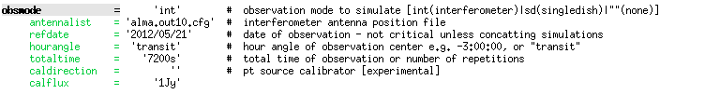
obsmode
obsmode sets total time, date, observing sequence
totaltime sets total observation time Here 7200s (2h) is the default value
Optionally specify the date, LST, and a calibrator sequence.
go simobserve simobserve creates a measurement set (MS) in projectname/projectname.ms
Notes:
Obsmode will set the total time, date, observing sequence..
We’ll leave the default values for our example.
These are the required inputs for simobserve to perform your simulation.
To proceed just type “go simobserve”, and you will obtain the simulated measurement set under your projectname directory

Slide 29
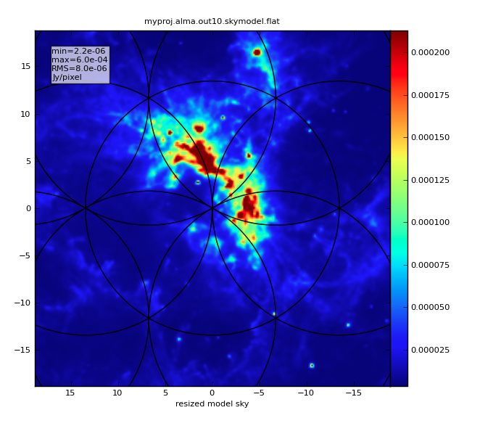
skymodel image
simobserve outputs several files to project directory:
projectname.alma.out10.ms/
projectname.alma.out10.observe.png
projectname.alma.out10.ptg.txt
Text files show the location of pointing centers
projectname.alma.out10.quick.psf
projectname.alma.out10.skymodel/
projectname.alma.out10.skymodel.flat/
projectname.alma.out10.skymodel.png
Notes:
Besides, simobserve also creates other output files in your projectname directory, such as
--diagnostic plots, showing the positions of the antennas, uv-coverage, synthesized beam, etc.
--a text file containing the positions of the pointings in the mosaic and observed time
--images of the synthesized beam, the model, the convolved model
--another figure showing the model and the position of the pointings

Slide 30
simobserve
Corruption with thermalnoise & toolkit
Corruption
(Optional)
Thermal noise, phase noise, polarization leakage
Notes:
The previous was an ideal simulation: no noise
You can try to do a more realistic simulation by corrupting the data, adding noise…

Slide 31


thermalnoise
Set observing conditions to add random noise to image
ATM model specific for ALMA site !
Use instead…
Notes:
Let’s see an example on how to add random thermal noise
--tsys-atm, uses an atmospheric model to obtain system temperatures from the provided pwv. NOTE the atm model is specific for the ALMA site (pressure, altitude, etc).
--by using tsys-manual, you can specify manually the sky brightness and compute zenit opacity using the conditions specific to the observatory.
Alternatively you could just use tsys-atm but with an appropriate pwv to scale the different conditions

Slide 32
thermalnoise
Set observing conditions to add random noise to image
ATM model specific for ALMA site !
See CASAguides and toolkit manual for other ways to corrupt data. (e.g., phase noise)
http://casaguides.nrao.edu/index.php?title=Corrupt
http://casa.nrao.edu/docs/casaref/CasaRef.html (Simulator tool, sm)
go simobserve simobserve creates a noisy measurement set (MS) in projectname/projectname.noisy.ms
Notes:
--see the CASAguides and the toolkit manual for more options on adding thermal noise and polarization leakage,
AND other ways to corrupt data, such as adding phase noise, using the simulator tool
--once you have introduce all the effects you want to corrupt your data, run simobserve with go
Now in the outputs there will be a NOISY ms

Slide 33

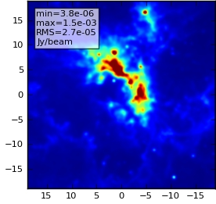
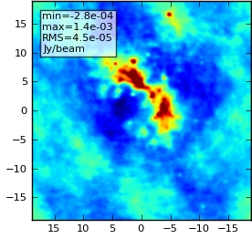
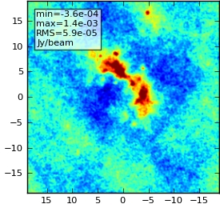
thermalnoise
Set observing conditions to add random noise to image
model no noise 3mm pwv
Notes:
In this slide you can see the effect on the resulting cleaned image of adding thermal noise.
To see it better, I have used a high amount of pwv for a 1mm observation,
AND also decreased the source brightness by a factor 3 (inbright=0.2 mJy/pixel)

Slide 34
Multiple sets of observations
One can simulate multiple sets of observations with multiple calls to simobserve, to:
simulate combining data with different hour angles
simulate combining data from different configurations (JVLA A+D), or arrays (ALMA 12m+ACA)
simulate combining data from interferometers and single dish telescopes (JVLA+GBT)
The CLEAN task can take multiple measurement sets to combine interferometric observations
The FEATHER task can combine single dish and interferometric observations
Notes:
You can simulate multiple sets of observations by running simobserve multiple times to combine data observed
--at different hour angles
--with different array configurations or combining different arrays
--from interferometers and single-dish to add zero-spacing
Once all the measurements sets have been obtained, you can combine them using
--clean to image multiple interferometer observations
--feather to combine interferometer and single-dish

Slide 35
Basic Simulation Workflow
In CASA…
Model Sky Distribution
(FITS, image, components)
simobserve
Simulated Measurement Set
(calibrated u-v data)
simanalyze
Simulated Image
& Analysis Plots Comparing “Observed”/original image
Notes:
Let’s see now how to use simanalyze…

Slide 36
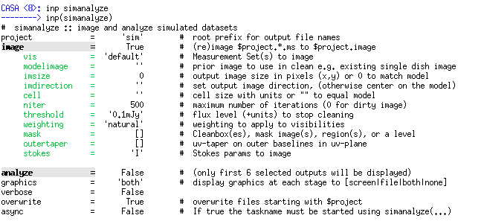
simanalyze
Image and analyze simobserve output
Notes:
This task will image the simobserve output visibilities
And will generate diagnostic plots to analyze the simulated results comparing with the input model

Slide 37
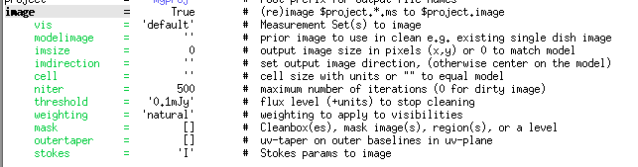
image
Grid, invert, and CLEAN the simulated data set.
Similar but reduced options compared to CLEAN. Defaults are “smart”, informed by the model.
You can also image the simulated observations with CLEAN. They are a normal CASA measurement set for all purposes
Notes:
The imaging performed with simanalyze uses a similar algorithm but with a limited number of parameters compared to CLEAN
In our example we’ll keep the default values, but for simulations intended for a proposal or science purposes, you may want to choose different values or define a region to be cleaned…
If you need more advanced options, you can always use CLEAN, and later use simanalyze only to obtain diagnostic plots (image=False, and very specific name of the image!)

Slide 38
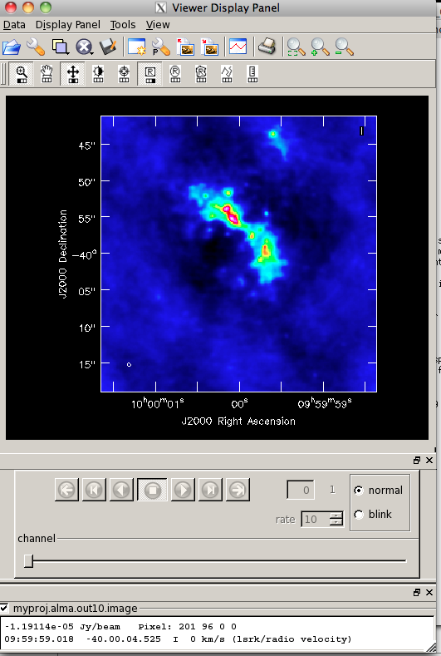
image
Output files can be examined with the CASA viewer. In CASA 3.4 these live in projectname/projectname.image
Notes:
Similarly, you can also use the CASA viewer to check the output images as those obtained with CLEAN

Slide 39
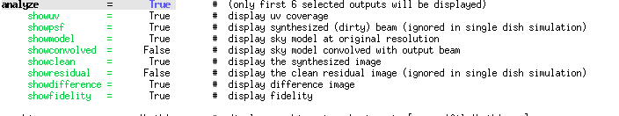
analyze
Create diagnostic plots based on simobserve and image
Pick up to 6 of these.
go simanalyze simanalyze creates images and diagnostic plots in projectname/
Notes:
By setting analyze=true, you can select which diagnostic plots you want simanalyze to create, up to 6 plots
Then run simanalyze using ‘go’

Slide 40
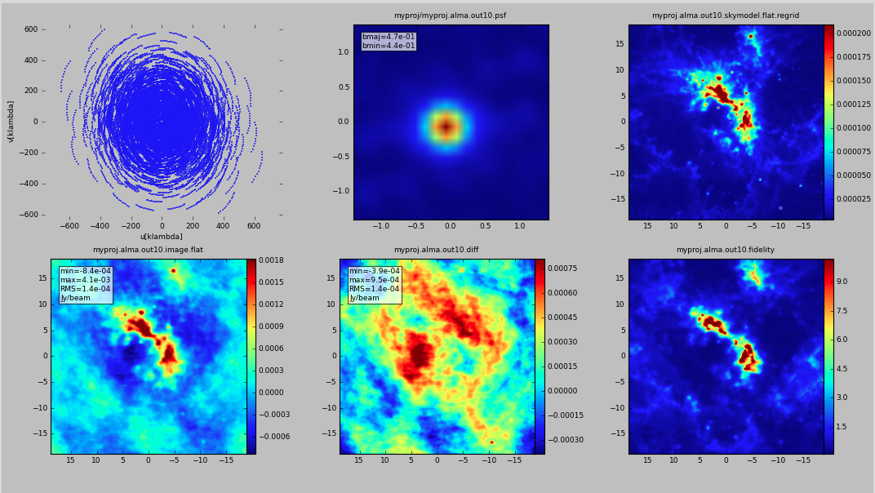
analyze
Create diagnostic plots based on simobserve and image
Notes:
This are the ones we selected before….

Slide 41
analyze
Create diagnostic plots based on simobserve and image
u-v coverage
Point spread function
Sky Model
Simulated image
Difference
Image Fidelity
Notes:
…which are:
--uv coverage
--synthesized dirty beam
--sky model at original resolution
--synthesized image
--difference = simulated cleaned image – input model convolved with psf
--fidelity image = input/max( abs(input-output), 0.7*rms(output) )

Slide 42
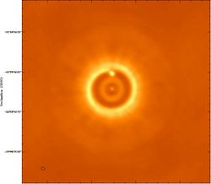
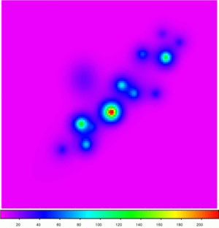
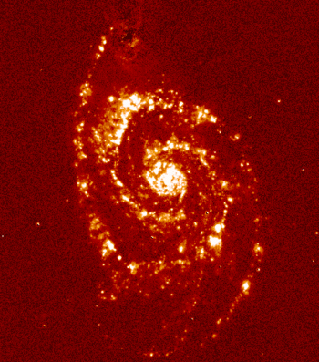
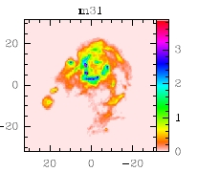
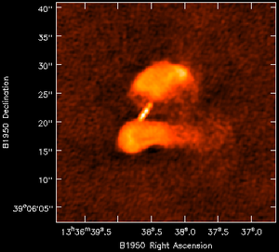
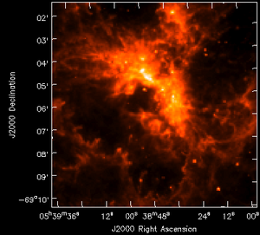
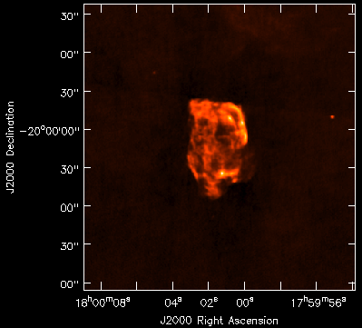
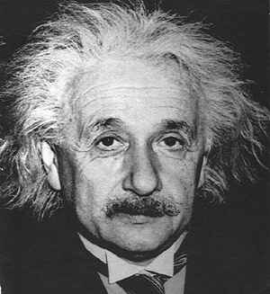
Try It Yourself!
Simulate one of the suite of model images at http://casaguides.nrao.edu/index.php?title=Sim_Inputs
Notes:
Now is your turn
You can find model images at the CASAguides site

