Slide 1


PROBLEM STATEMENT AND TEAM DETAILS
PROBLEM STATEMENT : FLEXPRICE × PATHWAY HACKATHON( CFO HELPER )
TEAM NAME :
CODEVISTA, 60D8D46D
TEAM LEADER NAME :
TULYA JYOTHI VEERLA
INSTITUTE NAME :
MAHATMA GANDHI INSTITUTE OF TECHNOLOGY
TEAM LEADER EMAIL ID :
tulyajyothiveerla007@gmail.com
DEPLOYMENT LINK :
https://innobudget.netlify.app

Slide 2
PROBLEM AND SOLUTION
PROBLEM
HARD TO MANAGE BUDGETS FOR EVENTS/STARTUPS.
EXCEL/MANUAL TRACKING IS SLOW AND ERROR-PRONE.
LEADS TO OVERSPENDING AND POOR PLANNING.
SOLUTION – CFO HELPER
AI TOOL TO TEST “WHAT-IF” SCENARIOS (SPEND, HIRE, PRICING).
SHOWS CLEAR FORECASTS WITH CHARTS/REPORTS.
FLEXPRICE → PAY PER SCENARIO/REPORT.
PATHWAY → LIVE UPDATES WITH FRESH DATA.
PLATFORM WHERE PARTICIPANTS SEE UPCOMING HACKATHONS & LIVE UPDATES, AND SPONSORS REGISTER SPONSORSHIPS TO SUPPORT ORGANIZERS

Slide 3
METHODOLOGY & IMPLEMENTATION
METHODOLOGY
Problem – Organizers struggle with budget forecasting.
Solution – CFO Helper inside INNOBUDGET
Features – Sliders for costs, AI insights, instant charts & reports.
Integration – FlexPrice (pay-per-use), Pathway (live data).
IMPLEMENTATION
FRONTEND – REACT + TAILWIND (RESPONSIVE UI).
BACKEND – NODE.JS/EXPRESS.
DATABASE – MONGODB.
AUTH – ROLES: ORGANIZER, PARTICIPANT, SPONSOR.
DASHBOARD – CFO HELPER TAB WITH SLIDERS & AUTO-REPORTS

Slide 4
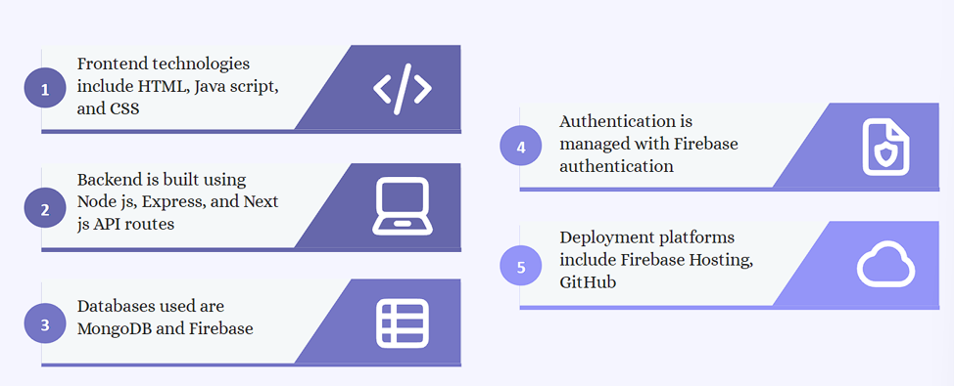
TECHNOLOGY USED

Slide 5
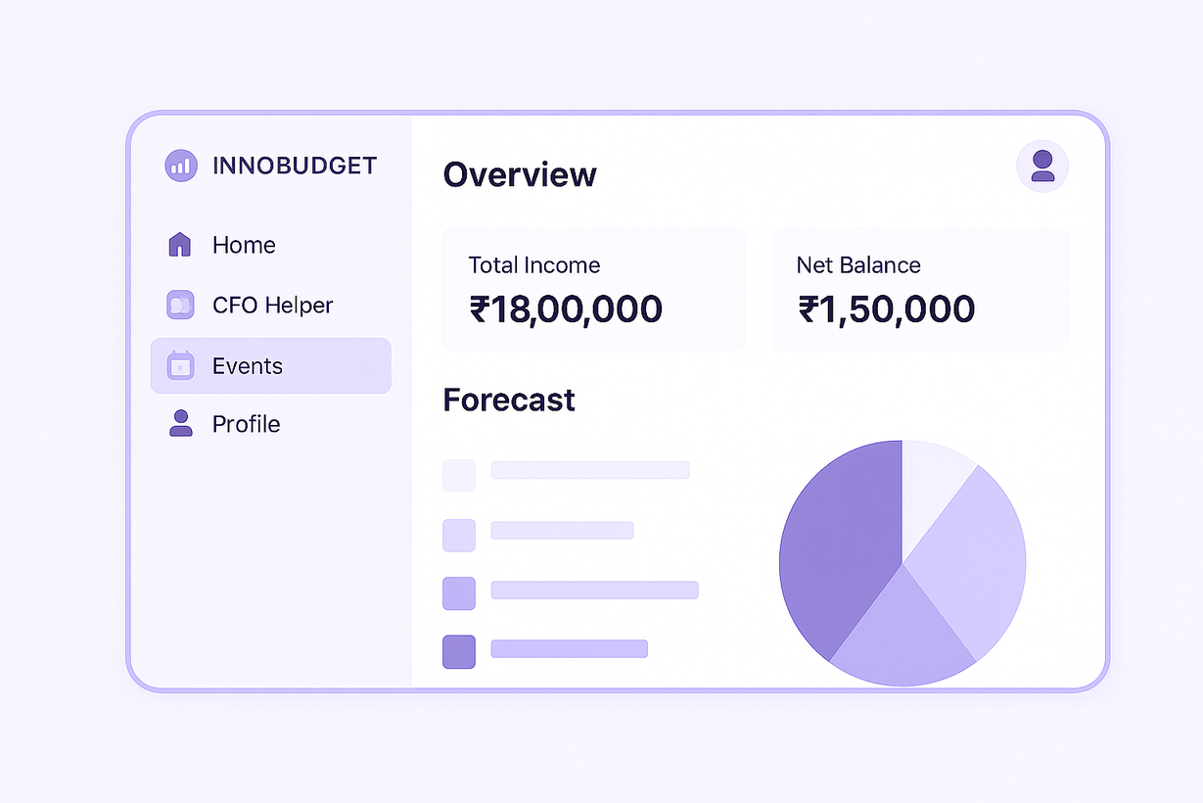
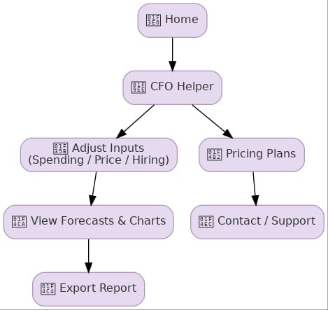
FLOWCHART & SUPPORTING IMAGES

Slide 6
FEASIBILITY AND MARKET USE
FEASIBILITY
TECHNICAL → USES COMMON TECH (REACT, NODE, MONGODB) → EASY TO BUILD & GROW.
ECONOMIC → FLEXPRICE BILLING → LOW COST TO START, SCALES WITH USAGE.
OPERATIONAL → SIMPLE DASHBOARDS & SLIDERS → EASY EVEN FOR NON-TECH USERS.
MARKET USE
ORGANIZERS → PLAN HACKATHON OR FEST BUDGETS.
STARTUPS → TEST “WHAT-IF” MONEY SCENARIOS.
STUDENTS/COLLEGES → MANAGE FEST FUNDS & SPONSORS.
SPONSORS → TRACK FUND USAGE → BUILDS TRUST

Slide 7
CONCLUSION
INNOBUDGET IS DESIGNED AS A SIMPLE YET POWERFUL PLATFORM THAT BRINGS TOGETHER EVERYONE IN THE HACKATHON ECOSYSTEM. ORGANIZERS CAN EASILY PLAN AND MANAGE BUDGETS WITH CLEAR “WHAT-IF” SCENARIOS, SPONSORS CAN REGISTER THEIR OFFERS AND GAIN VISIBILITY, WHILE PARTICIPANTS CAN EXPLORE UPCOMING HACKATHONS, SAVE THEIR FAVORITES WITH A WISHLIST, AND STAY NOTIFIED. WITH ITS USER-FRIENDLY DASHBOARDS, TRANSPARENT FUND USAGE, AND FLEXPRICE MODEL, THE PLATFORM NOT ONLY SIMPLIFIES EVENT MANAGEMENT BUT ALSO BUILDS TRUST AND ENGAGEMENT ACROSS ORGANIZERS, PARTICIPANTS, AND SPONSORS — MAKING HACKATHONS MORE ORGANIZED, EFFICIENT, AND IMPACTFU

Slide 8
PRESENTED BY:
RITHIK PEDAPUDI – FRONTEND DEVELOPMENT
TULYA JYOTHI VEERLA – BACKEND DEVELOPMENT BHAVANA BODDU – UI/UX & THEME DESIGN
HEMANT ANUMULA – CONTENT & DOCUMENTATION
VIVEK CHINTA – PRESENTATION & DEPLOYMENT

