Slide 1
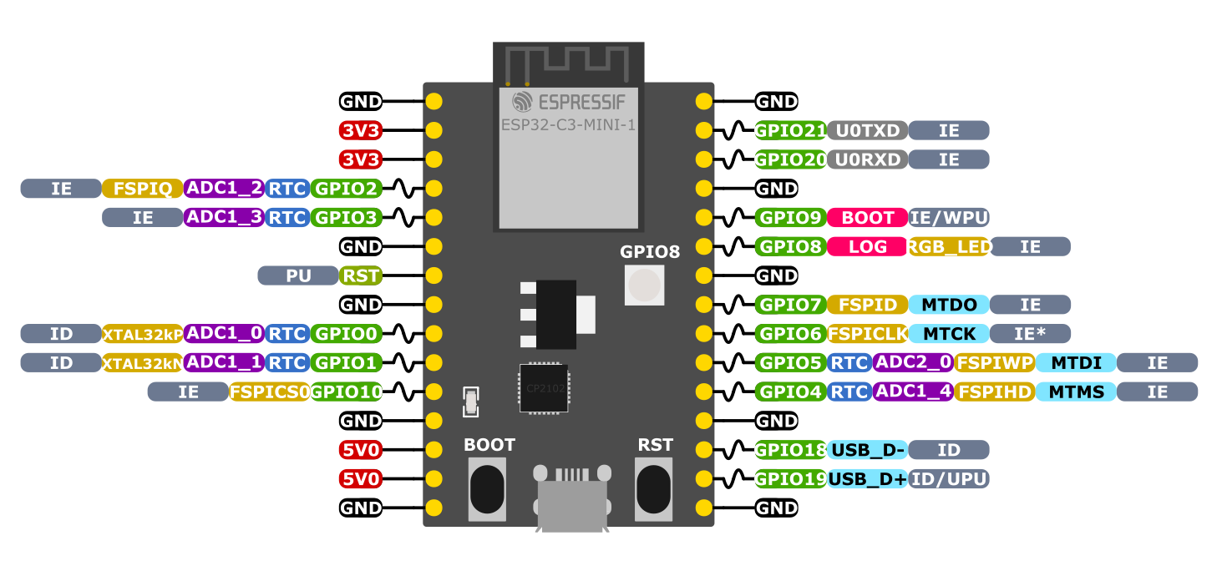
CO2_RDY
CO2_EN
SPI CS
I2C SDA
SPI MOSI (SI)
I2C SCL
SPI MISO (SO)
SPI SCK (CLK)

