Slide 1


Knowledge Aggregation with Subjective Logic in Self-Adaptive Cyber-Physical Systems
Evaluation results
(January 17, 2020)

Slide 2

Knowledge aggregation with CBF
Hypothesis: Better conflict resolution, however, gain in confidence of observations takes more time
Scenario 1:
2 robots
Spawn rate: 10s
Minimal noise: mean=0.022, std. dev: 0.02
5 runs
Scenario 2:
3 robots
Spawn rate: 10s
Additional noise: mean=0.044, std. dev: 0.04
5 runs

Slide 3
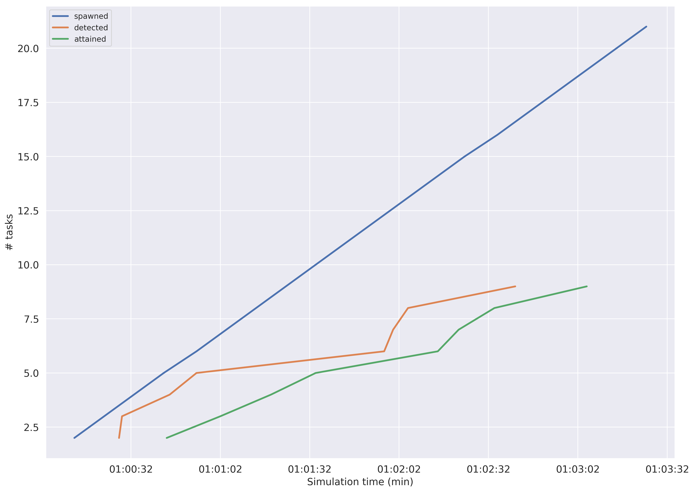
Results (Scenario 1)

Slide 4
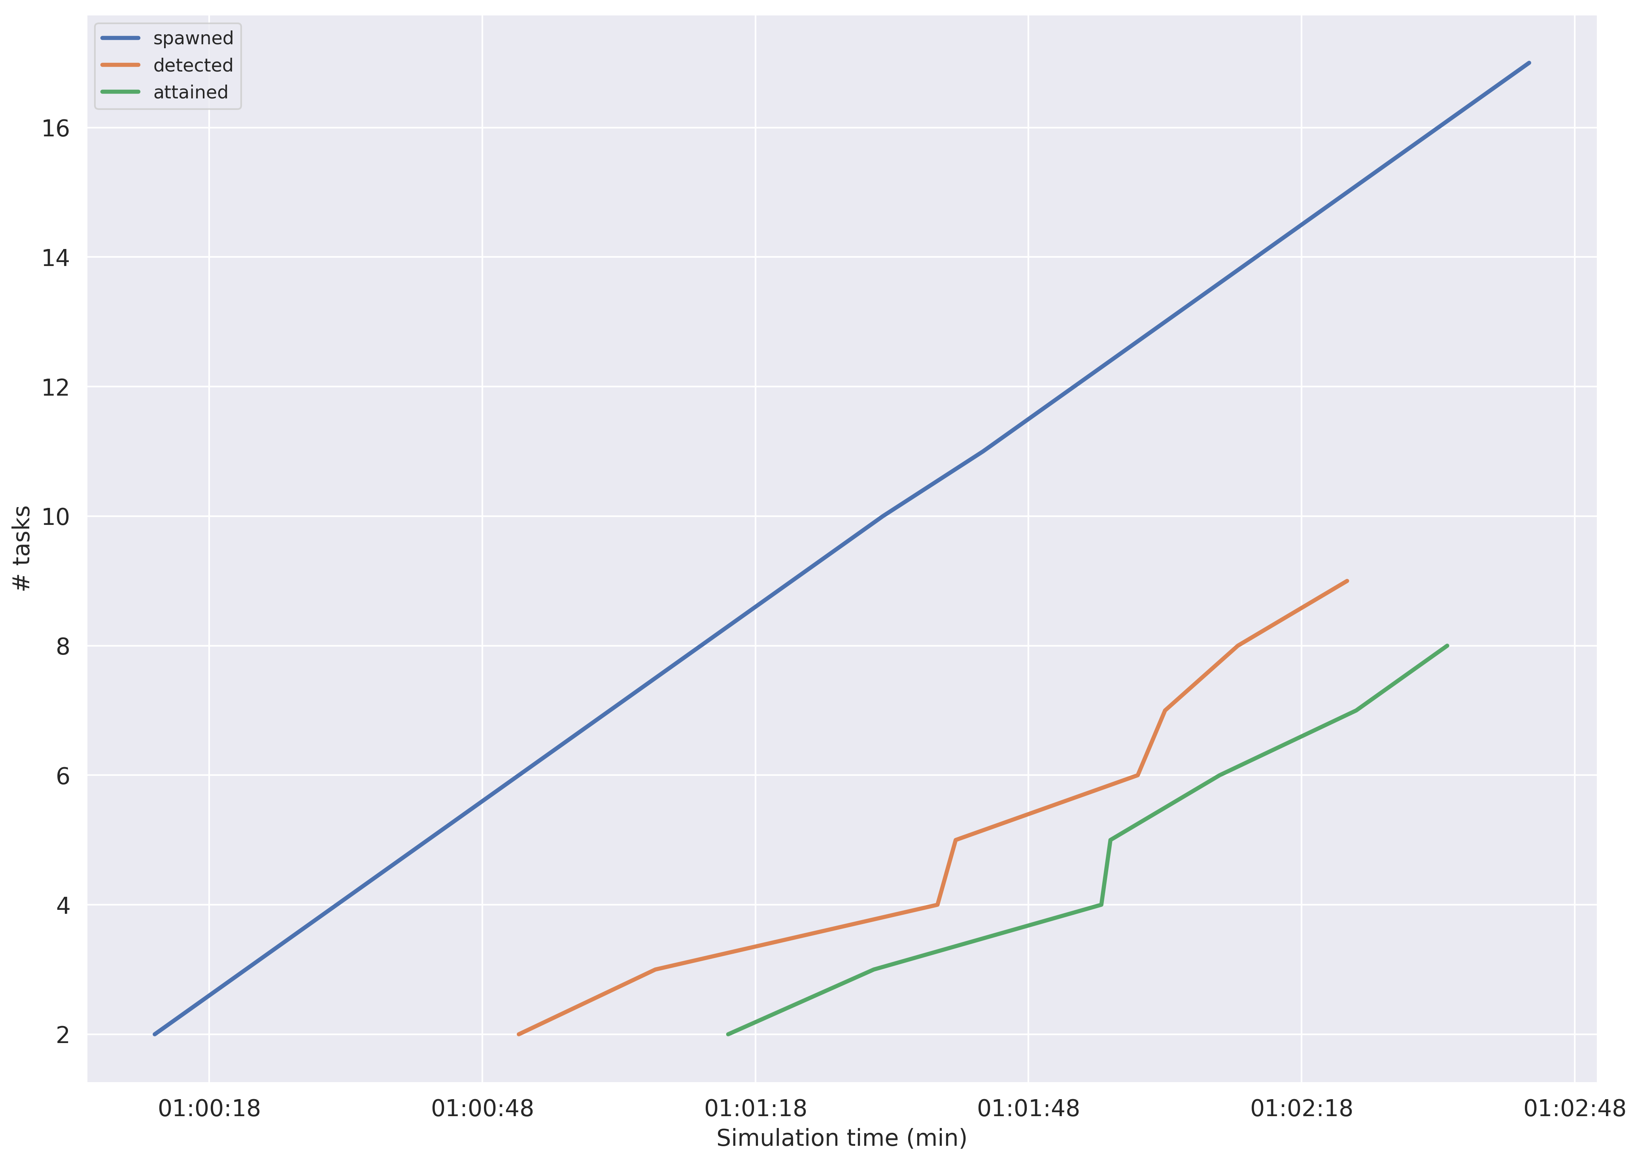
Results (Scenario 2)

Slide 5
Knowledge aggregation with C&CF
Hypothesis: More evidences from multiple agents, increase the confidence of the observations in less time
Scenario 1:
2 robots
Spawn rate: 10s
Minimal noise: mean=0.022, std. dev: 0.02
5 runs
Scenario 2:
3 robots
Spawn rate: 10s
Additional noise: mean=0.044, std. dev: 0.04
5 runs

Slide 6
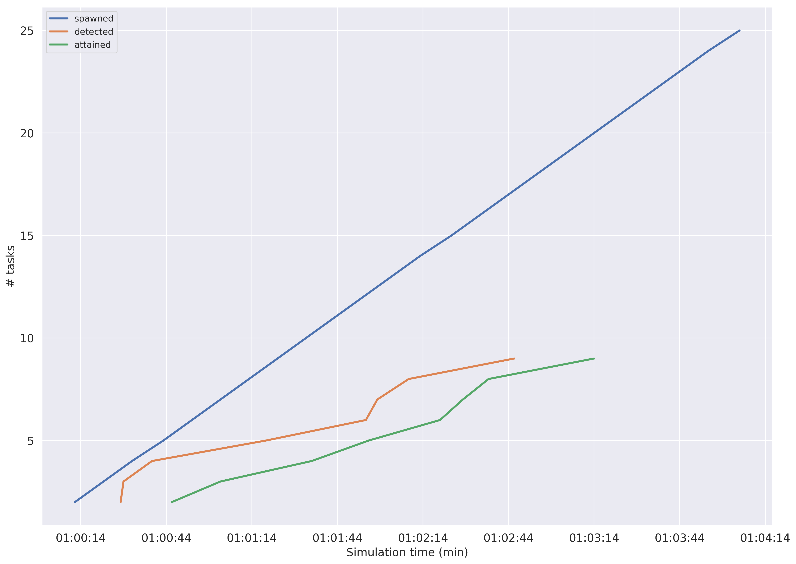
Results (Scenario 3)

Slide 7
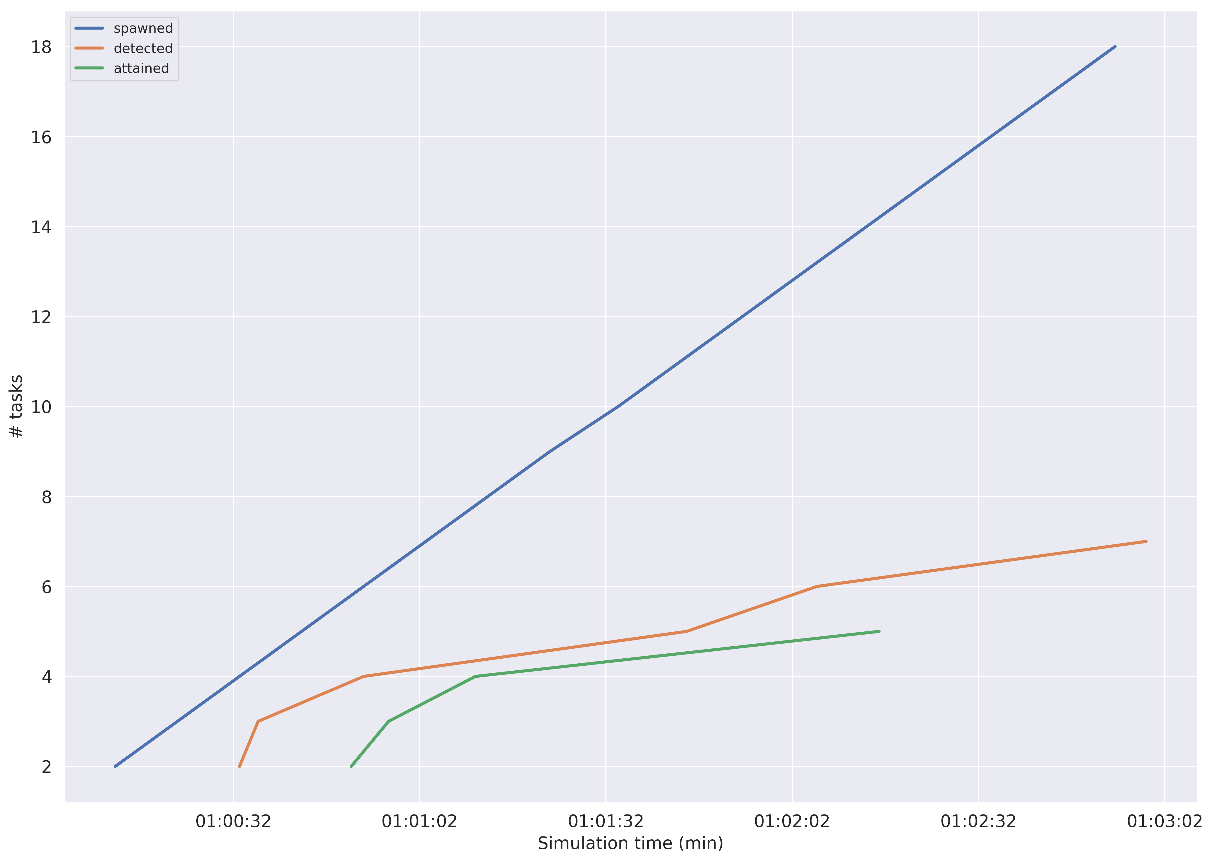
Results (Scenario 4)

