Slide 1


Knowledge Aggregation with Subjective Logic in Self-Adaptive Cyber-Physical Systems
Evaluation results
(January 19, 2020)

Slide 2

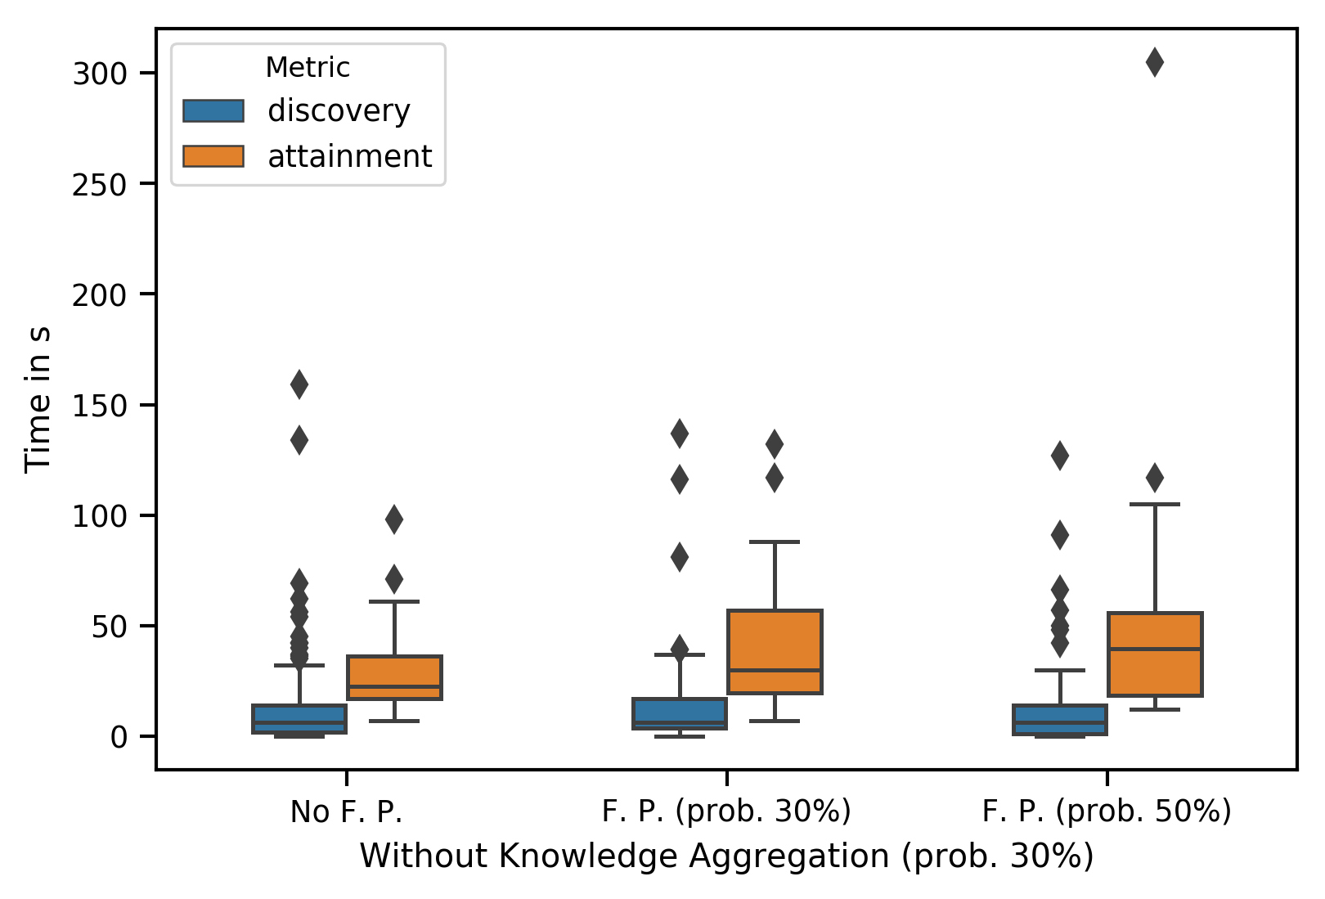
Without knowledge aggregation

Slide 3
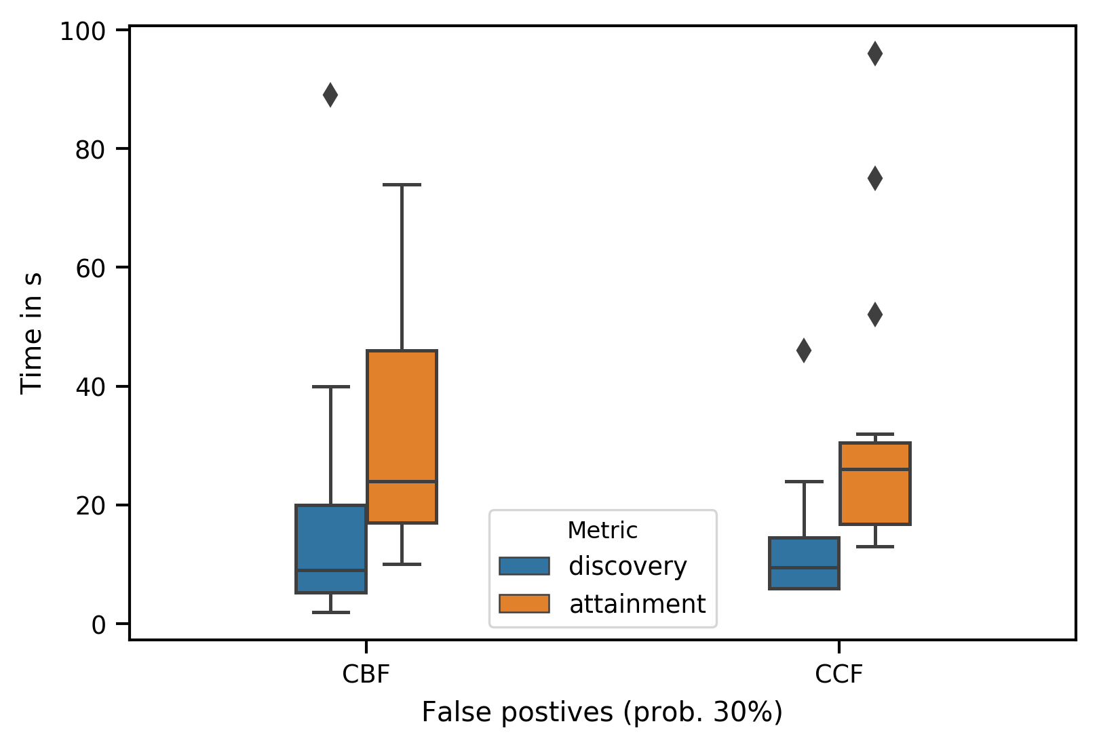
With knowledge aggregation

Slide 4
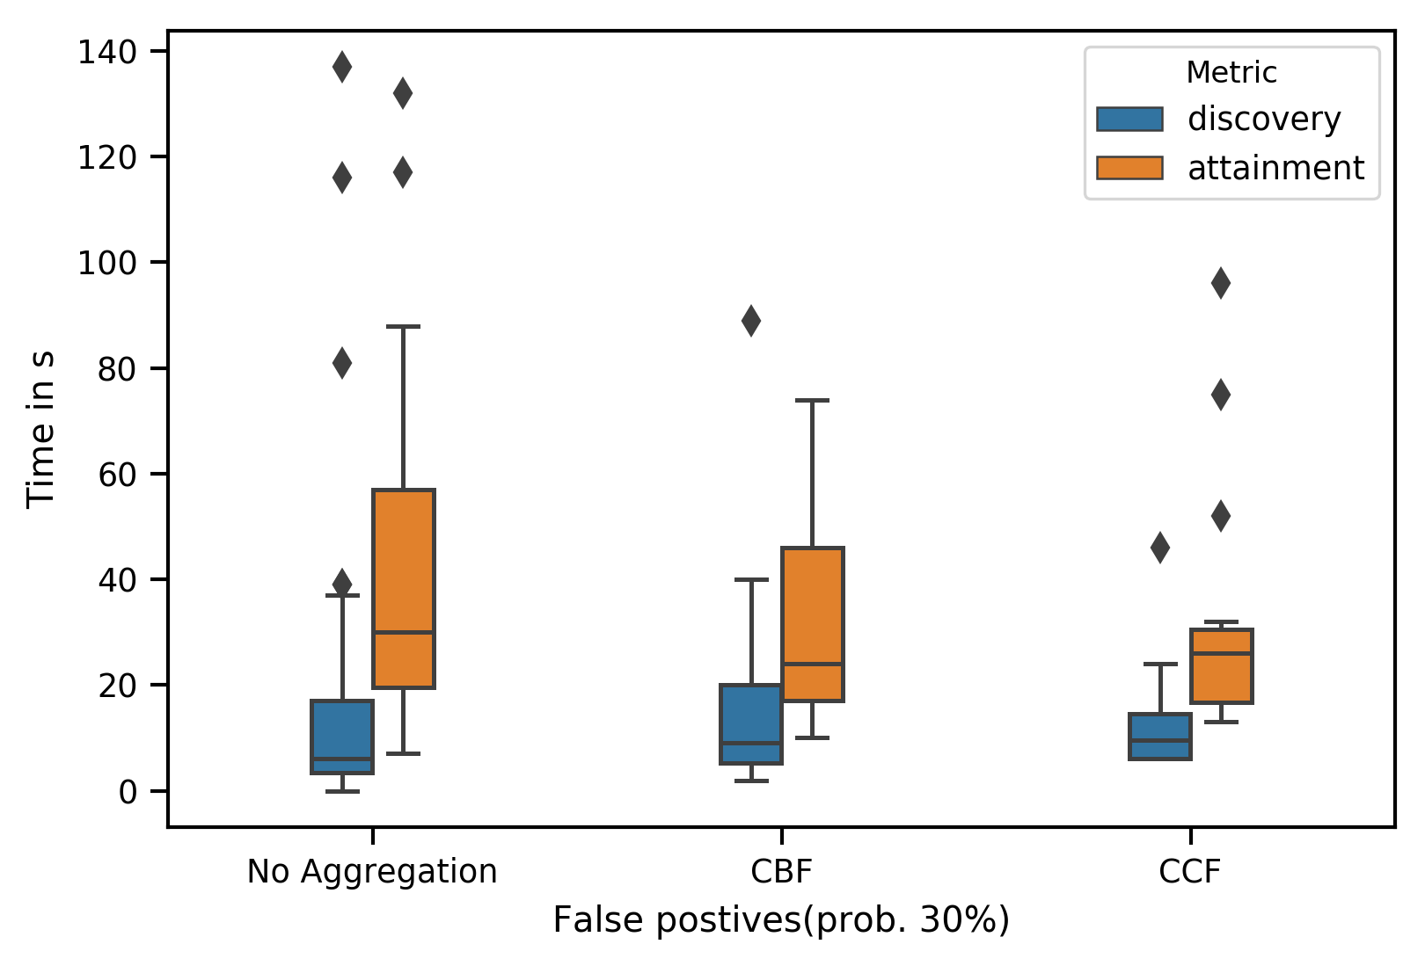
No aggregation vs Aggregation

