Slide 1

Attack Graph Generation for Microservice Architecture
Authors:
Amjad Ibrahim, M.Sc.
Stevica Bozhinoski
Prof. Dr. Alexander Pretschner

Slide 2
Content
Motivation
Background
Method
Evaluation
Related Work
Conclusion

Slide 3
Content
Motivation
Background
Method
Evaluation
Related Work
Conclusion

Slide 4
Motivation
Microservices are increasingly dominating the field of service systems
Increase of utilizing third-party components
Result in greater attack surface
Need for an automatic detection of potential vulnerabilities

Slide 5
Content
Motivation
Background
Method
Evaluation
Related Work
Conclusion

Slide 6
Background
Microservices
Vulnerability Scanners
Attack Graphs

Slide 7
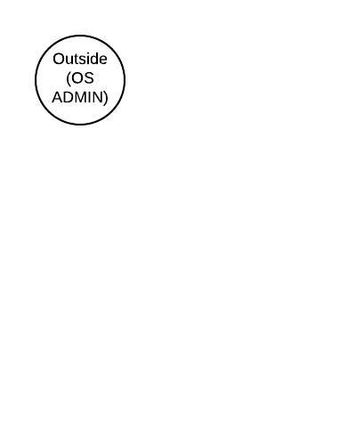
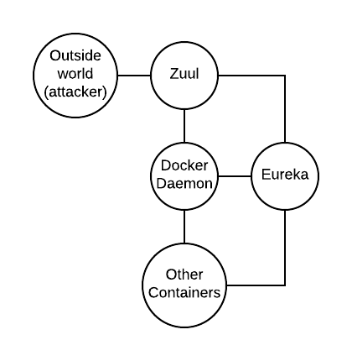
Example
Topology
Resulting Attack Graph

Slide 8
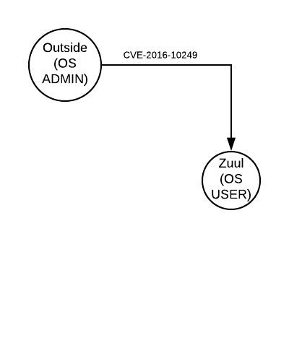
Example
Topology
Resulting Attack Graph

Slide 9
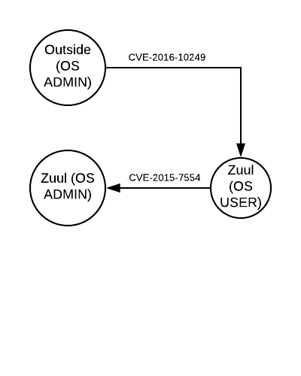
Example
Topology
Resulting Attack Graph

Slide 10
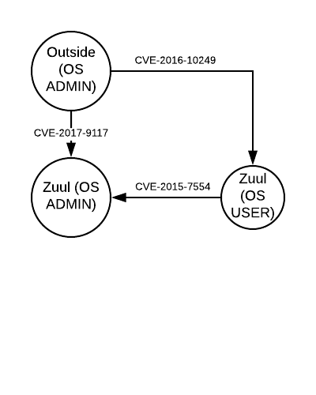
Example
Topology
Resulting Attack Graph

Slide 11
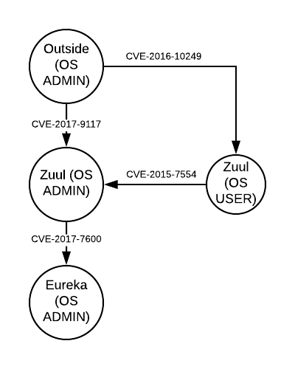
Example
Topology
Resulting Attack Graph

Slide 12
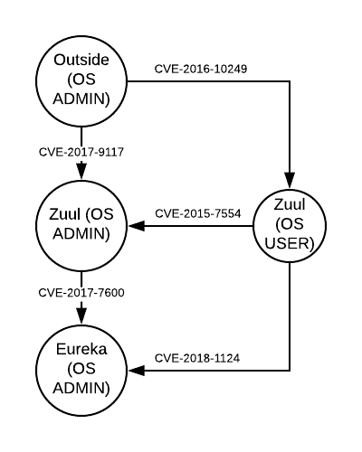
Example
Topology
Resulting Attack Graph

Slide 13
Content
Motivation
Background
Method
Evaluation
Related Work
Conclusion

Slide 14
Method
From Network Nodes to Microservices
System Overview
Attack Graph Generation for Docker Containers
  Topology Parser
  Vulnerability Parser
  Attack Graph Generator

Slide 15
From Network Nodes to Microservices
Adapt attack graph generator used in computer networks for microservices and map:
  Hosts -> containers
  Physical host link -> connection between containers
Four level of privileges – combination of access level(User, Admin) and access mode (virtual macine, host)
Preconditions/Postconditions from manually selected rules

Slide 16
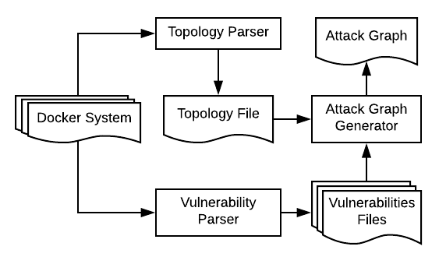
System Overview

Slide 17
Topology Parser
Utilizing information of the docker-compose.yml file
Networks keyword – connection between components
Published ports
Privileged access

Slide 18
Vulnerability Parser
Using Clair to generate vulnerabilities for each file
Input: a given image
Output: list of CVE-IDs, descriptions and attack vectors of the given image

Slide 19
Attack Graph Generator
Input: list of vulnerabilities and topology
Output: an attack graph
Breadth-first search (BFS) algorithm
  Monothonicity property
  Termination
  O(|N| + |E|) N – nodes, E – edges

Slide 20
Content
Motivation
Background
Method
Evaluation
Related Work
Conclusion

Slide 21
Evaluation
Evaluation of the proposed attack graph generator system
  Application on four systems with various technologies, number of containers and vulnerabilities
  Testing the system scalability with increasing number of containers and connections

Slide 22
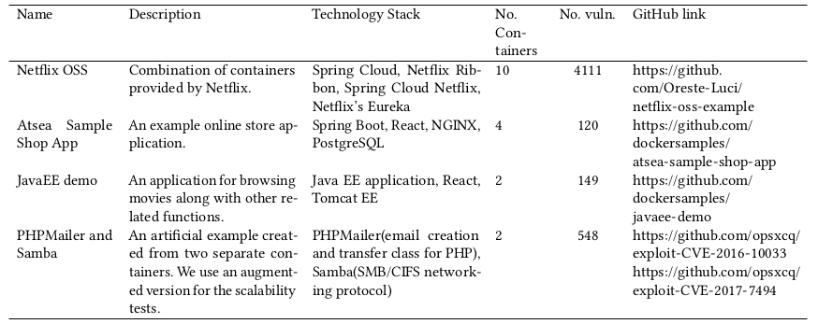
Use Cases

Slide 23
Scalability
Testing performance for increasing number of containers in fully-connected fashion
20, 50, 100, 500 and 1000 fully-connected containers
Topology parsing and vulnerability preprocessing result in linear increase in time
Attack generation time increases with number of connections
1000 fully-connected containers in 13 minutes

Slide 24
Content
Motivation
Background
Method
Evaluation
Related Work
Conclusion

Slide 25
Related Work
Model Checker (Sheyner et al.)
  Four hosts, eight attomic attacks in two hours
Logical attack graph (Ou et al.)
  1000 fully-connected nodes in 1000 seconds
Attack graph generator based on BFS (Ingols et al.)
  8901 nodes (23315 edges) in 0.5 seconds

Slide 26
Content
Motivation
Background
Method
Evaluation
Related Work
Conclusion

Slide 27
Conclusion
Successful attack graph generation in microservice systems
  Heterogeneous microservice systems with different technologies
  Fully automated
  Scalable solution for bigger systems

Slide 28
Thank you for your attention
Questions?

