Slide 1
Swarm Robots
Algorithms

Slide 2
Outline
Introduction to Swarm Robotics
Selected Concepts
Fuzzy Logic
Evolutionary Computing
Selected Algorithms
Distributed Bees Algorithm
Spill detection and perimeter surveillance
Teamwork in Self-organized Robot Colonies
Conclusion
References

Slide 3
Definition
Swarm Robotics is the study of how to coordinate a large number of autonomous and homogeneous robots in a distributed and decentralized way such that a desired collective behaviour emerges. [1]

Slide 4
Desirable properties
Robustness
Flexibility
Scalability
Decentralized control

Slide 5
Advantages
Disadvantages
Improved performance
Task enablement
Distributed sensing
Distributed action
High fault tolerance
Interference
Uncertainty
Cost

Slide 6
State of the Art experimental tasks
Aggregation
Dispersion
Pattern formation
Collective movement
Task allocation
Source search
Collective transport of objects
Collective Mapping
→ Real applications

Slide 7
Current challenges
Algorithm Design
Analysis and Modeling

Slide 8
Fuzzy Logic
Form of probabilistic logic
Truth value [0;1]
IF variable IS property THEN action
Self-Assembling for Swarm Modular Robots [2]
MIMO Fuzzy Controller
Input: measured distances using five fuzzy sets
Output: linear and angular velocity using five fuzzy sets

Slide 9
Evolutionary Computing
Genetic population-based optimization algorithm
Iterative, parallel → continuous & combinatorial optimization
Fitness function
Cooperative Hole Avoidance [3]
Coordinated motion for swarm-bot
Dynamic algorithm required due to many configurations
Problem: evolutionary algorithms are very slow!

Slide 10
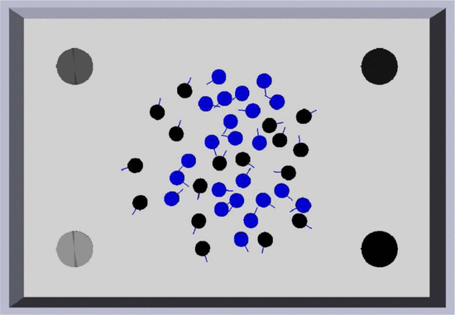
Distributed Bees Algorithm (DBA) [4]
Multi-robot task allocation (MRTA)

Slide 11
Problem definition
Assumptions:
All targets available for all robots
Decision once every target has been found
No reallocation allowed
N number of robots
M number of targets i

Slide 12
Algorithm
Costs
Distance
Targets visibility
Normalized Quality
Utility
Decision-making

Slide 13
Experimental evaluation
Simulator
Experimental setup
Simulation Results and Discussion
Mean absolute error (MAE)
Successful

Slide 14
Conclusion
The scalability and the ability to adopt to different environments are the features of utmost importance in the case of large, autonomous multirobot systems.
The parameters α und β provide a mechanism to adjust the swarm behavoir depending on the task.

Slide 15
Spill detection and perimeter surveillance [5]
Control law for a group of agents:
search for,
detect, and
track
a hazardous spill in an unknown environment

Slide 16
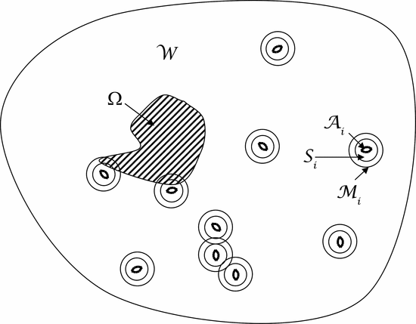
Problem definition
Path planning

Slide 17
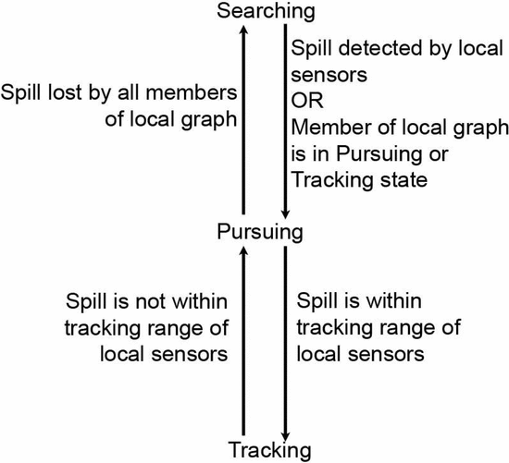
Solution (I)
Algorithmic state transitions

Slide 18
Solution (II)
Perimeter search
Random search technique
Repulsive potential field to avoid collision
Pursuit
Potential field used for navigation
Tracking spill boundary
Move along boundary
Measure length of perimeter
→ hybrid hierarchy

Slide 19
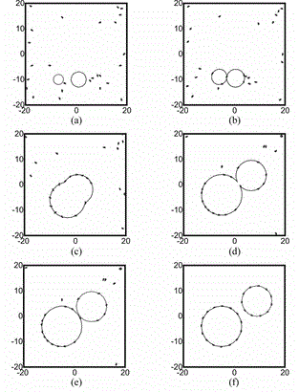
Simulation and experiment results
Stability checked analytically before
Simulation results
Completion of search, pursuit, and track
Convergence of velocity and distance
Experimental results

Slide 20
Conclusion
Hybrid system of finite states with feedback control
Successful detection and tracking of spills whose location, shape, size, and number may change over time

Slide 21
Teamwork in Self-organized Robot Colonies [6]
First self-organized multi-robot system that displays a dynamical hierarchy of teamwork
Task: Retrieve the prey to the nest
Navigation: Path formation
Self-assembly: Recruitment without human interaction
Group transport: Conveyance of the prey by two or more robots

Slide 22
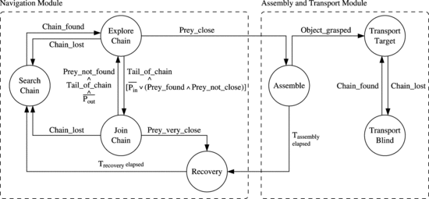
Solution
Hardware
Swarm-bot composed of s-bots
Controller
Finite state machine

Slide 23
Results
More agents will significantly decrease the time need for recruitment.
Decentralized control algorithm
Crucial mechanism: recovery
Dynamically changing hierarchy of teamwork

Slide 24
Conclusion
Established Algorithms are adapted to swarm robotics resulting in:
New challenges
Satisfying results
Many advantages
Promising prospects
Future work:
Mathematical modelling of swarm-robots systems

Slide 25
References (I)
[1] I. Navarro, and F. Matia, “An Introduction to Swarm Robotics,” ISRN Robotics, Vol. 2013, Article ID 608164, June 2012.
[2] T. Wang, H. Li, and C. Meng, “Self-Assembling for Swarm Modular Robots using MIMO Fuzzy Control,” ISRN Robotics, Vol. 2013, Article ID 598647, June 2013.
[3] V. Trianni, S. Nolfi, and M. Dorigo, “Cooperative Hole Avoidance in a Swarm-bot,” Technical Report No. TR/IRIDIA/2004-22, October 2004.
[4] A. Jevitić, A. Gutierrez, D. Andina, and M. Jamshidi, “Distributed bees algorithm for task allocation in swarm of robots,” IEEE Systems Journal, Vol. 6, No. 2, pp. 296-304, June 2012.

Slide 26
References (II)
[5] G. Zhang, G.K. Fricke, and D.P. Garg, “Spill detection and perimeter surveillance via distributed swarming agents,” IEEE Transactions on Mechatronics, Vol. 18, No. 1, pp. 121-129, Feb. 2013.
[6] S. Nouyan, R. Groß, M. Bonani, F. Mondada, and M. Dorigo, “Teamwork in self-organized robot colonies,” IEEE Transactions on Evolutionary Computation, Vol. 13, No. 4, pp. 695-711, Aug. 2009.

