Slide 1
Simulation of two 2-R planar robots handling an object using FEA for static and dynamic case
Final results of an internship with DAAD RISE at the VIT, Tamil Nadu, India, by Tobias Keute

Slide 2
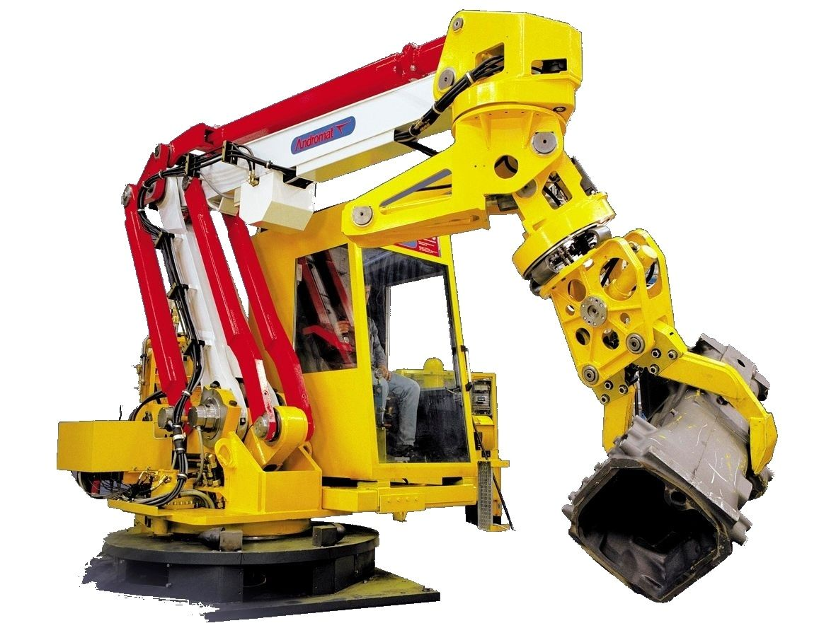
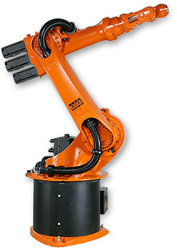
What is a robot/manipulator?
Several links connected serially or parallel
Joints connecting the links
Robot vs Manipulator: Robot is guided by Computer!

