Slide 1
Simulation-Based Autonomous Driving in Crowded City
SS 2023
Master Praktikum:
Baran Ekin Özdemir - Team 16

Slide 2
Contents
Problem Statement
Method
Steering Model
Model Architecture
ResNet Backbone
Dataset Acquisition
Training
Vehicle Detection with Faster R-CNN
Driving Logic
Limitations
Demo

Slide 3
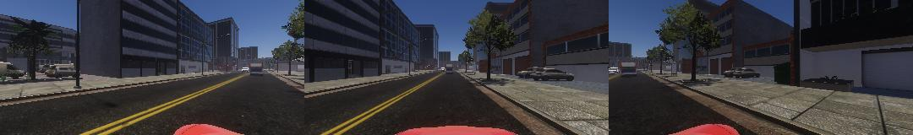
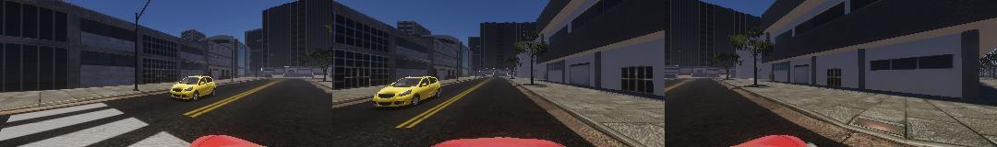
Problem Statement
We have a 3D simulated environment of a city with street roads, buildings, trees and various vehicle agents.
We have an ego car that needs to safely drive on the streets autonomously via perception using its three optical cameras looking forward.
There are no pedestrians or bikers.
There is no destination.

Slide 4
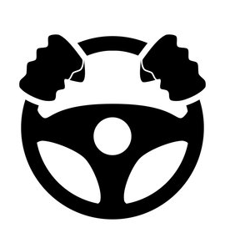
Method: Steering Model
Steering Model is the main component of this projects whole system.
Essentially it takes a single 1080x160 RGB image from all cameras at once and outputs a steering value.
Steering model has a ResNet backbone. Let’s take a look at it:
Steering Model
(3, 1080, 160) RGB
Steer
(-1, 1)
Image

Slide 5
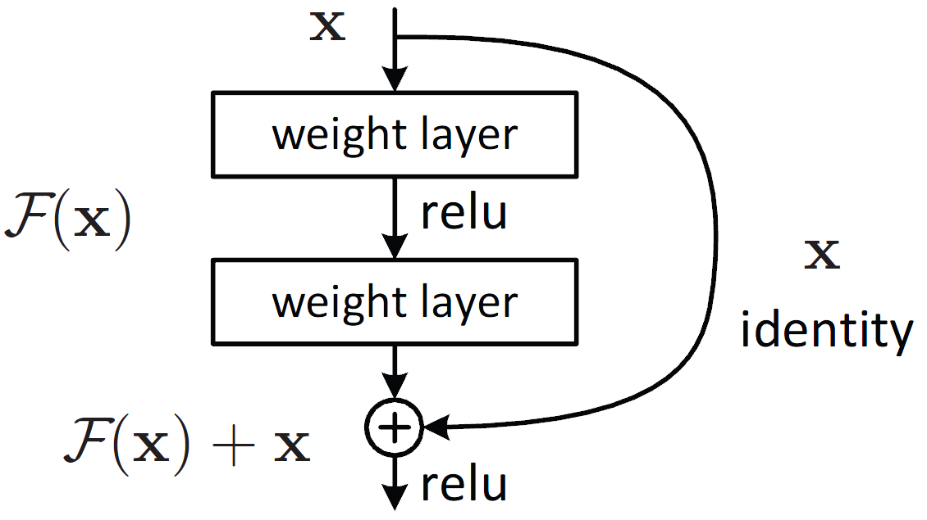
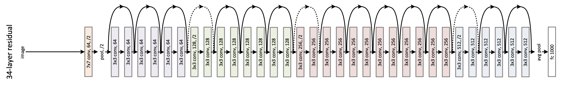
Method: ResNet Backbone
Steering Model uses ResFirst2 as a convolutional backbone.
ResFirst2 is the first 2 blocks (15 layers) of ResNet-34.
ResNet is a deep CNN architecture that employs skip connections to enable training of very deep networks and mitigate the vanishing gradient problem.
ResFirst2

Slide 6
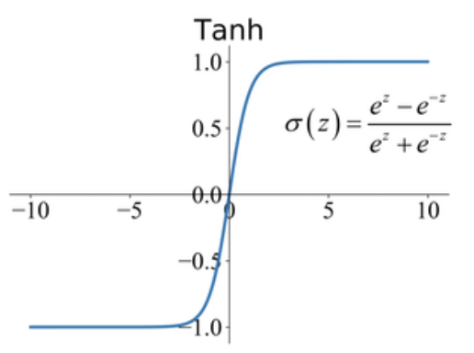
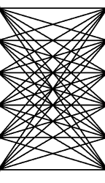
Method: Steering Model Architecture
Steering Model consists of additional 3 fully connected layers on top of ResFirst2 layers.
ResFirst2 is not pretrained.
To achieve output range of (-1, 1), TanH activation function is used.
Steering Model
ResFirst2
(First 2 Blocks of ResNet-34)
(3, 1080, 160) RGB
flatten
TANH
Steer (-1, 1)
Image
128
512
64

Slide 7
Method: Dataset Acquisition
Datasets are acquired from the simulator by very long capturing sessions.
Final dataset is a combination of all runs and consists of around 86.000 images.
During data capturing runs:
Mouse is used as a controller for smooth steering values.
Deterministically went straight at intersections. (Only turned when road turns.)
No traffic rules were followed.
No time wasted waiting behind other vehicles.

Slide 8
Method: Training
Final dataset with 86.000 images are used for training. Train: 80%, Validation: %20
As a data augmentation method, all images went through “Random Erasing”, where parts of the input image is randomly deleted and filled with either 0, 255, image mean or random noise.
This augmentation aims to mimic vehicles that are occluding parts of the camera, to ensure more generalization of the model for different situations.
Training is done for 2 Epochs, with a batch size of 8, using Adam optimizer with lr=1e-4

Slide 9
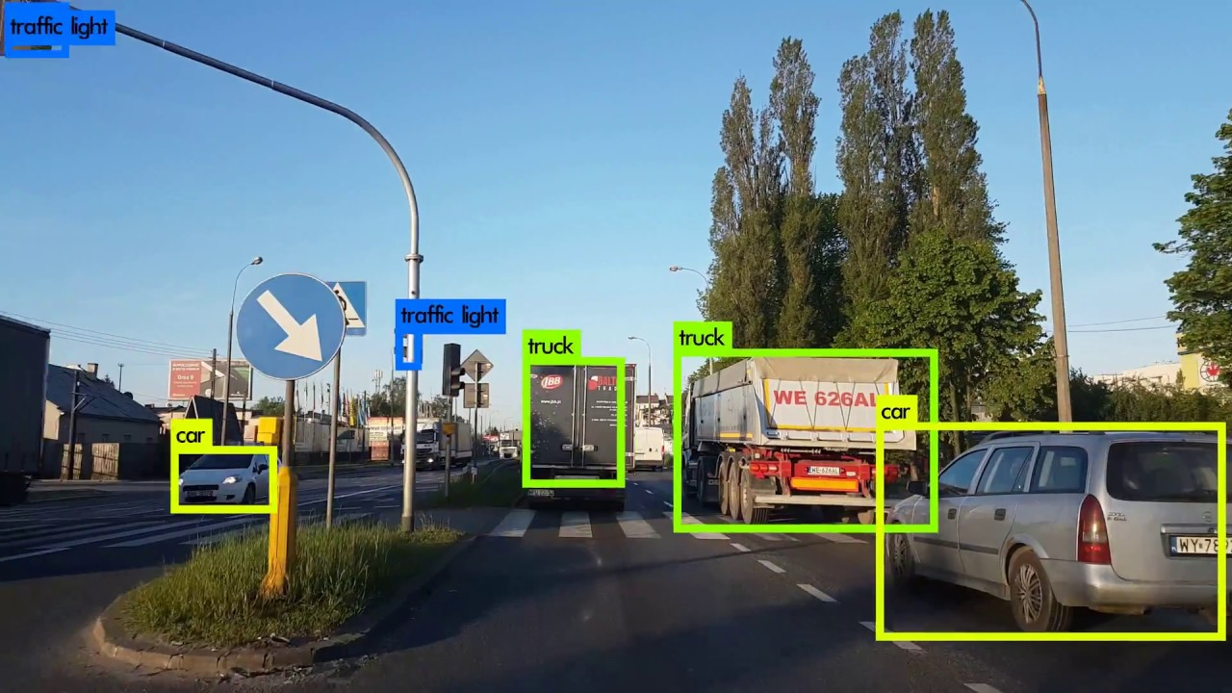
Method: Vehicle Detection with Faster R-CNN
While Steering Method takes care of the steering, it does not ensure safe driving in an environment where other vehicles exist.
To avoid collisions with other vehicles, a pre-trained Faster R-CNN is used as a second network to detect other vehicles around.
Faster R-CNN model is pre-trained for object detection task on COCO dataset. This includes classes such as car, truck and bus that is usable for this project.

Slide 10
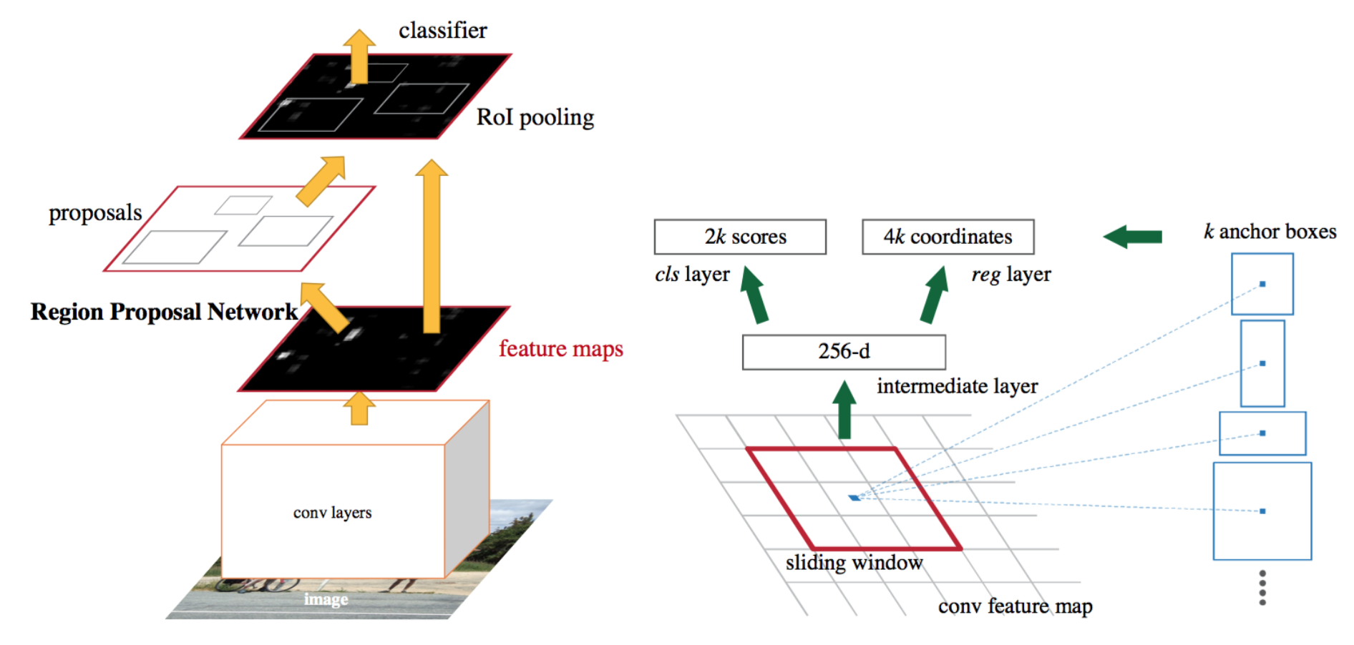
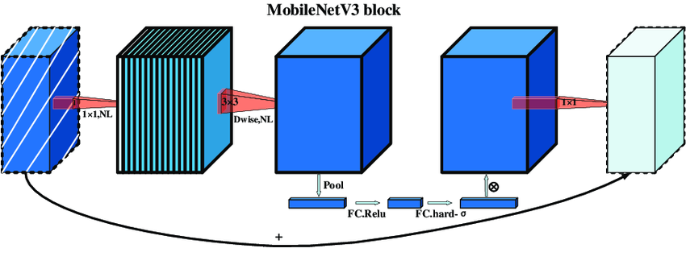
Method: Faster R-CNN
R-CNN is an object detection model that generates region proposals and classifies objects using convolutional neural networks.
Faster R-CNN improves the original R-CNN by introducing an integrated region proposal network (RPN) within, eliminating the need for external proposal generation, ensuring real-time capable speeds.
MobileNetV3 Backbone

Slide 11
Method: Faster R-CNN
Faster R-CNN can work with any convolutional backbone.
In this project, MobileNetV3 used as a backbone of Faster R-CNN.
MobileNetV3 is a highly efficient CNN that is designed for mobile and embedded devices.
It uses a combination of depth-wise separable convolutions, channel-wise and spatial-wise feature fusion to minimize computational cost.
MobileNetV3 Backbone

Slide 12
Method: Driving Logic
Velocity is kept at 20 km/h to ensure that the car can safely stop after detecting a vehicle.
Since training is done at 30 km/h, output of the steering model needs to be adapted to the new velocity.
Simulator
Left/Center/Right Cam
Velocity
Steering Model
(ResNetSteer)
Steering Adaptation
- Training velocity to test velocity
- Removing training steer bias
Raw Steer
(3, 1080, 160) RGB
Steer
Vehicle Control
- Keeping velocity at 20 km/h
- Ensuring smoother stopping
(3, 1080, 160) RGB
Vehicle Detector Model
(Faster R-CNN)
Collision Check
Stop/Slow Signals
Image
Vehicle Detections

Slide 13
Limitations
Path Planning:
Since this project does not include SLAM nor GPS mapping, long term trajectory can not be planned. Ego vehicle always goes straight until it needs to turn, which results in going through same places if not manually changed.
Traffic Light Detection/Classification:
Output resolution of the simulator is very low, resulting in traffic lights not being recognizable at meaningful distances. This results in ego vehicle not honoring traffic rules and possibly being hit at intersections.
Simulated Cars at Intersections:
Other vehicles in the simulation do not follow turning rules at intersections. Vehicle trying to turn right from the left lane (or turn left from the right lane) directly crashes into ego vehicle, changing its course.

Slide 14
Thank You!
Baran Ekin Özdemir - Team 16

