Slide 1
Evolution of Software Architecture! Cloud Native Microservice.
Viquar mohammed khan

Slide 2
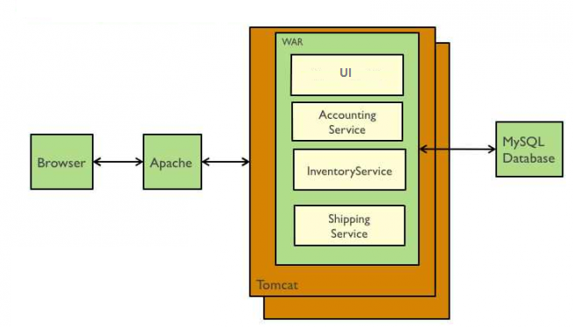
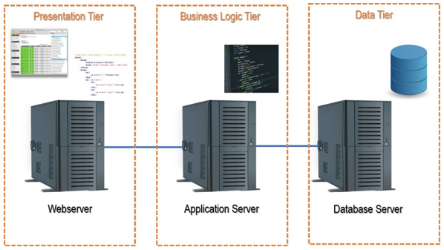
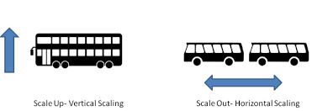

Traditional application architecture

Slide 3

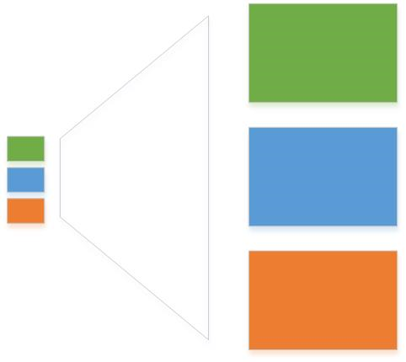
Monolith

Slide 4
Monolith Legacy Applications…
Issues:
Longer development cycles.
Quick deployments with frequent changes are difficult.
Long-term commitment to a particular technology stack.
May need to re-write the code of the entire application!
Scalability requires significant budget/time resources
Notes:
Monolithic pros–inheritance ,abstraction , don’t repeat yourself , sharing common code
-------------------------------------------------------------------------------------------------------
Monolithic cons -the code base grows with it, which can overload your IDE,
impossible to refactor ,
feelings with code ,
not agile ,
no polyglot development ,
single point of failure (If any single application function or component fails, then the entire application goes down) ,
not easy to upgrade
horizontal scaling. Each copy of the application in various servers will utilize the same amount of underlying resources, which is often not an efficient way to design.
Every release required complete application testing

Slide 5
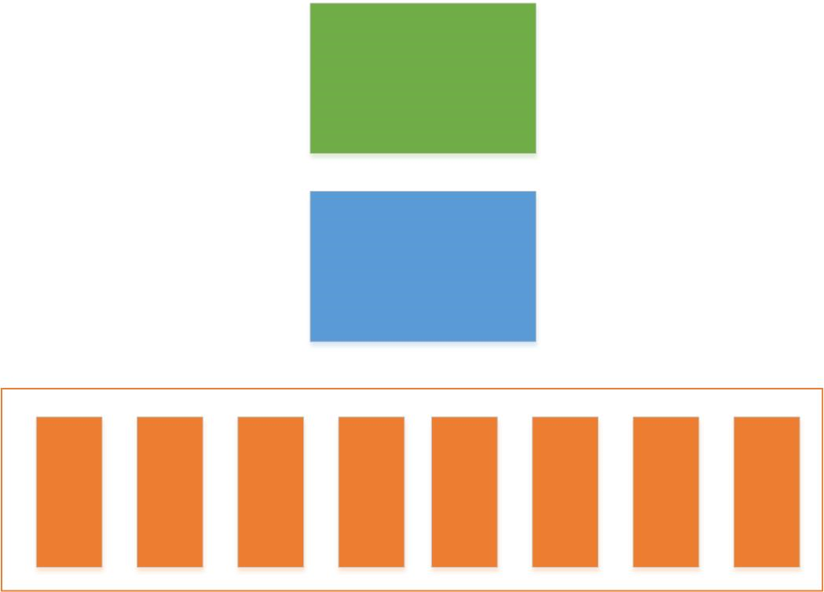
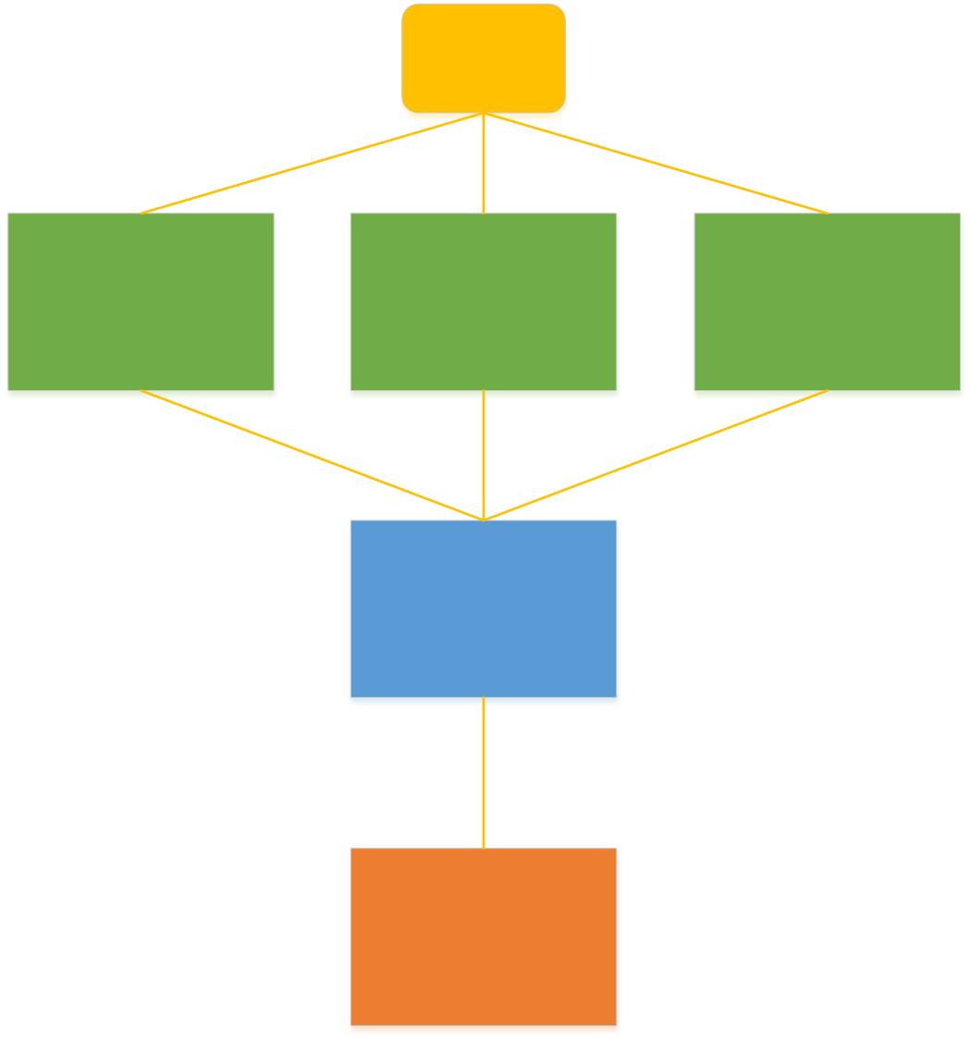
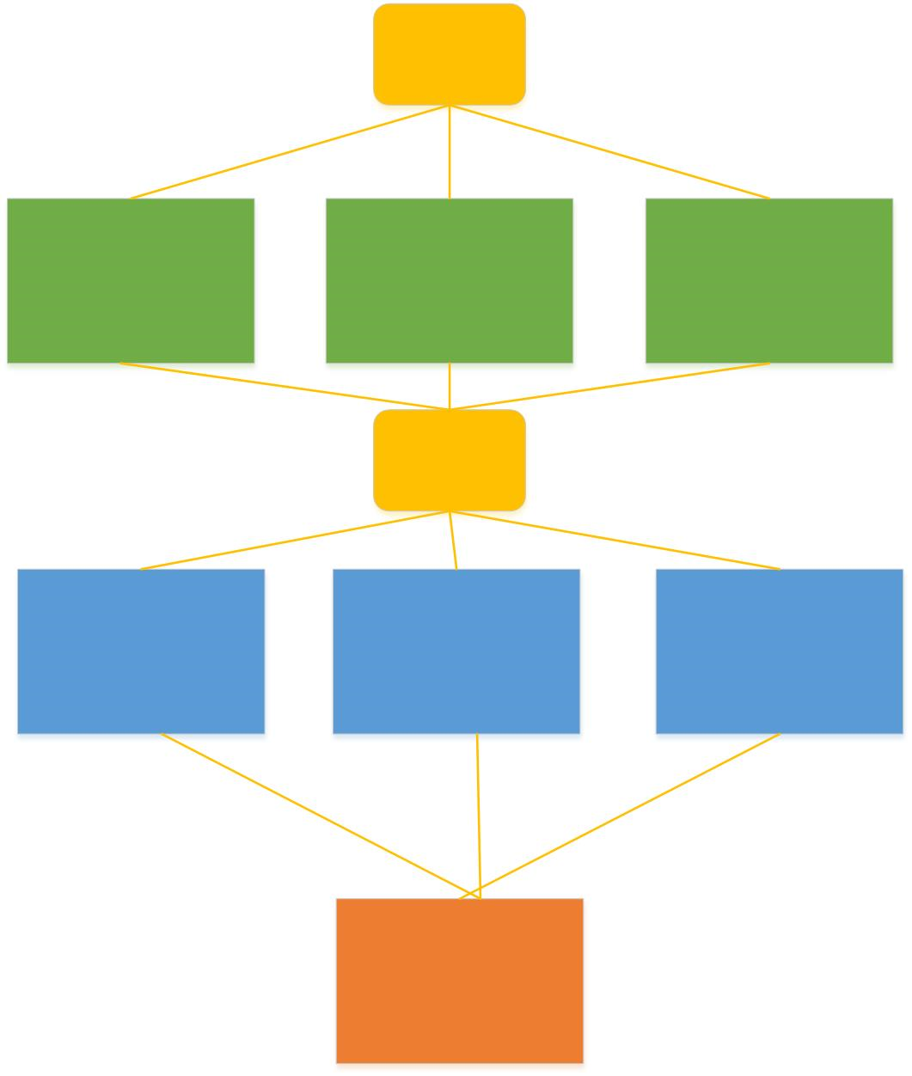
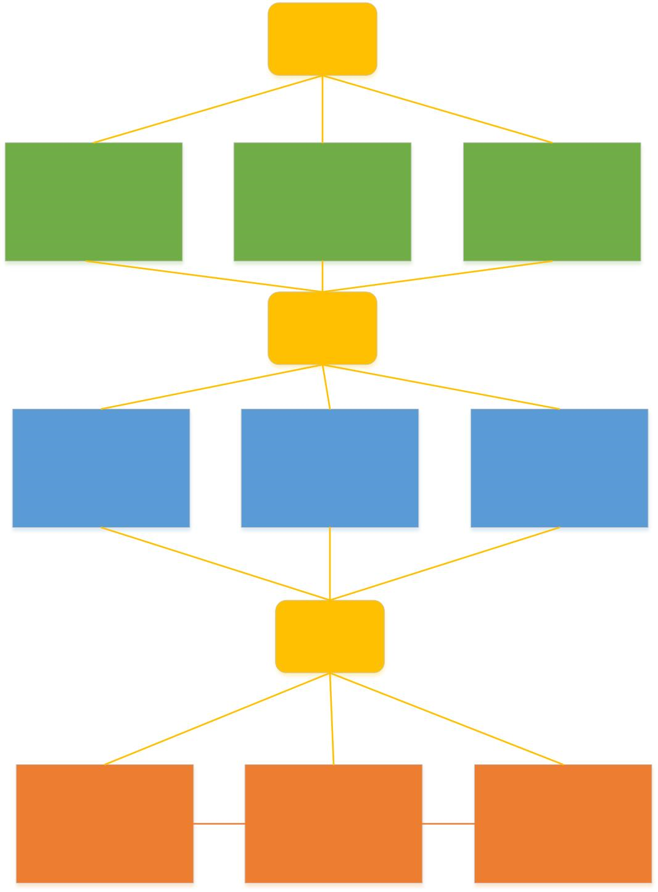
Distributed Monolithic
Notes:
Skip -
Integrated applications.
Applications can share resources.
A single instance of functionality can be reused.
Common user interfaces
Bottom-up approach
N-tier:
Deployment costs are low.
Database switching costs are low.
Business migration coasts are low.
Communication performance suffers
Maintenance costs are high.
-----------------------------------------------------------------------------------------------------------
Scaling - horizontal scaling. Each copy of the application in various servers will utilize the same amount of underlying resources, which is often not an efficient way to design
Scale monolithic
Developers must create multiple instance of the same functionality (service).
Proprietary (user) interfaces.

Slide 6
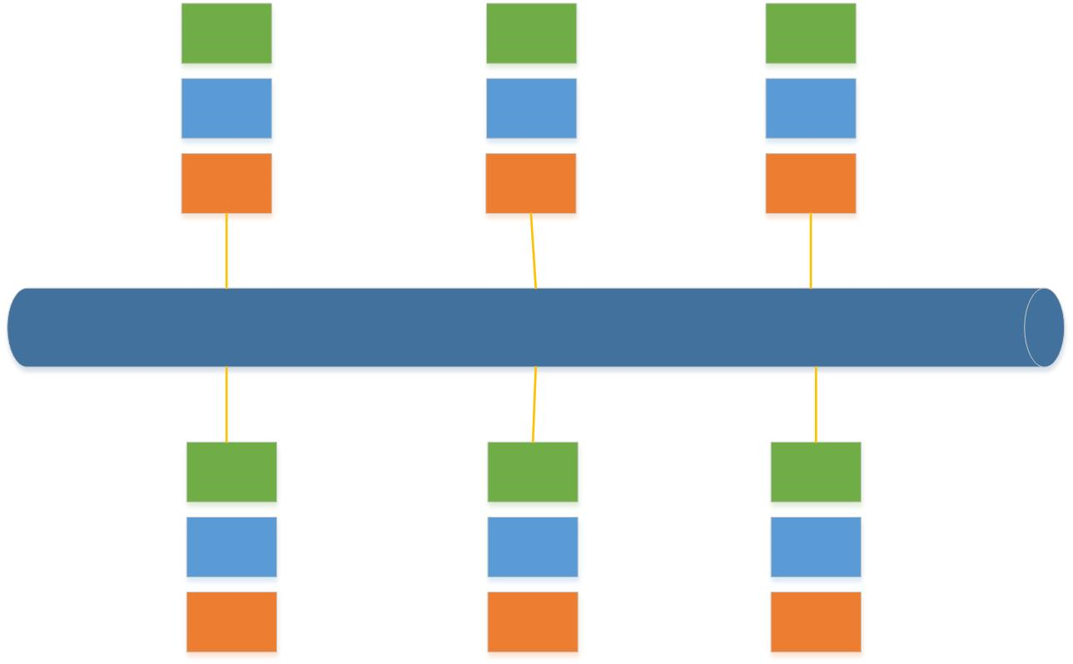

SOA

Slide 7
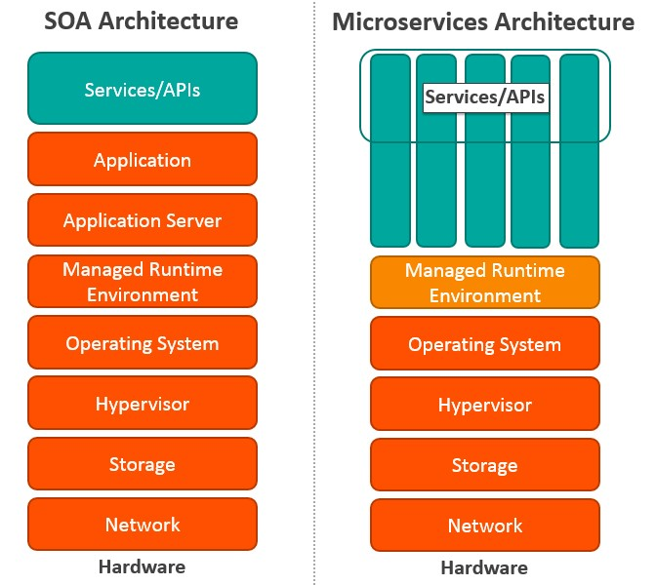
Key differences between SOA and MSA.

Slide 8
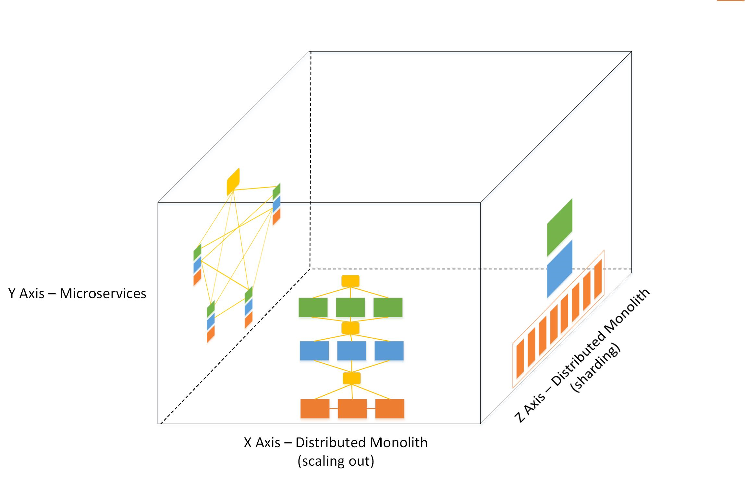
scalability cube

Slide 9
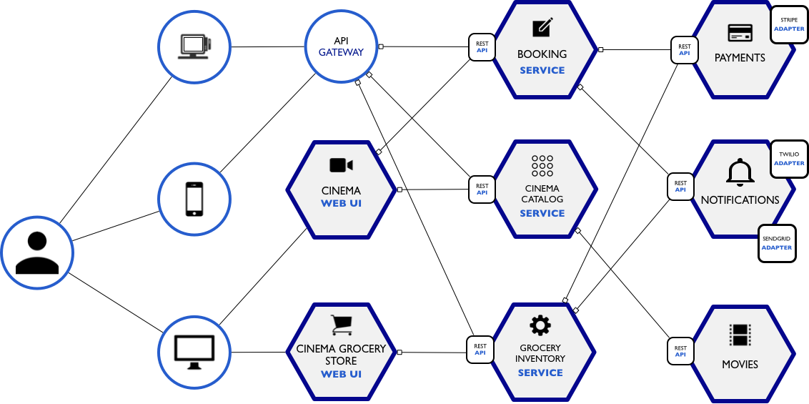
Microservices, or microservice architecture, is an approach to application development in which a large application is built as a suite of modular components or services. ... These services are built around business capabilities and independently deployable by fully automated deployment machinery."
Cloud Native-Applications adopting the principles of Microservices packaged as Containers orchestrated by Platforms running on top of Cloud infrastructure.
Micro Services

Slide 10
Microservice Architectures
Simple / Challenging - freedom to independently develop and deploy services
Modularity Based on Component Services - code for different services can be written in different languages
Change Cycles Decoupled / Enable Frequent Deploys - easy integration and automatic deployment
Efficient Scaling - starts the web container more quickly, deployment is also faster
Fault isolation- one instance fails, others will continue to work
Individual Components Less Intimidating to New Development-when change is required in a certain part of the application, only the related service can be modified and redeployed- no need to modify and redeploy the entire application
Enables Scaling of Development
Easy to scale and integrate with third-party services
Eliminates Long-Term Commitment to Technical Stack - no long-term commitment to technology stack
Notes:
Microservice Best practice:
1) Design monolithic first and think in bounded context
2) Twelve factor app
3) Small 2 Pizza team
4) Create a Separate Data Store for Each Microservice - You end up with the situation where if one team updates a database structure, other services that also use that structure have to be changed too.
5) Keep Code at a Similar Level of Maturity( -create new code instead of fixing old code to introduce bug
6) Do a Separate Build for Each Microservice- This sometimes leads to the situation where various microservices pull in a similar set of files, but at different revision levels.
7) shouldn't couple the services -Prefer choreography over orchestration
8 )Skip the Don’t Repeat Yourself (DRY) principle and don't share code between Microservices
9) Nothing share architecture -DB , binary dependency , code etc
11) Automated environment- continuous delivery ,new relic ,Splunk –don’t think microservice without it
12) Contract document -Swagger
13) Microservices versioning best practices
14) Implement a Self-Registration and Discovery Mechanism
15) Prefer Polyglot Over Single Stack
16) focus on business capabilities of apps.
------------------------------------------------------------------
independence of services
simplicity of adding new features.
fault tolerance.
implicit interfaces.
operational overhead
requires devops skills
operational complexity.
dev teams can deliver updates independently and roll out new releases more frequently
while keeping the rest of the system available and stable.
orchestration is a tightly couple approach for integrating microservices.
In orchestration we rely on the central system to control and call various microservices to complete a task.
In choreography each microservices works like a state machine and reacts based on the input from other parts.
microservices are application architecture style where independent, self contained programs
with a single purpose each can communicate with each other over a network.
typically these microservices are able to be deployed independently because they have separation
of responsibilities via a well defined specification with significant backward compatibility to avoid sudden dependency breakage.

Slide 11
Challenges of Microservices
Distributed System - Due to distributed deployment, testing can be complicated and tedious
Being a distributed system, it can result in duplication of effort
Remote Calls More Expensive Than In-process Calls - Increasing number of services can result in information barriers
Eventual Consistency- When number of services increases, integration and managing whole products can become complicated
Features Spanning Multiple Services- Handling use cases that span more than one service without using distributed transactions is not only tough but also requires communication and cooperation between different teams
Dependency Management / API Versioning - Developers have to put additional effort into implementing the mechanism of communication between the services
Refactoring Module Boundaries-Partitioning the application into microservices is very much an art
Notes:
ajay

Slide 12
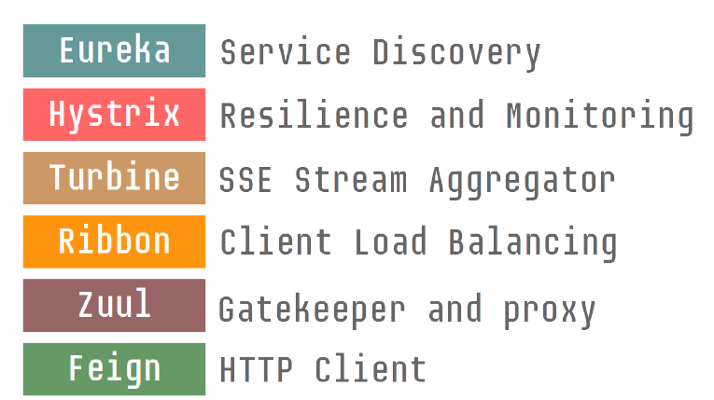
Spring Cloud Patterns
● Configuration management
● Service discovery
● Circuit breakers
● Intelligent routing
● Control bus
● Global lock
● Leadership election
● One-time tokens
● Distributed Sessions

Slide 13
Spring Boot
@RestController
class ItActuallyWorks {
@RequestMapping(“/”)
String home() {
“Hello Spring Boot!”
}
}

Slide 14
Annotation-driven
@SpringBootApplication
@EnableCircuitBreaker
@EnableDiscoveryClient
public class App extends RepositoryRestMvcConfiguration {
@Override
protected void configure(RepositoryRestConfiguration config) {
config.exposeIdsFor(Customer.class);
}
public static void main(String[] args) {
SpringApplication.run(CustomerApp.class, args);
}
}

Slide 15
Service Discovery: Eureka Server
@SpringBootApplication
@EnableEurekaServer
public class Application {
public static void main(String[] args) {
SpringApplication.run(Application.class, args);
}
}

Slide 16
Service Discovery: Eureka Server
port: ${PORT:8761}
eureka:
client:
registerWithEureka: false
fetchRegistry: false
server:
waitTimeInMsWhenSyncEmpty: 0

Slide 17
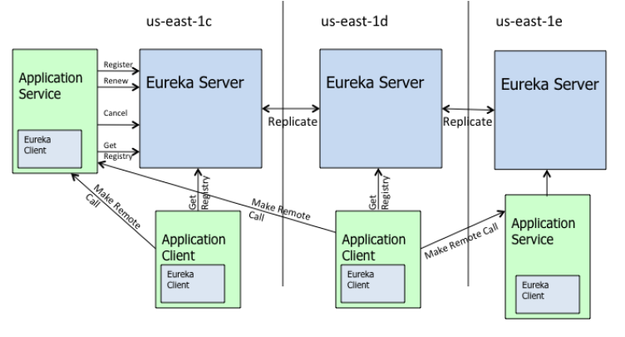
Service Discovery: Eureka Server

Slide 18
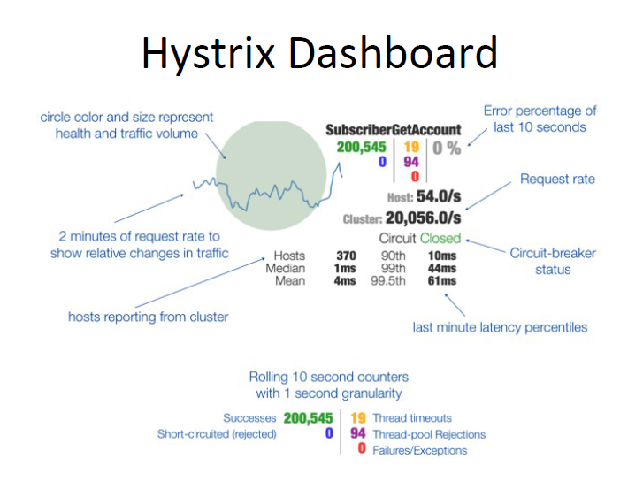
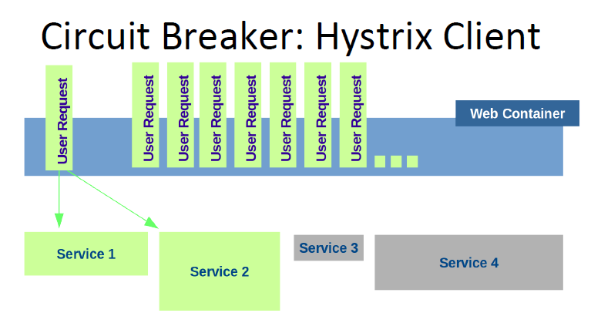
Circuit Breaker: Hystrix Client
Fault tolerance
● Isolate service access
● Prevent cascading failures
● Dashboard

Slide 19
Circuit Breaker: Hystrix Client
@SpringBootApplication
@EnableCircuitBreaker
public class Application {
public static void main(String[] args) {
new pringApplicationBuilder(Application.class).web(true).run(args);
}
}

Slide 20
Service Discovery: Eureka Server
src/main/resources/bootstrap.yml
spring:
application:
name: my-service

Slide 21
Config Server
@Configuration
@EnableAutoConfiguration
@EnableDiscoveryClient
@EnableConfigServer
public class ConfigServerApplication {
public static void main(String[] args) {
SpringApplication.run(ConfigServerApplication.class,args);
}
}

Slide 22
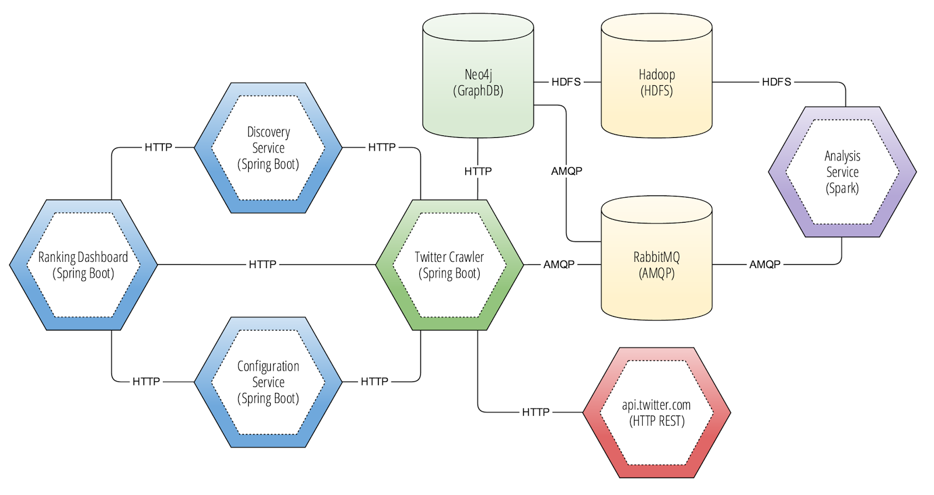
Code
https://github.com/vaquarkhan?utf8=%E2%9C%93&tab=repositories&q=micros&type=&language=
https://github.com/vaquarkhan/spring-boot-microservices-series

Slide 23

GIT Flow:

Slide 24








Release Process For Development Environment (Space)
Application Team
Build Trigger
Commit the changes
GIT
Deployment
Cloud Environment
Built Artifact (War/Jar)
Deployment
Junit
Jacoco
Sonar qube
Black duck
HP Fortify
Application server
CI/CD Pipeline

Slide 25

Release Process For Clod Native Applications
For Cloud
Application Team
once click deployment
Deployment by RM Team
RM Team
Build Trigger
Production Cloud
GIT
Built Artifact (War/Jar)
Non Prod Cloud
Junit
Jacoco
Sonar qube
Black duck
HP Fortify
Application server
CI/CD Pipeline

Slide 26
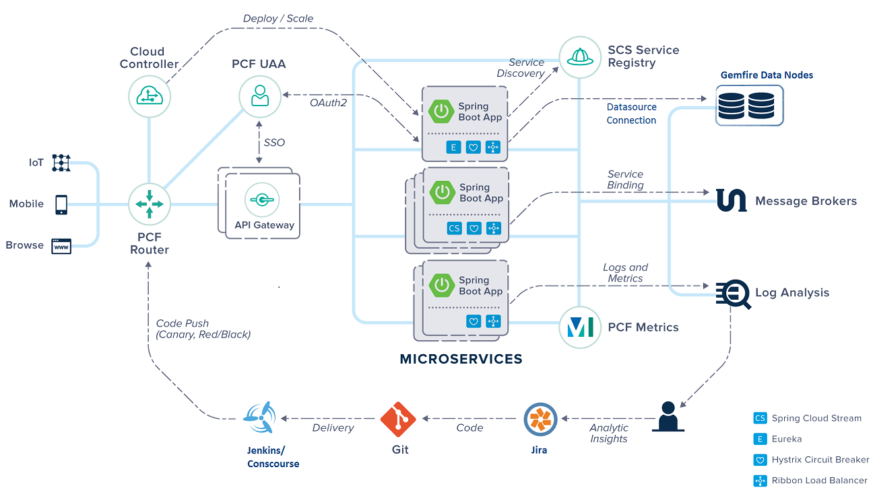

Slide 27

Questions?

Slide 28
Resources
● http://projects.spring.io/spring-cloud/
● http://martinfowler.com
● http://techblog.netflix.com

