Slide 1
Making Blockchain Real for Business

Slide 2
BLOCKCHAIN ESSENTIALS

Slide 3
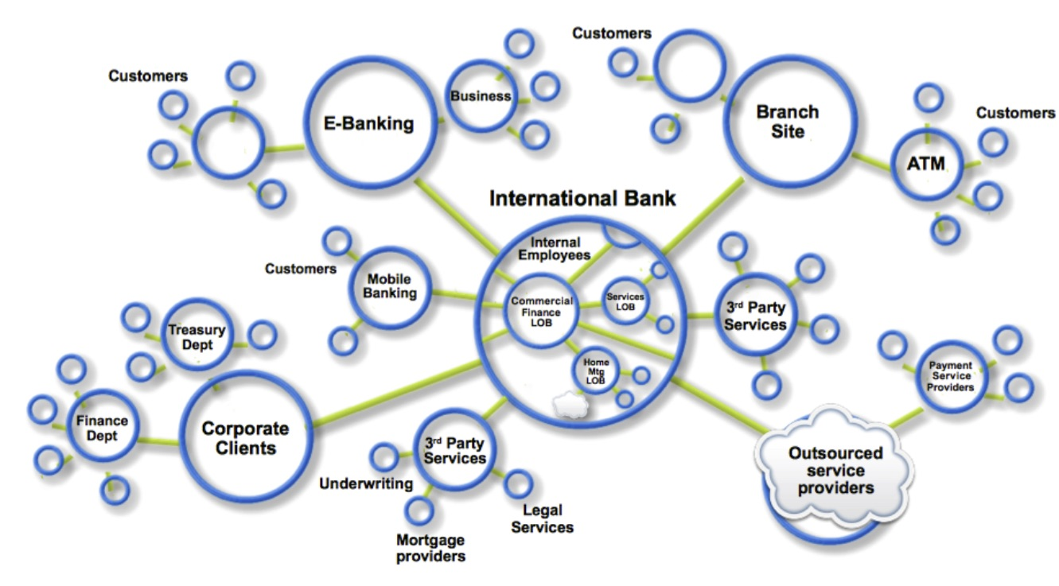
Business Networks, Markets & Wealth
Businesses don’t exist in isolation
Connected to customers, suppliers, banks, partners etc. through Business Network
Networks cross geography & regulatory boundary
Wealth is sum total of value of goods & services across business network
Growth constrained if silo’d or inefficient
Flow goods & services across business network is a Market
OPEN (fruit market, outcry commodities, or
CLOSED (supply chain financing, bonds)

Slide 4
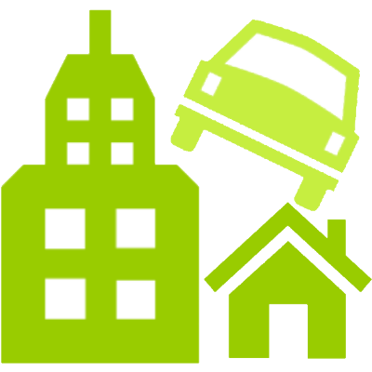

Transferring Assets, building Value
Anything that is capable of being owned or controlled to produce value, is considered an asset
can be tangible or intangible
value can be converted into cash.
Cash also an asset.
Asset examples:
Cars, value clothes (physical)
Bonds, securities, repurchase agreements (intangible)
Licenses & patents (intangible assets)
Music, video, games (intangible, digital)

Slide 5
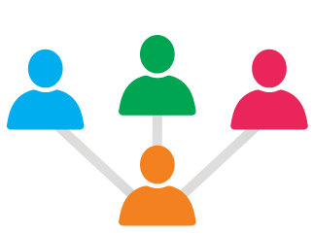

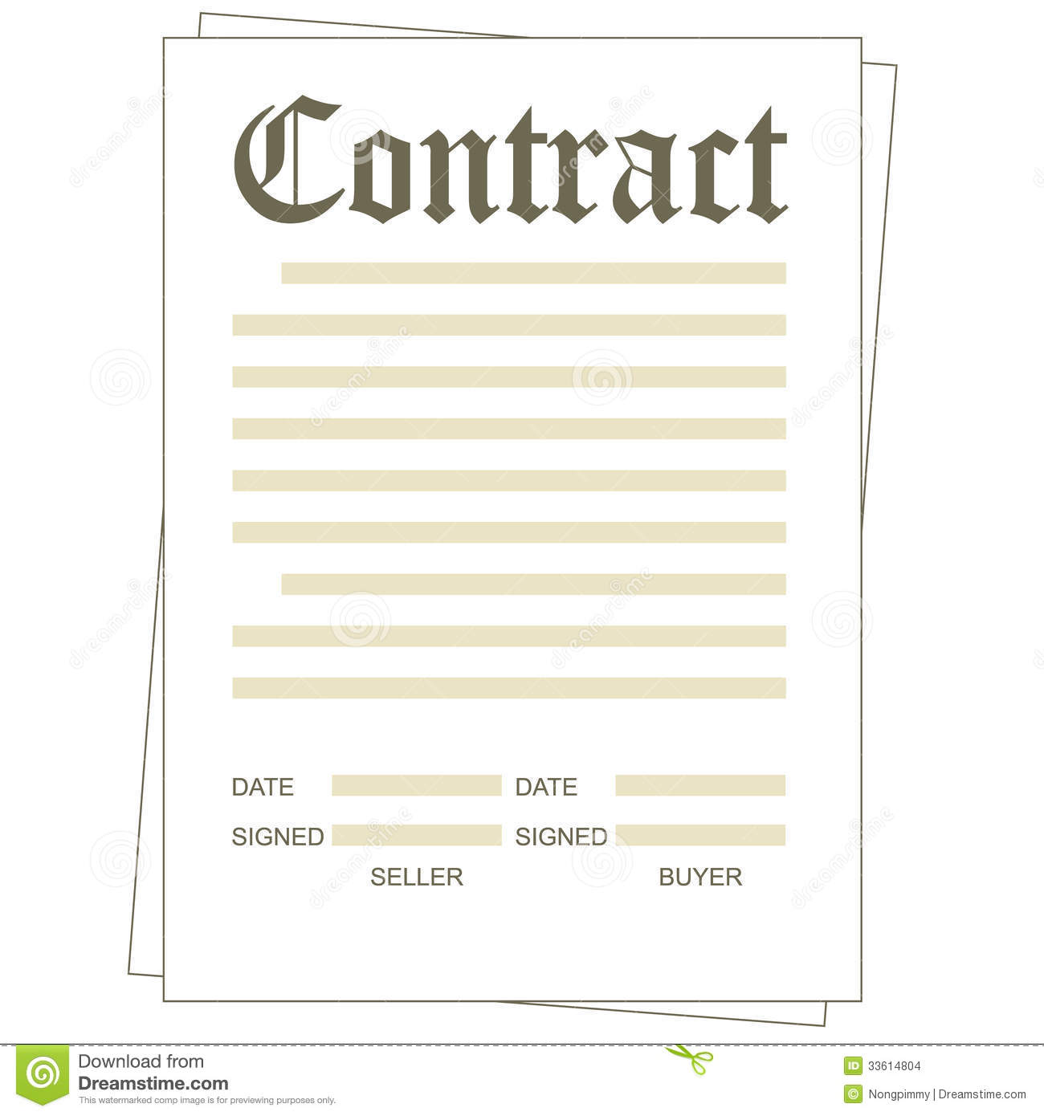
Participants, Transactions & Contracts
A participant is a member of a business network
Customer, Supplier, Government, Regulator
Usually reside in an organization
Have specific identities and roles
A transaction is an asset transfer between two or more participants, for example
John gives a car to Anthony (simple)
John gives a car to Anthony, Anthony gives money to John (more complex)
A contract is set of conditions under which transactions occur, for example
If Anthony pays John money, then car passes from John to Anthony (simple)
If car won't start, funds do not pass to John (as decided by independent third party arbitrator)
$

Slide 6
Blockchain in a nutshell
Append-only system of record shared across business network
Shared Ledger
Cryptography
Ensuring secure, authenticated & verifiable transactions
Consensus
Shared Contract
All parties agree to network verified transaction
Business terms embedded in transaction database & executed with transactions
Broader participation, lower cost, increased efficiency

Slide 7
Distributed Ledger - Components
Distributed Ledger
Independent permissioned blockchain
Distributed virtual machine (Turing-complete)
Smart contracts govern off-chain assets
Network achieves settlement finality
http://www.ofnumbers.com/wp-content/uploads/2015/04/Permissioned-distributed-ledgers.pdf
Notes:
Source: http://www.ofnumbers.com/wp-content/uploads/2015/04/Permissioned-distributed-ledgers.pdf

Slide 8
BLOCKCHAIN For Financial Services

Slide 9
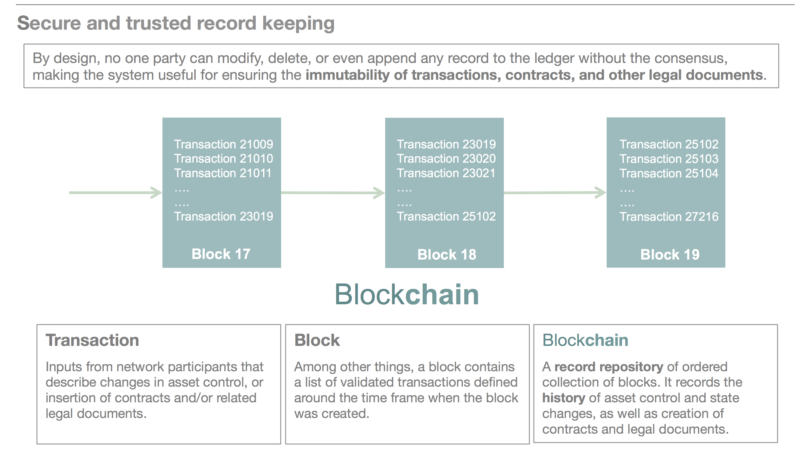
Why blockchain?
Blockchains are an emerging technology pattern that can radically improve banking, supply-chain and other transaction networks, giving them new opportunities for innovation and growth while reducing cost and risk.
Economic transactions on a distributed ledger can be programmed to record virtually anything of value: your identity, a will, a deed, a title, a license, intellectual property, and also almost any type of financial instrument.
“How seriously should we take this? I would take it as seriously as we should have taken the concept of the Internet in the 1990s.” —Blythe Masters, DAH http://bit.ly/1JENgb4

Slide 10
Reduce costs and complexity
Blockchain technology offers a way for market participants to access dematerialized assets directly without always going through other participants needlessly
Depository
Participant
Participant
Participant
…..…
Centralized Repository (today’s system): most participants are disconnected from their asset depository, settling transaction would require participants to collaborate in a flow that is slow, inefficient, and expensive
Custodian Bank
CCP
Trade Repository
Trading Platform
…..…
Depository (assets dematerialized on shared ledger)
Shared Repository: all participants can interact with depository directly without going involving third parties, potentially making post trade operations cheaper and faster

Slide 11
Financial Industry Applications best suited for Blockchain
Financial Instruments
Payments – Cross Border, P2P, Corporate and Interbank
Private Equity
Bonds
Derivative commodities
Trading records
Spending records
Mortgage/Loan records
Microfinance
Servicing records
Stack of Processes
Clearing Networks
International Transfers
Clearing and Settlement
auditing, reconciliation, reporting, settlement
Asset Ownership

Slide 12
Blockchain for Financial Market
Trading, clearing, and settlement functions can all be automated on a blockchain network using smart contracts and oracles.
Market
Clearing/Settlement
Oracles
Trading Application
Derivative
Contract 1
…..
…..
Exchange
Application
Derivative
Contract 19
Live Feed
Securities
Contract
Integration Bus
Off-chain
/On-chain
Off-chain
On-chain
…..….…….
……...
…..….…….
……...
…..….…….
……...
…..….…….
……...
Market
Clearing/Settlement
Oracle
Trading/exchange applications can live either on-chain or off-chain (i.e. off-chain applications are often more centralized, but likely offer better latency).
Final clearing/settlement of financial assets can be automated through smart contracts, which have direct access to assets defined on chain.
Oracles are off chain services that integrate on-chain contracts with existing systems; network participants do not interact with oracles directly.

Slide 13
IBM – Financial Services use cases for Blockchain
Blockchain for Banking
Letters of Credit As a bank handling letters of credit (LOC) for my clients, I need a common ledger that allows me and all counter-parties to have the same validated record of transaction and fulfilment of conditions, so that we can increase trust and speed of execution from 4 days to <1 day. If we can drive out 99% of the time and cost, we can offer innovative LOC solutions for a wider range of clients, including start-ups that are “born global.
Corporate Debt As a bank handler of corporate debt, I need a Blockchain based system so that I can pay vendor invoices for my corporate client immediately and win the highest NET discount while immediately letting my client validate that the invoice was executed and the money paid, and also so that I don't need to build another system for innovative factoring use cases and government oversight measures — one API for all. I want to do this at a market-level, so that I don’t have to build one for each of my client relationships, and so that I can spread the cost of building and maintaining the system.
Repurchase Agreements As a repurchase agreement trader, I need a transparent marketplace of bids and asks, so that I can discover, trade, and execute agreements with relative assurance that there will be no repudiation or other issues. I don’t want to have to be subject to the string of counterparties exerting control over the market; rather, I want to be an equal partner in the network, trade directly, and spread the costs/risks.
Supply Chain and Self-Executing B2B Contracts As a corporate buyer, I want to be able to submit my purchase contract to a network I share with the supplier, which will convert the agreement into a validated, trusted, self-executing process, so that when the PO is appended to the ledger, supply has been received, and other events occur, the terms of the contract are automatically executed, and both the suppler, me (the buyer), our banks, logistics partners and other stakeholders all can have visibility and be assured of proper completion of the transaction.

Slide 14
IBM – Financial Services use cases for Blockchain
Blockchain for Banking Consortia
Security Services | Security Settlement: Once financial assets are dematerialized on a shared ledger, all stakeholders will have direct access to the asset depository and the power to settle trades, without always going through intermediaries needlessly. Post Trade Operation: Post trade processes such as trade capture, enrichment, confirmation/affirmation, clearing, and settlement can be automated on shared ledger, potentially reducing post trade operation time from days to seconds. Trade Repository: By design, Blockchain is a secure record repository of ordered collection of financial transactions. It records the history of asset control and state changes, reducing the need of maintaining a separate trade repository for record keeping.
Capital Market | Derivative Trading: Connect potential buyers and sellers on a decentralized network. Offers placed on Blockchain network can be automatically seen by all participants, the network will be cheaper and potentially bigger than ECNs today because the risk and cost of maintaining the network is spread across all participants (there will not be a single owner charging premium for maintaining the service. Derivative Post-Trade Management: Derivatives contracts can be managed and automated through smart contracts on shared ledger, significantly cutting down the management cost and time while reducing the intra-day risk. Syndicated Loan: Help borrowers and arrangers to broadcast their offers to all potential investors on a Blockchain network, and to automate the syndication process.
Trade Finance | Cross-Currency Payment: Automatically connecting market makers and bypassing intermediaries to significantly reduces time taken for cross currency payment from days to seconds.
Card Operation | KYC: Creditor card issuers can record customer credit histories on a shared ledger so that customer information can be easily shared (or sold) between companies.

Slide 15
BLOCKCHAIN Financial Services
Ecosystem

Slide 16
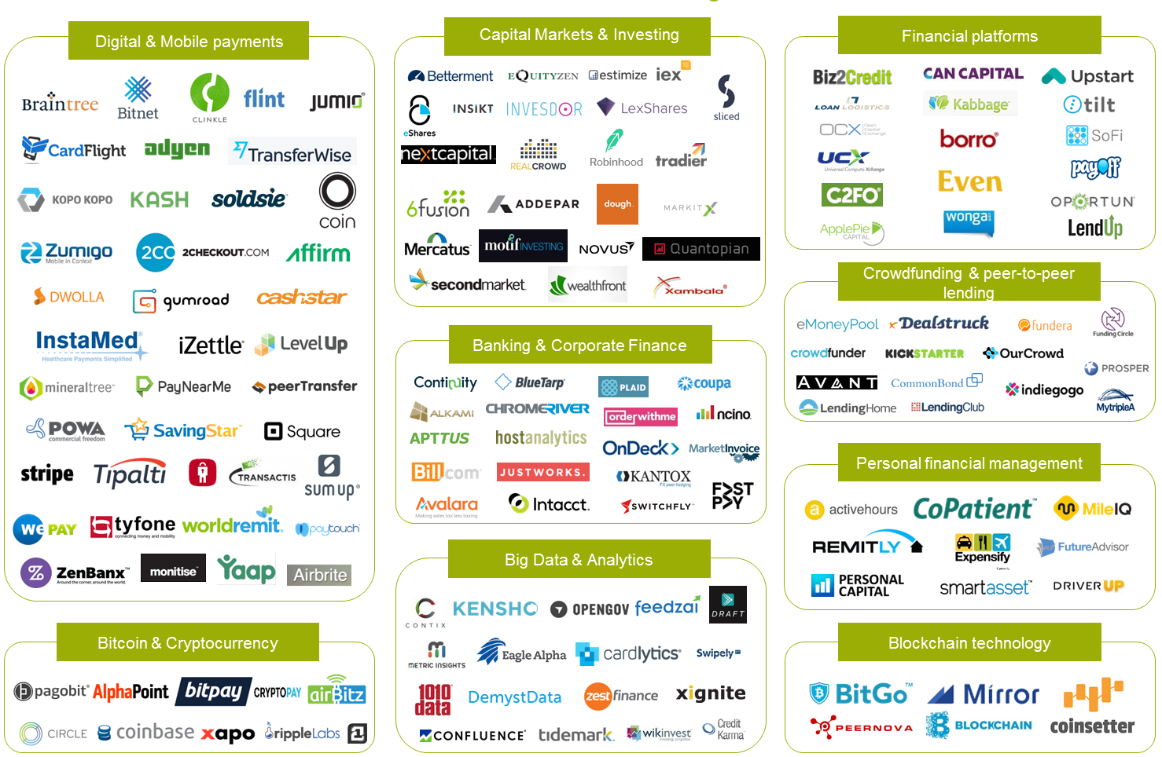
FinTech Landscape – Disruptive Forces in Financial services
Source: EverisDigital

Slide 17
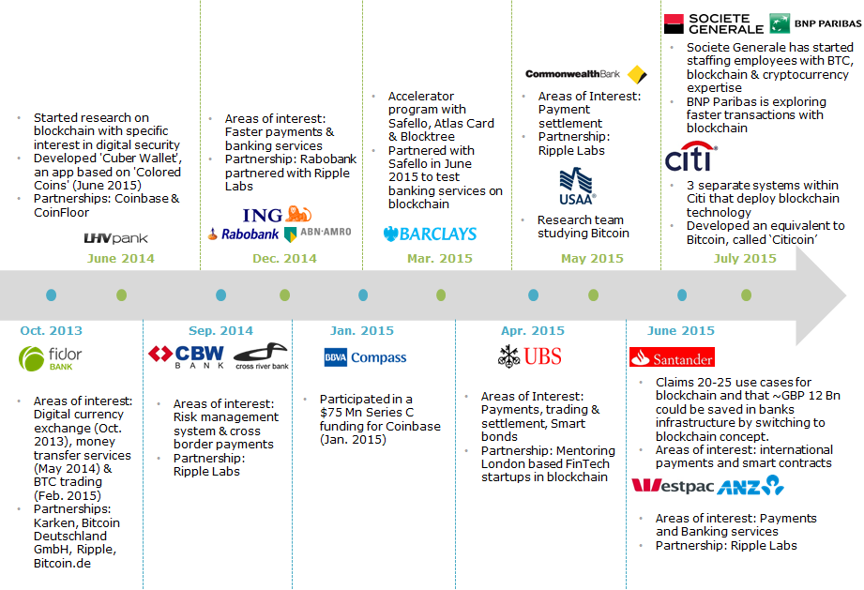
Blockchain Adoption – Understanding the Disruption
Source: Lets talk Payments

Slide 18
Investment Interest in Blockchain
Blockchain has the potential to reduce infrastructure cost by up to $20 billion a year.
P2P money Transfer across international borders - segment worth $500 B.
Anderseen Horowitz ( VC firm) has invested over USD $100 million into Blockchain technology
All time Public/VC investment into Blockchain startups - $894 million.
Over 4000 active fintech startups in the NY arena and investment in the sector tripling last year to $12 billion.
Source – LTP,Finextra

Slide 19
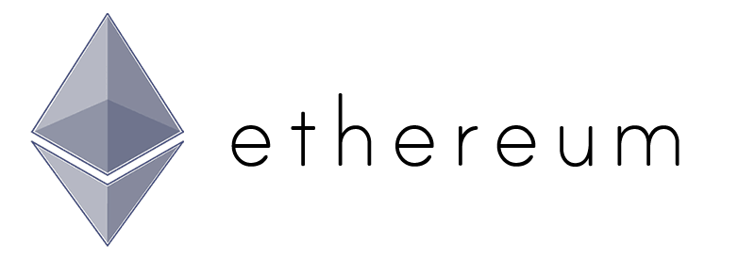
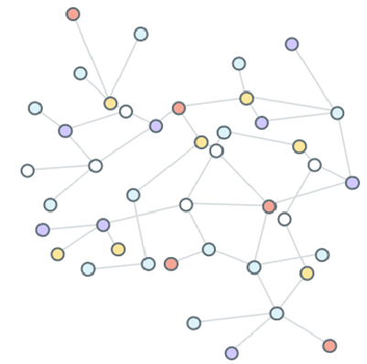



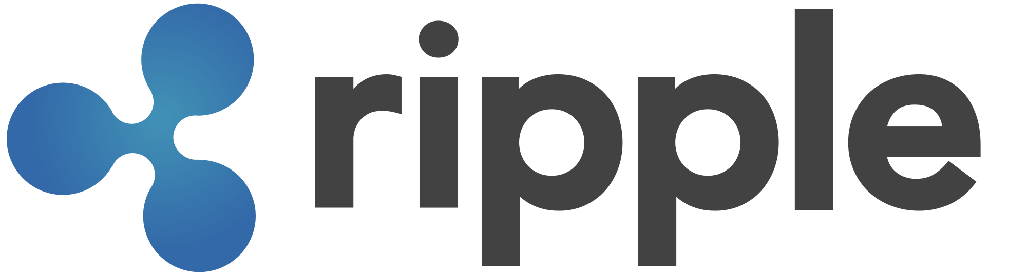

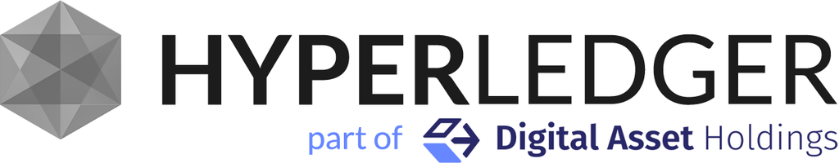
Why isn’t blockchain ready for business?
There are two options for building private network for businesses 1) Reconfigure a public network fabric for private use, or 2) Build on top of a untested private network fabric that’s available
Public Network Fabric
Private Network Fabric
Business Adoption Challenges
Business Adoption Challenges
Designed for public network
Slow and inefficient
Built-in virtual currency
Difficult to push upgrades
Heavily forked
Lack enterprise support
Incomplete & usually untested
Usually too simple & inflexible
Still lack critical enterprise features such as identity management system
Generally lack community support
Not standardized

Slide 20
IBM – What we bring and what needs to be done
IBM brings the advisory capabilities as well as necessary tools …
World Wide Cloud with Government Certification : one-click international multi-node geographic deployment of validating Blockchain peers that can be assigned to parties in the network, all on Softlayer.
World experts in identity and cryptography research, significant IP in works.
World leader in business rules processing.
Domain experts in financial services, government systems, and supply chain.
…to execute in this field:
Identity, Certificates: In order to transact on the Blockchain without exposing strategic information to others, a party’s identity must be both transparent to the party it’s transacting with while opaque to others. This requires sophisticated identity management, which IBM is researching and developing.
Inter-network services: In addition to identity management, current Blockchain platforms are challenged in enabling cross-ledger services. Say, for example, a bank performed KYC on a merchant in one network, and now the same bank is working with the same merchant in another network. Why do KYC twice? IBM can provide the support for this and other cross-network managed operations.

Slide 21
Back up

Slide 22
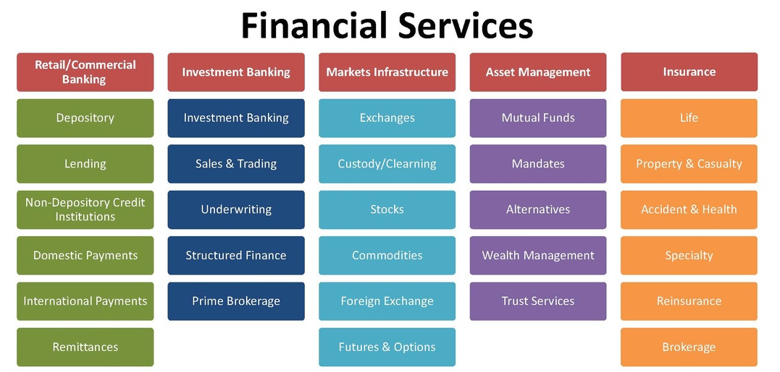
Silos of the Financial Services Industry
http://www.digifinancegirl.com

Slide 23
Phases of Blockchain Innovation
Business Value
Add services
Business value-add services and blockchain applications. These include embedded transactions, collateral networks (such as Interledger), conditional payments, and smart contracts and business applications that leverage the overlay networks.
Overlay Services
These include exchanges, wallets, and consumer and merchant services.
Pioneering
Bitcoins, alt-coins, the initial stage of blockchain fabric technology

Slide 24
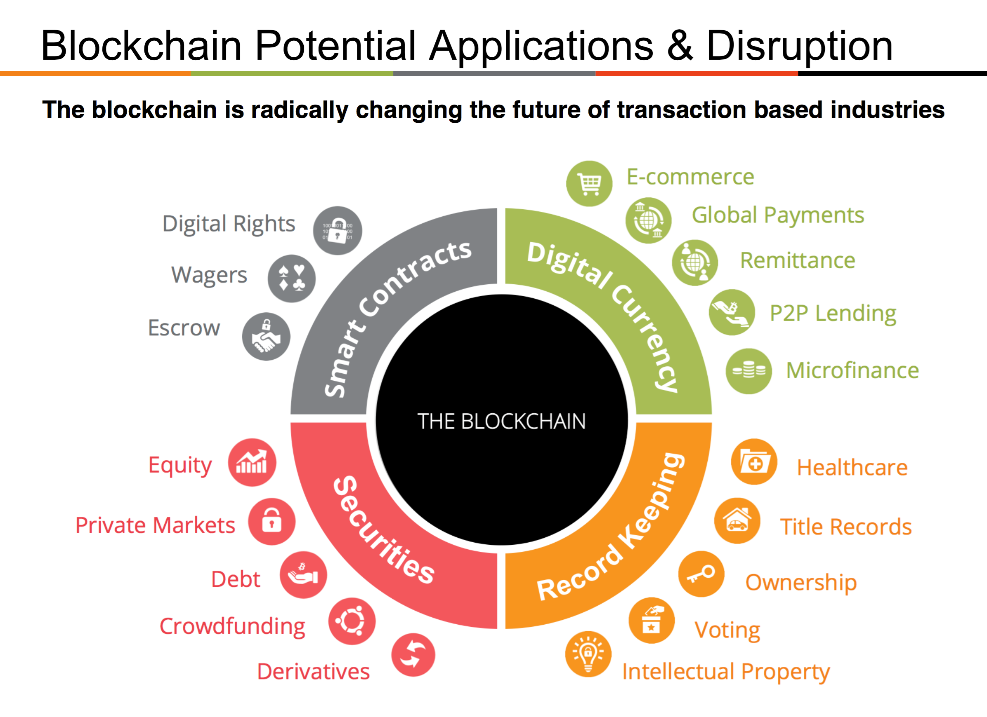

Slide 25
