Slide 1
Docker, Cloud Foundry & OpenStack Leading OpenSource Triumvirate - How do they all come together!
Animesh Singh @AnimeshSingh
IBM Cloud Architect

Slide 2
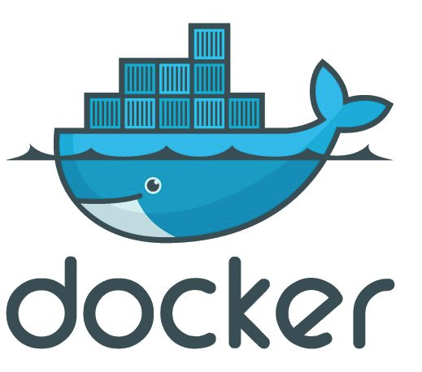
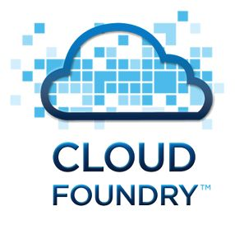
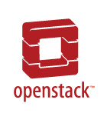
Docker, Cloud Foundry & OpenStack – Leading OpenSource Triumvirate!

Slide 3
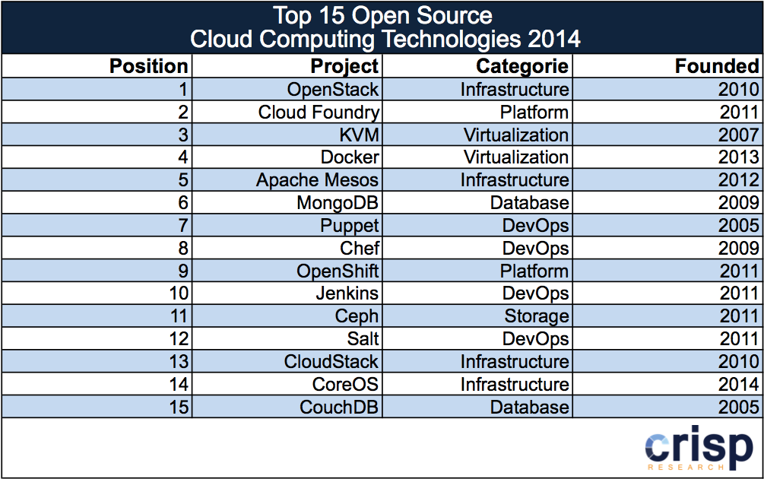
Docker, Cloud Foundry & OpenStack - In Top Five !
http://analystpov.com/cloud-computing/top-15-open-source-cloud-computing-technologies-2014-24727

Slide 4






















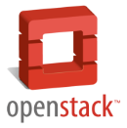
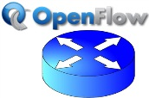

IBM cloud and open technologies
At all tiers, IBM is committed to building its cloud on an open cloud architecture
API economy
OAuth
Software as a Service
Cloud operating environment
Platform as a Service
TOSCA
Software- defined environment
OSLC
Infrastructure as a Service
Products and services built on open source and open standards benefit IBM and customers
http://www.ibm.com/developerworks/cloud/library/cl-open-architecture/
Notes:
Cloud computing needs to be built on open source and standards. To build flexible and interoperable cloud architectures, IBM is building on open cloud projects - OpenStack for IaaS, deployment automation tools like Chef, PaaS fabrics like Cloud Foundry , databases like MongoDB, portable workload template standards like TOSCA and many others.

Slide 5
OpenStack

Slide 6
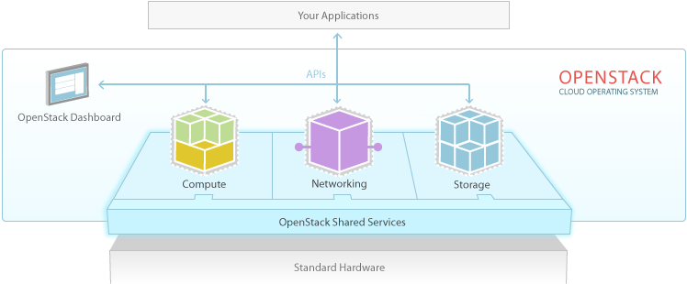
OpenStack Overview:
Collection of well integrated IaaS modules:
Compute (Nova)
Networking (Neutron)
Object Storage (Swift)
Block Storage (Cinder)
Identity(Keystone)
Image Service (Glance)
Dashboard (Horizon)

Slide 7
Cloud Foundry

Slide 8
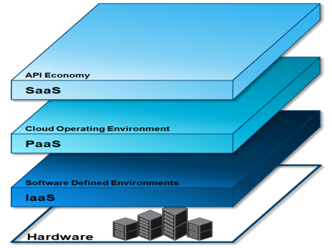
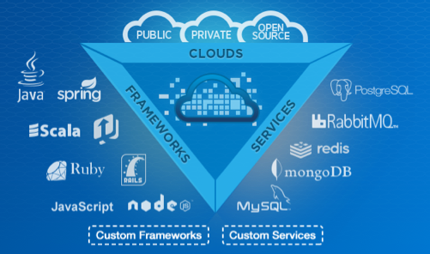





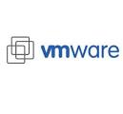
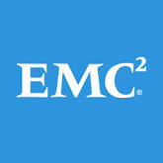

Cloud Foundry Overview
Open Cloud Platform
There is an increasing appetite for cloud-based mobile, social and analytics applications from line-of-business executives - drives the need for a more open cloud development platform
Compelling Community
Cloud Foundry has a compelling community and emerging ecosystem as well as a mature set of capabilities and robustness
Meets Developer’s Needs
Focus on app development, not provisioning VMs, databases, messaging servers, etc
Agile development model
Deploy and scale in seconds
TOTAL CONTRIBUTORS
LINES OF CODE
1,165
739k
Platinum Founding Sponsors
Notes:
why Cloud Foundry fits so well ?
Well to begin with its 100% OpenSource like OpenStack, which means no vendor lock-ins. The tools and software you will build for Cloud Foundry can be easily ported across all implementations.
And 2ndly its a fits exactly in Platform as a Service space. Just like OpenStack provides a great foundation for compute, networking and storage, Cloud Foundry provides that for your runtimes, apps and services.
And last but not the least, as we are hearing through the conference, it has very vibrant community. Both IBM and Rackspace are platinum founding members of the Cloud Foundry community, along with a host of other companies.
And the community is growing - with more than 1200 developers , 700k lines of code and 43 companies contributing. I
iBM is also #2 in contributions to Cloud Foundry and we have 42 IBMers who are approved to contribute to the core Cloud Foundry code base. We have contributed to many components like Elastic runtimes , Eclipse integration and even open sourced many IBM components like WebSphere Java build pack, admin UI, and Performance acceptance tests.

Slide 9

Cloud Foundry Developer Experience
CLI
Eclipse IDE
cf push
Browser
http

Slide 10
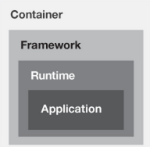
Cloud Foundry Architecture
CLI
DEA Pool
DEA Pool
Droplet Execution
Agent (DEA) VM Pool
cf push
Cloud Controller
(API)
Eclipse IDE
Browser
NATS
(Message bus)
Health
Manager
http
Router

Slide 11
Docker

Slide 12
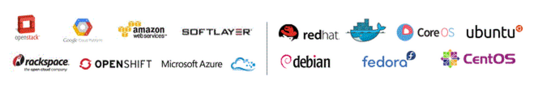
Docker Overview
One of the most disruptive technologies of recent past
Every significant vendor (IBM, RedHat, Google, AWS, VMWare etc) has announced support for Docker
First Docker conference was a huge success – with over 1000 attendees
What is it ? A tool to
Run applications: An open source tool to run applications inside of a Linux container, a kind of light-weight virtual machine
Package applications: In addition to running, it also offers tools to package containerized applications through Docker files
Distribute applications: Create your own Docker registries or hubs, a cloud service for sharing applications and automating workflows.

Slide 13
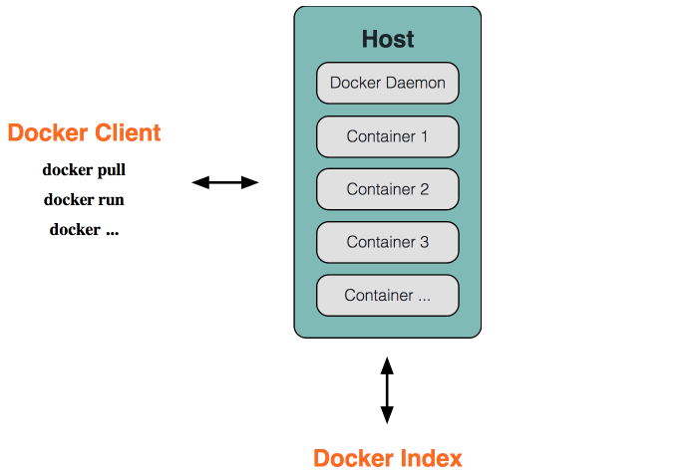
Docker Architectural Overview
Docker uses a client-server architecture.
The Docker client talks to the Docker daemon, which does the heavy lifting of building, running, and distributing your Docker containers.
Both the Docker client and the daemon can run on the same system, or you can connect a Docker client to a remote Docker daemon.
The Docker client and daemon communicate via sockets or through a RESTful API.
Notes:
Docker uses a client-server architecture.
The Docker client talks to the Docker daemon, which does the heavy lifting of building, running, and distributing your Docker containers.
Both the Docker client and the daemon can run on the same system, or you can connect a Docker client to a remote Docker daemon.
The Docker client and daemon communicate via sockets or through a RESTful API.

Slide 14
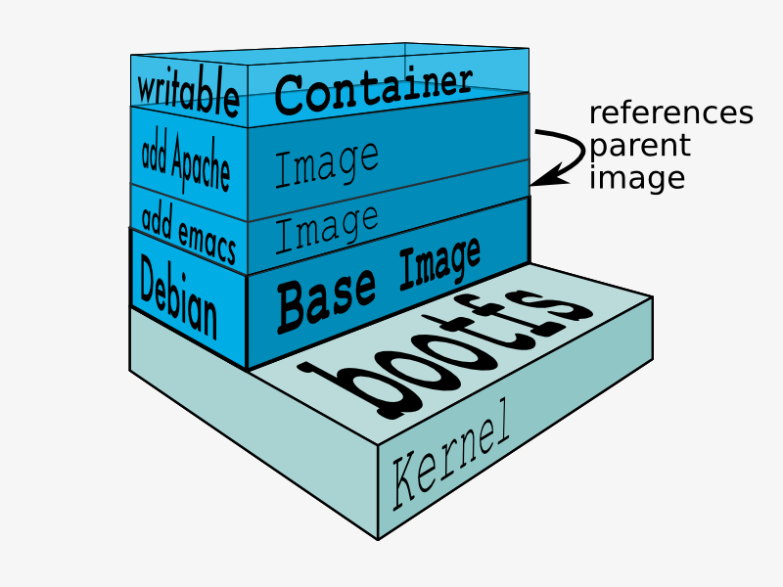
Docker Containers
A Docker container consists of an operating system, user-added files, and meta-data – Basically a way to run mini operating systems in your host operating system with strong guarantees of isolation
The Docker image is read-only. When Docker runs a container from an image, it adds a read-write layer on top of the image (using a union file system) in which your application can then run.
Underlying Technology : Written in Go and makes use of several Linux kernel features
Namespaces - pid, net, mnt, ipc, etc.
Control Groups - cgroups (memory, cpu, blkio, devices)
Union File Systems - UnionFS (AUFS, btrfs, vfs)
Container Format - libcontainer or LXC
Notes:
Namespaces
Docker takes advantage of a technology called namespaces to provide the isolated workspace we call the container. When you run a container, Docker creates a set of namespaces for that container.
This provides a layer of isolation: each aspect of a container runs in its own namespace and does not have access outside it.
Some of the namespaces that Docker uses are:
The pid namespace: Used for process isolation (PID: Process ID).
The net namespace: Used for managing network interfaces (NET: Networking).
The ipc namespace: Used for managing access to IPC resources (IPC: InterProcess Communication).
The mnt namespace: Used for managing mount-points (MNT: Mount).
The uts namespace: Used for isolating kernel and version identifiers. (UTS: Unix Timesharing System).
Control groups
Docker also makes use of another technology called cgroups or control groups. A key to running applications in isolation is to have them only use the resources you want. This ensures containers are good multi-tenant citizens on a host. Control groups allow Docker to share available hardware resources to containers and, if required, set up limits and constraints. For example, limiting the memory available to a specific container.
Union file systems
Union file systems, or UnionFS, are file systems that operate by creating layers, making them very lightweight and fast. Docker uses union file systems to provide the building blocks for containers. Docker can make use of several union file system variants including: AUFS, btrfs, vfs, and DeviceMapper.
Container format
Docker combines these components into a wrapper we call a container format. The default container format is called libcontainer. Docker also supports traditional Linux containers using LXC. In the future, Docker may support other container formats, for example, by integrating with BSD Jails or Solaris Zones.

Slide 15
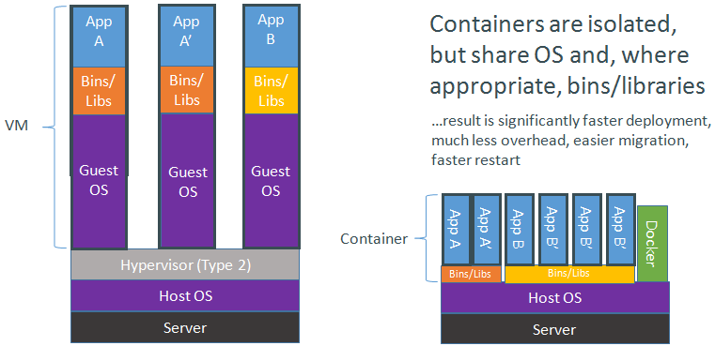
Docker Containers vs Virtual Machines
Virtual Machines
Each virtualized application includes not only the application - which may be only 10s of MB - and the necessary binaries and libraries, but also an entire guest operating system - which may weigh 10s of GB.
Docker
The Docker Engine container comprises just the application and its dependencies. It runs as an isolated process in userspace on the host operating system, sharing the kernel with other containers
Compared with Hypervisors, Docker which is OS-Level Virtualization:
CPU Performance => native performance
Memory Performance => few % for (optional) accounting
Network Performance => small overhead; can be optimized to zero overhead
creating a new base image takes a few seconds (copy-on-write)
apps in different containers can share the same binaries / libs
Notes:
Virtual Machines
Each virtualized application includes not only the application - which may be only 10s of MB - and the necessary binaries and libraries, but also an entire guest operating system - which may weigh 10s of GB.
Docker
The Docker Engine container comprises just the application and its dependencies. It runs as an isolated process in userspace on the host operating system, sharing the kernel with other containers
Compared with Hypervisors, Docker which is OS-Level Virtualization:
CPU Performance => native performance
Memory Performance => few % for (optional) accounting
Network Performance => small overhead; can be optimized to zero overhead
creating a new base image takes a few seconds (copy-on-write)
apps in different containers can share the same binaries / libs

Slide 16
How do Docker and OpenStack intersect ?

Slide 17
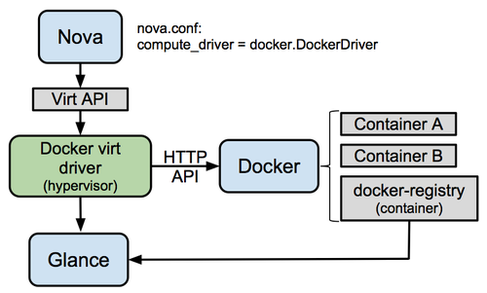
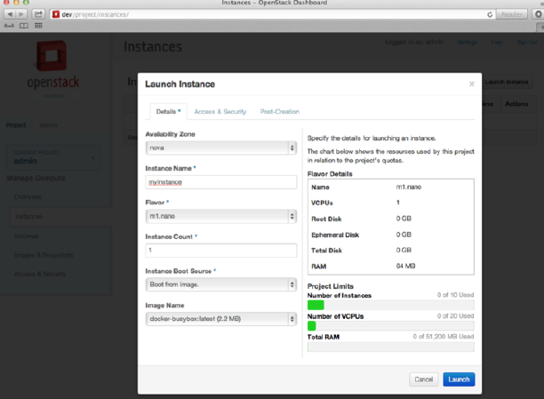
Docker in OpenStack
Docker is hypervisor driver for Openstack Nova Compute. It was introduced with the Havana release, but lives out-of-tree for Icehouse and Juno.
The Nova driver embeds a tiny HTTP client which talks with the Docker internal Rest API through a unix socket. It uses the HTTP API to control containers and fetch information about them.
The driver will fetch images from the OpenStack Image Service (Glance) and load them into the Docker filesystem. Images may be placed in Glance by exporting them from Docker using the 'docker save' command.
Well integrated with Horizon UI
Source: https://wiki.openstack.org/wiki/Docker
Notes:
Namespaces
Docker takes advantage of a technology called namespaces to provide the isolated workspace we call the container. When you run a container, Docker creates a set of namespaces for that container.
This provides a layer of isolation: each aspect of a container runs in its own namespace and does not have access outside it.
Some of the namespaces that Docker uses are:
The pid namespace: Used for process isolation (PID: Process ID).
The net namespace: Used for managing network interfaces (NET: Networking).
The ipc namespace: Used for managing access to IPC resources (IPC: InterProcess Communication).
The mnt namespace: Used for managing mount-points (MNT: Mount).
The uts namespace: Used for isolating kernel and version identifiers. (UTS: Unix Timesharing System).
Control groups
Docker also makes use of another technology called cgroups or control groups. A key to running applications in isolation is to have them only use the resources you want. This ensures containers are good multi-tenant citizens on a host. Control groups allow Docker to share available hardware resources to containers and, if required, set up limits and constraints. For example, limiting the memory available to a specific container.
Union file systems
Union file systems, or UnionFS, are file systems that operate by creating layers, making them very lightweight and fast. Docker uses union file systems to provide the building blocks for containers. Docker can make use of several union file system variants including: AUFS, btrfs, vfs, and DeviceMapper.
Container format
Docker combines these components into a wrapper we call a container format. The default container format is called libcontainer. Docker also supports traditional Linux containers using LXC. In the future, Docker may support other container formats, for example, by integrating with BSD Jails or Solaris Zones.

Slide 18
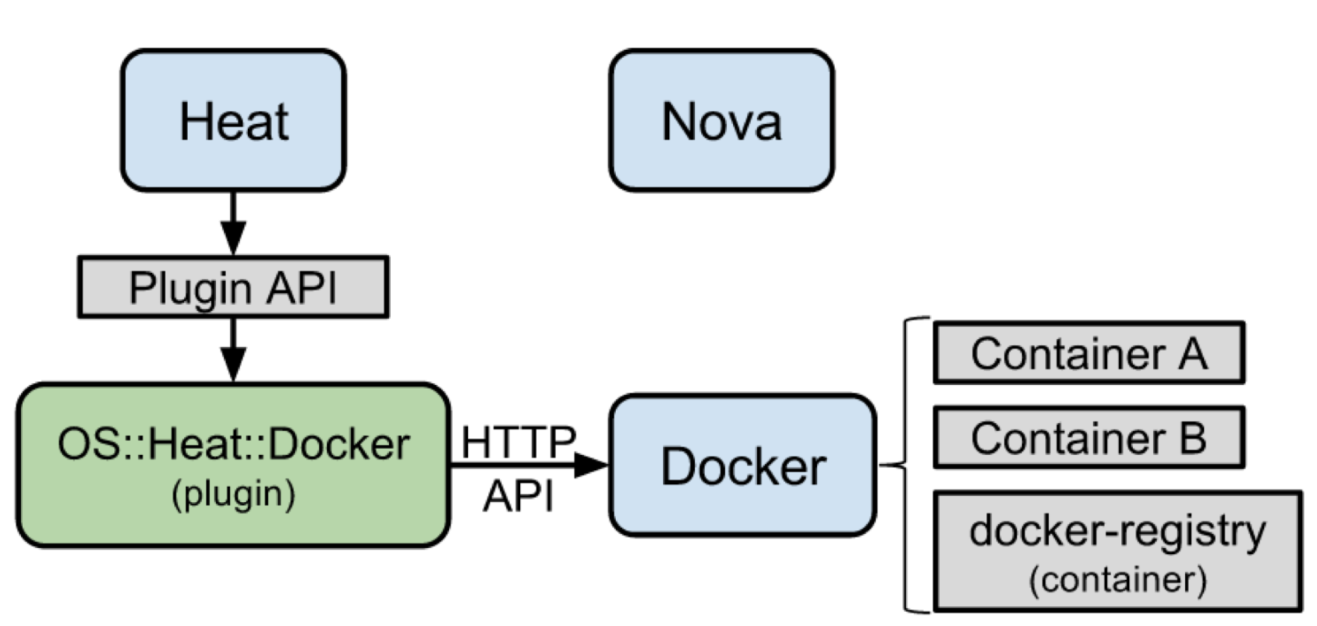
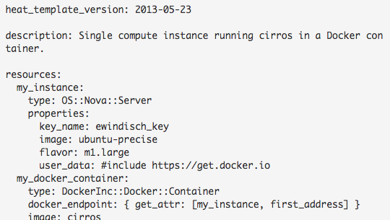
Heat Template Plugin for Docker in OpenStack
Not a replacement for Docker Nova Driver
OpenStack Orchestration (Heat) is a solution for providing orchestration of resources inside OpenStack clouds.
Using the Heat plugin, users may deploy and manage Docker Containers on top of traditional OpenStack deployments, making it compatible with existing OpenStack clouds.
It allows to use the whole Docker API from a Heat template, and makes linking of containers easier
In the example here, multiple containers may be created and linked together by simply adding more sections like “my_docker_container”. They’re not constrained by the OpenStack APIs and may leverage the full power of the Docker Remote API.
Notes:
Namespaces
Docker takes advantage of a technology called namespaces to provide the isolated workspace we call the container. When you run a container, Docker creates a set of namespaces for that container.
This provides a layer of isolation: each aspect of a container runs in its own namespace and does not have access outside it.
Some of the namespaces that Docker uses are:
The pid namespace: Used for process isolation (PID: Process ID).
The net namespace: Used for managing network interfaces (NET: Networking).
The ipc namespace: Used for managing access to IPC resources (IPC: InterProcess Communication).
The mnt namespace: Used for managing mount-points (MNT: Mount).
The uts namespace: Used for isolating kernel and version identifiers. (UTS: Unix Timesharing System).
Control groups
Docker also makes use of another technology called cgroups or control groups. A key to running applications in isolation is to have them only use the resources you want. This ensures containers are good multi-tenant citizens on a host. Control groups allow Docker to share available hardware resources to containers and, if required, set up limits and constraints. For example, limiting the memory available to a specific container.
Union file systems
Union file systems, or UnionFS, are file systems that operate by creating layers, making them very lightweight and fast. Docker uses union file systems to provide the building blocks for containers. Docker can make use of several union file system variants including: AUFS, btrfs, vfs, and DeviceMapper.
Container format
Docker combines these components into a wrapper we call a container format. The default container format is called libcontainer. Docker also supports traditional Linux containers using LXC. In the future, Docker may support other container formats, for example, by integrating with BSD Jails or Solaris Zones.

Slide 19

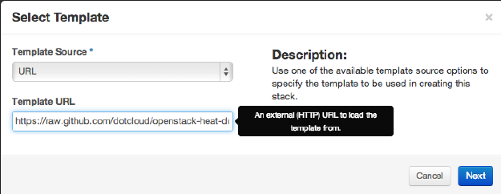
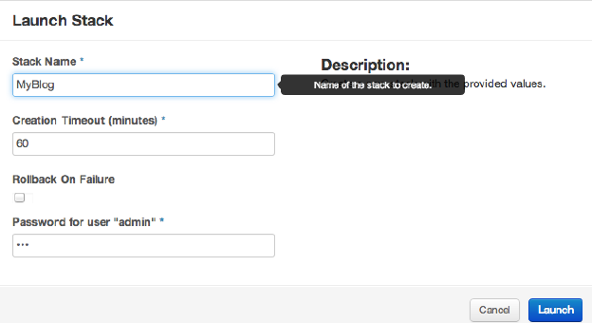
UI Integration with Horizon
Horizon UI > Orchestration > Stacks
Configure the Stack (parameters of the Heat template)
Notes:
Namespaces
Docker takes advantage of a technology called namespaces to provide the isolated workspace we call the container. When you run a container, Docker creates a set of namespaces for that container.
This provides a layer of isolation: each aspect of a container runs in its own namespace and does not have access outside it.
Some of the namespaces that Docker uses are:
The pid namespace: Used for process isolation (PID: Process ID).
The net namespace: Used for managing network interfaces (NET: Networking).
The ipc namespace: Used for managing access to IPC resources (IPC: InterProcess Communication).
The mnt namespace: Used for managing mount-points (MNT: Mount).
The uts namespace: Used for isolating kernel and version identifiers. (UTS: Unix Timesharing System).
Control groups
Docker also makes use of another technology called cgroups or control groups. A key to running applications in isolation is to have them only use the resources you want. This ensures containers are good multi-tenant citizens on a host. Control groups allow Docker to share available hardware resources to containers and, if required, set up limits and constraints. For example, limiting the memory available to a specific container.
Union file systems
Union file systems, or UnionFS, are file systems that operate by creating layers, making them very lightweight and fast. Docker uses union file systems to provide the building blocks for containers. Docker can make use of several union file system variants including: AUFS, btrfs, vfs, and DeviceMapper.
Container format
Docker combines these components into a wrapper we call a container format. The default container format is called libcontainer. Docker also supports traditional Linux containers using LXC. In the future, Docker may support other container formats, for example, by integrating with BSD Jails or Solaris Zones.

Slide 20
How do Docker and Cloud Foundry intersect ?

Slide 21
Cloud Foundry Service Broker
CLI
cf create-service
DEA Pool
S
E
R
V
I
C
E
B
R
O
K
E
R
Service Backend
Cloud Controller
(API)
Service instance
Fetch Catalog
(GET /v2/catalog
Eclipse IDE
Service instance
cf bind-service
Provision Instance
(PUT /v2/service instances/:id)
Service instance
Browser
Create Binding
(PUT /v2/service_instances/:id
DEA Pool
DEA Pool
App
App
App

Slide 22
Docker Service Broker for Cloud Foundry
Docker Service Broker for Cloud Foundry
(Source : Ferran Rodenas, Pivotal)
(Source : Ferran Rodenas, Pivotal)
An easy and convenient way to expose development and testing services to your applications without the overhead of creating an specific service broker by just using Docker images
Services Catalog: predefined Docker services
Provision an instance: create and start a predefined Docker container and assign random credentials via environment variables
Bind an instance to an application: send service credentials hash back to the bound application
Unbind an instance
Unprovision an instance: destroy Docker container
Expose a management dashboard: top processes, stdout/stderr logs, …
Syslog drain URL: drain your application logs to a Docker syslog (logstash, …)

Slide 23
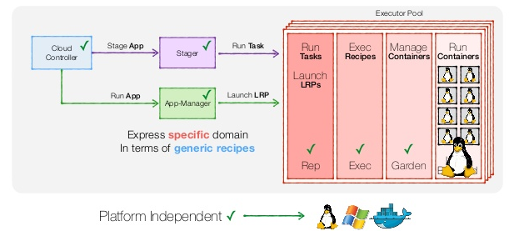
Diego – Rewrite of Cloud Foundry Runtime (supporting Docker)
Diego is a rethinking of the Droplet Execution Agent (DEA) within the Cloud Foundry Runtime. The primary functions of the DEA are to stage apps, run them in Warden containers, and manage their lifecycle by starting and stopping apps upon request of the Cloud Controller component.
Number of problems in the current Elastic Runtime model:
Tight coupling
Poor separation of concerns
Creating “triangular dependencies”
Cloud Foundry container technology, Warden has been rewritten in Go and is called Garden (now).
Garden separates the server from backend, and it supports using Docker as root file system of a container.
Notes:
Namespaces
Docker takes advantage of a technology called namespaces to provide the isolated workspace we call the container. When you run a container, Docker creates a set of namespaces for that container.
This provides a layer of isolation: each aspect of a container runs in its own namespace and does not have access outside it.
Some of the namespaces that Docker uses are:
The pid namespace: Used for process isolation (PID: Process ID).
The net namespace: Used for managing network interfaces (NET: Networking).
The ipc namespace: Used for managing access to IPC resources (IPC: InterProcess Communication).
The mnt namespace: Used for managing mount-points (MNT: Mount).
The uts namespace: Used for isolating kernel and version identifiers. (UTS: Unix Timesharing System).
Control groups
Docker also makes use of another technology called cgroups or control groups. A key to running applications in isolation is to have them only use the resources you want. This ensures containers are good multi-tenant citizens on a host. Control groups allow Docker to share available hardware resources to containers and, if required, set up limits and constraints. For example, limiting the memory available to a specific container.
Union file systems
Union file systems, or UnionFS, are file systems that operate by creating layers, making them very lightweight and fast. Docker uses union file systems to provide the building blocks for containers. Docker can make use of several union file system variants including: AUFS, btrfs, vfs, and DeviceMapper.
Container format
Docker combines these components into a wrapper we call a container format. The default container format is called libcontainer. Docker also supports traditional Linux containers using LXC. In the future, Docker may support other container formats, for example, by integrating with BSD Jails or Solaris Zones.

Slide 24
Cloud Foundry – Docker – Phase 1 Use Cases (Support being added)
Use Cases
As a user I want to push docker images from the public https://hub.docker.com (not Dockerfile)
As a user I want to be able to start/stop and scale my docker image based application
As a user I can see the health of my docker image based application
As an operator I want to be able to toggle docker image support

Slide 25
How do Cloud Foundry and OpenStack Intersect

Slide 26

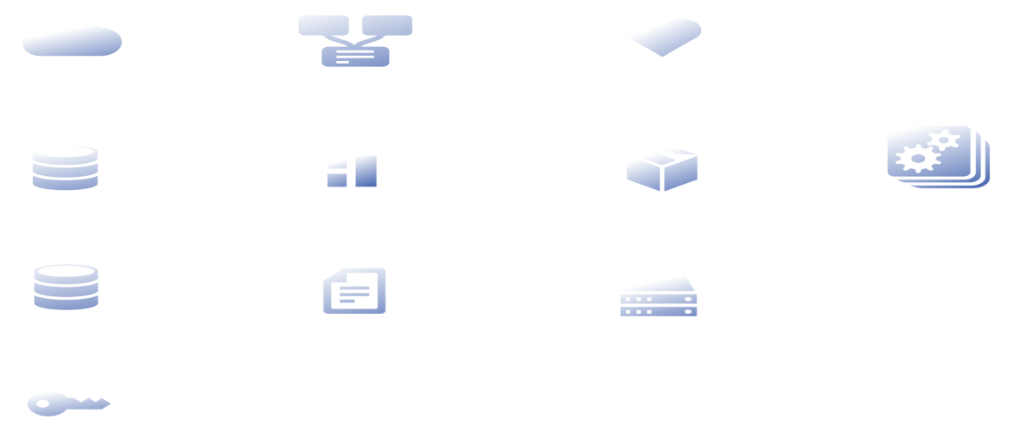

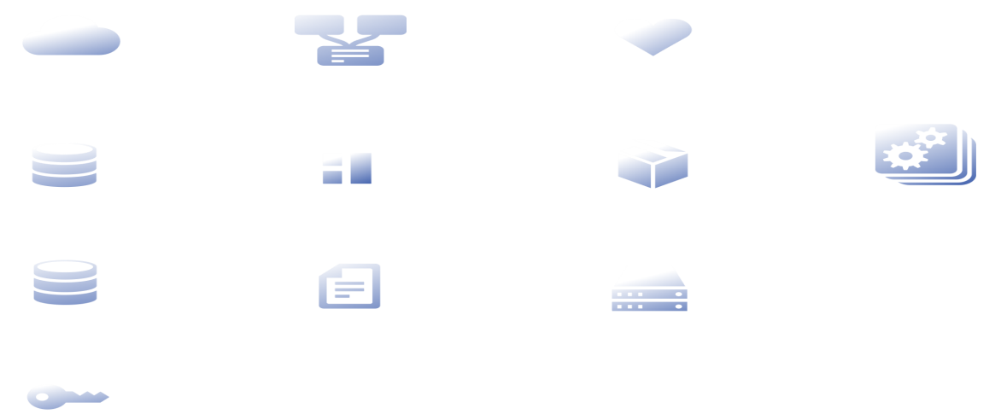




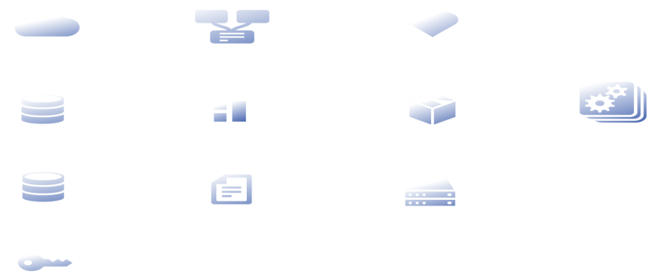


Cloud Foundry , OpenStack Integration
Router
UAA
Cloud
PaaS
Cloud Controller
Health Manager
DEA Pool
Apps
Service Nodes
Service Connector
Build Packs
BOSH
Integration
Messaging
Cloud Provider Interface
IaaS
Notes:
In this case the integration is provided by BOSH. BOSH is a release deployment and lifecycle management tool for Cloud Foundry, and it provides Cloud Provide Interface, for deploying Cloud Foundry on VMWare, AWS and OpenStack. BOSH Cloud Provider Interface has few of the methods which need to be implemented for any IaaS, and in this case have been implemented for OpenStack and leverage the preexisting open source fog ruby gem
In addition to this, Cloud Foundry has certain requirements from the IaaS - basically it needs the IaaS to provide support for static ips for intercommunication, persistent disks for storing runtimes and application files, specialized security groups for management and application traffic, and custom vm configurations for different components of Cloud Foundry.
As Egle described, OpenStack via its Compute, Networking and Storage components provides all these capabilities, and more.

Slide 27
How do they all come together?

Slide 28
Cloud Foundry , OpenStack & Docker – What`s Possible Now
Router
D
O
C
K
E
R
S
E
R
V
I
C
E
B
R
O
K
E
R
UAA
Cloud
PaaS
Cloud Controller
Health Manager
DEA Pool
Apps
Service Nodes
Service Connector
Build Packs
BOSH
Messaging
Integration
Cloud Provider Interface
IaaS
Notes:
In this case the integration is provided by BOSH. BOSH is a release deployment and lifecycle management tool for Cloud Foundry, and it provides Cloud Provide Interface, for deploying Cloud Foundry on VMWare, AWS and OpenStack. BOSH Cloud Provider Interface has few of the methods which need to be implemented for any IaaS, and in this case have been implemented for OpenStack and leverage the preexisting open source fog ruby gem
In addition to this, Cloud Foundry has certain requirements from the IaaS - basically it needs the IaaS to provide support for static ips for intercommunication, persistent disks for storing runtimes and application files, specialized security groups for management and application traffic, and custom vm configurations for different components of Cloud Foundry.
As Egle described, OpenStack via its Compute, Networking and Storage components provides all these capabilities, and more.

Slide 29
Cloud Foundry , OpenStack & Docker – What`s Possible Now
Router
D
O
C
K
E
R
S
E
R
V
I
C
E
B
R
O
K
E
R
UAA
Cloud
PaaS
Cloud Controller
Health Manager
DEA Pool
Apps
Service Nodes
Service Connector
Build Packs
BOSH
Messaging
Integration
Cloud Provider Interface
IaaS
Notes:
In this case the integration is provided by BOSH. BOSH is a release deployment and lifecycle management tool for Cloud Foundry, and it provides Cloud Provide Interface, for deploying Cloud Foundry on VMWare, AWS and OpenStack. BOSH Cloud Provider Interface has few of the methods which need to be implemented for any IaaS, and in this case have been implemented for OpenStack and leverage the preexisting open source fog ruby gem
In addition to this, Cloud Foundry has certain requirements from the IaaS - basically it needs the IaaS to provide support for static ips for intercommunication, persistent disks for storing runtimes and application files, specialized security groups for management and application traffic, and custom vm configurations for different components of Cloud Foundry.
As Egle described, OpenStack via its Compute, Networking and Storage components provides all these capabilities, and more.

Slide 30
Cloud Foundry , OpenStack & Docker – What`s Coming
Router
D
O
C
K
E
R
S
E
R
V
I
C
E
B
R
O
K
E
R
UAA
Cloud
PaaS
Cloud Controller
Health Manager
DEA Pool
Apps
Service Nodes
Service Connector
Build Packs
BOSH
Messaging
Integration
Cloud Provider Interface
IaaS
Notes:
In this case the integration is provided by BOSH. BOSH is a release deployment and lifecycle management tool for Cloud Foundry, and it provides Cloud Provide Interface, for deploying Cloud Foundry on VMWare, AWS and OpenStack. BOSH Cloud Provider Interface has few of the methods which need to be implemented for any IaaS, and in this case have been implemented for OpenStack and leverage the preexisting open source fog ruby gem
In addition to this, Cloud Foundry has certain requirements from the IaaS - basically it needs the IaaS to provide support for static ips for intercommunication, persistent disks for storing runtimes and application files, specialized security groups for management and application traffic, and custom vm configurations for different components of Cloud Foundry.
As Egle described, OpenStack via its Compute, Networking and Storage components provides all these capabilities, and more.

Slide 31
Cloud Foundry , OpenStack & Docker – What Can be future
Router
D
O
C
K
E
R
S
E
R
V
I
C
E
B
R
O
K
E
R
UAA
Cloud
PaaS
Cloud Controller
Health Manager
DEA Pool
Apps
Service Nodes
Service Connector
Build Packs
BOSH
Messaging
Integration
Cloud Provider Interface
IaaS
Notes:
In this case the integration is provided by BOSH. BOSH is a release deployment and lifecycle management tool for Cloud Foundry, and it provides Cloud Provide Interface, for deploying Cloud Foundry on VMWare, AWS and OpenStack. BOSH Cloud Provider Interface has few of the methods which need to be implemented for any IaaS, and in this case have been implemented for OpenStack and leverage the preexisting open source fog ruby gem
In addition to this, Cloud Foundry has certain requirements from the IaaS - basically it needs the IaaS to provide support for static ips for intercommunication, persistent disks for storing runtimes and application files, specialized security groups for management and application traffic, and custom vm configurations for different components of Cloud Foundry.
As Egle described, OpenStack via its Compute, Networking and Storage components provides all these capabilities, and more.

Slide 32
References and Links
Diego Design Notes
CF Summit Keynote (Slides)
Cloud Foundry: Diego Explained
Docker OpenStack Wiki
Heat for Docker
More Heat for Docker
Docker Service Broker Blog Post

Slide 33
IBM Sponsored Sessions on Wednesday, November 5th
9:50 in Room 243
Step on the Gas: See how Open Technologies are driving the future of the enterprise Todd Moore, Director, Open Technologies and Partnerships David Lindquist, Chief Technology Officer / Vice President Strategy and Architecture
11:50 Room 212/213
IBM and OpenStack: Collaborations beyond the code Manuel Silveyra, Daniel Krook
13:50 Room 212/213
A Use Case Driven view of IBM’s OpenStack based Offerings Moe Abdula, Vice President of Cloud Strategy
14:40 Room 212/213
IBM OpenStack Offerings in Action Moe Abdula, Vice President of Cloud Strategy
Notes:
Step on the Gas: See how Open Technologies are driving the future of the enterprise
Todd Moore, Director, Open Technologies and Partnerships
David Lindquist, Chief Technology Officer / Vice President Strategy and Architecture
OpenStack, Cloud Foundry, Docker and more. These are the open technologies reshaping the new model for Cloud and are the source of inspiration for more change to come. Join Dave Lindquist, IBM's VP & CTO Strategy and Architecture of IBM's Cloud Technology and Todd Moore IBM's Director for Open Technologies to get the inside story on how these technologies and others are reshaping the IT industry and the model for Enterprise software development. Learn how open source software is driving interoperability amongst vendor solutions at an unparalleled velocity of innovation. See how this fuels IBM's long standing commitment to the growth and health of open source communities such as OpenStack. IBM contributes new features and function to OpenStack, but even more importantly, we improve interoperability and stability. Join us to learn where we are currently engaged, such as our substantial commitments to DefCore and RefStack, and to learn our thoughts on the future, and along the way see some of the cool demos of new product offerings IBM has built on OpenStack
IBM and OpenStack: Collaborations beyond the code
Manuel Silveyra, Daniels Krook
As the largest open source project in the world, OpenStack is produced by a huge and diverse community of global contributors.
The most high profile efforts come from the individuals and organizations that produce the code and package the releases, however there are many other ways to get involved.
In this sponsored session, we will highlight some of the key ways that IBM participates in the OpenStack community.
We'll start off by reviewing some of our major code contributions, then we will highlight our conference and summit content, local meetup leadership activity, social media activism, web content, and more.
After this presentation, you'll appreciate the full range of the activities that make an open source community strong, and learn how you can take part in the OpenStack community, as IBMers have.
Finally, you'll have a chance to provide your feedback to guide IBM with its community activities, and have a starting point to get involved yourself.
A Use Case Driven view of IBM’s OpenStack based Offerings
Moe Abdula, Vice President of Cloud Strategy
IBM has made a huge commitment to OpenStack, and too that end we have built a number of solutions on top of OpenStack. Whether you are looking for a hosted managed OpenStack instance ready to use in under and hour, or you want to build an on premise OpenStack region using a hardened distribution, or if you want to orchestrate the delivery of cloud service across multiple OpenStack regions; IBM has a solution for you. In this session we will look at adoption use cases and customer examples that highlight the breadth of our offerings.
We will cover the following solutions: IBM Cloud OpenStack Services, IBM Cloud Manager with OpenStack, IBM PowerVC, IBM Cloud Orchestrator
IBM OpenStack Offerings in Action
Moe Abdula, Vice President of Cloud Strategy and offerings SMEs
In the previous session you have heard about our offerings now we will show you a demonstration of some of them in action. Our scenario will revolve around an innovator looking to build cloud solutions on OpenStack. We will explore from getting started with OpenStack all the way up to delivering production workloads fully integrated into data center processes. You should walk away from this session with a detailed understanding of how IBM can help you succeed with OpenStack.

Slide 34
IBM Technical Sessions
IBM Sessions on Monday, November 3rd
15:20 R.251 | When Disaster Strikes the Cloud: Who, What, When, Where and How to recover |  | Ronen Kat, Michael Factor, and Red Hat
11:40 A.Blue | IPv6 Features in OpenStack Juno |  | Xu Han Peng, Comcast, and Cisco
15:20 R252 | Why is my Volume in 'ERROR' State!?! An Introduction to Troubleshooting Your Cinder Configuration |  | Jay Bryant
16:20 A.Blue | Group Based Policy Extension for Networking |  | Mohammad Banikazemi, Cisco, Midokura, and One Convergence
IBM Sessions on Tuesday. November 4th
11:15 R252 | The perfect match: Apache Spark meets Swift. | Gil Vernik, Michael Factor, and Databricks
15:40 R242 | Docker Meets Swift: A Broadcaster's Experience | Eran Rom, and RAI
16:40 Maillot | User Group Panel: India, Japan, China | Ying Chun Guo, Guang Ya Liu, Qiang Guo Tong
14:50 Passe | A Practical Approach to Dockerizing OpenStack High Availability | Manuel Silveyra, Shaun Murakami, Kalonji Bankole, Daniel Krook
IBM Sessions on Wednesday, November 5th
09:00 R241 | Monasca DeepDive: Monitoring at scale |  | Tong Li , Rob Basham, HP and Rackspace
09:00 R242 | Beyond 86: Managing multi-platform environments with OpenStack |  | Shaun Murakami, Philip Estes
09:50 R253 | Troubleshooting Problems in Heat Deployments |  | Fabio Oliveira,Ton Ngo,Priya Nagpurkar, Winnie Tsang
11:50 R251 | Keystone to Keystone Federation Enhancements for Hybrid Cloud Enablement |  | Steve Martinelli, Brad Topol, CERN, and Rackspace
17:50 R253 | Practical advice on deployment and management of enterprise workloads |  | Jarek Miszczyk, Venkata Jagana

Slide 35
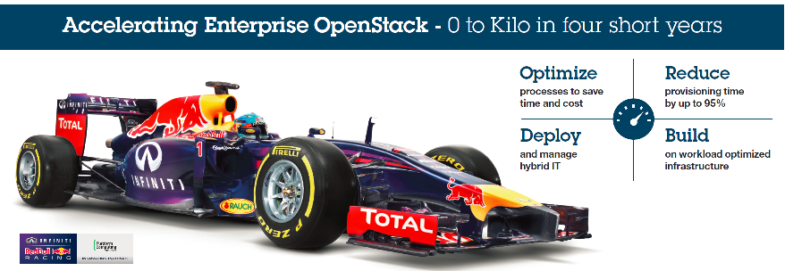
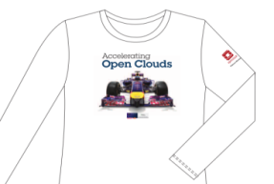
Learn more at these IBM sponsored sessions on Wednesday:
9:50 Room 243 Step on the Gas: See how Open Technologies are driving the future of the enterprise
11:50 Room 212/213 IBM and OpenStack: Collaborations beyond the code
1:50 Room 212/213 A Use Case Driven view of IBM’s OpenStack based Offerings
2:40 Room 212/213 IBM OpenStack Offerings in Action
Stop by the IBM Booth (B4)
Demos, games and FREE tee shirt.

Slide 36


Slide 37
Legal Disclaimer
© IBM Corporation 2011. All Rights Reserved.
The information contained in this publication is provided for informational purposes only. While efforts were made to verify the completeness and accuracy of the information contained in this publication, it is provided AS IS without warranty of any kind, express or implied. In addition, this information is based on IBM’s current product plans and strategy, which are subject to change by IBM without notice. IBM shall not be responsible for any damages arising out of the use of, or otherwise related to, this publication or any other materials. Nothing contained in this publication is intended to, nor shall have the effect of, creating any warranties or representations from IBM or its suppliers or licensors, or altering the terms and conditions of the applicable license agreement governing the use of IBM software.
References in this presentation to IBM products, programs, or services do not imply that they will be available in all countries in which IBM operates. Product release dates and/or capabilities referenced in this presentation may change at any time at IBM’s sole discretion based on market opportunities or other factors, and are not intended to be a commitment to future product or feature availability in any way. Nothing contained in these materials is intended to, nor shall have the effect of, stating or implying that any activities undertaken by you will result in any specific sales, revenue growth or other results.
If the text contains performance statistics or references to benchmarks, insert the following language; otherwise delete: Performance is based on measurements and projections using standard IBM benchmarks in a controlled environment. The actual throughput or performance that any user will experience will vary depending upon many factors, including considerations such as the amount of multiprogramming in the user's job stream, the I/O configuration, the storage configuration, and the workload processed. Therefore, no assurance can be given that an individual user will achieve results similar to those stated here.
If the text includes any customer examples, please confirm we have prior written approval from such customer and insert the following language; otherwise delete: All customer examples described are presented as illustrations of how those customers have used IBM products and the results they may have achieved. Actual environmental costs and performance characteristics may vary by customer.
Please review text for proper trademark attribution of IBM products. At first use, each product name must be the full name and include appropriate trademark symbols (e.g., IBM Lotus® Sametime® Unyte™). Subsequent references can drop “IBM” but should include the proper branding (e.g., Lotus Sametime Gateway, or WebSphere Application Server). Please refer to http://www.ibm.com/legal/copytrade.shtml for guidance on which trademarks require the ® or ™ symbol. Do not use abbreviations for IBM product names in your presentation. All product names must be used as adjectives rather than nouns. Please list all of the trademarks that you use in your presentation as follows; delete any not included in your presentation. IBM, the IBM logo, Lotus, Lotus Notes, Notes, Domino, Quickr, Sametime, WebSphere, UC2, PartnerWorld and Lotusphere are trademarks of International Business Machines Corporation in the United States, other countries, or both. Unyte is a trademark of WebDialogs, Inc., in the United States, other countries, or both.
If you reference Adobe® in the text, please mark the first use and include the following; otherwise delete: Adobe, the Adobe logo, PostScript, and the PostScript logo are either registered trademarks or trademarks of Adobe Systems Incorporated in the United States, and/or other countries.
If you reference Java™ in the text, please mark the first use and include the following; otherwise delete: Java and all Java-based trademarks are trademarks of Sun Microsystems, Inc. in the United States, other countries, or both.
If you reference Microsoft® and/or Windows® in the text, please mark the first use and include the following, as applicable; otherwise delete: Microsoft and Windows are trademarks of Microsoft Corporation in the United States, other countries, or both.
If you reference Intel® and/or any of the following Intel products in the text, please mark the first use and include those that you use as follows; otherwise delete: Intel, Intel Centrino, Celeron, Intel Xeon, Intel SpeedStep, Itanium, and Pentium are trademarks or registered trademarks of Intel Corporation or its subsidiaries in the United States and other countries.
If you reference UNIX® in the text, please mark the first use and include the following; otherwise delete: UNIX is a registered trademark of The Open Group in the United States and other countries.
If you reference Linux® in your presentation, please mark the first use and include the following; otherwise delete: Linux is a registered trademark of Linus Torvalds in the United States, other countries, or both. Other company, product, or service names may be trademarks or service marks of others.
If the text/graphics include screenshots, no actual IBM employee names may be used (even your own), if your screenshots include fictitious company names (e.g., Renovations, Zeta Bank, Acme) please update and insert the following; otherwise delete: All references to [insert fictitious company name] refer to a fictitious company and are used for illustration purposes only.

