Slide 1


vs.
Krishna M Kumar, Lead Architect, Huawei@Bangalore

Slide 2
Mesos & Yarn
Both Allow you to share resources in cluster of machines.
Mesos can manage all the resources in your data center but not application specific scheduling.
YARN can safely manage Hadoop jobs, but is not designed for managing your entire data center.
Two use cases – Mesos for non-Hadoop & Yarn for Hadoop.

Slide 3
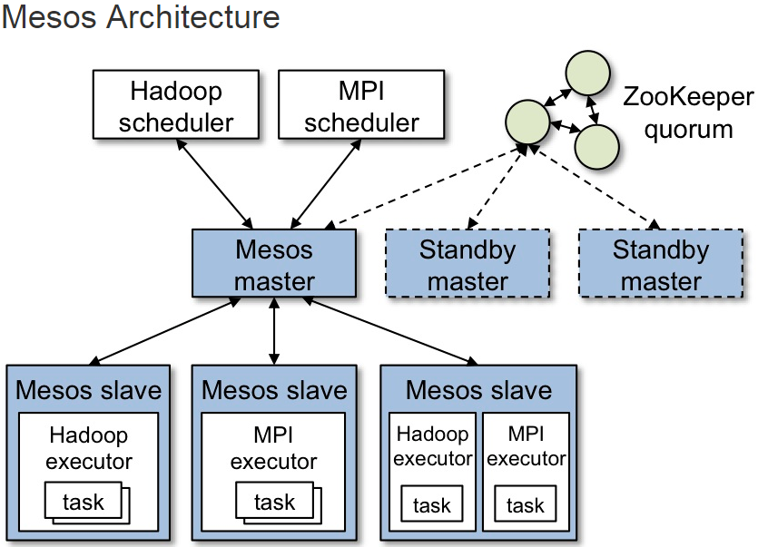
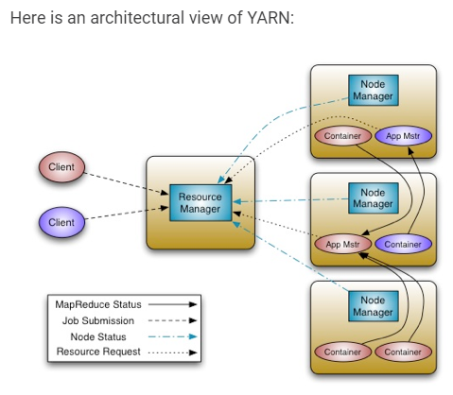
Mesos vs. Yarn

Slide 4
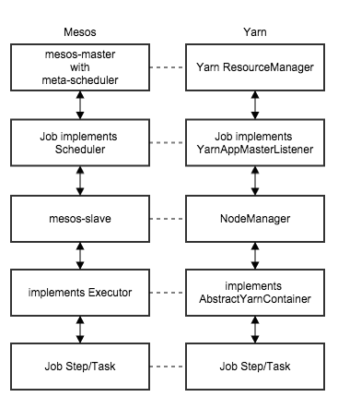
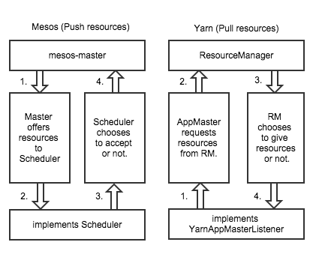
Mesos vs. Yarn

Slide 5
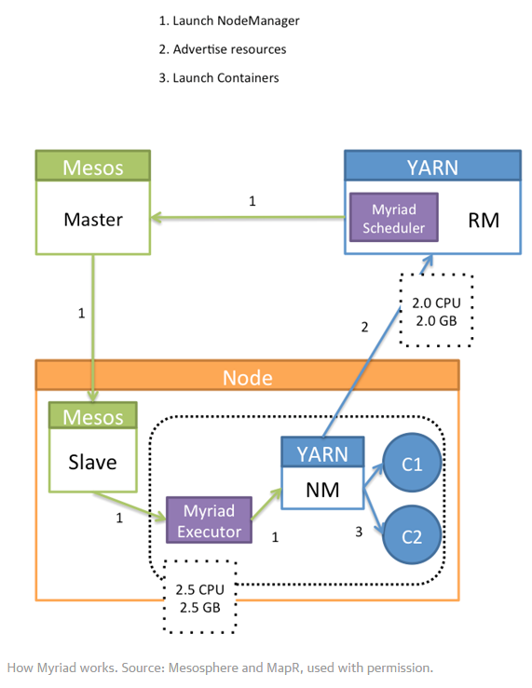
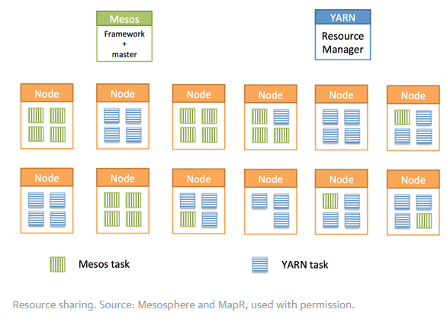

Myriad
Myriad – A open source software project is both a Mesos framework and a YARN scheduler that enables Mesos to manage YARN resource requests.

Slide 6
Mesos | Yarn
Written in C++, good for time sensitive works | Written in Java, JVM based app
Memory & CPU scheduling – Push based | Mainly memory scheduling – Pull based
Use Linux Container groups | Use Simple Unix processes
Framework get Resource offer to choose – very minimal information as just needed | Framework ask a container with specification + preferences(like local). Lots of information passed
Core Mesos is lighter but one need to write a Framework | It’s a Framework of its own and so its 3x code vs.Mesos
Mesos, you need to deal with the security | Yarn inherit Hadoop security
Mesos is general purpose scheduler for Data Center. Application writer deploy applications the way wanted | Mainly exists on Hadoop world – it’s a application scheduler. Framework setup unix process/application
The Framework takes care the application specific items | Can supports clustered applications
Fault tolerance, app portability, etc. - the Framework has to deal with | Can enforce global constraints and local – so application can deploy to right place
High performance Actor Style Messaging passing | Hadoop RPC Architecture – direction piggy backs heart beat
Lower level abstraction | Can run Yarn on Mesos (Myriad)

Slide 7
Mesos | Yarn
Production Hardened at massive scale at Twitter & AirBnb | Designed to do MapReduce Scale, used for Hadoop scaling at Yahoo & Hortonworks
It’s a two level scheduler- schedulers on multi tenant on the same cluster – better scaling capacity is there | Evaluate all the request and place the job. Resource Manager does the job. It’s a monolithic scheduler
Mesos supported non-Hadoop things such as Google Kubernetes, Docker, Redis, Spark, etc. Supports Resource revocation, Pre-emption, dynamic reservation, optimistic offers | Good for batch jobs for long run times (e.g: Hadoop) & stateless batch jobs which can restart easily. Not designed for long running services, short lived queries, Web servers, SOA apps, real time workloads, state full services like DB or distributed File system.
Works well with legacy applications which can be scheduled in VM, Containers & BareMetal. Multiple Frameworks can be called as needed. | Legacy applications must be scheduled with customization.
Ben Hindman and the Berkeley AMPlab team worked closely with the team at Google designing Omega so that they both could learn from the lessons of Google’s Borg and build a better non-monolithic scheduler. Written in UC Berkeley & project now with Mesosphere | Written by Yahoo/HortonWorks. YARN was created out of the necessity to scale Hadoop. Prior to YARN, resource management was embedded in Hadoop MapReduce V1, and it had to be removed in order to help MapReduce scale.

Slide 8

References
https://www.quora.com/How-does-YARN-compare-to-Mesos - with Arun Murthy’s(Hadoop Founder) comments
https://www.oreilly.com/ideas/a-tale-of-two-clusters-mesos-and-yarn
https://www.mapr.com/blog/apache-mesos-vs-hadoop-yarn-whiteboard-walkthrough
https://mesosphere.com/blog/2015/02/11/yarn-on-mesos-big-data/
https://www.youtube.com/watch?v=aXJxyEnkHd4
https://engineering.twitter.com/university/videos/running-yarn-alongside-mesos
http://www.slideshare.net/payberah/mesos-43904525?qid=eb2d0eb2-c866-4826-819b-3cb405183231
http://www.slideshare.net/sameertiwari33/scheduling-on-large-clusters
http://blog.typeobject.com/a-quick-comparison-of-mesos-and-yarn
https://dzone.com/articles/workload-and-resource-management-yarn-mesos-and-my
Of course, some of these information was pulled directly from web without any modifications.

