Slide 1
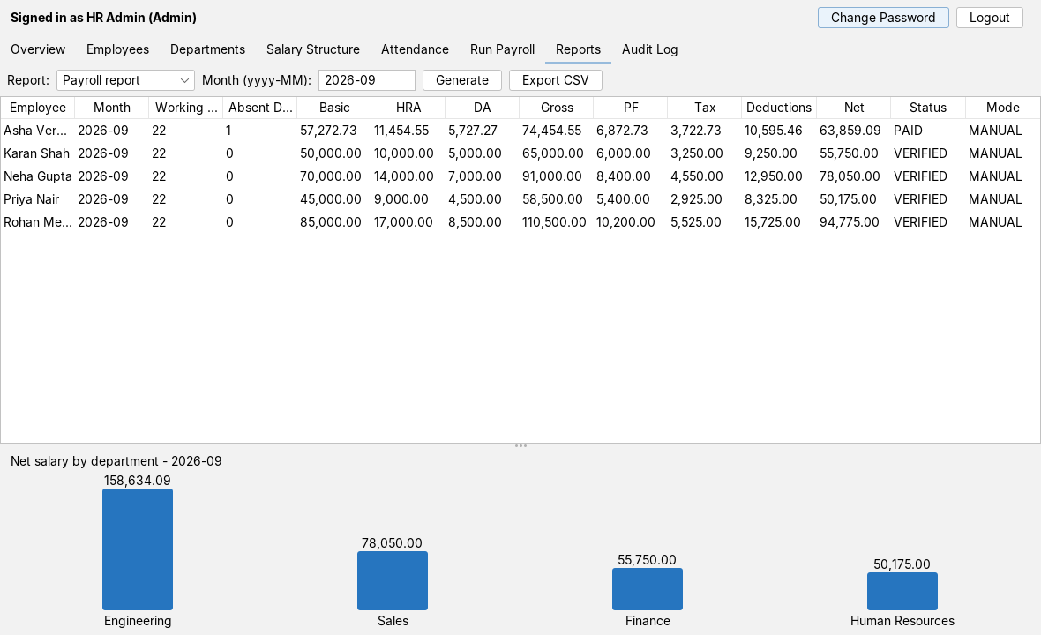
Payroll Management System
Project presentation
A Java Swing desktop application that takes a company from attendance to payslip: employee records, salary calculation, approval and audit, stored in MySQL.
Reports screen of the running application (demo data)
Java 17 · Swing · JDBC · MySQL
Notes:
Introduce the project: a desktop payroll system built with Java Swing for the screens, JDBC for data access and MySQL for storage. The screenshot is the real application running on demo data.

Slide 2
The system covers the full monthly payroll cycle, from attendance to payslip
Keep employee, department and salary-structure records
Record daily attendance: present, absent or on leave
Calculate each month's salary, reducing basic pay for absences
Review, verify and pay each payroll record
Give every employee a payslip they can download as PDF
Keep an audit trail of every payroll action
Who uses it
Admin / HR
Maintains the data, runs payroll and approves it
Employee
Sees their profile, attendance and verified payslips
Payroll scheduler
Runs the previous month's payroll on the 1st, while the app is open
Notes:
Walk through the six jobs the system does, then the three kinds of user. The scheduler is not a person: it is a timer inside the app that runs last month's payroll on the 1st.

Slide 3
A conventional Java stack: Swing, JDBC and MySQL
Concern | Technology | Used for
Interface | Java Swing + FlatLaf | Login window, admin dashboard, employee portal
Business logic | Java 17 services | Payroll calculation, authentication, reports, scheduler
Data access | JDBC + HikariCP | PreparedStatement DAOs, pooled connections, transactions
Database | MySQL | Seven tables with foreign keys and unique constraints
Passwords | jBCrypt | Salted one-way password hashes
Documents | OpenPDF | Payslip PDF (CSV export is written by hand)
Build and test | Maven, JUnit 5, H2 | 19 automated tests plus a UI smoke test
Notes:
Nothing exotic here. Each library does one job: FlatLaf for the look, HikariCP for pooled connections, jBCrypt for password hashes, OpenPDF for payslips.

Slide 4
Four layers keep screens, business rules and SQL apart
Interface
Screens call services, never SQL
Slow work runs in a SwingWorker, so the window never freezes.
Services own the rules
Validation, status changes and the salary formula live here. PayrollCalculator has no database access.
DAOs only run SQL
Every query is a PreparedStatement. Inside inTransaction, all DAO calls share one connection and commit or roll back together.
LoginFrame · AdminDashboard · EmployeePortal · eight tab panels
Services
AuthService · EmployeeService · AttendanceService · PayrollService · PayrollCalculator · ReportService · PayslipService · PayrollScheduler
Data access
UserDAO · EmployeeDAO · DepartmentDAO · SalaryStructureDAO · AttendanceDAO · PayrollDAO · AuditDAO
Database
MySQL, reached through DBConnection (HikariCP pool and transactions)
Notes:
Read the stack top to bottom. The key idea: screens never contain SQL, and the salary maths never touches the database, which is why it can be unit-tested on its own.

Slide 5
Seven tables hold everything, and payroll is unique per employee and month
users
employee
department
1 = one row, * = many rows. Each of employee's children (salary structure, attendance, payroll) references it by emp_id.
id (PK)
name, email, username
password_hash, role
failed_attempts, locked_until
emp_id (PK, FK to users)
designation, joining_date
basic_salary, is_active
dept_id (FK)
dept_id (PK)
dept_name (unique)
location
1
1
1
*
1
1
*
*
salary_structure
attendance
payroll
payroll_audit
emp_id (unique, FK)
hra_percent, da_percent
pf_percent, tax_percent
emp_id (FK), att_date
status: PRESENT / ABSENT / LEAVE
UNIQUE (emp_id, att_date)
emp_id (FK), pay_month
working_days, absent_days
basic, hra, da, gross, pf, tax
net_salary, status, mode
UNIQUE (emp_id, pay_month)
payroll_id (FK)
action, action_by
action_time, details
1
*
Notes:
Accounts for both admins and employees live in users; employee adds the HR fields and shares the same key. The UNIQUE(emp_id, pay_month) constraint is what makes a payroll run safe to repeat.

Slide 6
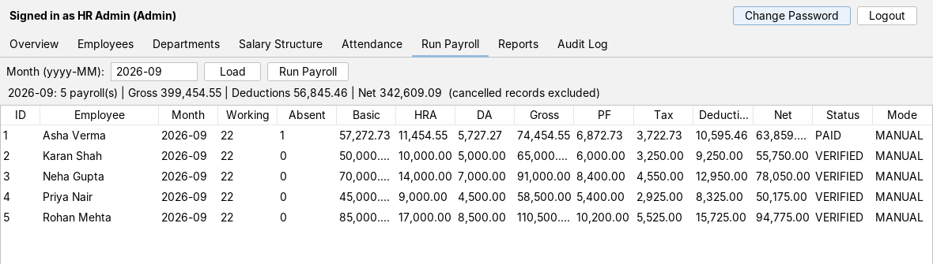
HR runs the whole payroll cycle from one dashboard
Admin dashboard, Run Payroll tab (demo data)
Employees add, edit, search, deactivate, reset password
Departments add, rename; delete blocked while staffed
Salary structure HRA, DA, PF and tax % per employee
Attendance mark present, absent or leave per day
Run Payroll generate, verify, pay, cancel, reprocess
Reports payroll, attendance, employee; CSV export
Audit log who changed which record, and when
Overview headcount and last month's totals
Notes:
Each tab in the screenshot is one feature area. Highlight Run Payroll: that is where the calculation, verification and payment happen. Screenshot uses demo employees.

Slide 7
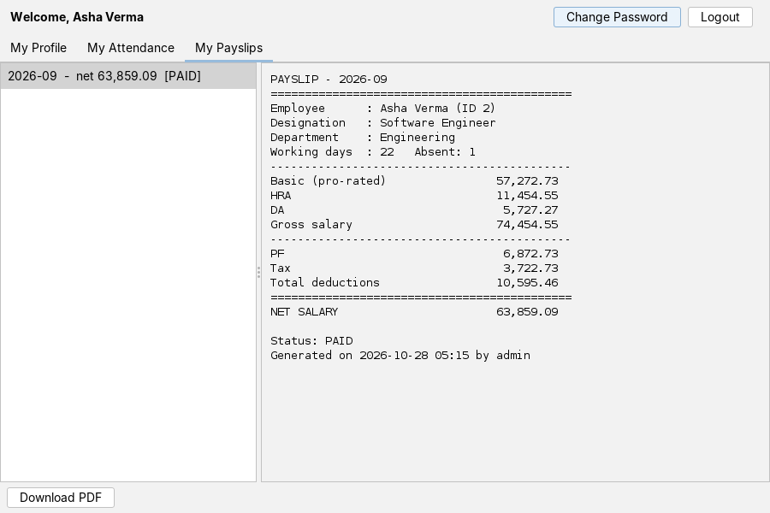
Employees see only their own data, and payslips only after HR verifies the month
Profile
Edit name and email, change password
Attendance
Pick a month; see marked days with absent and leave totals
Payslips
Lists verified and paid months only; full breakdown from basic to net
Download
Save any payslip as a PDF
Employee portal, My Payslips tab (demo data)
Notes:
The payslip list only contains months whose payroll is VERIFIED or PAID, so an employee never sees a figure that HR might still change. The PDF is generated on demand with OpenPDF.

Slide 8
A payroll run is a single transaction: every employee is processed, or none
Start
Check
Load
Decide
Calculate
Save
HR clicks Run Payroll, or the scheduler fires on the 1st
Month not in the future; open the transaction
Fetch all active employees
Skip if already processed or joined later; check basic salary
Read structure and absent days; apply the formula
Insert the payroll row and a GENERATED audit row
Repeated for each active employee
All employees processed
COMMIT. HR sees a summary: records created, skipped, and any employees that could not be processed.
Any error along the way
ROLLBACK. Nothing is saved, so there are no half-finished months. Run it again once the cause is fixed.
Notes:
This is the heart of the system. Whether HR clicks Run Payroll or the scheduler fires on the 1st, the same service method runs. If anything fails, nothing is saved, and because rows are unique per employee and month, running it again is safe.

Slide 9
Absences reduce basic pay, and the other amounts follow
Working days
Monday to Friday days in the month
Basic
basic salary × (working − absent) ÷ working
HRA, DA
basic × HRA %, basic × DA %
Gross
basic + HRA + DA
PF, Tax
PF = basic × PF %, Tax = gross × tax %
Net salary
gross − (PF + Tax)
Worked example: basic salary 60,000, no absences
Basic | 60,000.00
HRA (20%) | 12,000.00
DA (10%) | 6,000.00
Gross salary | 78,000.00
PF (12% of basic) | 7,200.00
Tax (5% of gross) | 3,900.00
Total deductions | 11,100.00
Net salary | 66,900.00
Leave is paid; days with no record count as present. A new employee starts with HRA 20, DA 10, PF 12 and tax 5 percent, editable per employee.
With one absent day out of 23 working days (January 2025), basic becomes 57,391.30 before the percentages apply. Figures are from the project's unit tests.
Notes:
Work through the formula once, then the worked example on the right. Only ABSENT days reduce pay; leave is paid, and days with no record count as present. The example numbers come straight from the unit test.

Slide 10
A payroll record moves through four states, and PAID is final
GENERATED
verify()
VERIFIED
markPaid()
PAID
final
reprocess()
cancel()
GENERATED Figures calculated. HR can recalculate from the latest attendance and salary structure. Hidden from the employee.
VERIFIED Approved by HR. The employee can now see and download the payslip.
PAID Payment recorded. No further changes.
CANCELLED Left out of month totals. Can be reprocessed.
cancel()
CANCELLED
recalculate() keeps a record in GENERATED. Each change also writes a row to the audit log.
Notes:
Generated is where HR can still recalculate. Verified releases the payslip to the employee. Paid is final. Cancel is possible before payment; a cancelled record can be reprocessed back to Generated with fresh figures. Every move is written to the audit log.

Slide 11
Safeguards cover logins, data integrity and the payroll run
Accounts
Data and payroll
Hashed passwords. BCrypt with a salt; plain text is never stored.
Lockout. Five wrong passwords lock the account for 15 minutes.
Soft delete. A deactivated employee cannot log in, but payroll history stays intact.
Role-based windows. Admins and employees get different screens.
PreparedStatements for every query, so input never becomes SQL.
Unique per employee and month, so a payroll cannot be created twice.
Constraints. Foreign keys and CHECK rules reject invalid rows.
Audit rows for every generate, recalculate, verify, pay, cancel and reprocess.
CSV export neutralises cells that start like spreadsheet formulas.
Notes:
Group these into accounts and data. The point for a payroll system: money figures cannot be duplicated, silently changed or traced to nobody.

Slide 12
Tested end to end; the remaining gaps are known
19
Limitations and future work
automated tests pass
The automatic run needs the app open on the 1st; HR can always run it manually
Tax is a flat percentage, with no tax slabs
Employees who join mid-month are not pro-rated
One currency, one company, desktop only
No concurrency testing with many simultaneous users
5 cover the salary maths; 14 run the full workflow: login and lockout, payroll runs, status changes, payslip PDF, reports and rollback
The workflow suite passes on in-memory H2 and on a MariaDB 10.11 server
A UI smoke test opens every window against demo data
Not yet run against MySQL 8 itself
Notes:
Be straightforward about scope. The workflow suite passes on H2 and on a MariaDB server; MySQL 8 itself has not been run, though the SQL is standard. The limitations on the right are the natural next steps.

Slide 13
One calculation engine, one audit trail, two kinds of users
Questions?
Source code, UML diagrams and tests are in the project folder payroll-system/
Notes:
Close with the three ideas: a single place where salary is calculated, a complete audit trail, and separate experiences for HR and employees. Then take questions.

