Slide 1




FNB HACKATHON 2026
UniversityFlow
From Grade 10 to graduation.
A companion for South African learners. It checks every university's own rules, keeps the dates, and stays to the last exam.
Tumo Mogame
Tumoolo
GRADE 10
UNIVERSITY
GRADUATION
Notes:
Open with the journey: Grade 10, university, graduation. Most help stops at the application. UniversityFlow is the friend who walks the whole way.

Slide 2
Five years where learners fall through the cracks
01 · THE JOURNEY TODAY
GRADE 9 TO 10
GRADE 11
GRADE 12
FIRST YEAR
EVERY YEAR
Subject choice
Results
Apply and fund
Arrive
Finish
Maths or Maths Literacy decides which degrees stay open.
Many universities make early offers on final Grade 11 marks.
Six universities, six ways to score, six closing dates. Then NSFAS.
A new city, registration, modules. Many leave after year one.
DP, subminimum, supplementary: learned the day it costs a year.
"They may not know what an APS is, which subjects close which doors, when applications close, or what NSFAS needs from them."
Quote: UniversityFlow plan, §1.1 (who it's for). The admission rules are summarised from the six universities' prospectuses (plan §2).
Notes:
Walk the path left to right. Every stop is a place a learner can fall out for lack of information, a missed date, or feeling alone.

Slide 3

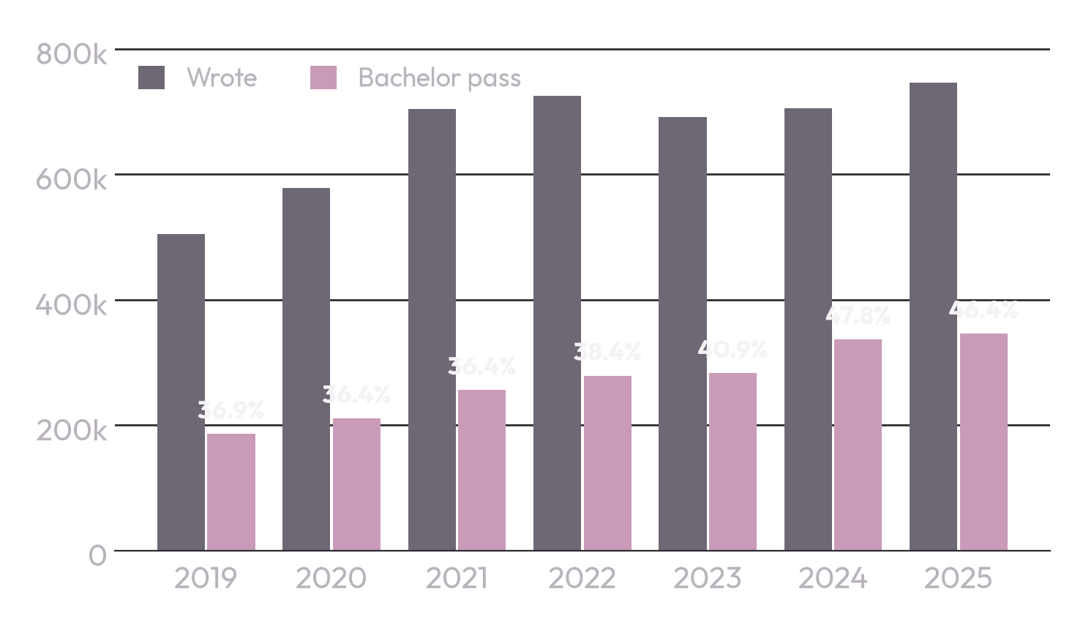
Under half earn a bachelor pass
02 · MATRIC
2025: 746 110 full-time candidates wrote. 345 857 (46.4%) earned a bachelor pass, the pass needed to apply for a degree.
Source: DBE, NSC Examination Reports 2021, 2024 and 2025 (full-time candidates). Labels show the bachelor-pass rate.

Slide 4

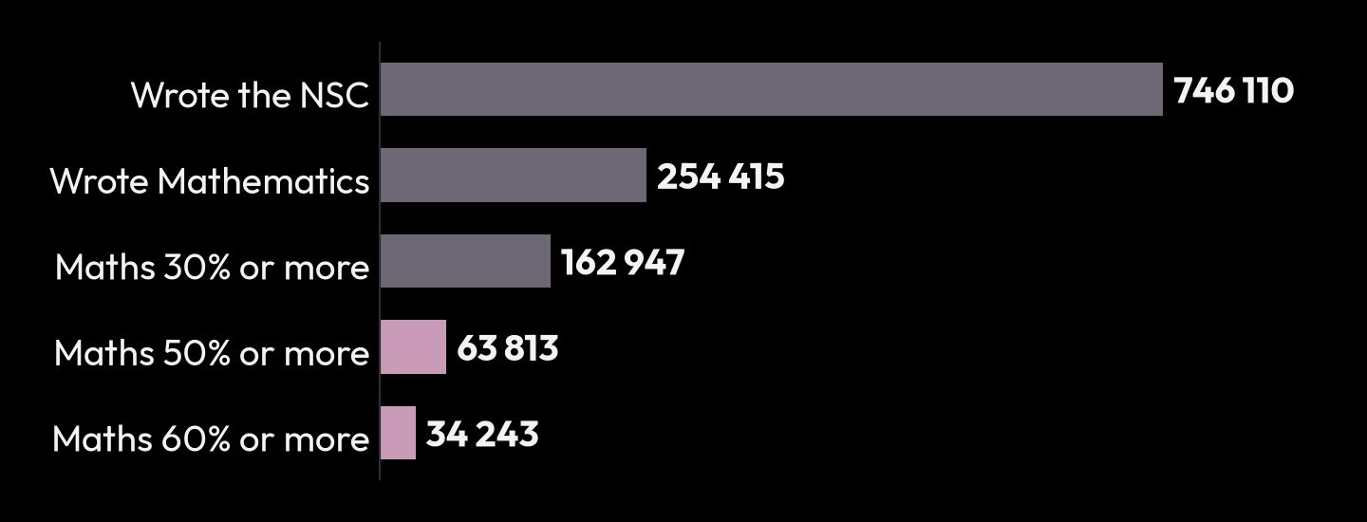
Maths closes doors early
03 · MATHEMATICS
254 415
477 160
25.1%
wrote Mathematics
wrote Maths Literacy
of Maths candidates scored 50% or more
NSC 2025, full-time candidates
Source: DBE, 2025 NSC Examination Report (Tables 1, 2.1, 3, 6.3.8). Subjects are chosen before Grade 10; many science, engineering and commerce degrees ask for Mathematics.

Slide 5
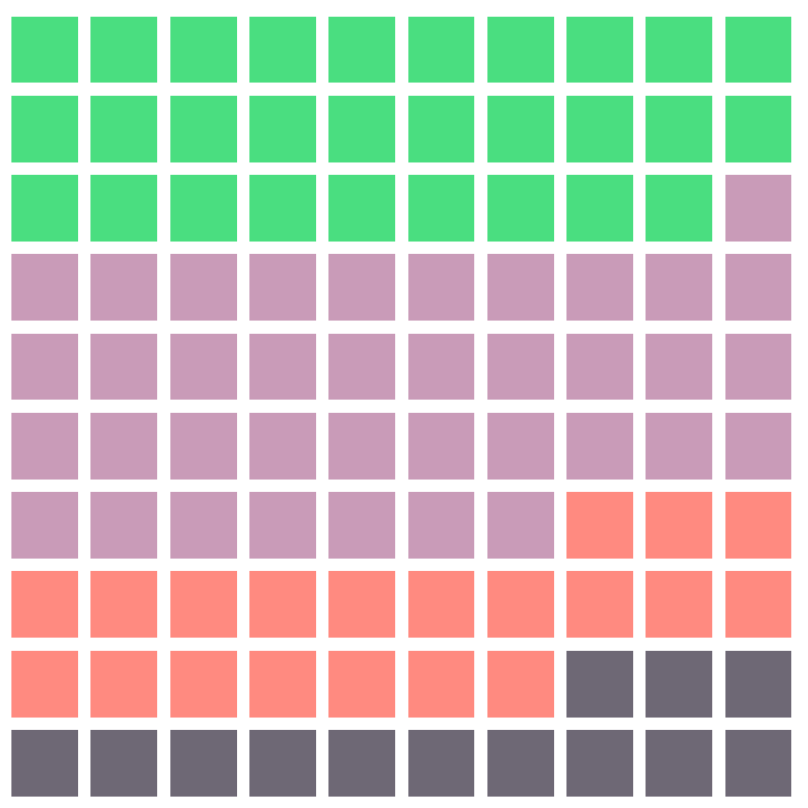
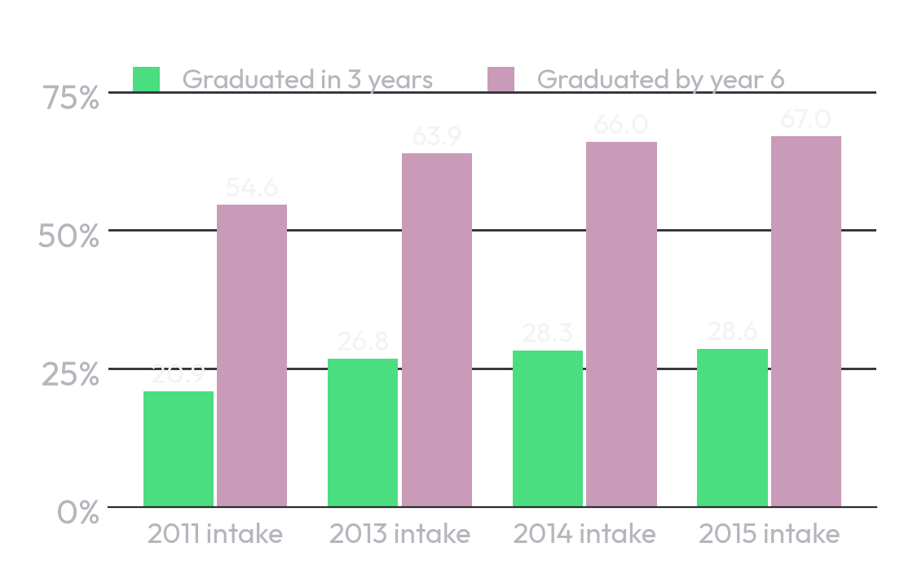
Getting in is only half the journey
04 · UNIVERSITY
Of 100 who started a three-year degree in 2015
Finishing on time, by intake
28.6%
graduated in three years
38.4%
more by year 6 (67.0% in all)
20.2%
dropped out by year 6, 13.9% of them after year one
12.8%
Better each year, but fewer than 3 in 10 finish on time.
had neither graduated nor dropped out by year 6
Source: DHET, 2000 to 2019 First Time Entering Undergraduate Cohort Studies (2022), Table 28: three-year degrees, contact and distance (includes UNISA). Squares rounded; labels exact.

Slide 6




Funding and jobs raise the stakes
05 · MONEY AND WORK
593 543
R350 000
62.8%
university students funded by NSFAS in 2025
household income a year: the NSFAS limit
unemployment rate for young people aged 15 to 24
R47.86 billion paid out for them that year.
R600 000 for students with a disability. Applying is free.
Q2 2026. 3.8 million are not in work, education or training.
UniversityFlow is built so the learner who gets in stays in, and finishes.
Sources: Minister of Higher Education, reply to Parliament NW874 (2026, via PMG); NSFAS criteria as published by universities (e.g. Rhodes); Stats SA QLFS Q2 2026.

Slide 7

INTRODUCING
UniversityFlow
A friend from Grade 10 to graduation.
It checks a learner's marks against each university's own rules, keeps every date, explains funding, stays close through the exams, and keeps going after the offer: arrival, modules, every year to the last exam.
Code decides. The AI explains. A person is always there.
Notes:
The turn of the story: from the dark problem slides to the brand's mauve. Code decides (scores, requirements, deadlines come from checked records); the AI explains them in plain words.

Slide 8
Naledi, 16: the first in her family to aim for university
06 · ONE LEARNER'S STORY
GRADE 11
GRADE 11
GRADE 12
GRADE 12
JANUARY
EVERY YEAR
Her report, read
A goal she can see
Applied on time, for free
Through the exams
The first week
Every module
She takes a photo of her report. Each mark is read, then confirmed by her. She sees what she is on track for, what is close, and a Plan B.
BCom Accounting at UJ. What I need gives the mark to aim for in each subject. Her plan map ticks off each step.
A checklist and closing date for UJ and Wits, her NSFAS documents ready, and a warning: nobody can sell her a place.
A countdown to each paper, at most one message a day, and care first on the night she says she is not coping.
She accepts UJ's offer. A first-week checklist, the campus tour, and her modules checked before the last day to change them.
How each module is marked, her DP, the exam mark she still needs, free books. Then the next year, to graduation.
Every step above is built and on the live demo. Naledi is made up, and so is everything she enters: try her yourself.
Notes:
The user journey as one story. Naledi is the judge demo's Grade 11 learner (apps/web/lib/server/demo/personas.ts): goal UJ BCom Accounting, shortlist Wits BCom and UJ's Diploma in Accountancy. The exam rhythm is packages/messaging cadence.ts (at most one a day).

Slide 9





One companion for every stop
07 · HOW IT WORKS
1
1 School
Marks checked against each university's rules: qualify now, close, or Plan B. Subjects that keep doors open.
BUILT
2 Apply
A checklist and closing date per university. NSFAS: who qualifies, the documents, the free application.
5
2
BUILT
3 Matric
A goal, the exam timetable, reminders and care through the exams. Re-checks after each report.
UniversityFlow
BUILT ON STAND-INS
4 Arrive
Offers, campus, the first week, and modules checked against the published curriculum.
4
3
BUILT
5 University
Module cards, the mark calculator, free books, plan maps and My CV now. Next: a study coach.
BUILT
Notes:
Every row carries an honest status. Built means built, tested and audited, running on local stand-ins until the owner connects the real accounts (SMS, WhatsApp, the production AI key). Next means proposed and waiting for approval.

Slide 10



Access to higher education: five focus areas, answered
08 · THE CHALLENGE
Applications, bursaries and NSFAS
Every course scored the university's own way, a checklist and closing date each, NSFAS steps and the N+ rule, scam warnings.
Apply and fund
Cost planning
What NSFAS pays and who qualifies, the application fee step, money safety before a deposit. Next: a cost-of-study planner.
Money, planned
Student wellness
Care before facts, a crisis check before any AI (red team 100%), real helplines, and Report this reply.
Care · Crisis
Academic persistence
Registration check, module cards, DP and the exam mark still needed, free books. Next: the study coach.
Arrive · University years
Connectivity and accessible learning
Light pages for cheap phones, SMS and WhatsApp, an offline calculator, Read aloud, WCAG 2.2 AA tested.
For every learner
Right-hand column: the slide that shows it. Focus areas as listed in the FNB Hackathon 2026 challenge "Access to higher education".

Slide 11

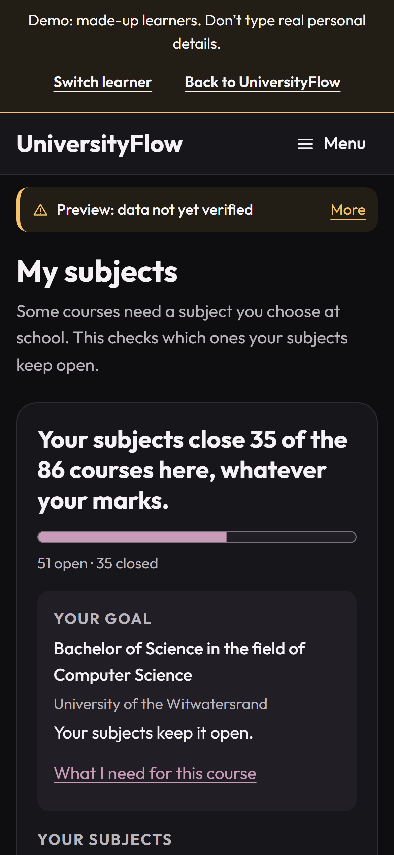
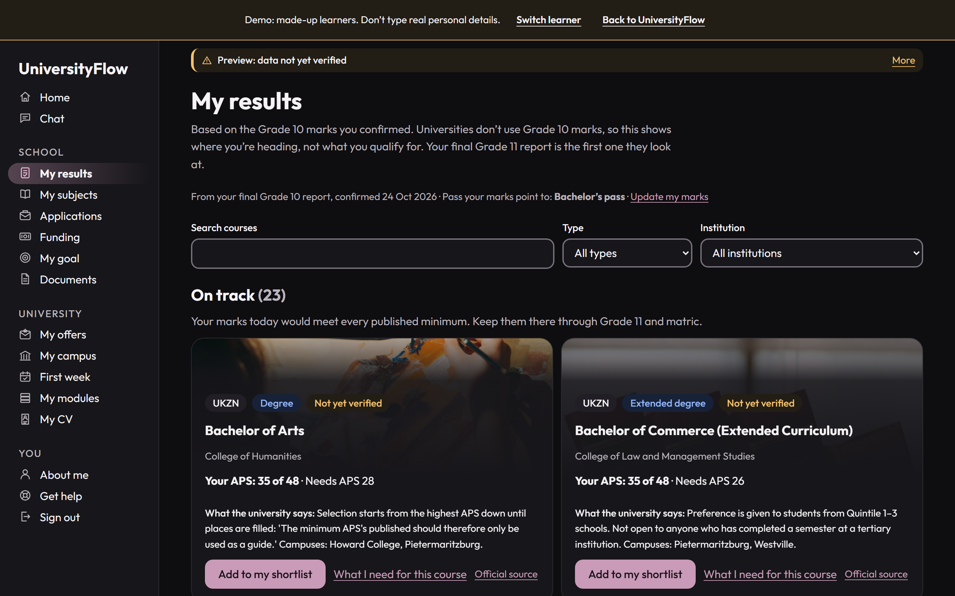



Your marks, against each university's own rules
09 · SCHOOL, GRADES 10 TO 12
SCHOOL
APPLY
MATRIC
ARRIVE
UNIVERSITY
Qualify now, close, or Plan B
Each course scored the way that university scores it: APS, points or its own formula.
What I need
The mark to aim for in each subject, for the course the learner wants most.
Subjects that keep doors open
From Grade 10: which courses a subject choice opens or closes, before it's too late to change.
Only checked facts
Naledi, Grade 11: My results
Every requirement carries its source and year. Unchecked records are labelled and never reach real learners.
Thabo, Grade 10: My subjects
Today: 86 programmes at Wits, UJ, UP, UCT, TUT and UKZN, researched as drafts and awaiting a person's verification. Screens: the live judge demo, made-up learners.

Slide 12
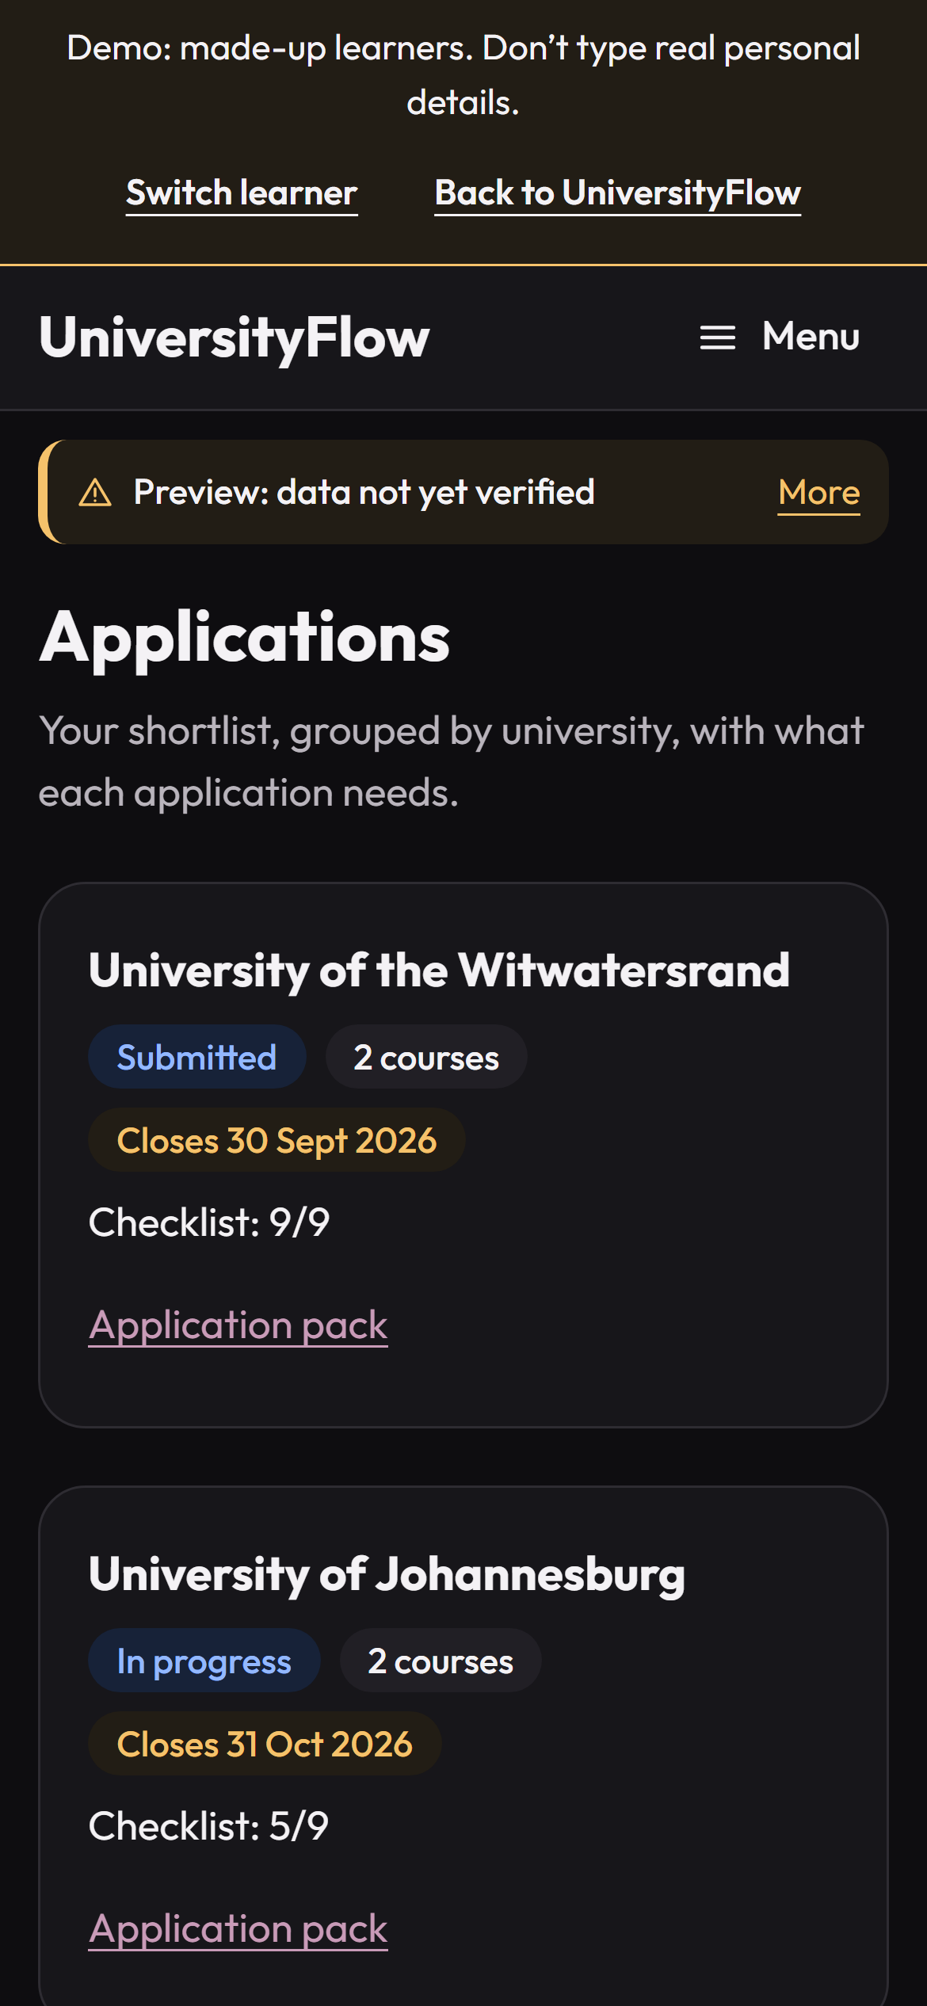
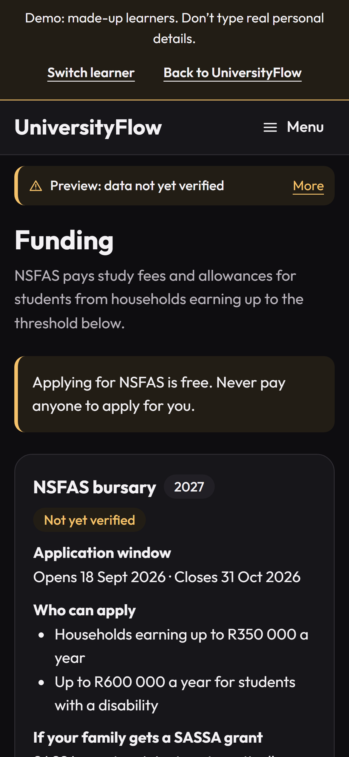
Applications on time. Funding explained
10 · APPLY AND FUND
SCHOOL
APPLY
MATRIC
ARRIVE
UNIVERSITY
Applications
BUILT
A checklist and closing date for each university, and the next step on the home page.
NSFAS
BUILT
Who can apply, the window, the documents, and keeping funding (the N+ rule). It explains; NSFAS decides.
Follow-ups
BUILT ON STAND-INS
Reminders when an application still has something to do, and before an offer's reply-by date.
Scam warnings
BUILT
Nobody can sell a place or a bursary. Applying for NSFAS is free.
Bursaries beyond NSFAS
NEEDS A PARTNER
Matching to bursaries, and pre-filled applications with funders who agree.
Screens: the live judge demo (made-up learner Amahle, Grade 12). Pre-filled funding applications are gate H3 of the plan: only with a signed agreement.

Slide 13



Cost planning, honestly
11 · MONEY, PLANNED
SCHOOL
APPLY
MATRIC
ARRIVE
UNIVERSITY
What NSFAS pays, who qualifies
BUILT
Study fees and allowances, for households earning up to R350 000 a year (R600 000 with a disability). The documents, and how to keep funding (the N+ rule).
NEXT: PROPOSED
A cost-of-study planner
Application fees
BUILT
For each course on the shortlist: tuition, residence, transport, books and data, against what NSFAS or a bursary pays, and the gap the family must plan for.
The fee step on each university's checklist: paid, or a waiver approved. Some charge nothing: UJ has no application fee.
Money safety
BUILT
Never pay anyone for a place, a bursary or an NSFAS application. A check before paying a deposit on an offer.
Built from each university's published fees, and shown only once a person has checked them. A wrong fee breaks a family's budget; we will not guess one.
Bursaries beyond NSFAS
NEEDS A PARTNER
Matching to bursaries, and pre-filled applications with funders who agree.
Built: the Funding page (packages/content funding.ts, safety.ts), the application checklist, the offers reminders. NSFAS limits as published by universities (e.g. Rhodes); UJ: "No application fee" (its 2027 prospectus, a draft record).

Slide 14


Close through the exams, never in the way
12 · MATRIC, THROUGH THE EXAMS
SCHOOL
APPLY
MATRIC
ARRIVE
UNIVERSITY
TERM
A WEEK BEFORE
PAPER DAY
NEW REPORT
UniversityFlow · SMS
Up to 2 a week
Up to 1 a day
Silent
Re-check
UniversityFlow: this is the study reminder you asked for. Time for a little practice today. You've got this. Reply STOP to stop.
Only about their own goal. Nothing to say, nothing sent.
Study reminders they asked for, never above their own cap.
Nothing from an hour before a paper to 30 minutes after.
June and September marks re-run what they qualify for.
Every message is fixed, reviewed text. No name and no marks ever travel in a message: the details wait inside the app.
Motivation that is theirs
The home keeps their goal and the mark each subject needs in view; the chat recalls the goal in their words.
Consent first
BUILT ON STAND-INS
Opt-in per channel; a guardian's for under-18s. No messages at night. STOP works at once.
Rules as built in packages/messaging (cadence.ts); the numbers are the owner's to confirm. SMS, WhatsApp and push run on stand-ins until a provider is chosen.

Slide 15







When a learner is struggling
13 · CARE
Care comes before facts. The companion asks how they are before it asks about marks.
A bad result
Exam stress
Kind and honest: what the marks still allow, and Plan B. Never a promise it can't keep.
Never "don't worry". One small next step from their own timetable, and sleep before a paper.
Giving up
Pressure at home
Their own goal, in their own words, without pressure. Another route is not a failure.
Helps them find the words for family, a teacher or the school counsellor.
An AI, and says so
Arriving alone
Asked if it's a person, it says no, and names a parent, teacher or counsellor.
A lost offer or a hard first week gets care first, then real next steps.
As built: the charter and its care guidance (packages/agent, charter.ts, system-prompt.ts). UniversityFlow is not therapy and never a substitute for a counsellor, doctor or psychologist.
Notes:
These are the agent's written rules, tested by the eval suite. The wording of the guidance still goes to a clinician or Childline for review (finding A10-53).

Slide 16
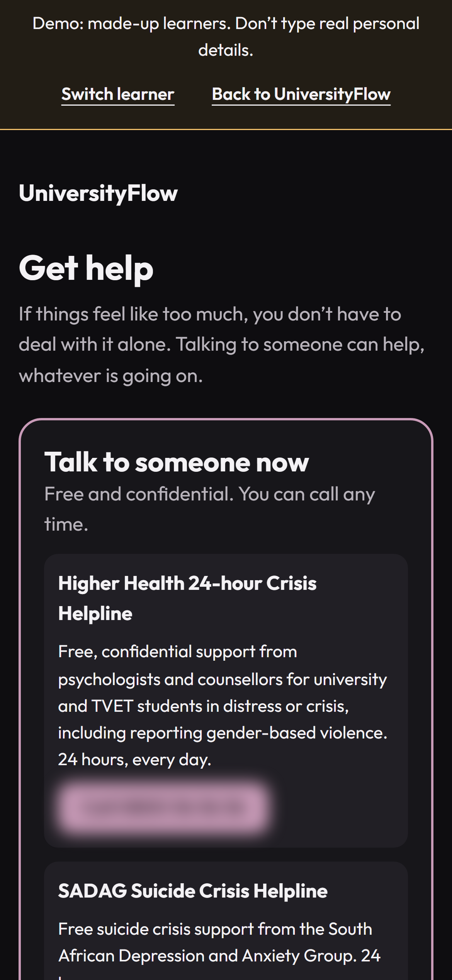

A crisis is answered by code, before any AI
14 · WHEN IT IS MORE THAN SADNESS
1
2
3
Get help: the crisis card's helplines. Numbers blurred here until a person verifies them.
A learner writes
A fixed check
Coaching stops
Every message, in the chat or a plan map, is checked first.
Words of suicide, self-harm or abuse are matched by rules, not a model.
A reviewed reply and the crisis card: free helplines, then a person.
It errs towards help
A false alarm costs a few seconds; a miss could cost far more.
Tested on every change
A red-team suite of over 450 crisis cases must pass 100% for any change to the agent or its words.
Report this reply
A button on every AI reply, so a learner can flag a bad answer.
Owed before launch, by people: each helpline number checked on the organisation's own site; crisis phrases in isiZulu, isiXhosa, Sesotho, Setswana and Afrikaans reviewed by first-language speakers; the care guidance reviewed by a clinician or Childline (A10-53).
Notes:
Built: packages/agent crisis.ts (a deterministic check on every message before any model), the crisis card, the red-team suite in packages/evals (hard rule 7). A design principle is not a clinical guarantee: the reviews above are owed by people.

Slide 17
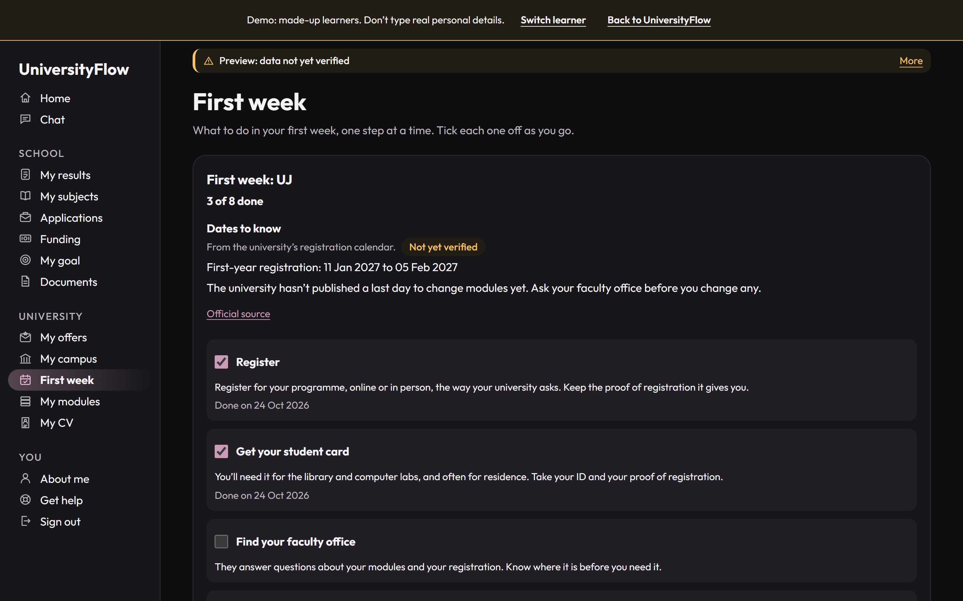


From the offer to the first lecture
15 · ARRIVE
SCHOOL
APPLY
MATRIC
ARRIVE
UNIVERSITY
Offers
What kind of offer it is, what it still depends on, and the date to reply by.
Campus and first week
Where things are, walking routes, and the university's own safety advice, quoted.
Registration check
Modules checked against the published curriculum, before the last day to change them.
Reminders
Registration day, reply-by dates, and money safety before paying a deposit.
Lerato, first year at UJ: First week
BUILT
Phase 5, built and audited. Campus and curriculum records are drafts until verified.

Slide 18

Every year, until the last exam
16 · UNIVERSITY YEARS
NOW
NEXT
Module cards, mark calculator
Study coach
How each module is marked: DP, subminimum, and the exam mark still needed. Works offline.
Reads marked tests, finds weak topics, plans around busy weeks. Phase 7, Mar 2028.
Free books
A plan that fits your life
Open textbooks and the university library for each module, free and legal.
A study week with room for classes, travel, work, family and rest. Phase 7.
Plan maps and My CV
Portfolio, My thread
Goal maps you tick off; projects, skills and marks into a first CV (off for real learners until consent v4).
Projects built along the way, one degree-long project. Proposed.
The aim: catch a missed DP or a wrong module before the next semester, while there is still time to fix it.

Slide 19






Forecasts from the learner's own marks, explained
17 · IT THINKS AHEAD
AT SCHOOL
Where marks are heading
Every course, forecast
What I need
Re-check
The pass her marks would give, and each subject’s change since Grade 10.
→
Qualify now, on track, close or Plan B, each scored the university’s own way.
→
The mark to aim for in each subject to reach her goal.
→
After each new report: which courses moved up, which slipped.
AT UNIVERSITY, AND ALWAYS
The exam mark needed
It remembers
Knows when to be quiet
Reads distress first
From the year mark so far: DP met or not, the subminimum, what the exam must give.
Goals, preferences and notes, kept across years. The learner sees and deletes them.
Messages fit her exam timetable: at most one a day, never during a paper or after 21:00.
A crisis check on every message, before the AI, then a person to talk to.
How it thinks: the AI picks among 18 tools, code works out the answer, the AI explains it. Next (Phase 7): a study coach that ranks topics by the marks they cost across tests and their weight in the exam.
Built: packages/admissions (eligibility, school-record, what-i-need, recheck, mark-needed), packages/agent (tools.ts, crisis.ts), packages/messaging (cadence.ts). Phase 7: docs/plans/phase-7-proposal.md.
Notes:
Why code decides: a wrong requirement or deadline costs a learner a year, so every forecast here can be explained and checked. No predicted exam mark is ever shown as a promise (Phase 7, D8). A Bayesian Knowledge Tracing model replaces the v1 heuristic only once it predicts the next test better on consented, de-identified data.

Slide 20








Connectivity and accessible learning
18 · FOR EVERY LEARNER
Light on data
SMS and WhatsApp
Works offline
Read aloud
Built for cheap phones: the shared code every page loads is held under 150 KB, checked on every change.
Reminders and replies without the app or a data bundle.
The mark calculator runs on the phone. Lost signal? It says so and tries again.
Campus places and directions read out, with step-free routes.
BUILT
BUILT ON STAND-INS
BUILT
BUILT
Free, legal books
Accessible by design
Five languages in a crisis
Free for learners
Open textbooks and practice for school, the university library for every module.
WCAG 2.2 AA, every journey tested with axe, from a 360 px phone up, reduced motion.
Crisis words recognised in isiZulu, isiXhosa, Sesotho, Setswana and Afrikaans.
No fee, no adverts, nothing sold. The payers are those who gain when learners finish.
BUILT
BUILT
BUILT
BUILT
SMS and WhatsApp run on stand-ins until a provider is chosen. Crisis phrases await first-language review.

Slide 21
Technical architecture
19 · UNDER THE HOOD
Web app
Phone app
SMS and WhatsApp
Data, in South Africa
Next.js 16, installable, any browser
Expo: Android and iOS, one codebase
Reminders, replies, STOP honoured
Postgres and file storage in AWS Cape Town (af-south-1). Row-level security. IDs only in logs. The demo: made-up learners only.
↓
API on Vercel, Cape Town
Sign-in by phone PIN · guardian consent gate · rate limits · security headers. The app never holds a key or calls the AI.
↓
Every provider swappable
Code decides
The AI explains
AI, SMS, WhatsApp, push, voice, CV (Mmereko), jobs, errors: each behind an interface, with a fake and contract tests.
admissions: scores, verdicts, What I need, mark maths
catalogue: every record with source, year, checked by
messaging · documents (each mark confirmed) · planner
crisis check first, then the model behind an interface (Claude; Gemini on the demo only), 18 tools, the care charter. Red team: over 450 cases, 100%.
One TypeScript monorepo · over 5 000 automated tests · guards in CI · 13 audit types per phase · E2E with axe on a production build
Notes:
Repository: planning.md §16 (stack and structure) and §16.4 (hard rules). The demo runs on its own Vercel project with a Supabase database and made-up learners only; production is Vercel cpt1 with RDS and S3 in af-south-1. Test count: the per-package suites in status.md (web 1887, catalogue 555, db 565, native 470, agent 390, messaging 311, documents 302, admissions 299, tokens 289 and more).

Slide 22
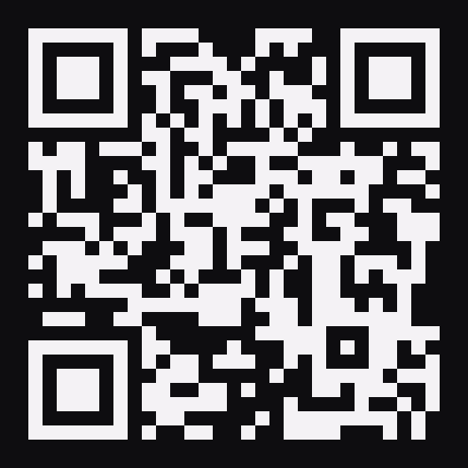
Live demo: six made-up learners, one journey
20 · WHAT WE SHOW TODAY
Thabo
Naledi
Amahle
Lerato
Sipho
Kagiso
Grade 10
Grade 11
Grade 12
First year, UJ
Second year, Wits
Final year, UCT
01
02
03
04
05
06
My subjects: swap a subject and see which courses it opens or closes.
My results, then What I need for the course she wants.
Applications and their checklists, then Funding for NSFAS.
First week: tick a step, then the campus tour.
My modules, then ask the chat how to find a place.
The campus tour, then what's coming next.
universityflow.tumoolo.tech/demo
NO PASSWORD NEEDED
Press Try as Naledi (or any learner): a private copy, deleted after 24 hours. Or Sign up as a new learner with any 080 number: the PIN shows on screen. University facts are drafts, labelled "Not yet verified". The chat is the real AI, with every safety check on.
Notes:
Judge takeaway: it already works across the whole journey, on made-up learners, with every safety rule on. Nothing real is at stake in the demo.

Slide 23
56 changes shipped from 23 to 25 October
21 · BUILT THIS WEEKEND
56
The judge demo
Six made-up learners, a private copy each, a three-minute guide, live on universityflow.tumoolo.tech.
Sign up as a new learner
The real sign-up journey on made-up details: PIN and guardian link on screen.
pull requests merged during the hackathon, each through the full test gate before it went live
Phase 6: semester setup
How marks work, the module outline, module cards and the mark calculator, free books.
50 TVET colleges
Every public college in Plan B, and "Is this college registered?"
Before the weekend: Phases 0 to 5 (the school years to arrival) were built and audited, September to October 2026.
My CV and plan maps
A first CV (with Mmereko, behind a switch); plan maps you pan, zoom and tick off.
A second AI model
Gemini beside Claude; every reply records which model wrote it.
Safer
Two Critical framework advisories patched; two crisis gaps closed, each with a failing test first.
From the repository history, 23 to 25 October 2026: pull requests #81 to #138, not counting automated dependency updates and one empty merge.

Slide 24







Built for children's data
22 · TRUST BY DESIGN
Data stays in South Africa
Guardian consent
Real learners' data in AWS Cape Town (af-south-1). The demo holds made-up learners only.
Nothing about an under-18 is processed before a guardian's consent is recorded, in the database.
Code decides
Never their password
Requirements, deadlines and scores only from checked records. The AI never works them out.
We never log into a university system as a learner. A student number is profile data.
POPIA by design
Care first
IDs only in logs and jobs. Learners confirm every mark read from a document.
A crisis check on every message, a 100% red-team suite, a human route always.

Slide 25

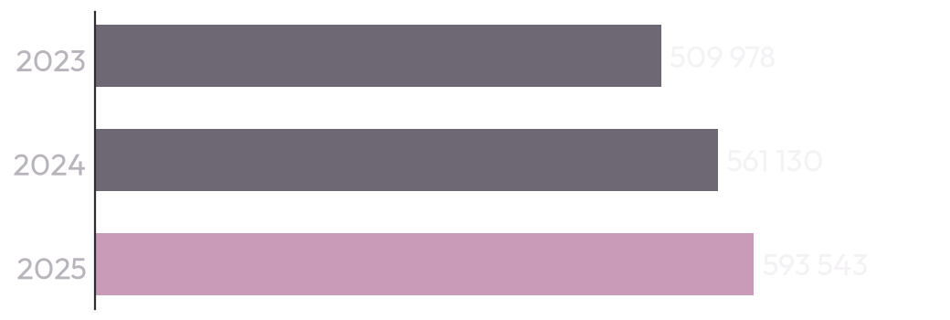
Free for learners, paid for by those who gain
23 · WHO PAYS, AND WHY
R0
Sponsor a learner
R420 a year each
R35 a month, paid by companies (CSI and B-BBEE), bursary funders and SETAs. Anonymous impact reports.
for learners, always. The people who lose money when a student drops out pay instead.
Schools
R6 000 a year
Per fee-paying school, Grades 10 to 12. No-fee schools are free, sponsored.
One NSFAS-funded student costs about R80 600 a year (R47.86 billion for 593 543 students in 2025). Keep one learner in 200 from dropping out, and the sponsorship for all 200 has paid for itself.
Universities, from 2028
R250 000 a year
Per university: first-year arrival, registration check, study coach. A pilot at R100 000.
Employers, from 2029
R2 500 a month
Reach graduates who chose to share their CV (18 and over only).
R80 600 is our arithmetic on the Minister's reply to Parliament (NW874, 2026). Prices are UniversityFlow's proposal (25 Oct 2026); no payer has signed yet.

Slide 26
About R10.50 a learner a month to run
24 · WHAT IT COSTS
PER ACTIVE LEARNER, PER MONTH
FIXED, PER MONTH (YEAR 1)
AI chat: 30 replies (Claude Sonnet 5.5, cached)
R7.50
Hosting and database, Cape Town
R2 000
Reading a school report (Claude Opus 5.5)
R0.35
WhatsApp provider, monitoring, jobs, voice
R4 800
SMS: sign-in PINs and reminders
R1.20
Legal and POPIA, fact checkers
R11 000
WhatsApp: 10 utility messages
R1.20
App stores
R150
Hosting, per learner
R0.25
Team: founder and a part-time developer
R45 000
Variable cost
R10.50
Fixed cost
about R63 000
R24.50
2 600
R1.8 m
margin a month on each sponsored learner (R35 less R10.50)
sponsored learners to break even
Year 1 target: 5 000 learners (4 000 sponsored) and 20 schools, against about R1.39 m in costs
Estimates, 25 Oct 2026, at R18 to the US$. AI: Anthropic list prices with prompt caching; Haiku 5.5 for simple replies would bring the total to about R6. SMS and WhatsApp: plan §7.4. Hosting: docs/deploy/costs.md. Measured once the real AI key runs.

Slide 27
Timed to the first cohort: Grade 11 in 2026
25 · ROADMAP
NOW · OCT 2026
MAR 2027 · MVP
JUN 2027
JAN TO FEB 2028
MAR TO NOV 2028
Built
Applications open
Exams, app stores
Arrive and set up
Coach and portfolio
Phases 0 to 5 and most of 6 on stand-ins, tested and audited. The judge demo is live.
Results, applications, funding, for real learners once data, legal and accounts are in.
WhatsApp, SMS and push live before the June exams.
Offers, registration, then semester setup (Phase 6).
Study coach (Phase 7), then portfolio and career (Phase 9).
PARTNER GATES · EACH ONLY WITH A SIGNED AGREEMENT
H1 2027: apply with UniversityFlow at one university (UJ first). H2 Jan 2028: official NSC results with the DBE. H3 2028: NSFAS and bursary funders accept pre-filled applications.

Slide 28


A learner who finishes
THE DESTINATION
Our ask: help us open UniversityFlow to real learners by March 2027.
People to verify the university data (86 programmes, six universities)
A legal review of consent for under-18s (POPIA)
An SMS and WhatsApp provider
Hosting in AWS Cape Town (af-south-1) for learners' data
A first university partner, and bursary funders
UniversityFlow
From Grade 10 to graduation.
Notes:
Close on the destination: not an application sent, a learner who finishes. The ask is what stands between the built product and real learners (status.md, Blocked on).

Slide 29
Sources
APPENDIX
1. DBE, 2025 NSC Examination Report (Tables 1, 2, 2.1, 3, 6.3.8), 2026. education.gov.za
2. DBE, 2024 NSC Examination Report (Tables 1, 6.1.4, 6.3.3; Figure 2), 2025. education.gov.za
3. DBE, NSC Examination Report 2021 (Tables 2, 6.2.1, 6.3.9), 2022. education.gov.za
4. DHET, 2000 to 2019 First Time Entering Undergraduate Cohort Studies for Public HEIs, 22 Feb 2022, Table 28. dhet.gov.za
5. Minister of Higher Education, written reply to question NW874 (NSFAS funding 2023 to 2025), 2026. pmg.org.za/committee-question/37471
6. NSFAS household income criteria, as published by Rhodes University (ru.ac.za/registrar/nsfas); NSFAS's own site could not be reached
7. Stats SA, Quarterly Labour Force Survey Q2 2026, media release and presentation, 11 Aug 2026. statssa.gov.za
8. UniversityFlow plan (planning.md §0, §1, §2, §7, §10, §11, §19) and status (status.md, 24 Oct 2026), in the repository
9. Built behaviour: packages/messaging (cadence.ts), packages/agent (crisis.ts, charter.ts, system-prompt.ts), packages/content (messages.ts)
10. Screens: the live judge demo, universityflow.tumoolo.tech, made-up learners, captured 25 Oct 2026
11. Costs: Anthropic list prices (Oct 2026); docs/deploy/costs.md (hosting, checked 23 Oct 2026); plan §7.4 (SMS, WhatsApp). Estimates at R18 to the US dollar
12. Full list with exact URLs, numbers and image credits: pitch/README.md

