Slide 1
INTERMEDIATE(MPC)
2 YEARS

Slide 2
WHAT NEXT..?
MPC
Engineering
Architecture
Degree
Charted Accountant
Teaching
B.Ed
D.Ed

Slide 3
ENGINEERING
ADMISSION :-
The most popular exams include JEE Main, JEE Advanced, BITSAT, VITEEE, WBJEE and state wise CET’s and JEE’s.
Majority of subjects mathematics , physics and chemistry.
Fill out application form.
Once results are out ,eligible students will be called for counselling sessions. During counselling , students will be able to choose the college and branch of their choice.
Completion of admission process includes fee payments , undertaking form etc..,

Slide 4
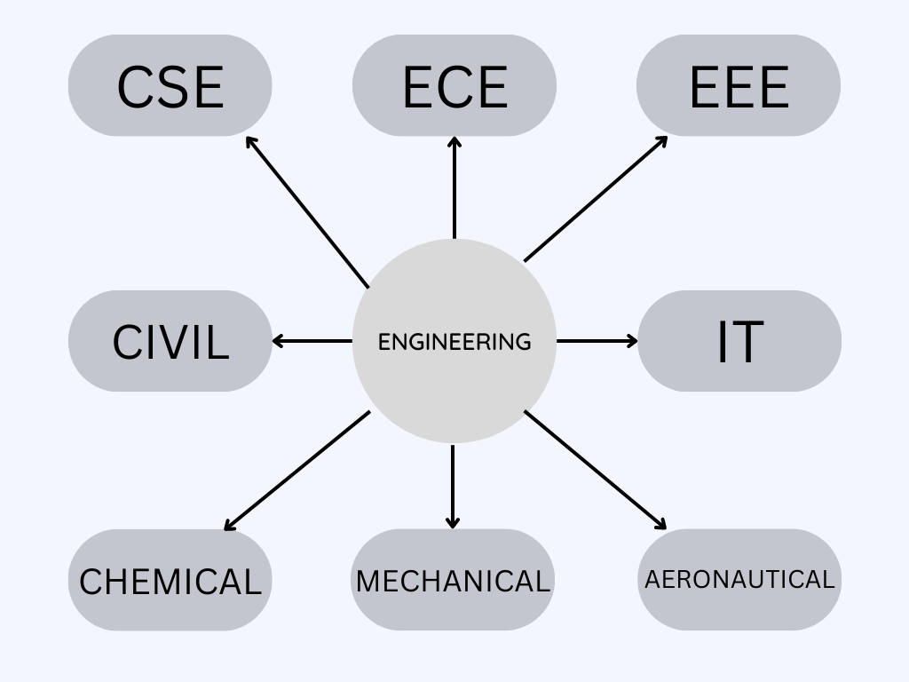
MAJOR ENGINEERING STREAMS

Slide 5
MAJOR JOBS IN RESPECTIVE BRANCHES
CSE & IT
Software Developer
Data Scientist
Cyber security Specialist
Artificial Intelligence Engineer
System Administrator
Network Engineer
Web Developer
Database Administrator
MECHANICAL
Design Engineer
Manufacturing Engineer
Research and Development Engineer
Project Engineer
Quality Control Engineer
Sales Engineer
Technical Writer
Energy Engineer
CIVIL
Structural Engineer
Construction Manager
Urban Planner
Environmental Engineer
Geotechnical Engineer
Water Resource Engineer
Transportation Engineer
Project Manager
AERONAUTICS
Aerospace Engineer
Avionics Engineer
Aircraft Maintenance Engineer
Flight Test Engineer
Manufacturing Engineer
Project Manager
Researcher

Slide 6
ECE
Telecommunications Engineer
Embedded Systems Engineer
Electronic Design Automation (EDA) Engineer
Control Systems Engineer
Power Electronics Engineer
Signal Processing Engineer
Robotics Engineer
IoT Engineer
EEE
Power Systems Engineer
Telecommunications Engineer
Automation and Control Engineer
Renewable Energy Engineer
Electrical Design Engineer
Power Electronics Engineer
Instrumentation and Control Engineer
Research and Development Engineer
CHEMICAL
Process Engineer
Plant Engineer
Chemical Researcher
Environmental Engineer
Energy Engineer
Quality Control Engineer
Technical Sales Engineer
Project Engineer

Slide 7
ARCHITECTURE
Entrance Exam:
In India, you may required to take national-level entrance exams, such as the National Aptitude Test in Architecture (NATA) or the Joint Entrance Examination (JEE).
Application Process:
Once students have met the educational requirements and completed the necessary entrance exams, they can apply to the architecture program of their choice. The application process typically includes submitting an application form, transcripts, test scores, and other supporting documents.

Slide 8
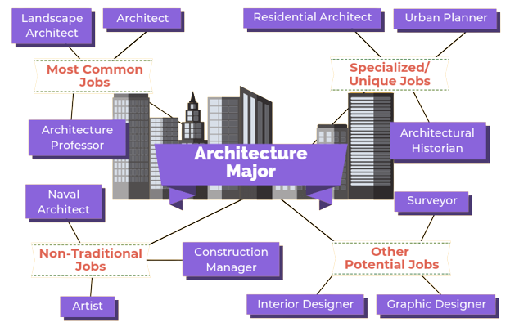
Career out of architecture

Slide 9
b.Ed and d.ed admission
Eligibility : Includes minimum marks required in the qualifying examination, age limit, and other criteria.
Application Form: The candidate needs to fill the application form for the desired program. This can be done online or offline, depending on the institution's policy.
Entrance Test: Some colleges may require the candidate to take an entrance test as part of the admission process. The entrance test could be conducted online or offline, and it may test the candidate's aptitude, knowledge, and skills in the relevant subjects.
Merit List: After the entrance test (if applicable), the university or college will prepare a merit list based on the candidate's performance in the qualifying examination and/or entrance test. Candidates who meet the cut-off score will be eligible for admission.
Counseling: The candidates who have qualified for admission will be called for counseling. During counseling, the candidates will be able to choose the program and college of their choice based on the availability of seats
Admission: Once the candidate has been allotted a seat, they will need to complete the admission process by submitting the required documents and paying the admission fee.

Slide 10
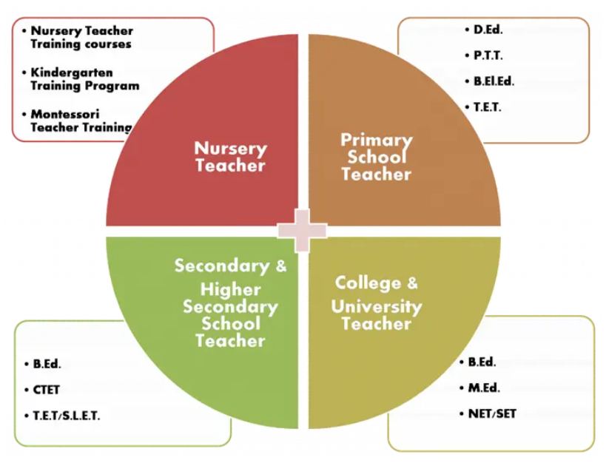
Next step in teaching

Slide 11
Degree courses
Bachelor of Science (B.Sc.):
You can opt for a B.Sc. degree in Mathematics, Physics, Chemistry, or Computer Science, depending on your interest{Higher edu. M.SC}.
Bachelor of Commerce (B.Com):
If you are interested in commerce and finance, you can opt for a B.Com degree{Higher edu. M.Com}
Bachelor of Business Administration (BBA):
You can consider a BBA degree if you are interested in management and business administration{Higher edu. MBA}

Slide 12
Major Career options after b.sc
Higher Education : You can pursue higher education by opting for a Master of Science (M.Sc.) degree, which can lead to research-based or academic careers in the field of science.
Research : You can work in research-oriented careers in the field of science by joining research institutes, government organizations, or private companies.
Teaching : You can opt for a career in teaching by pursuing a B.Ed. degree or other teaching qualifications. You can work as a teacher in schools or colleges or as a lecturer in universities.
Can also compete for central and state govt. jobs

Slide 13
Major Career options after b.com
Accountant
Finance Analyst
Tax Consultant
Banking and Finance
Stockbroker
Chartered Accountancy (CA)
Can compete for govt. jobs including banking

Slide 14
Major Career options after bba
Sales and Marketing
Human Resources : You can work in human resources roles in companies, government agencies, or consulting firms. Your job would involve recruiting, training, and managing employees.
Banking and Finance
Supply Chain Management : job involves managing the flow of goods and services from suppliers to customers.
Event Management
Can compete for govt. jobs including banking.

Slide 15
Road map to ca
Enroll for the CA Foundation : You can register for the course online at the ICAI website.
Meet the Eligibility Criteria: To be eligible for the CA Foundation Course, you must have completed your Intermediate (MPC) with minimum of 50% marks.
Complete the Course: The CA Foundation Course consists of four papers(Accounting, Economics, Business Laws, Business Mathematics)and you must pass all of them to qualify for the next level
Register for the CA Intermediate Course: Once you have cleared the CA Foundation Course, you can register for the CA Intermediate Course. This course consists of two groups, and you must pass both of them to qualify for the next level.
Complete Articleship Training: After clearing the CA Intermediate Course, you must complete a three-year Articleship Training under a practicing CA. During this period, you will gain practical experience in v

Slide 16
Clear the CA Final Exam : The final step towards becoming a CA is to clear the CA Final Exam, which is conducted by the ICAI. The exam consists of two groups, and you must pass both of them to become a Chartered Accountant.

Slide 17
Major career options after ca
Practice as a Chartered Accountant : you can start your own CA firm and provide accounting, taxation, and other financial services to clients.
Accounting and Finance : You can work in various roles in accounting and finance departments of companies, such as Chief Financial Officer, Finance Manager, or Internal Auditor.
Investment Banking : Investment Banker, Equity Analyst, or Venture Capitalist. job involves advising clients on investments, and fundraising.
Consulting : Financial Consultant, Tax Consultant, or Management Consultant. involves providing advice to clients on financial and business-related matters.
Government Jobs : Income Tax Officer, Sales Tax Officer, or Deputy Comptroller and Auditor General (CAG).
Academia and Research : You can pursue a career in academia and research by taking up teaching roles in universities or research institutions

Slide 18
THANK you

