Slide 1
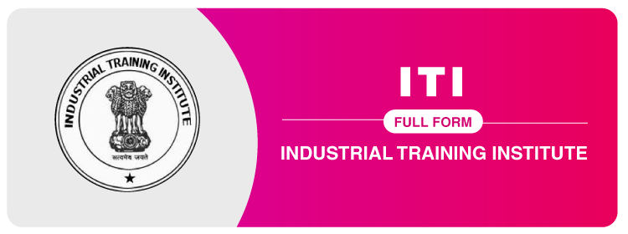
ITI
INDUSTRIAL TRAINING INSTITUTE

Slide 2
Eligibility
Admission
Trades
Jobs, Salary
Career options

Slide 3


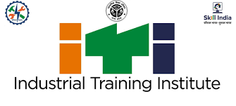

About ITI
Industrial Training Institute.
Established in 1950 under the Craftsmen Training Scheme.
Essential to country’s economic growth.
Currently, they operate under the Directorate General of Training (DGT), Ministry of Skill Development and Entrepreneurship(MSDE), Government of India.

Slide 4
Disadvantages:
Limited Career Options
Benefits:
Easy employment
Early job settlement
Advantages:
Practical knowledge
Allows us to become more productive
Course Duration:
Depends on the trade chosen(6 or 12 or 24 months)

Slide 5
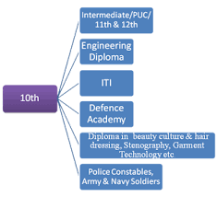
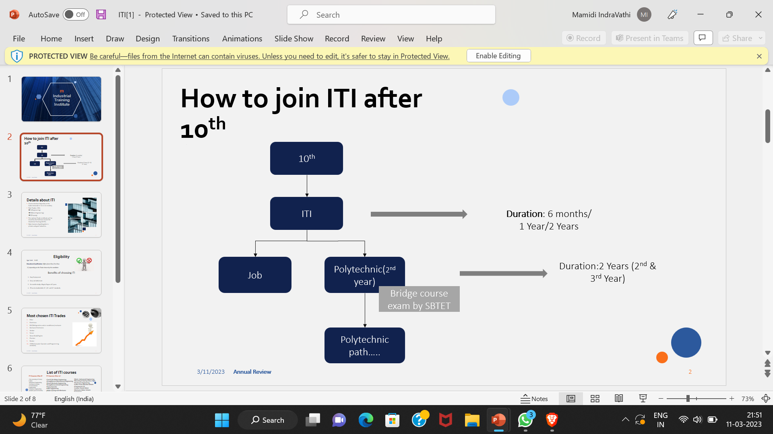
After 10th
If you opt for ITI
ITI

Slide 6
Eligibilities
Age Limit : 14-40 years
Educational Qualification : Differs from Class 8 to Class 12
depending on the Trade chosen
by the candidate.
Can be studied after 8th , 10th and 12th grades.

Slide 7
Admission
Exam Name | ITI Entrance Exam
Exam conducting body | Respective State Boards of Technical Education
Purpose of Exam | Admission to ITI Courses
Mode of Payment and Application fees | Offline and Online 250₹
The online/offline Application process begins | May/June /July
Application process Ends | May/June/July
Admission process | June/ July/ August
Commencement of Course | August

Slide 8

Top 10 ITI Courses in India
Fitter
Electrician
RAC(Refrigeration and air conditioner) mechanic
Mechanic Electronics
Welder
Turner
Steno Hindi/English
Plumber
Painter
COPA(Computer Operator and Programming assistant)

Slide 9
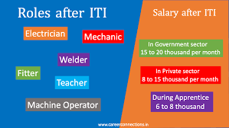
Jobs/Salary

Slide 10

Diploma Courses
Specialized Short term Courses
All India Trade Test
Job in public and private sector
Self Employment
Job in Foreign Countries

