Slide 1
PARAMEDICAL

Slide 2
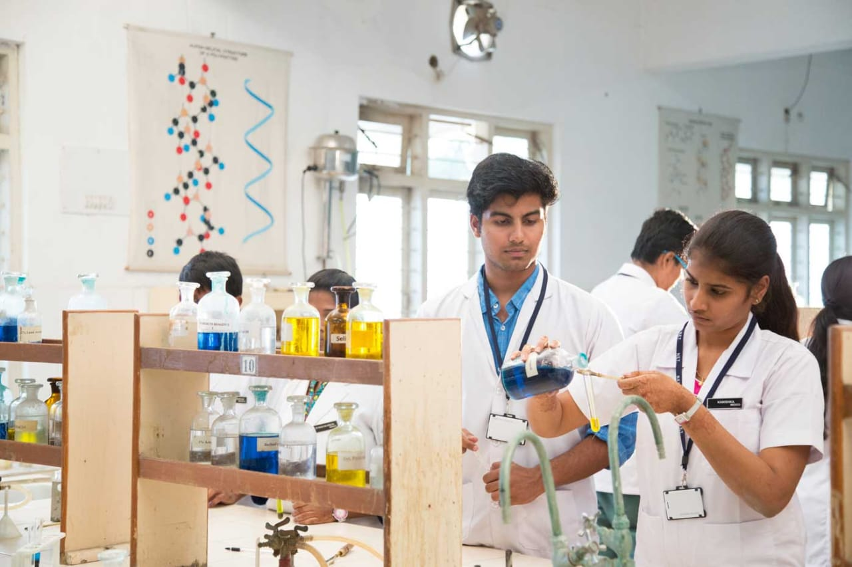
Flowchart
10th class
Intermediate
(BiPC)
Paramedical

Slide 3
PROCESS
Register for B.Sc Exams in EAMCET
Attempt the exam
Rank card
Attend counselling
Select collage and branch in wedoptions
Report to allotted collage
Select your prefered course

Slide 4
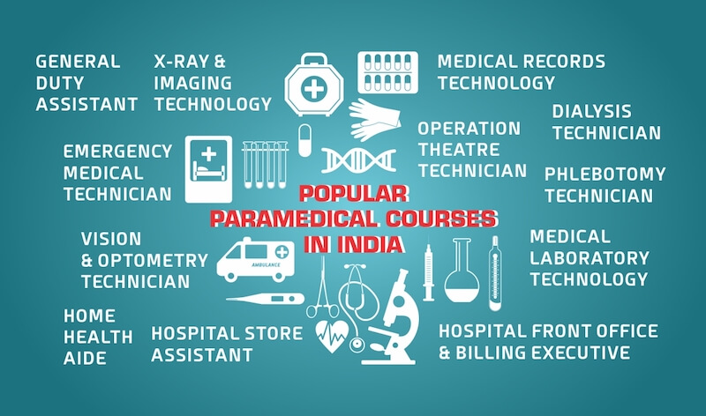
Courses

Slide 5
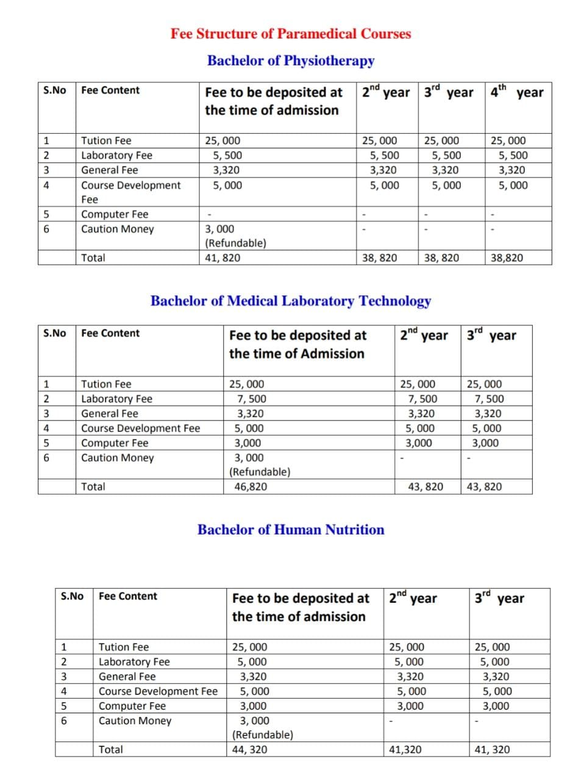
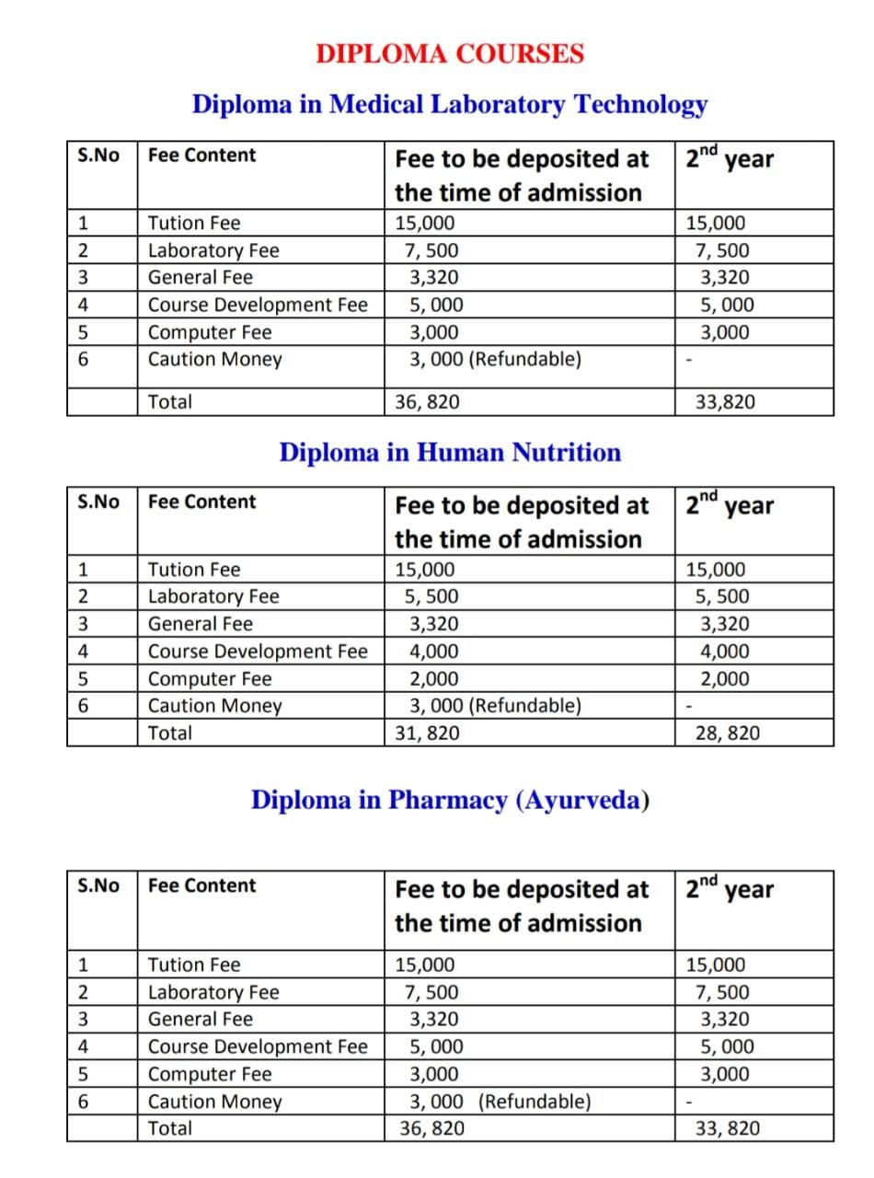
FEE STRUCTURE

Slide 6

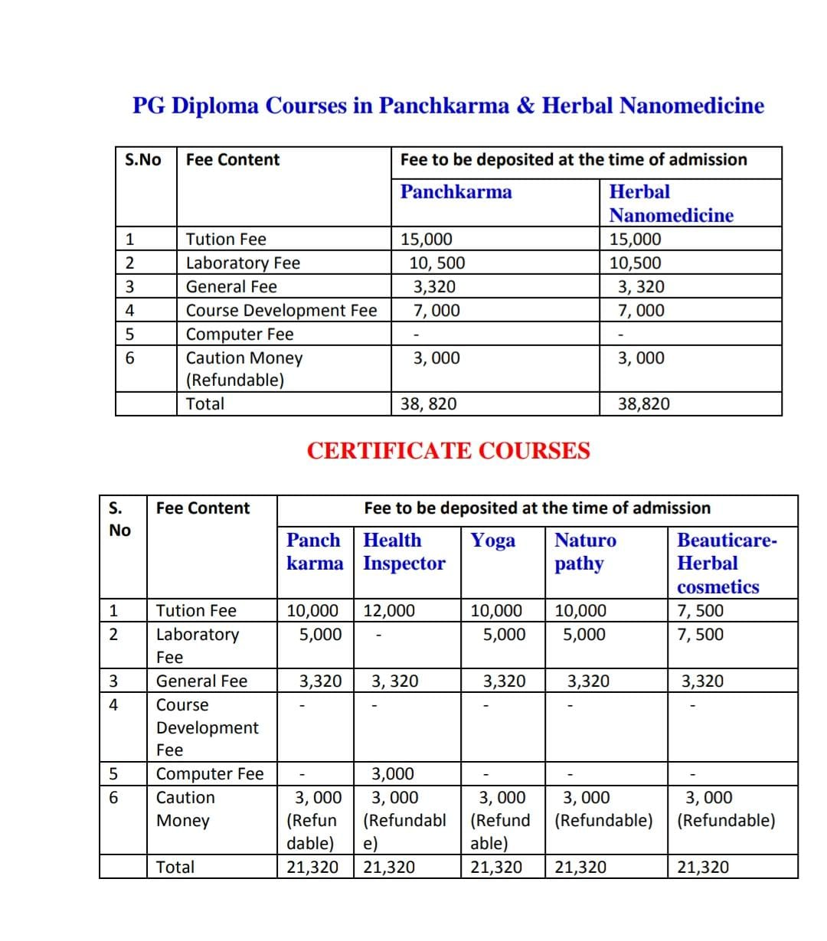

Slide 7
Some skills needed for being a paramedic
Discipline
Leadership
Communication
Interpersonal Skills
Patience
Teamwork
Mental Toughness
Strong Stomach
Physical Fitness

Slide 8
Some of the best colleges for studying
GITAM College, Vishakapatnam – INR 4.25 LPA
Jagannath University, Jaipur – INR 43,000 to 1 LPA
Jagannath Institute of Management Sciences – INR 22,500 to 1.5 LPA
Centurion University – INR 50,000 to 2.5 LPA

Slide 9
Top Paramedic Courses in India
Bachelor of Occupational Therapy (UG) – INR 4 Lacs
B.SC Nursing (UG) – INR 1 Lac to 2 Lacs
Diploma in Rural Health Card (after 10th) – INR 2 Lacs
Diploma in Medical Record Technology (after 10th) – INR 2 Lacs
Master of Physiotherapy (PG) – INR 30,000 to 5 Lacs
Post Graduate Diploma in Anasthesiology(PG) – INR 10,000 to 10 Lacs

Slide 10
Jobs Paramedics can participate as
ENT Specialist
Specialization in Anasthesia
Technician for machines like the EMT, X-Rays etc.
Maintaining a medical shop
Physiotherapist
Pathologist
Emergency Services

Slide 11
Thank you

