Slide 1
POLYTECHNIC
(3 YEARS)
Notes:
When listing all project collaborators, either use commas or bullets

Slide 2
Map of polytechnic
10th
Polytechnic
JOB
B.TECH
POLYCET
INTERVIEWS
ECET
Notes:
Insert a map of your colony (draw it, ink it, or create it in PPT- be creative!)
Insert -> Pictures for photos
Draw for digital inking
Insert -> Shapes if you want to create it in PPT
All mountains, towns/villages, bodies of water/waterways, landmarks, etc. should be clearly labeled

Slide 3
Polycet process
Register for polycet
Attempt exam
Download rank card
Report to allotted college
Attend councelling
Select college and branch in web options
Download allotment order

Slide 4
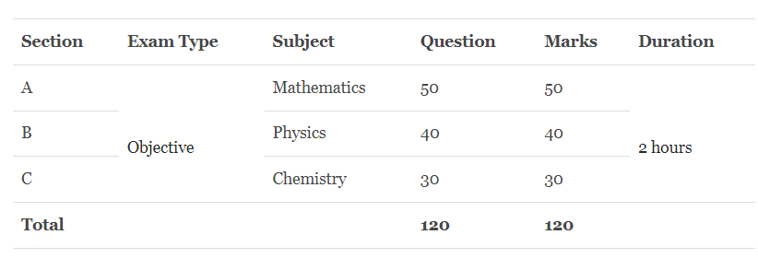
POLYCET
Notes:
Think about the questions listed above and answer them.
Can you think of anything else in regards to economy and trade that you would like to add?

Slide 5
Imp Dates:
Last date to apply :April 30
AP POLYCET exam date: May 10
Website: polycetap.nic.in

Slide 6
Some References
Syllabus is similar to 10th class syllabus
APPOLYCET-2022 Booklet
Mathematics for polycet
Physics for polycet
Chemistry for polycet
Note: click on the names to watch Maths , physics, chemistry youtube playlists

Slide 7
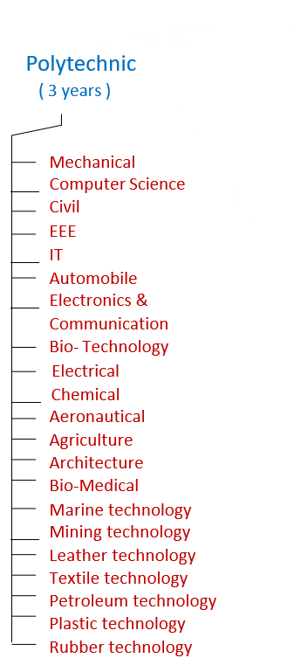

Branches
Notes:
What is the name of your colony song?
Write lyrics to the song and, if you are feeling creative, use a computer program or instruments to create the music that goes along with it!
To insert an audio file, click on Recording -> Audio -> Audio on My PC and choose your file

Slide 8
Fee structure
Rs. 25,000/- per year (Jagananna Vidya Deevena Available)
Jagananna Vasathi Deevena(scholarship) : Rs.15,000/- per year

Slide 9
C-20 structure.
1
3
4
YEAR
English
Maths - I
Physics
Chemistry
Engineering Drawing
Branch subjects-2
Labs -4
SEM
SEM
Maths - II
Branch Subjects – 4
Labs - 4
Maths - III
Branch Subjects – 4
Labs - 4
5
6
SEM
SEM
Branch Subjects – 5
Labs - 4
Industrial Training.
Notes:
What are the rules and laws of your colony? Think about what helps the colonists stay safe and maintain a healthy, happy colony.
In each shape…
Name the rule/law
Describe why it’s important for the colony/colonists
Explain the consequences for not following this rule/law
To add more shapes, click on the last shape, then on SmartArt Tools -> Design -> Add Shape After

Slide 10
JOB
Need to learn :
Aptitude
Technical

Slide 11
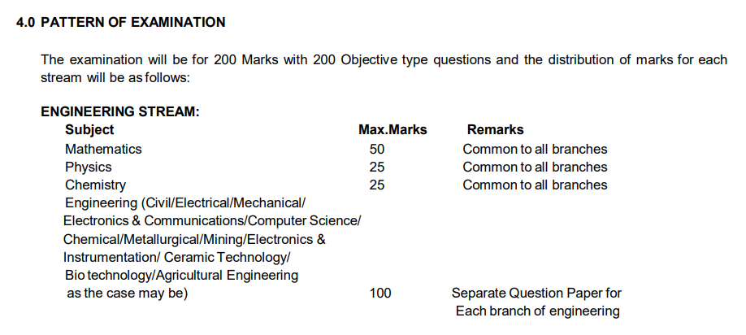
ECET (B.tech)

Slide 12
Top 5 gov jobs
S.No | Job | Salary (Rs.) | Branches
1. | RRB Assistant Loco Pilot | 35,000 | Mech, Electrical , Electronics ,Automobile
2. | PSU jobs | 16,400-50,500 | All
3. | Indian railway junior engineer | 40,000 | Mech ,Electrical, Civil, CSE, Instrumentation, Automobiles
4. | DRDO | 40,000 | Mechanical , Electronics
5. | SSC junior Engineer | 44,000 | Mech ,Civil ,Electrical

Slide 13
Thank you

