Slide 1
Mutual Fund Analytics Capstone Project
Tumul Singh
NIT Kurukshetra

Slide 2
Problem Statement & Objectives
Analyze mutual fund industry trends, fund performance, investor behavior, portfolio composition, and benchmark performance.

Slide 3
Dataset Overview
10 datasets: Fund Master, NAV History, AUM, SIP, Category Inflows, Folios, Scheme Performance, Investor Transactions, Portfolio Holdings, Benchmark Indices.

Slide 4
Project Architecture
Raw Data → Cleaning → SQLite → Python Analytics → Power BI Dashboard → Insights

Slide 5
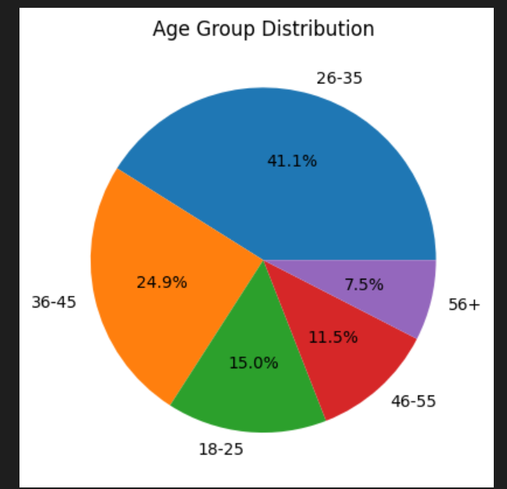
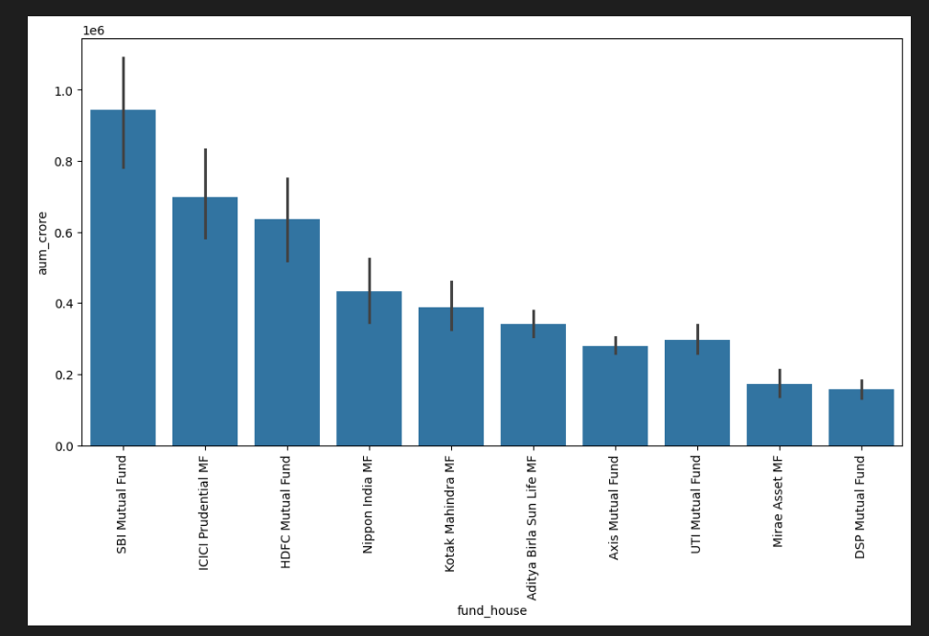
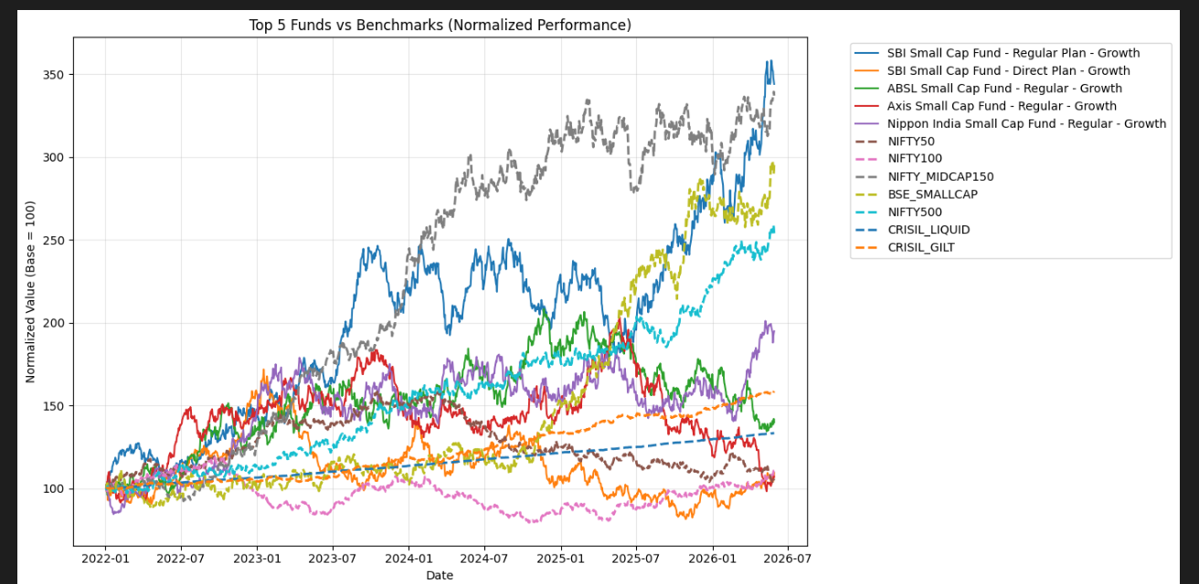
EDA Highlights

Slide 6
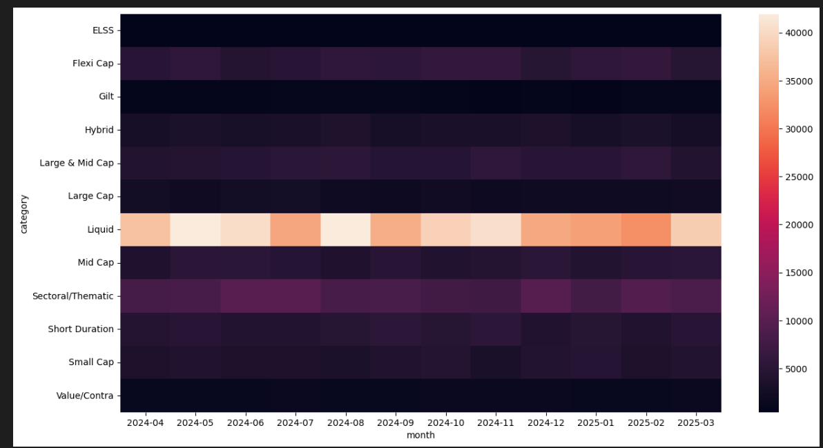
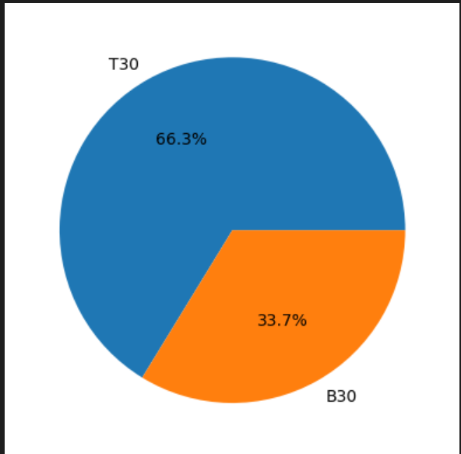
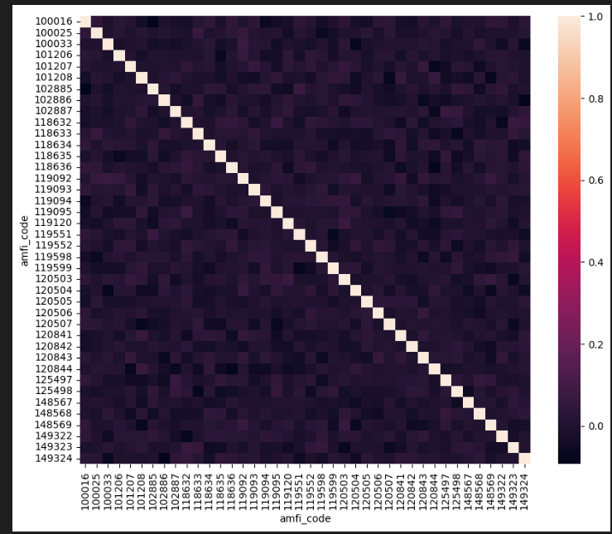
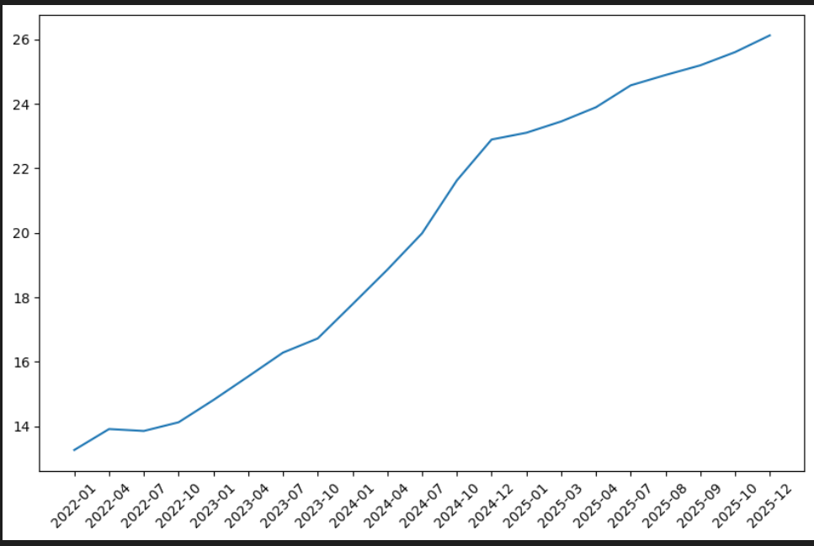

Slide 7
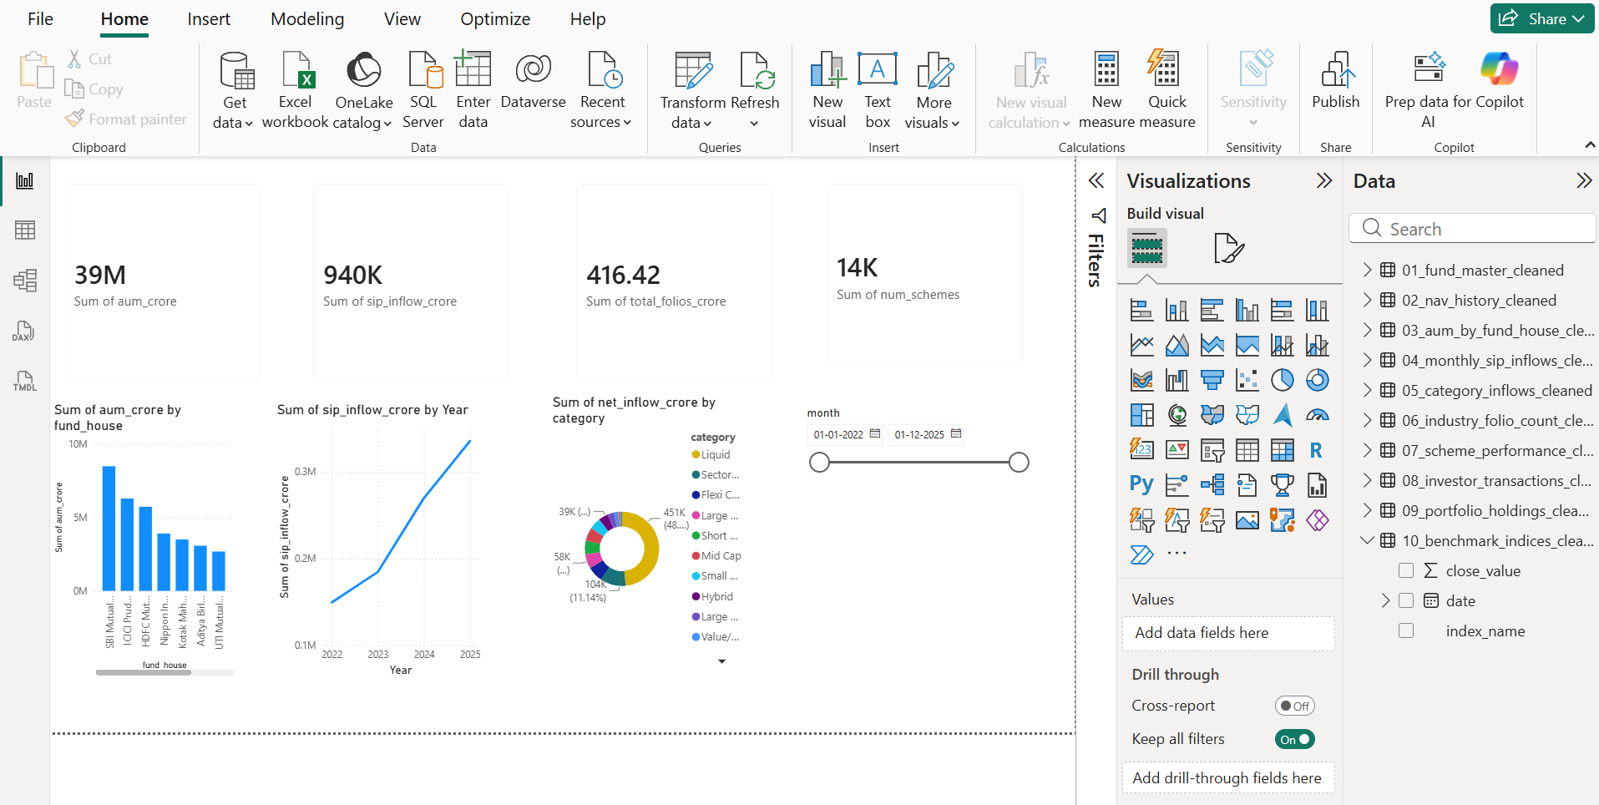
Industry Overview Dashboard
INDUSTRY_ANALYSIS

Slide 8
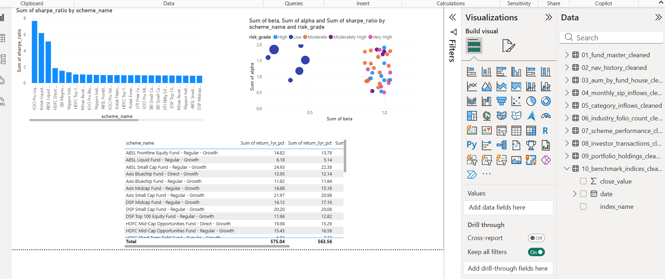
Fund Performance Dashboard
FUND_ANALYSIS

Slide 9
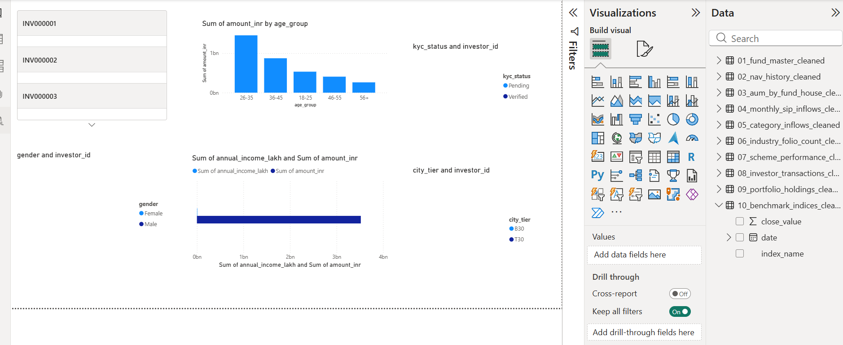
Investor Analysis Dashboard
INVESTOR_ANALYSIS

Slide 10
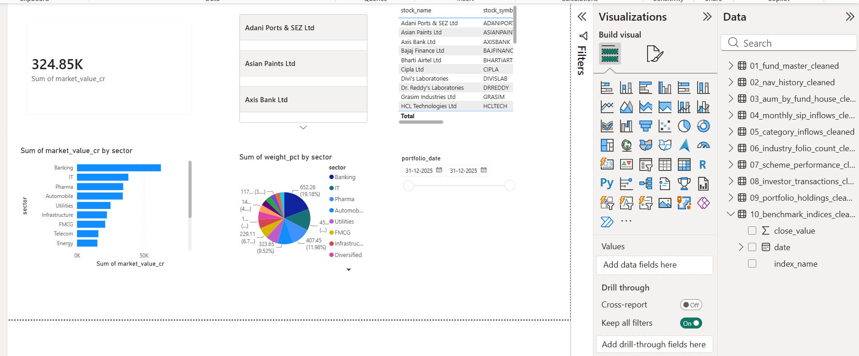
Portfolio Holdings Dashboard
MUTUAL_FUND_ANALYSIS

Slide 11
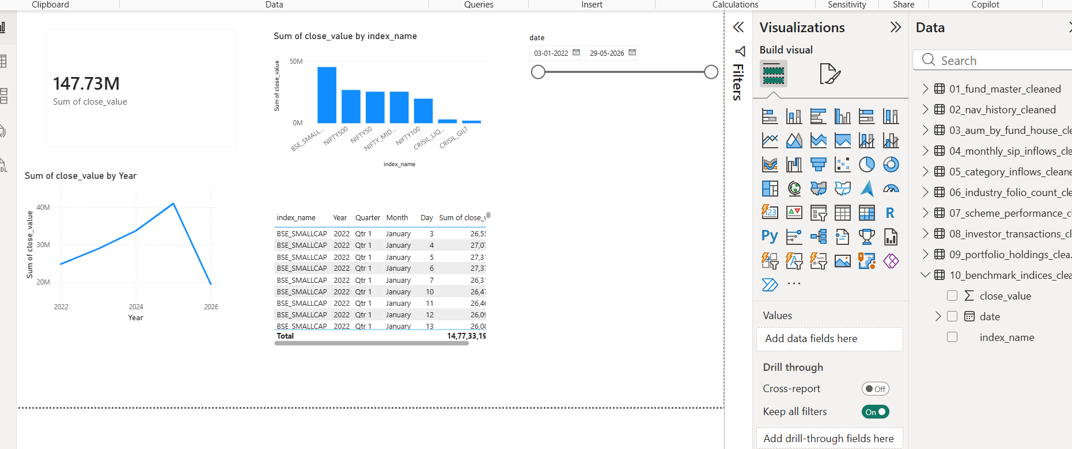
Benchmark Analysis Dashboard
BENCH_MARK

Slide 12
Key Findings & Conclusion
Industry growth, rising SIP adoption, useful dashboard insights.
Thank You.

