Slide 1
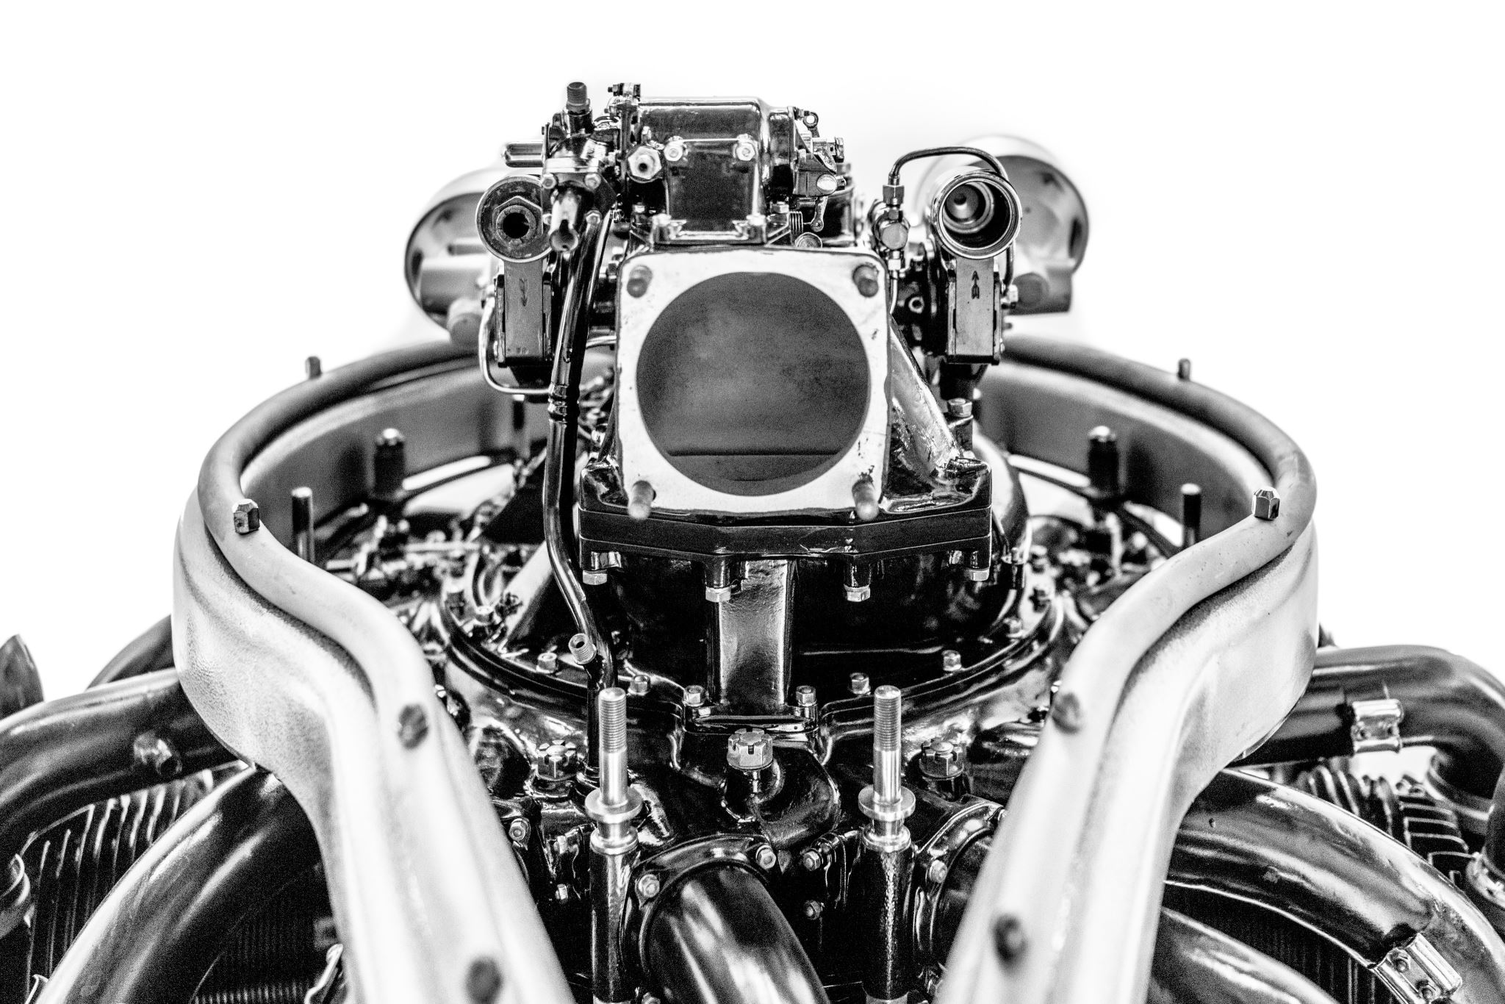
INNOVISTA
Performance Analysis and Comparative Study
Group-2

Slide 2

Classification Problem
There are 3 types of datasets that are given and the task is to predict classes based on the values we input
B-type and C-type datasets have 2 classes and O-type has 10 classes
For the B-type we should be able to input a number and get the correct class
For the c-type we should be able to input a vector of any length and get the correct class for each element in the vector
For O-type we need to input a vector that contains 8 numbers and get the correct class for the vector

Slide 3
Parameters considered to find the Perfect solution
Our first phase of testing was based just upon the "Accuracy of the model"
Based on Accuracy alone we narrowed our option to Nebula and Mckintel
We took into account parameters like ease of use, errors and editing required to use the code
Finally, after in-depth testing we found Nebula to be the most optimal solution, from the options available in the market.

Slide 4

The Nebula Classifier
For B and C Type Classifiers
The Nebula classifier works by using the Euclidean Distance between the mean of two groups and input values
For O Classifier
The classifier use a FOR loop to iterate over the rows and then they find the difference between the input value and current row. It keeps going until the difference is 0 and classifies it according the row it stops at

Slide 5
Strengths
High Accuracy of the model
The Code was cleanly written
Good Responsiveness
Weaknesses
The code is not user-friendly
It requires user to have a strong understanding of R to operate
The code didn't have any built-in features to test accuracy
For O classifier the run time is too high

Slide 6

Overview and Key Features of Innovista
The Innovista classifier is a user-friendly tool that simplifies the process of classifying user input using UI-based menus and algorithms. It is designed for individuals with minimal R code knowledge.
UI-based menus for easy navigation and input
01
Error handling for NAs and strings in input
03
Automatic results storage in the global environment
04
Automatic algorithm selection based on dataset structure
02

Slide 7
Setup and selection
The function is called without parameters or variable assignment. It checks for required packages and prompts for installation if necessary.
The classifier prompts the user to select a dataset from a list of matching files in the current directory. If the desired dataset is not listed, the user can select "other" and input the file name manually.

Slide 8

Classifiers:
B Type Classification
For B type datasets, the classifier uses KNN to predict the class of the input value(s). It provides a message with the results and stores them in a data frame in the global environment.
C Type Classification
For C type datasets, the classifier uses KNN to predict the class of the input value(s). It provides a message with the results, stores them in a data frame in the global environment, and creates graphs.
O Type Classification
For O type datasets, the classifier uses multinomial logistic regression to predict the class of the input based on the 8 feature values provided. It provides a message with the results and stores them in the global environment.
Error Handling
The classifier checks for NAs and strings in the input and issues an error message if any are found, listing the index of the error. This allows the user to easily identify and rectify the issue.

Slide 9
K-Nearest Neighbors (KNN) in Innovista Classifier KNN is like your classifier asking similar inputs for advice on classifying a new input.
Content:
R- code uses KNN to predict a class based on the majority class of its nearest neighbors.
If most similar inputs have a certain class, your classifier predicts that class for the new input.
Real-Life Analogy:
Imagine you're deciding what movie to watch, and you ask your friends who have similar tastes. If most of them like action movies, you'd likely enjoy an action movie too.
Application in Innovista:
KNN is utilized when deciding the class of an input based on its similarity to others in the dataset.

Slide 10
Multinomial Logistic Regression in Innovista Classifier Multinomial Logistic Regression is like assigning weights to different factors (features) to predict the class of an input.
Content:
code applies Multinomial Logistic Regression for datasets with eight features to predict the class based on these features.
Real-Life Analogy:
Consider predicting the genre of a movie based on various factors like its rating, actors, and director. If highly-rated movies often fall into the drama genre, a new highly-rated movie is likely a drama.
Application in Innovista:
Multinomial Logistic Regression is used when predicting the class of an input based on its features in the eight-feature datasets.

Slide 11
Comparison Among different companies: B-classifier
Team 4 (Nebula):
Utilizes a weighted approach with Euclidean distance, providing a nuanced classification.
Clarity and readability are good.
Addresses overlap cases.
Team 1 (Mckintel):
Straightforward threshold-based classification.
Clarity and readability are decent.
Lacks complexity compared to Team 2.
Team 5 (Warriers):
Uses a simple for loop for classification.
Clarity is moderate.
Teams 6 (a3mos) and 3 (Project_Classification):
Similar approach to Team 3.
Basic threshold-based classification.
Clarity is decent.

Slide 12
C-classifier
Team 1 (Mckintel):
Utilizes two files for classification based on different criteria.
Clarity and readability are good.
Teams 4 (Nebula), 5 (Warriers)
Both teams use a straightforward mean-based classification.
Clarity is decent.
Teams 6 (a3mos) and 3 (Project_Classification):
Similar to Teams 2 and 3 but slightly less clear.
Lacks detailed explanation for the approach.

Slide 13
O-classifier
Team 1 (Mckintel):
Uses dplyr for clear data manipulation.
Clarity and readability are good.
Teams 4 (Nebula), 5 (Warriers), and 3 (Project_Classification):
Similar approaches with Euclidean distance.
Clarity is decent.
Team 6 (a3mos):
Similar to Teams 2 and 3 but slightly less clear.
Lacks detailed explanation for the approach.

Slide 14
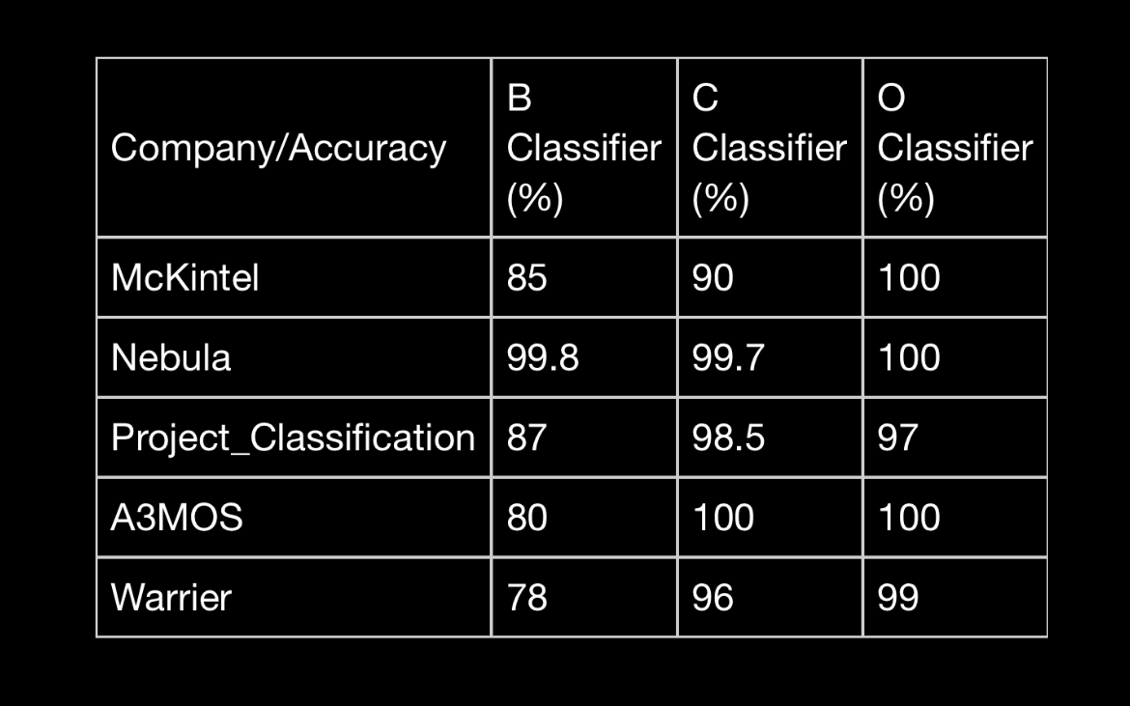
Accuracy comparison for different companies

Slide 15
Overall Rankings
Team 4 (Nebula):
Innovative approach in the B Classifier.
Clarity and efficiency are commendable.
Team 1 (Mckintel):
Good overall performance in all classifiers.
Clarity and readability are strong.
Teams 5 (Warriers), 6 (a3mos), and 3 (Project_Classification):
Similar performance with minor variations.
Adequate clarity but lacking some detail.

Slide 16

Recommendations:
Teams might consider error handling and informative messages for better usability.
Consideration of edge cases, such as when a class cannot be determined, may enhance robustness.
Teams may want to optimize their code for efficiency and clarity.

Slide 17
Thank you

