Slide 1
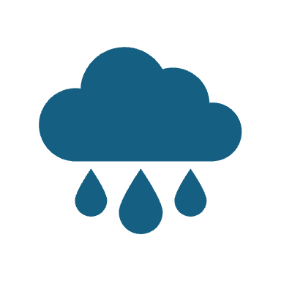
Need an Umbrella?
Arvindh Velrajan and Adrien Tolno

Slide 2
Motivation
Most don’t check weather
Through this, based on location, app can, using barometer and air pressure, predict whether there is a chance of rain or snow, hence my app name ‘Need an Umbrella?’

Slide 3
Features
Accessible to both iOS AND Android users
Uses GPS location to nofity the user of their surroundings to warn them if it was going to rain or maybe snow (This has been tested through bringing the Android device outside during rainy days)

Slide 4
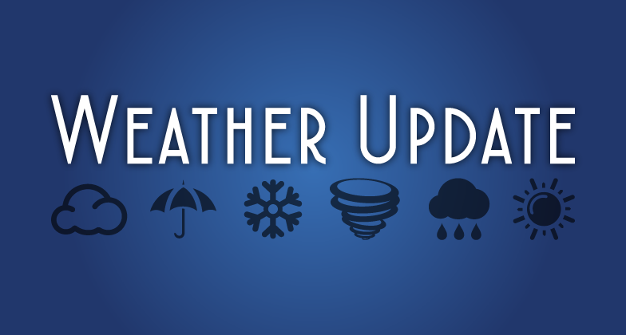
Weather Reloadable to Refresh to current location

