Slide 1
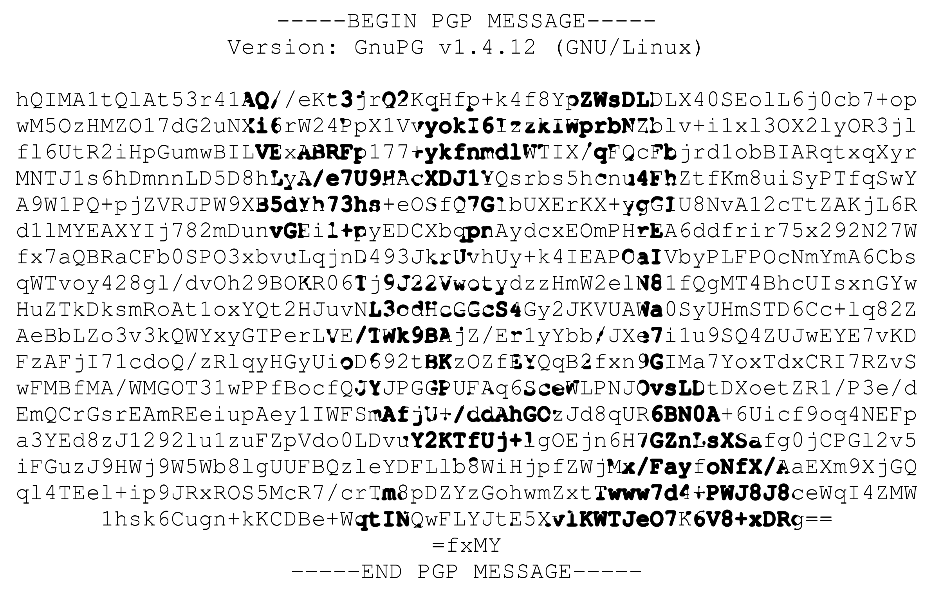
Encrypting your Internet

Slide 2

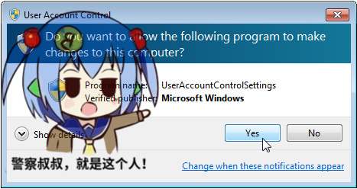


What Can Cryptography Do?
Cryptography protects your data in a mathematical way.
Modern cryptography focuses on four aspects.
  Data Confidentiality
  Data Integrity
  Authentication
  Non-repudiation

Slide 3
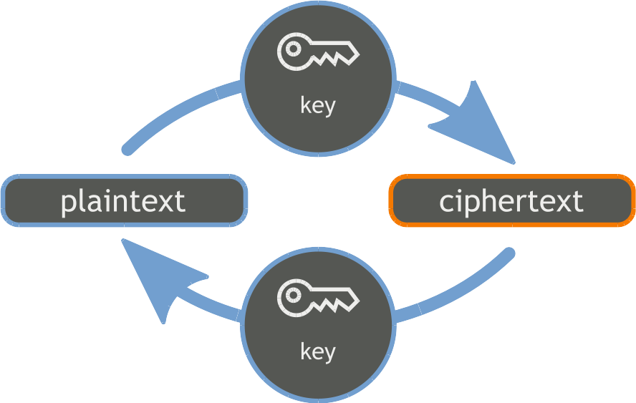
Two Types of Cryptography
Symmetric Cryptography
Asymmetric Cryptography
Shared Key / Public Key
Shared Key / Private Key

Slide 4
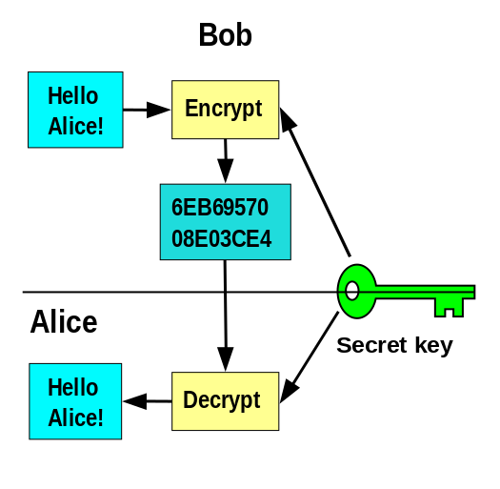
Alice in Cryptoland
It seems that Alice has tons of things to send

Slide 5
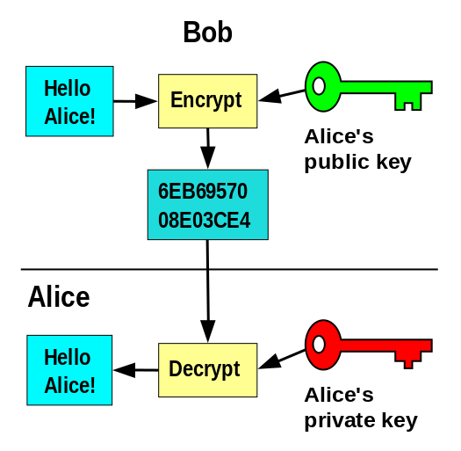
Alice in Cryptoland
It seems that Alice always wants to send a message

Slide 6
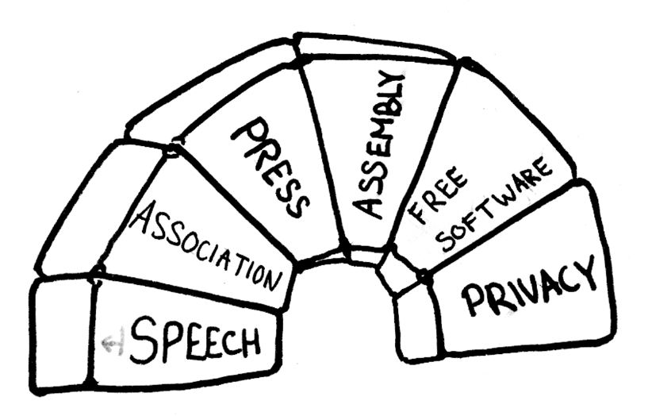
Why Cryptography?

Slide 7
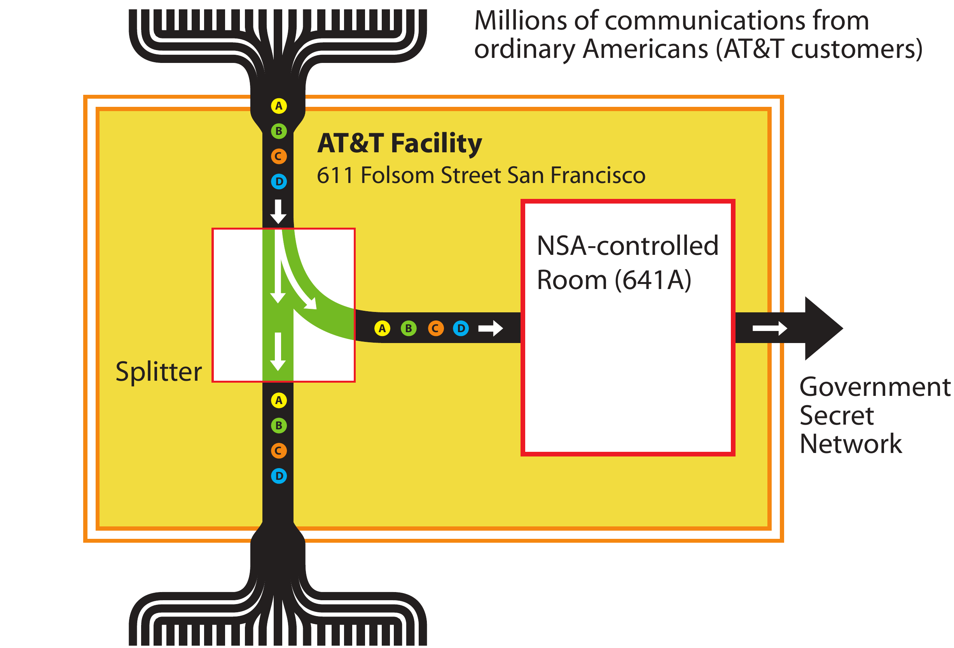
Why Cryptography?

Slide 8
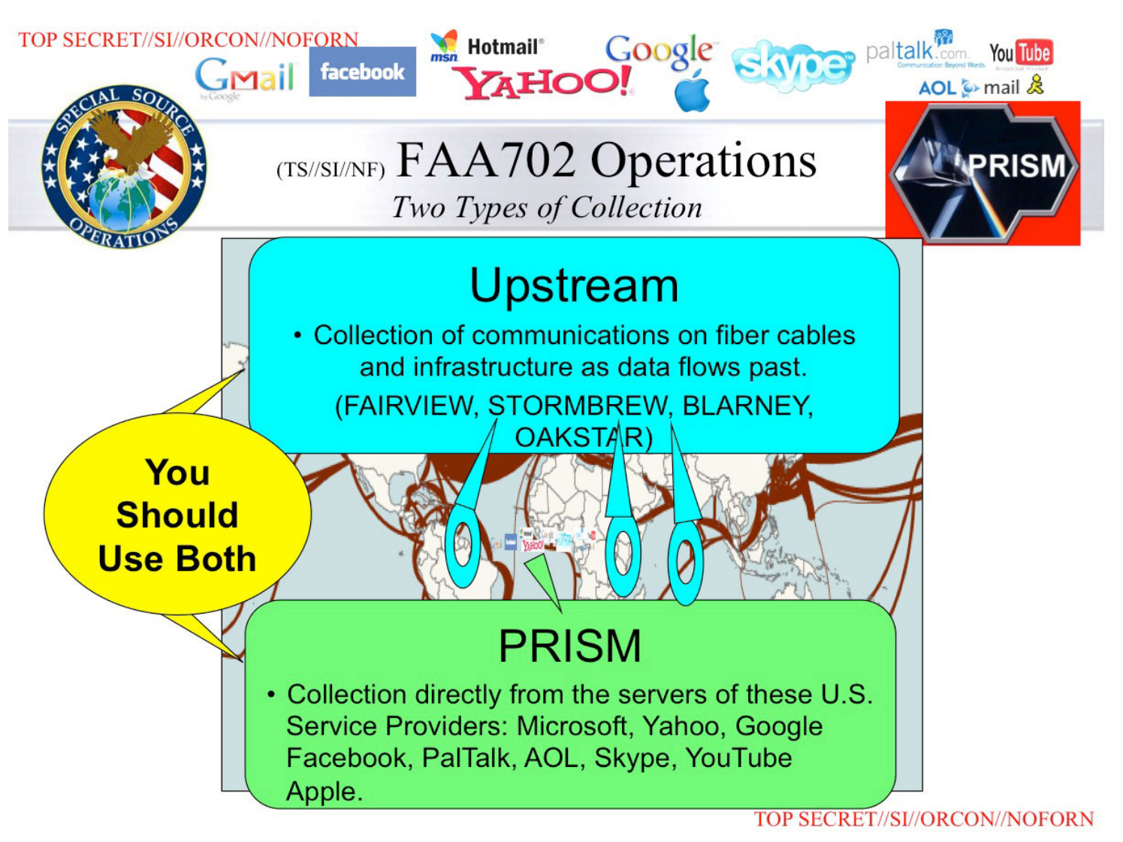
Why Cryptography?

Slide 9
Safe Algorithms?
Symmetric
  AES-128/AES-256
  ChaCha20
Asymmetric
  RSA-2048/RSA-4096
  Ed25519/Poly25519 (NIST Prime256v1 ?!)
Hash
  SHA256/SHA512
  Whirlpool

Slide 10

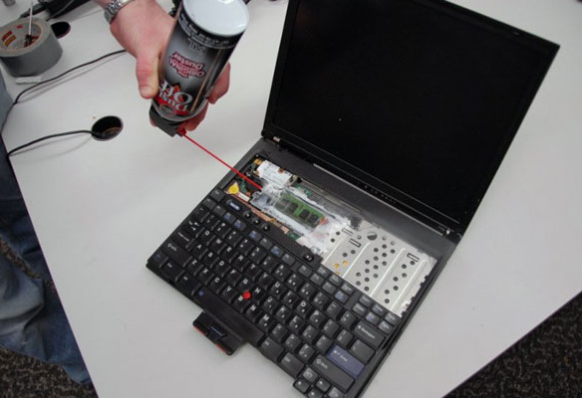
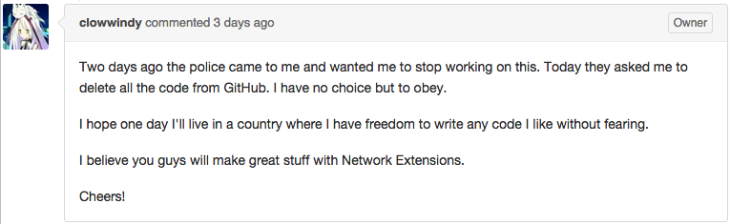
What Can't Cryptography Do?
100% Safety and Security
  Threat Model
Software Implementations
  System Security
Physical Security
Law Enforcement
  Plausible Deniability may help?
Personal Safety
if ((err = SSLHashSHA1.update(&hashCtx, &signedParams)) != 0)
goto fail;
goto fail;

Slide 11
Implementation: SSL/TLS
Secure Sockets Layer

Slide 12

Implementation: SSL/TLS
Secure Sockets Layer
Transport Layer Security
  v1.2
Enabling TLS is as easy as few lines?
  listen 10.0.0.1:443 ssl;
  ssl_protocols SSLv2 SSLv3 TLSv1 TLSv1.1 TLSv1.2;
  ssl_ciphers HIGH;
Does it really work?

Slide 13
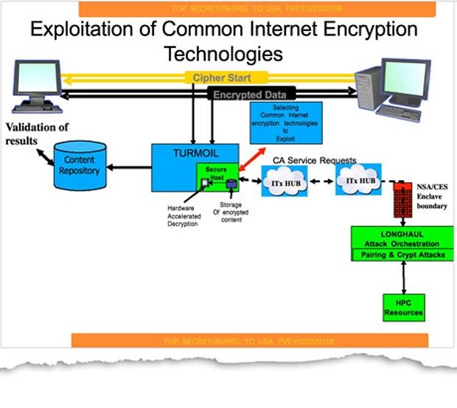
Implementation: SSL/TLS

Slide 14
Implementation: TLS
  Enabling TLS is as easy as write few lines?
    listen 10.0.0.1:443 ssl;
    ssl_protocols SSLv2 SSLv3 TLSv1 TLSv1.1 TLSv1.2;
    ssl_ciphers ECDHE-ECDSA-AES256-GCM-SHA384:ECDHE-RSA-AES256-GCM-SHA384:DHE-ECDSA-AES256-GCM-SHA384:DHE-RSA-AES256-GCM-SHA384:ECDHE-ECDSA-AES128-GCM-SHA256:ECDHE-RSA-AES128-GCM-SHA256:DHE-ECDSA-AES128-GCM-SHA256:DHE-RSA-AES128-GCM-SHA256:ECDHE-ECDSA-AES128-GCM-SHA256:ECDHE-RSA-AES128-GCM-SHA256:DHE-ECDSA-AES128-GCM-SHA256:DHE-RSA-AES128-GCM-SHA256:AES128-GCM-SHA256:ECDHE-ECDSA-AES256-SHA:ECDHE-RSA-AES256-SHA:DHE-ECDSA-AES256-SHA256:DHE-RSA-AES256-SHA256:DHE-ECDSA-AES256-SHA:DHE-RSA-AES256-SHA:!aNULL:!eNULL:!EXPORT:!DSS:!DES:!RC4:!3DES:!MD5:!PSK;
    This is my configuration.
  References:
    http://hardenedlinux.org/cryptography/2015/07/28/ss-tls-deployment-1.4.html

Slide 15
Implementation: GnuPG
A free software implementation of OpenPGP, support asymmetric and symmetric encryption.
pub rsa4096/E88E8D6D 2015-01-01
Key fingerprint = 2552 11B2 395A 5A3E 0E48 A0F1 FAD3 EB05 E88E 8D6D
uid [ultimate] Yifeng Li (Tom Li, or biergaizi) <biergaizi2009@gmail.com>
uid [ultimate] Yifeng Li (Tom Li) <biergaizi@member.fsf.org>
uid [ultimate] Yifeng Li (Tom Li) <tomli@tomli.me>
sub rsa4096/01EE20CD 2015-01-01
sub rsa4096/26DC385B 2015-01-01
Every single user generates a group of public and private keys.

Slide 16
Implementation: GnuPG
gpg
gpg: Go ahead and type your message
gpg –-send-keys / gpg –-recv-keys
gpg –-encrypt
gpg –-decrypt
gpg --sign

Slide 17
Which key is real?
Anyone can create any key with any name, if there is no way to verify whether the key belongs to its true owner…
Search results for 'stallman richard'
pub 4096R/3B811125 2014-02-25 Richard M Stallman (Join us now and share the software) <rms@gnu.org>
pub 2048R/6BAC3A66 2013-11-05 Fake Richard Stallman
pub 1024R/4BDB6AD2 2013-08-22 Richard Stallman (Big Fat Nigger Cunt) <rms@gnu.org>
pub 4096R/2A8E4C02 2013-07-20 Richard Stallman <rms@gnu.org>
pub 2048R/624E14A9 2013-04-07 Richard Joseph Stallman
pub 1024D/A925536A 2008-07-26 Richard Stallman (For Jabber) <richard.stallman@jabber.org>
pub 1024D/373D44AF 2008-07-26 Richard Stallman (Lots of flavour in an old cock) <richardstall815@gmail.com>
pub 1024D/135EA668 2001-03-05 Richard Stallman (Chief GNUisance) <rms@gnu.org>
pub 1024D/A839EC1A 2000-12-30 Richard M. Stallman (Chief GNUisance) <rms@gnu.org>

Slide 18
Trust Models
Tofu, trust on first use
  The authenticity of host '192.168.0.1 (192.168.0.1)' can't be established.
  RSA key fingerprint is SHA256:QN5tTcWTZnS012sbm03QH1BsGPniPlOZj4aFSxOJJNg.
  Are you sure you want to continue connecting (yes/no)?
PGP, Web of Trust
Trust
J. Random Hacker Trust Alice Trust Bob

Slide 19
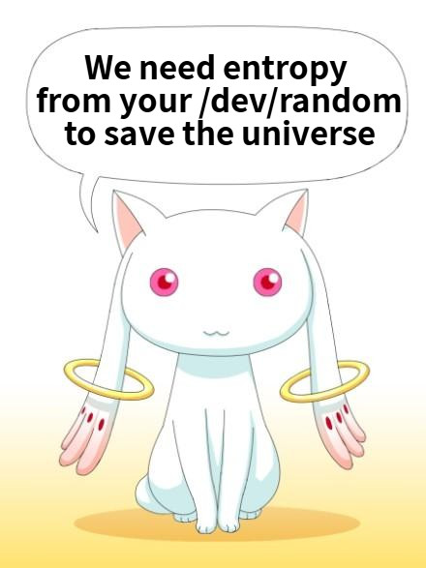
RNG & Entropy
In order to generate a random key, we need random data, that provides by RNG.
Unpredictable vs. Randomness
Seeded RNG vs. Entropy Collector
  arc4random()
    A Replacement Call for Random
  Linux /dev/random
Vulnerabilities of /dev/random
HRNG
  Quantum Mechanism

Slide 20
HTTPS Everywhere
Many sites on the web offer some limited support for encryption over HTTPS, but make it difficult to use.
For instance, they may default to unencrypted HTTP, or fill encrypted pages with links that go back to the unencrypted site.
The HTTPS Everywhere extension fixes these problems by using clever technology (regular expressions) to rewrite requests to these sites to HTTPS.
https://www.eff.org/https-everywhere

Slide 21
Thanks
while (sfdtime() >= 0) {
Question *q = question_queue_get();
for (size_t i = 0; i < ANSWERS_LEN; i++) {
if (matches(question, answers[i])) {
return answers[i];
}
}
return NULL;
}

