Slide 1

Power TUNA
汪彧之(Justin Wong)
@bigeagle_xd
i@bigeagle.me

Slide 2
What is TUNA
这是什么社团
Tsinghua University TUNA Association
Former name: 清华大学网管会
Website: http://tuna.moe/

Slide 3
Who are We?

Slide 4
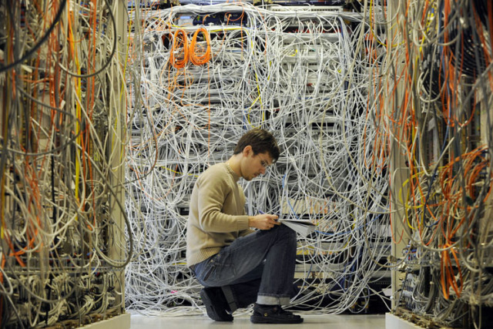
Who are We?
Network and System Administrators

Slide 5

Who are We?
Programmers & Code Monkeys

Slide 6

Who are We?
Hackers, Geeks, Nerds

Slide 7

Who are We?
Free and Open Source Supportors

Slide 8

Who are We?
Ghosts and 酱油党s

Slide 9
What do we play
我们玩什么

Slide 10
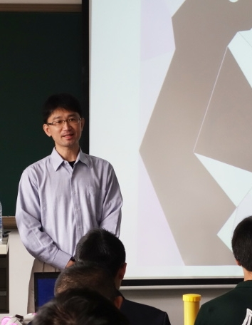
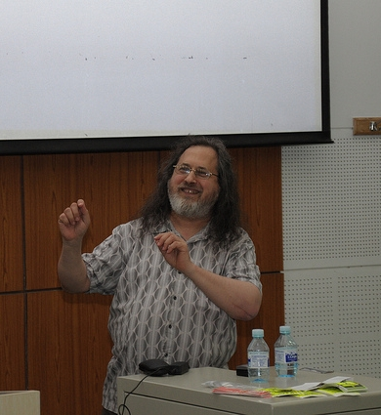
Play with Big Names

Slide 11
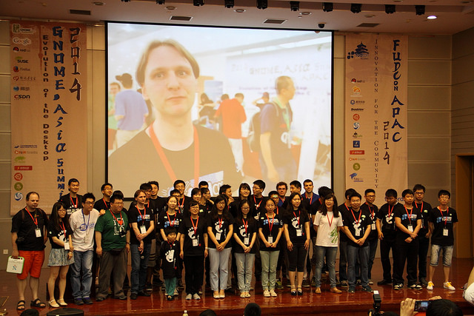
Community Events

Slide 12
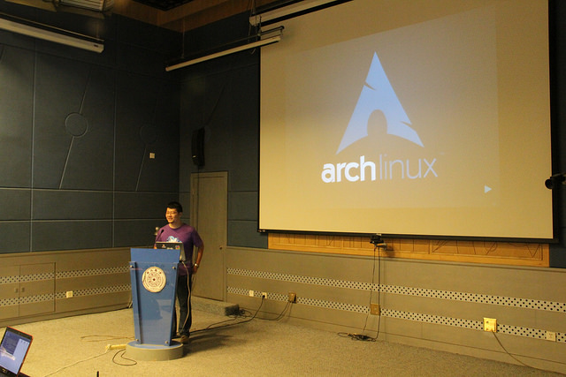
Software Freedom Day

Slide 13
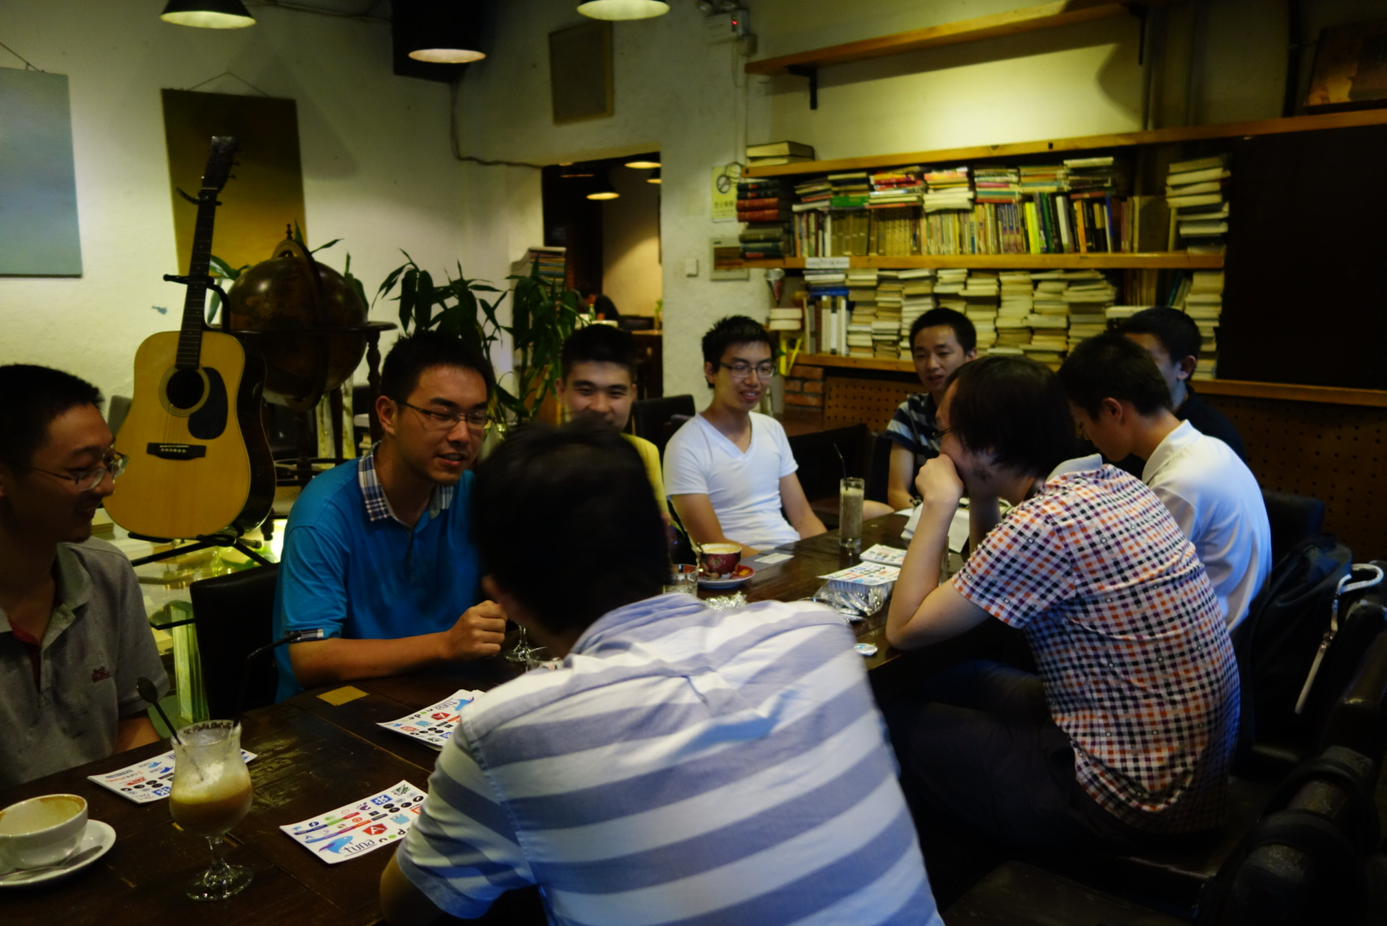
Tunight

Slide 14
Any Projects?
有趣的项目

Slide 15
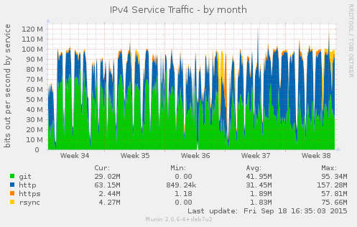
Mirrors 开源镜像站
https://mirrors.tuna.tsinghua.edu.cn/
Official mirror of many projects
Provide fast and stable downloading service to FLOSS users & developers
Official mirror of many projects

Slide 16
Mirrors 开源镜像站
https://github.com/tuna/tunasync
Mirror job controller
Implemented in Python
Support rsync upstream and custom mirror script

Slide 17
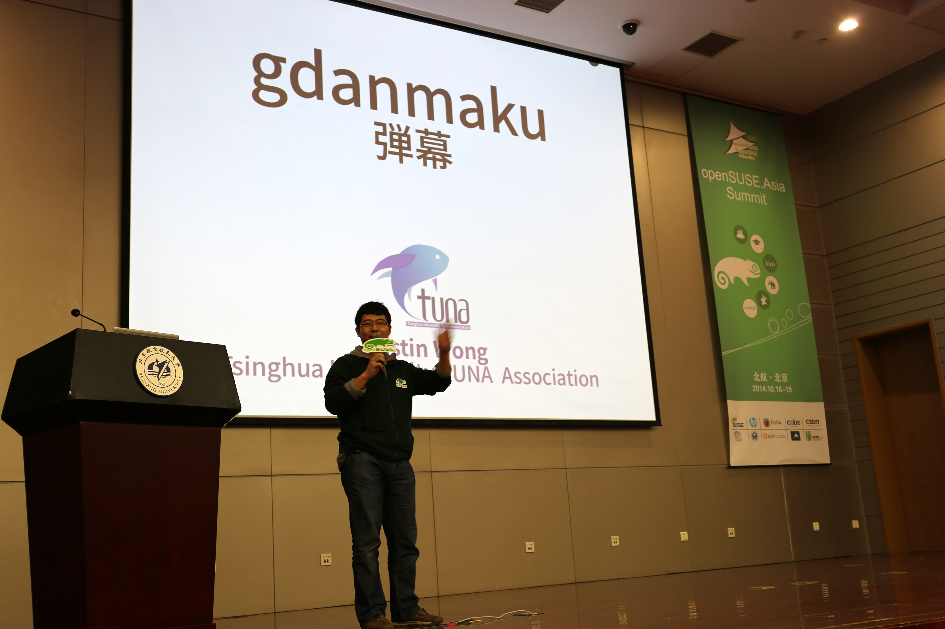
Danmaku 弾幕

Slide 18
Danmaku 弾幕
Free Danmaku System
Play on any screen
Designed for interaction between speakers and audiences
Works on GNU/Linux and M$ Windows
https://github.com/tuna/gdanmaku-server
https://github.com/bigeagle/danmaq

Slide 19
Fishroom 聊天室
http://fishroom.tuna.moe/
https://github.com/tuna/fishroom
Support multiple IMs
  Telegram
  IRC
  XMPP MUC
  Web (Read-Only)
Support image and long text

Slide 20
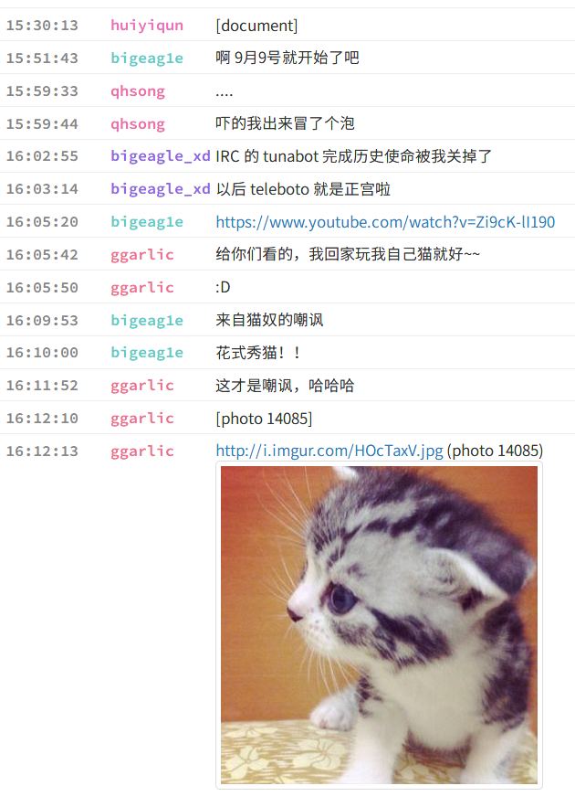
Fishroom 聊天室
http://fishroom.tuna.moe/
Join the Chat
  #tuna @ freenode
  tuna@conference.xmpp.jp

Slide 21
Thank you !
很惭愧，只做了一点微小的工作

