Slide 1
Tasty Bytes – Future of Data
Scalable, real-time, open lake-house architecture and
deep dive
Subhajit Basu
Date | Version

Slide 2


Tasty Bytes: Problem Statement
Current Challenges
Data silos
No REAL time
insights
Ops and
RELIABILITY issues
Multiple data ingestion patterns pulling data from disparate sources like MySQL(product), PostgreSQL(sales), files, clickstream etc.
Once a day ETL batch for analytics and BI – lack of real time insights like recommendations, fraud detection etc.
Unreliable on-prem infra and support resulting in downtime and revenue loss
Lack of interoperability
Lack of GOVERNANCE
Loss of DATA And ACTIONABLE INSIGHTS
Multiple vendors and data formats resulting in silos and vendor lock-in, thus increased licensing cost!
Broken data security, privacy, lack of data tagging, lineage
Clickstream data is collected but not utilized – missed insights and possible revenue!

Slide 3

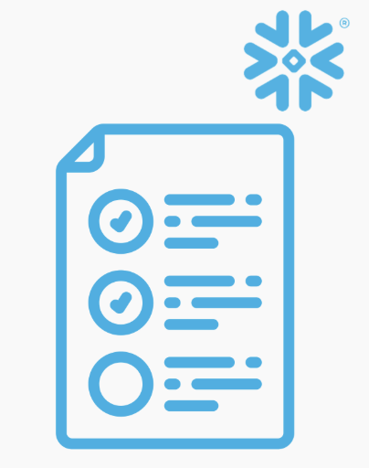

Tasty Bytes: PROPOSED TARGET DATA ARCHITECTURE
DATA SOURCES
Snowflake Horizon (Catalog, Lineage, Tags, Discovery)
SNOWFLAKE DATA CLOUD
DATA CONSUMPTION
Schema Management
Orchestration & Workflow
DevOps
Cataloging
Metadata Management
Discovery & Modeling
Transactional Systems
PostgreSQL
Unified Ingestion
RAW(Bronze)
CONFORMED(Silver)
CONSUMPTION(Gold-
Semantic Layer)
CONSUMER INTERFACES
Reporting/BI
Orders, Menu
Trucks, Ops
Customers, Vendors
Reviews
LANDING ZONE
1 RAW
Table
4 Dynamic tables
with all business logic
1 Typed
Table
DATA ACCESS SERVICES
7 views with core KPIs all built from the 4 Dynamic Tables in the Silver layer
Snowflake Postgres Connector Agent
(Replicates 13 PostgreSQL tables with CDC)
Executives
Schema-TASTY_BYTES_V2.FOODTRUCK
13 Internal Tables
Operations
Marketing
Stream+Task
Real-Time / Event Systems
Stream +Task
1 Iceberg
Table
Snowsight
Product
Kafka (Trucks Ops Telemetry)
Kafka Connectors
(1 Kafka Topic)
Schema- TASTY_BYTES_ICEBERG_DB.FOODTRUCK
In raw VARIANT format
JDBC
Speed, Fuel
Fridge, Temperature
Exceptions
Note: Not having sales data. Just real-time Ops telemetry
Schema- TASTY_BYTES_ICEBERG_DB.FOODTRUCK
Typed format
Schema- TASTY_BYTES_ICEBERG_DB.FOODTRUCK
Iceberg format
ODBC
Applications(optional)
Mobile Apps
GOVERNANCE
Desktop
Future-Ready(Optional)
Tagging
RBAC
Metadata
Column Level Governance
Other Apps
Salesforce
GenAI/Text Agents
ADVANCED ANALYTICS INTERFACES
Data
Science
Agents/GenAI
Realtime Ops

Slide 4
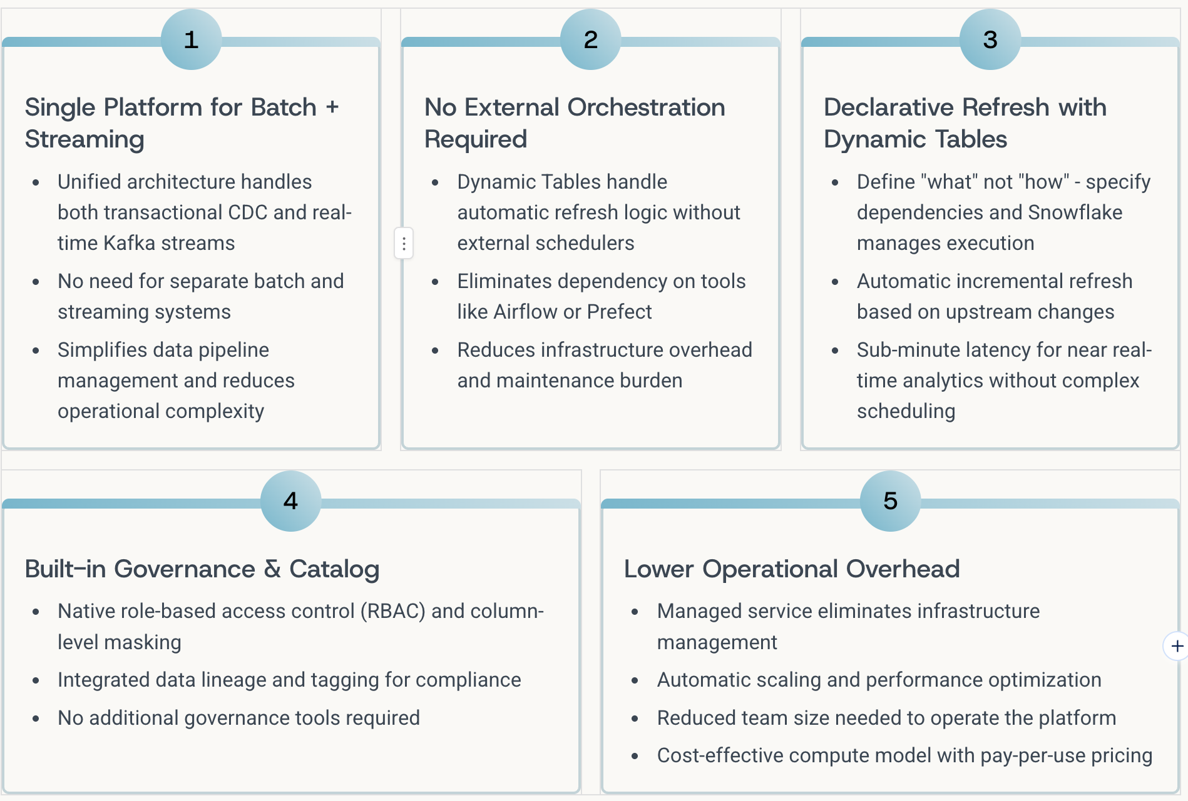
Why Snowflake: The Unified Data Platform
Tasty Bytes chose Snowflake as the foundation for its data platform because it uniquely combines the capabilities needed for modern data operations—eliminating the complexity of managing multiple specialized tools while delivering enterprise-grade governance and performance.
By consolidating data ingestion, processing, governance, and analytics into a single platform, Snowflake enables Tasty Bytes to focus on business value rather than infrastructure management.

Slide 5
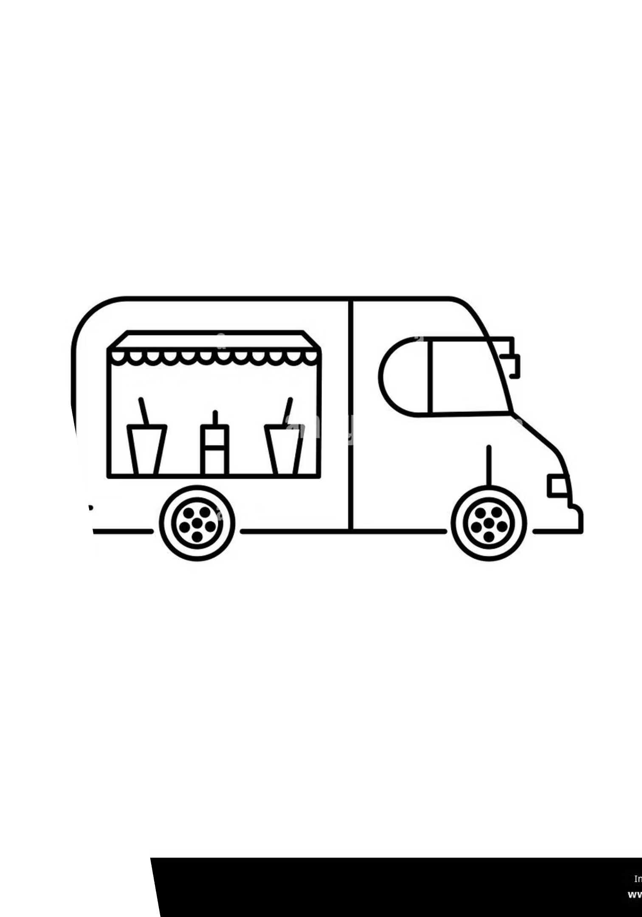
Modern Data Architecture
Tasty Bytes: Unified Data Platform on Snowflake
A comprehensive end-to-end data architecture powering real-time analytics and business intelligence for a growing food truck franchise. This platform seamlessly integrates transactional systems with operational telemetry to deliver actionable insights across the organization.

Slide 6
Data Sources & Ingestion
The Tasty Bytes platform captures data from two primary sources: PostgreSQL for transactional truth and Kafka for operational telemetry. This data is ingested into Snowflake through real-time CDC and streaming connectors.
PostgreSQL: Transactional Data
Kafka: Real-time Operational Telemetry
Core transactional database
Real-time event streams
Orders & Customers
Vehicle Performance
Trucks, Vendors, & Menus
Resource Utilization
Customer Reviews
Cold Chain Monitoring
Maintenance Signals
Data Ingestion into Snowflake
PostgreSQL to Snowflake CDC
Kafka to Snowflake Streaming
Snowflake's native PostgreSQL Connector
Kafka Connect with Snowflake sink connector
Automated Change Data Capture (CDC)
Progressive refinement: Raw (Bronze) → Typed (Silver) → Iceberg (Silver)
Continuous streaming to TASTY_BYTES_V2.foodtruck
Raw events are persisted as immutable VARIANT records, preserving schema flexibility
and auditability, then converted to typed before finally being written to an iceberg format
Replicates 13 core tables with sub-minute latency
Ensures near-real-time transactional data for analytics
Enables real-time event streaming for operational insights

Slide 7
Processing & Analytics: From Raw Data to Business Intelligence
The Tasty Bytes platform uses a three-layer processing architecture (Bronze, Silver, Gold) to progressively refine data and transform it into strategic business intelligence.
Bronze Layer
Silver Layer (Conformed)
Gold Layer
Raw event capture and immutable audit trail. Stores Kafka events with metadata and ingestion timestamps, providing point-in-time recovery and retroactive schema evolution.
Typed, validated, and deduplicated data. Structures Kafka events with explicit schemas, applies data quality checks, and deduplication logic.
Core transactional data like Orders, Order item, customer feedback lands here directly from PostgesSQL DB
Foundation for all downstream analytics.
Business-ready aggregates and KPIs. Dynamic Tables implement core business logic, revenue analytics, and operational metrics. Abstracts complexity and optimizes for analytical queries.
Gold Dynamic Tables
This layer centralizes and standardizes all business logic, ensuring consistency, auditability and reuse across downstream consumers.
DT_REVENUE_DAILY
DT_OPS_DAILY
DT_NPS_DAILY
DT_EXEC_DAILY_SCORECARD
Source: PostgreSQL (Orders, Order Items)
Source: Kafka (Telemetry Streams)
Source: PostgreSQL (Reviews)
Source: Revenue + Ops + NPS Dynamic Tables
Metrics: Total Orders, Gross Revenue, AOV
Metrics: Avg Speed, Idle Time, Fuel Efficiency, Fridge Temp Violations, Maintenance Cost
Metrics: NPS = % Promoters (9-10) - % Detractors (≤6)
Aggregates transactional data by truck and day, calculating key revenue indicators for auditability and compliance.
Metrics: Unified per-truck, per-day view with rolling 90-day window
Computes Net Promoter Score, classifying respondents into Promoters, Passives, and Detractors, while tracking review volume and sentiment trends.
Synthesizes real-time operational telemetry into daily operational health scores per truck, detecting anomalies and tracking fleet efficiency.
A cornerstone table that joins Revenue, Operations, and NPS metrics for executive decision-making. Implements a 90-day rolling window for cost optimization.

Slide 8
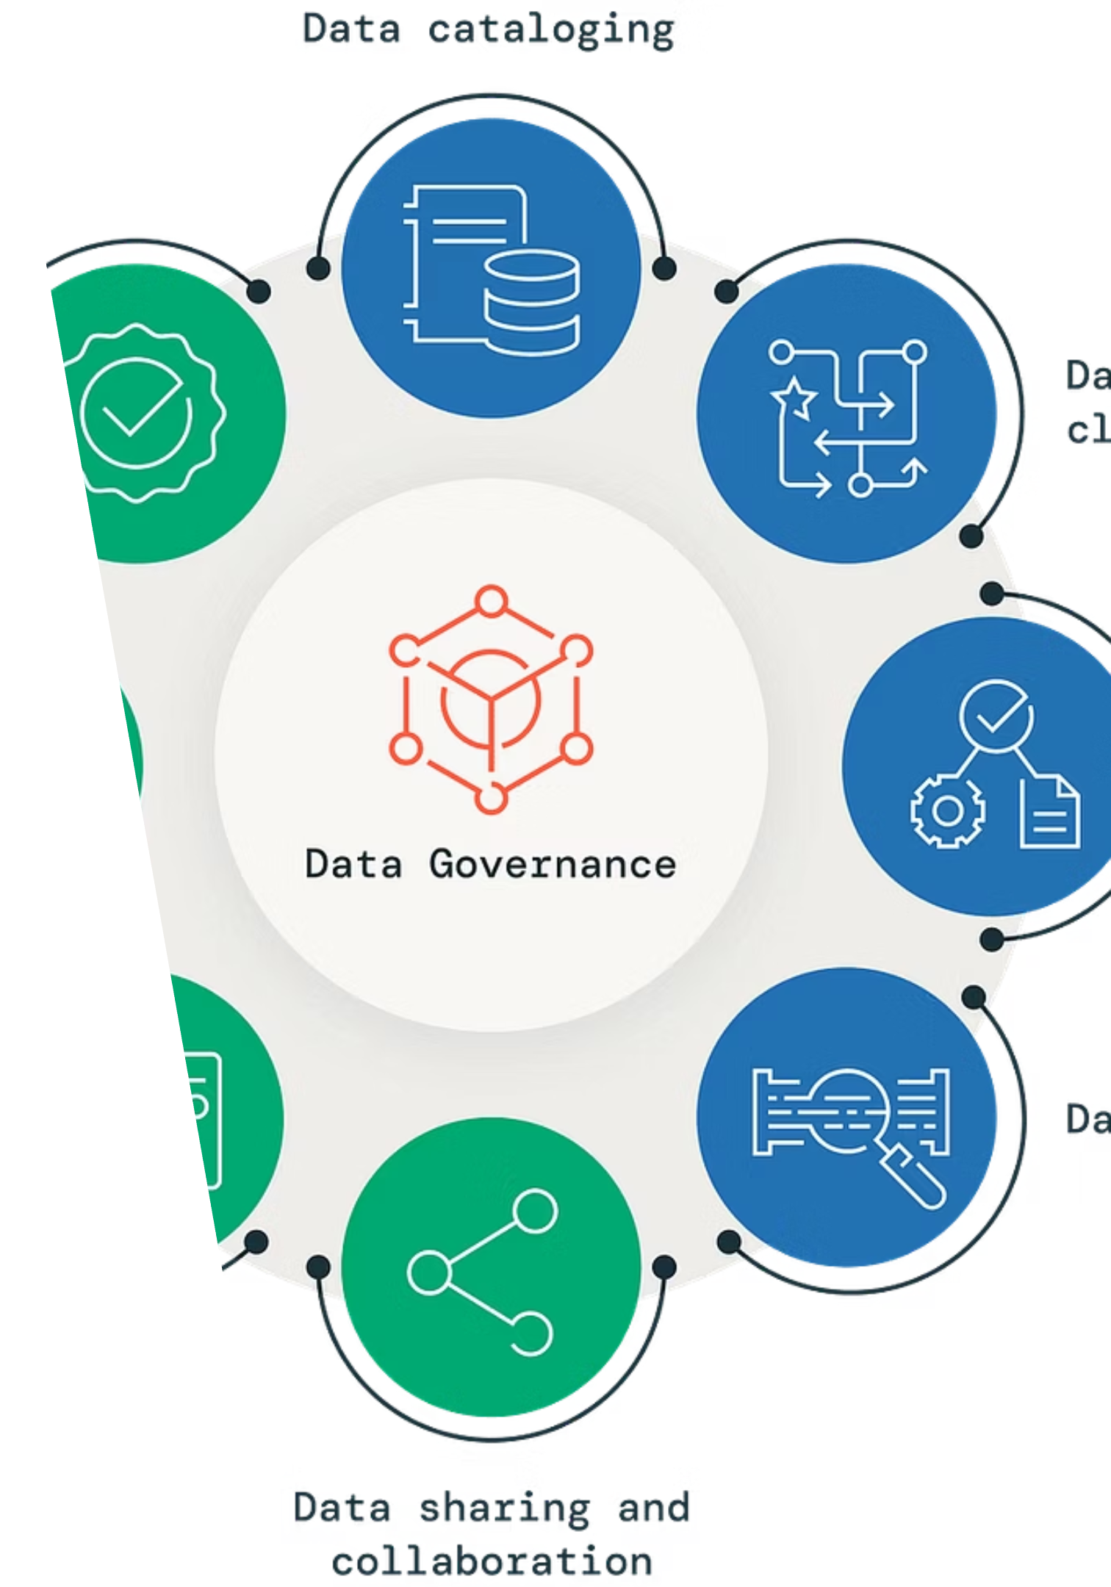








Governance & Consumption: Role-Based Analytics & Security
The Consumption layer (formerly Presentation) exposes Gold tables through curated, role-based views with comprehensive governance controls, security policies, and optimized query patterns for self-service analytics across the organization.
Consumption Layer Architecture
The Consumption layer implements a comprehensive governance framework including role based access control, safe views for not exposing sensitive information, optimized query patterns for BI tool performance, business-friendly naming conventions, and integration with popular BI tools (Tableau, Looker, Power BI).
KPI Views
Executive & Strategic Views
V_EXEC_DAILY_SCORECARD: Daily metrics dashboard with drill-down analysis.
V_REVENUE_DAILY: Fleet-wide revenue rollups and trend analysis.
V_TOP_TRUCKS_REVENUE: Leaderboard ranking by revenue performance.
V_REVENUE_GROWTH: Week-over-week and month-over-month growth rates.
Operational & Analytical Views
V_OPS_DAILY: Aggregated operational metrics (fuel efficiency, idle time).
V_OPS_EXCEPTIONS_DAILY: Anomaly detection for out-of-bounds metrics.
V_NPS_DAILY: NPS trend analysis with sentiment classification.
V_MAINTENANCE_FORECAST: Predictive maintenance for service needs.
Governance Framework
Role Based Access Control (RBAC)
Safe Views (Masking PII)
Enforce granular permissions based on user roles and organizational hierarchy.
Only expose safe (non PII, non sensitive) columns for engineers, analysts.
End-to-End Snowflake Data Lineage
Tagging
Track data flow from source systems through all processing layers to consumption views for compliance and debugging.
Implement data classification and lineage tracking through comprehensive tagging strategy.
The 90-day rolling window in DT_EXEC_DAILY_SCORECARD balances analytical depth and compute costs.. This significantly reduces warehouse compute cost while maintaining sub-minute freshness.

Slide 9
Demo
1
3
Generate New PostgreSQL Orders + Kafka Telemetry
Simulate new customer orders being placed in PostgreSQL
Trigger Kafka events for vehicle telemetry (speed, fuel consumption, temperature)
Show data flowing into Snowflake in real-time
Demonstrate CDC capturing order changes and Kafka streams ingesting telemetry
Show Baseline KPIs
Display current state of V_EXEC_DAILY_SCORECARD with existing metrics
Show Total Orders, Gross Revenue, AOV, Fleet Efficiency, NPS Score
Establish the starting point for the live demonstration
Talk to my data: Meet
TASTY BYTES DATA HERO
A Snowflake AI agent which works with multiple cortex analyst agents to answer critical business questions from executives and other personas in a natural language manner
Show Real-Time KPI Updates
Watch DT_REVENUE_DAILY automatically recalculate with new orders
Observe DT_OPS_DAILY refresh with updated operational metrics
See V_EXEC_DAILY_SCORECARD update in real-time reflecting new data
Highlight the sub-minute latency from data generation to dashboard refresh
2
4
*If time permits, then a demo on lineage and tagging to cover the governance aspects
Disclaimer: We did not incorporate CI/CD, Openflow (edition limitation), Masking policy(edition limitation), ML and used small warehouses to ensure we cover most things in a pragmatic manner. In a production rollout will probably use most of these services.

