Slide 1
Nanoelectronic Metarials and Devices
Tuncay Yılmaz 1401020010
Kaan Baysal 130102
Selim Saral 150102

Slide 2
Nanoelectronics
Nanoelectronics refer to the use of nanotechnology in electronic components
The term covers a diverse set of devices and materials, with the common characteristic that they are so small that inter-atomic interactions.

Slide 3
hybrid molecular/semiconductor electronics, one-dimensional nanotubes/nanowires or advanced molecular electronics.
Recent silicon CMOS technology generations, such as the 22 nanometer node, are already within this regime.

Slide 4
In 1965 Gordon Moore observed that silicon transistors were undergoing a continual process of scaling downward, an observation which was later codified as Moore's law.
transistor minimum feature sizes have decreased from 10 micrometers to the 28-22 nm range in 2011

Slide 5
The field of nanoelectronics aims to enable the continued realization of this law by using new methods and materials to build electronic devices with feature sizes on the nanoscale.
The critical length scale of integrated circuits is already at the nanoscale (50 nm and below) regarding the gate length of transistors in CPUs or DRAM devices.

Slide 6
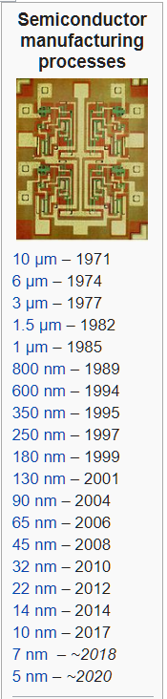
Computers
Nanoelectronics holds the promise of making computer processors more
powerful than are possible with conventional semiconductor fabrication techniques.

Slide 7
In 1999, the CMOS transistor developed at the Laboratory for Electronics and Information Technology in Grenoble, France, tested the limits of the principles of the MOSFET transistor with a diameter of 18 nm
It enabled the theoretical integration of seven billion junctions on a €1 coin

Slide 8
Today it would be impossible to master the coordinated assembly of a large number of these transistors on a circuit and it would also be impossible to create this on an industrial level.

Slide 9
Memory Storage
Electronic memory designs in the past have largely relied on the formation of transistors.
Currently, crossbar switch based electronics have offered an alternative using reconfigurable interconnections between vertical and horizontal wiring arrays to create ultra high density memories.

Slide 10
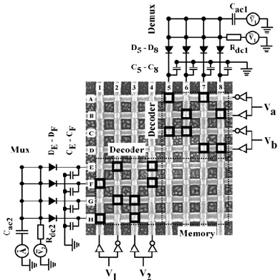

Slide 11
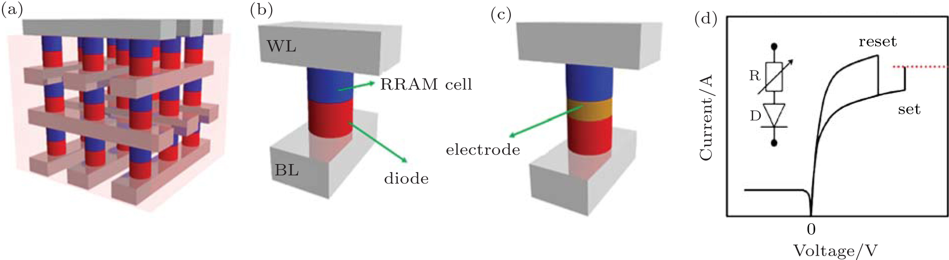
Two leaders in this area are Nantero which has developed a carbon nanotube based crossbar memory called Nano-RAM

Slide 12
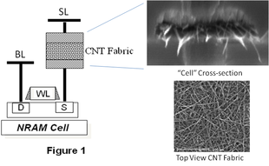

Slide 13
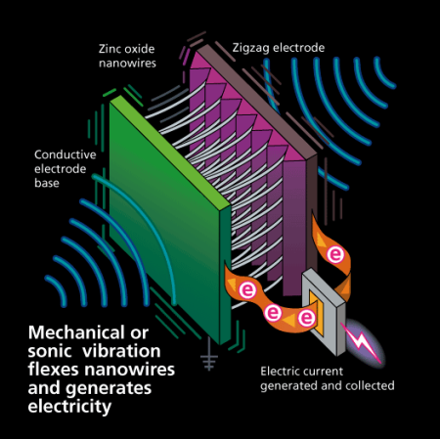
Energy Production
Research is ongoing to use nanowires and other nanostructured materials with the hope to create cheaper and more efficient solar cells than are possible with conventional planar silicon solar cells. It is believed that the invention of more efficient solar energy would have a great effect on satisfying global energy needs.

Slide 14
Energy Production
There is also research into energy production for devices that would operate in vivo, called bio-nano generators. A bio-nano generator is a nanoscale electrochemical device, like a fuel cell or galvanic cell, but drawing power from blood glucose in a living body, much the same as how the body generates energy from food. To achieve the effect, an enzyme is used that is capable of stripping glucose of its electrons, freeing them for use in electrical devices.

Slide 15
Energy Production
The average person's body could, theoretically, generate 100 watts of electricity (about 2000 food calories per day) using a bio-nano generator. However, this estimate is only true if all food was converted to electricity, and the human body needs some energy consistently, so possible power generated is likely much lower.
The electricity generated by such a device could power devices embedded in the body (such as pacemakers), or sugar-fed nanorobots. Much of the research done on bio-nano generators is still experimental, with Panasonic's Nanotechnology Research Laboratory among those at the forefront.

Slide 16
Novel Optoelectronic Devices
In the modern communication technology traditional analog electrical devices are increasingly replaced by optical or optoelectronic devices due to their enormous bandwidth and capacity, respectively.

Slide 17
Two promising examples are photonic crystals and quantum dots. Photonic crystals are materials with a periodic variation in the refractive index with a lattice constant that is half the wavelength of the light used. They offer a selectable band gap for the propagation of a certain wavelength, thus they resemble a semiconductor, but for light or photons instead of electrons.

Slide 18
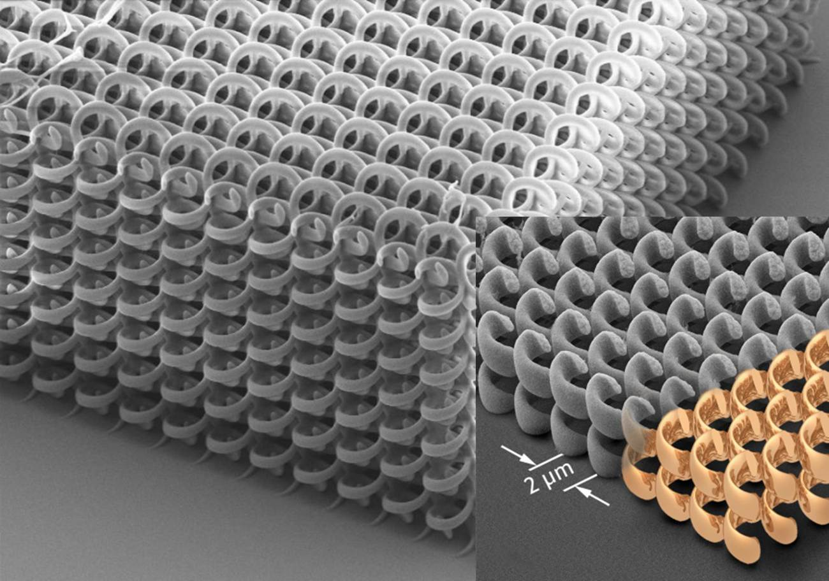

Slide 19
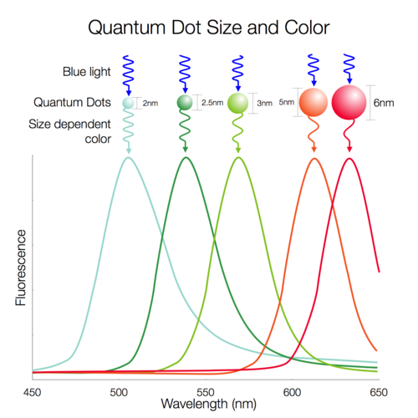
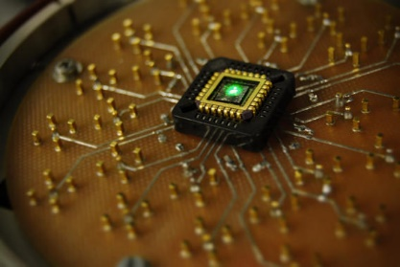
Quantum dots are nanoscaled objects, which can be used, among many other things, for the construction of lasers. The advantage of a quantum dot laser over the traditional semiconductor laser is that their emitted wavelength depends on the diameter of the dot. Quantum dot lasers are cheaper and offer a higher beam quality than conventional laser diodes.

Slide 20
Displays
The production of displays with low energy consumption might be accomplished using carbon nanotubes (CNT) and/or Silicon nanowires.
Such nanostructures are electrically conductive and due to their small diameter of several nanometers, they can be used as field emitters with extremely high efficiency for field emission displays (FED). The principle of operation resembles that of the cathode ray tube, but on a much smaller length scale

Slide 21
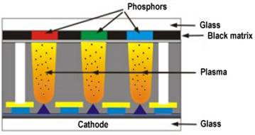
Field Emission Display
FED consists of a matrix of cathode ray tubes, each tube producing a single sub-pixel, grouped in threes to form red-green-blue (RGB) pixels.

Slide 22
Quantum Computers
Entirely new approaches for computing exploit the laws of quantum mechanics for novel quantum computers, which enable the use of fast quantum algorithms.
The Quantum computer has quantum bit memory space termed "Qubit" for several computations at the same time. This facility may improve the performance of the older systems.

Slide 23
Quantum Computers
Quantum computing studies computation systems (quantum computers) that make direct use of quantum-mechanical phenomena, such as superposition and entanglement, to perform operations on data.

Slide 24
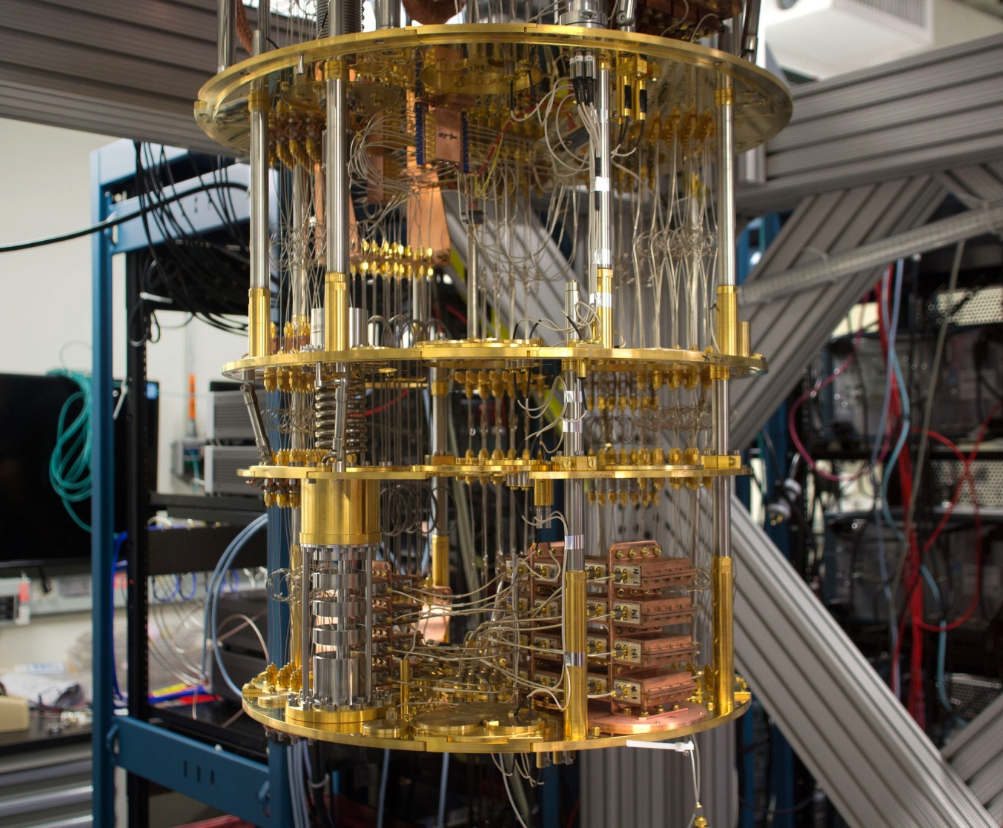

Slide 25
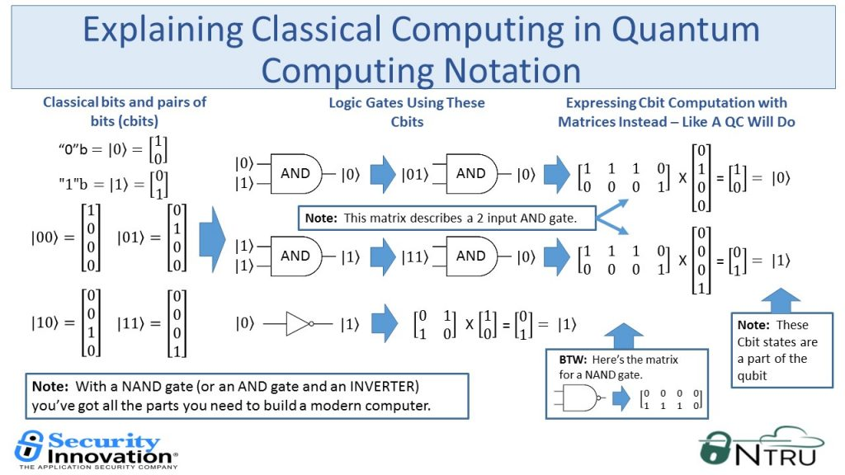

Slide 26
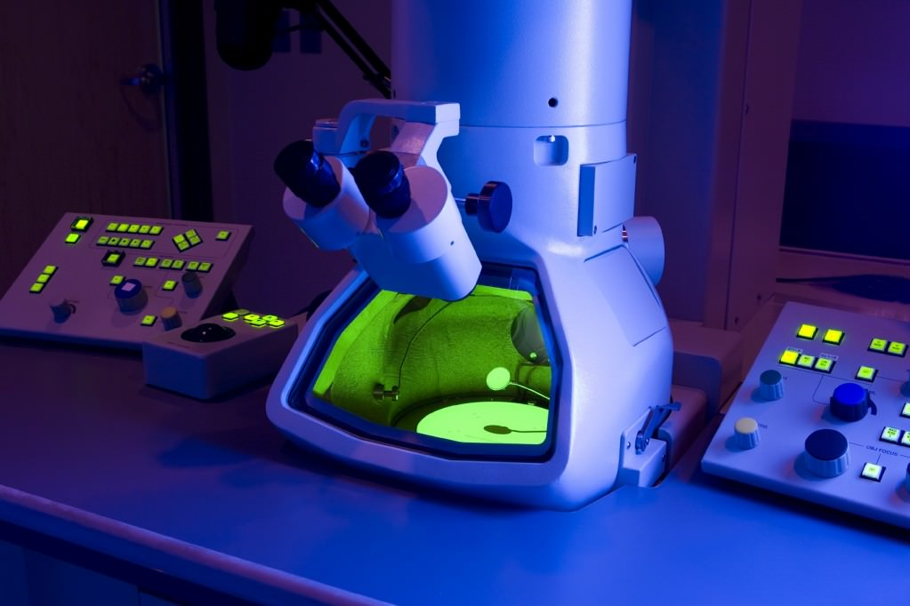
Medical Diagnostics
There is great interest in constructing nanoelectronic devices that could detect the concentrations of biomolecules in real time for use as medical diagnostics, thus falling into the category of nanomedicine.

Slide 27
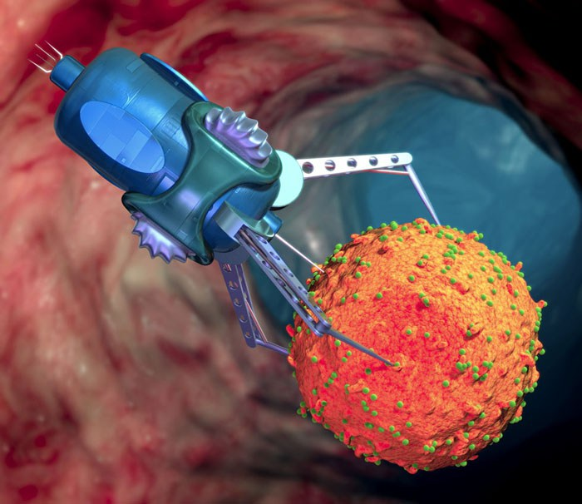
Medical Diagnostics
A parallel line of research seeks to create nanoelectronic devices which could interact with single cells for use in basic biological research. These devices are called nanosensors.

Slide 28
Medical diagnostic
Nanotechnology offers tools and techniques for more effective detection, diagnosis and treatment of diseases.
Nanorobots will be able to do
      Drug delivery
      Cancer detection
      Imaging
      Sensing
      Blood purification
      Tissue engineering

Slide 29
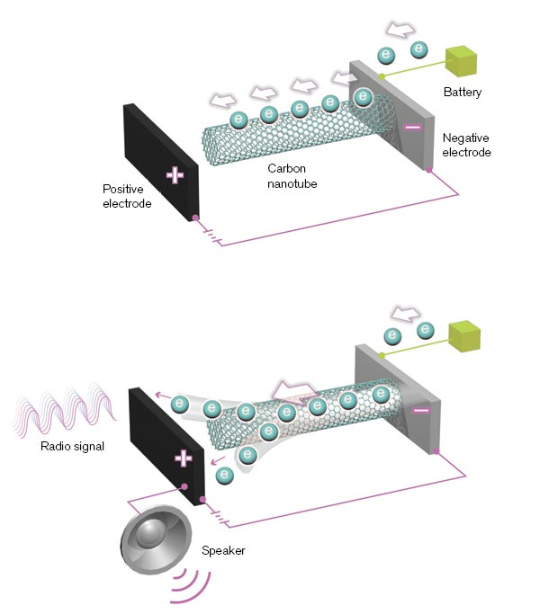
Nano Radios
a nanotechnology acting as a radio transmitter and receiver by using carbon nanotubes.

Slide 30
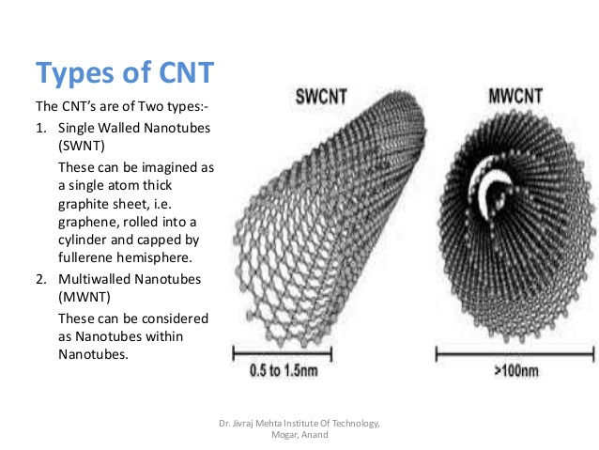
Carbon Nanotube(CNT)
Carbon nanotubes (CNTs) are allotropes of carbon with a cylindrical nanostructure.
Valuable for nanotechnology, electronics, optics and other fields of materials science and technology.

Slide 31
Carbon Nanotube(CNT)
CNT are at least 100 times stronger than steel, but only one-sixth as heavy
nanotube fibers could strengthen almost any material.
conduct heat and electricity far better than copper.

Slide 32
Nano Radios
Radio antenna made from a single conductive carbon nanotube (less than a micron long and 10 nm wide) positioned between two conductive plates.

Slide 33
Nano Radios
When a voltage is placed across the two plates, the nanotube's free end becomes electrically charged oppositely from the nearby plate, and the electrostatic attraction keeps the nanotube under mechanical tension.
Electrically charged plate moves in response to an ambient radio frequency electric field
The resonant frequency of the antenna is simply the mechanical resonant frequency of the nanotube under tension.
The tension be changed by changing the voltage across the two conducting plates, and in this way the radio can be tuned.

Slide 34
References
http://willware.blogspot.com.tr/2008/03/
https://hal.archives-ouvertes.fr/hal-01565119/document
http://en.0wikipedia.org/index.php?q=aHR0cHM6Ly9lbi53aWtpcGVkaWEub3JnL3dpa2kvTmFub3JhZGlvI1Byb3BlcnRpZXM
http://en.0wikipedia.org/index.php?q=aHR0cHM6Ly9lbi53aWtpcGVkaWEub3JnL3dpa2kvQ2FyYm9uX25hbm90dWJl
http://www.nanoscience.com/applications/education/overview/cnt-technology-overview/

