Slide 1

PROBLEM: Computer purchase
Jolanta Śliwa

Slide 2

Problem Statement
Suppose you're trying to help a company determine
which computers to purchase.

Slide 3
Data Utilization data by employee:
The company has been able to pull utilization data by employee that classifies users into 3 bins, depending on how much they use their computer in their work:
Low usage - spends a lot of time in meetings, checking email, doing people management
Average usage - requires some compute power, with balanced mix of heads down/technical work along with a good amount of meetings/email writing
High usage - power user, relies heavily on computer performance

Slide 4
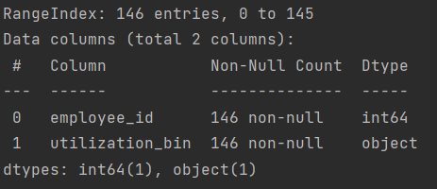
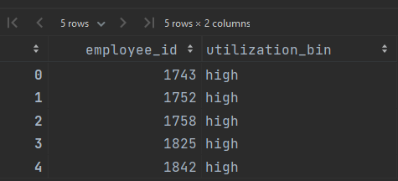
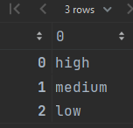
Let’s look at our data:
Information about DataFrame:
Few rows from DataFrame to see how it looks like:
Checking types of utilization:
➔ average usage is stored as „medium”

Slide 5
Data: survey
Additionally, they've surveyed employees to collect the relative importance of the following variables describing a computer's performance:
Memory
Processing
Storage
Price inverse - this metric was given to you by the company as you can see in the dataset, with the directive that price inverse being fixed at a 25% weight in the purchase decision

Slide 6
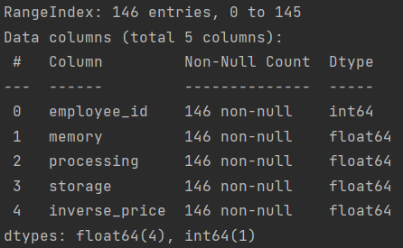
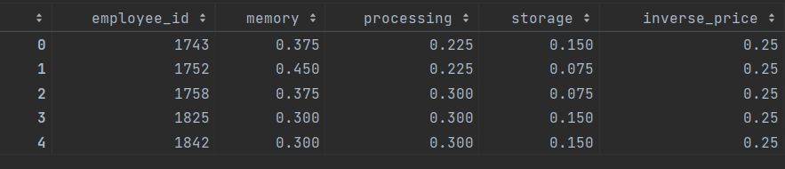
Let’s look at our data:
Information about DataFrame:
Few rows from DataFrame to see how it looks like:
Luckily preferences per employee sum to 1.0 → 100%

Slide 7
Data: computers
Lastly, the company is looking to purchase a maximum of 3 different computer models, and have compiled the following list scoring their memory, processing, storage, and relative price. Each dimension is scored from 0-10, with 10 being the best.

Slide 8
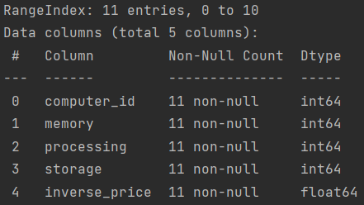
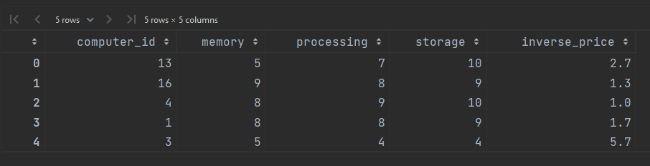
Let’s look at our data:
Information about DataFrame:
Few rows from DataFrame to see how it looks like:

Slide 9
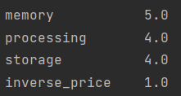
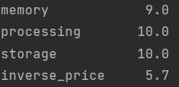
Let’s look at our data:
Min:
Max:
Checking „real” min and max scores:

Slide 10

TASK
Given this information, provide the company with a recommendation on which computers to purchase.

Slide 11
Preparing data:
Making a list of parameters:
['memory', 'processing', 'storage', 'inverse_price’]
Merging survey and utilization into employees column:
# It will be more convenient for me to store all employees
# related data in one DataFrame instead of two.
# Note:
# Normally (e.g. if we would like to make some predictions)
# it would be better to store "object" (nominal data - categorical data)
# using one-hot-encoding but in this case it is more convenient
# for me to leave it like that.

Slide 12

Solution: concept
For me possible soultions can be presented in a simmilar way as states in Salesman problem:
Slalesman: [1, 5, 8, 0, …]
Computers: [(3, 2, 1), (6, 9, ..)],
Where any permutation of numbers inside their colour groups is the same solution:
[ (3, 1, 2), (8, 5, ..)], [ (2, 1, 3), (8, 5, ..)] … are the same state like this one above
So we can use one of well-known algorithms to try to find our optimum.
Proposition:
Simulated annealing

Slide 13

Metric / distance function
For me it was natural to use the fact that all elements were scored using the same range of values.
Without utilization_bin:
metric( employee, computer )
=
$$\sum_{i}{\text{computer}\text{_}\text{parameter}\text{_}\text{val}\text{(}\text{i}\text{) ∗ }\text{employee}\text{_}\text{survey}\text{_}\text{parameter}\text{_}\text{val}\text{(}\text{i}\text{)}}$$
Where i $∈$ paremeters = ['memory', 'processing', 'storage', 'inverse_price’]

Slide 14

Metric / distance function
With utilization_bin:
I set a maximum for all 3 groups
e.g. for „low”: computer with memory 10 is „the same” as all above 3 (or 5 – two implementations)
Metric:
metric( employee, computer )
=
$$\sum_{i}{\text{computer}\text{_}\text{parameter}\text{_}\text{scale}\text{_}\text{val}\text{(}\text{i}\text{) ∗ }\text{employee}\text{_}\text{survey}\text{_}\text{parameter}\text{_}\text{val}\text{(}\text{i}\text{)}}$$
Where i $∈$ paremeters = ['memory', 'processing', 'storage', 'inverse_price’]
$$\text{computer}\text{_}\text{parameter}\text{_}\text{scale}\text{_}\text{val}\text{(}\text{parameter}\text{, }\text{computer}\text{) = }\text{min}\text{(}\text{max}\text{_}\text{val}\text{, }\text{computer}\text{_}\text{parameter}\text{_}\text{val}\text{)}$$
e.g. for „low”: (score for memory for c1: 8, $\text{max}\text{_}\text{val}$(low) = 3)
$\text{computer}\text{_}\text{parameter}\text{_}\text{scale}\text{_}\text{val}\text{(}\text{memory}\text{, }\text{c}\text{1) = }\text{min}\text{(3, 8)}$ = 3

Slide 15

Metric / distance function
With utilization_bin:
I scale a values for all 3 groups and limit maximum
This way metric for every group will be in range from 0 to 10
e.g. for „low”: computer with memory 10 is „the same” as all above 3 (or 5 – two implementations)
Metric:
metric( employee, computer )
=
$$\sum_{i}{\text{computer}\text{_}\text{parameter}\text{_}\text{scale}\text{_}\text{val}\text{(}\text{i}\text{) ∗ }\text{employee}\text{_}\text{survey}\text{_}\text{parameter}\text{_}\text{val}\text{(}\text{i}\text{)}}$$
Where i $∈$ paremeters = ['memory', 'processing', 'storage', 'inverse_price’]
$$\text{computer}\text{_}\text{parameter}\text{_}\text{scale}\text{_}\text{val}\text{(}\text{parameter}\text{, }\text{computer}\text{) = }\text{min}\text{(10, }\text{computer}\text{_}\text{parameter}\text{_}\text{val}\text{ ∗ }\text{ratio}\text{(}\text{group}\text{_}\text{employee}\text{))}$$
e.g. for „low”: (score for memory for c1: 8, $\text{r}\text{atio}$(low) = 3 / 1)
$\text{computer}\text{_}\text{parameter}\text{_}\text{scale}\text{_}\text{val}\text{(}\text{memory}\text{, }\text{c}\text{1) = }\text{min}\text{(10, 8 ∗ ( 3 / 1))}$ = 10

Slide 16

Goal
In this implementation we are trying to find local maximum
(instead of typical: minimum)

Slide 17
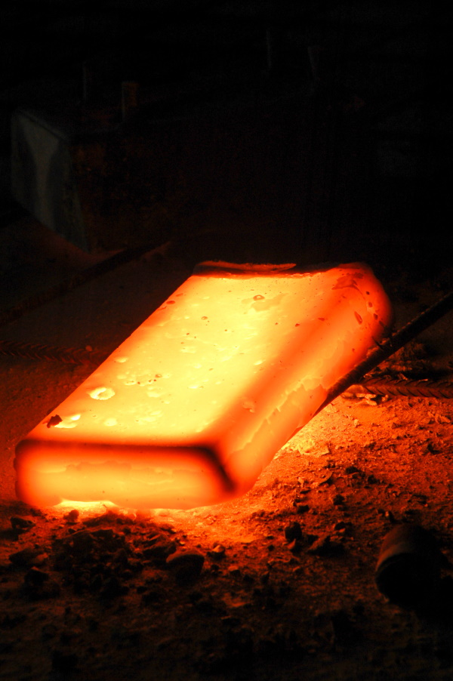
Simulated annealing: by Wikipedia
Starts at a random state
At each step, the simulated annealing heuristic considers some neighboring state s* of the current state s
If neighboring state is better accepts it
otherwise probabilistically decides between moving the system to state s* or staying in-state s.
These probabilities ultimately lead the system to move to states of lower energy. Typically this step is repeated until the system reaches a state that is good enough for the application, or until a given computation budget has been exhausted.

Slide 18
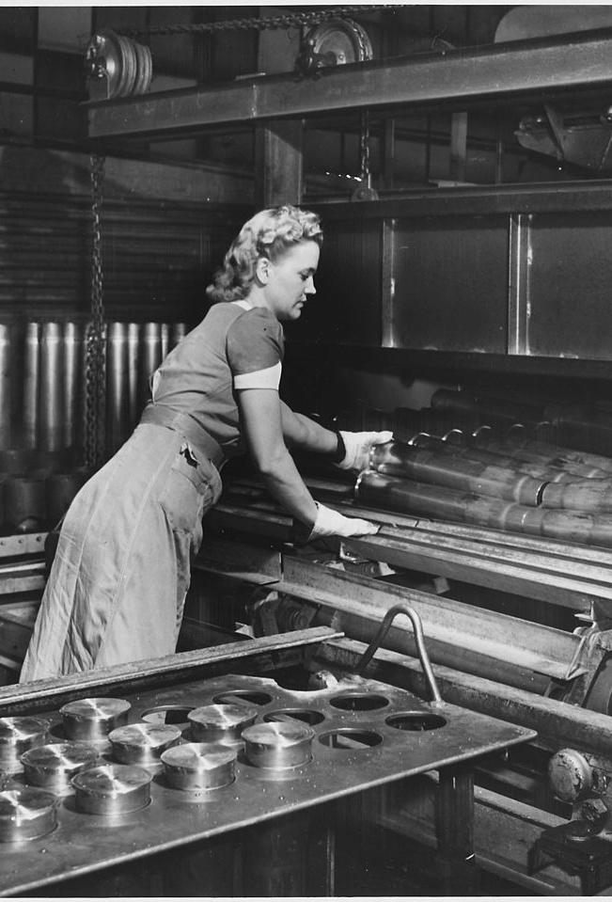
My implementation
Steps are repated untill timer contdown is terminated
If algorithm is in the same state for a chosen amount of steps it assumes that it is stuck and use one of 2 ways to escape:
Reheat temperature – higher probability to move to different step even if it is worse than current one
Change current state to the other random one

Slide 19


State cost
For (3) computers in our state algorithm chooses „the best” one for each employee – according to metric (the higher the better)
Then we sum metrics of all employees of their chosen one („the best”) computer
State_cost(state)
=
$$\sum_{e}{max⁡(metric\left(e, c\right))}$$
Where e $∈$ employees and c $∈$ state
(and c $∈$ computers)

Slide 20

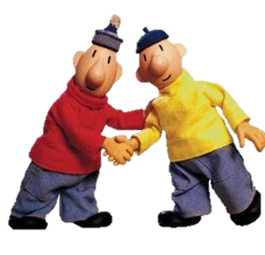
Neighbours
Neighbours of curent state are generated by changing only one computer in state (in top three)
e.g. for (3, 5, 7)
Neighbours: (3, 5, 8), (6, 5, 7), (3, 4, 7), (3, 5, 1), ….
Not neighbours: (3, 4, 2), (1, 2, 9)...

Slide 21
class Problem
Methods related to states
→ Ways of counting metric for employee
→ Counting state cost
Generating neighbours

Slide 22

class SimulatedAnnealing
Using SimulatedAnnealingConfig (list of algorithm parameters) performs simmulated annealing algorithm on a given problem

Slide 23



Naive solution
Since there is already class Problem I also prepered solution that checks all posible states and returns „the best” one according to metric
In this case there are only $\left(\begin{matrix}11 \\ 3\end{matrix}\right)=165$ so we can check them all just to see whether our Simulated Annealing found right solution

Slide 24



THE END
LET’S SEE the CODE!

