Slide 1
APP USER
Data Visualization

Slide 2
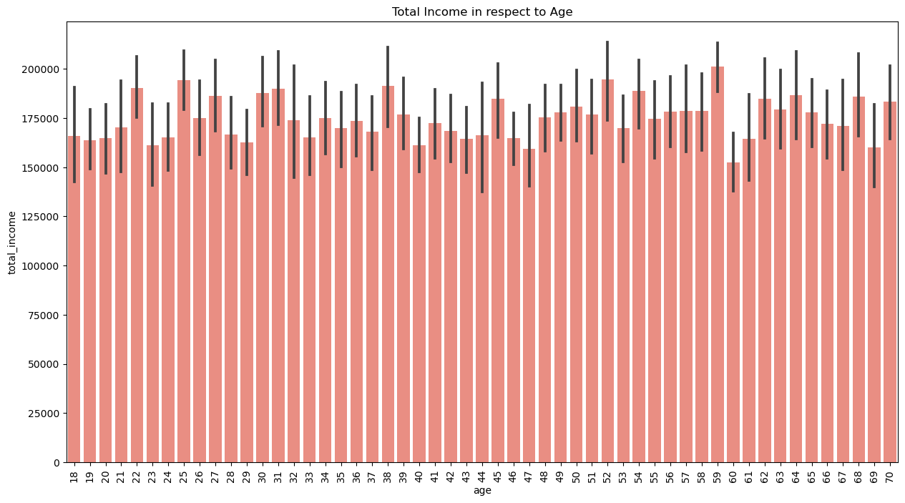
Age vs Total Income

Slide 3
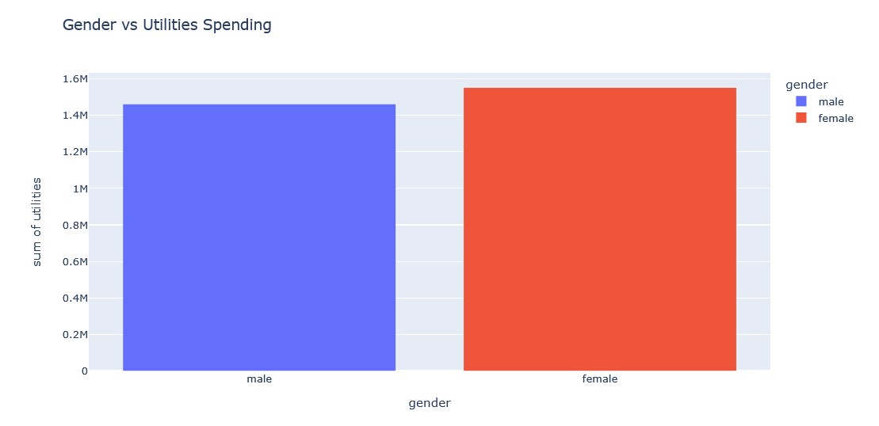
Utilities Spending according to Gender

Slide 4
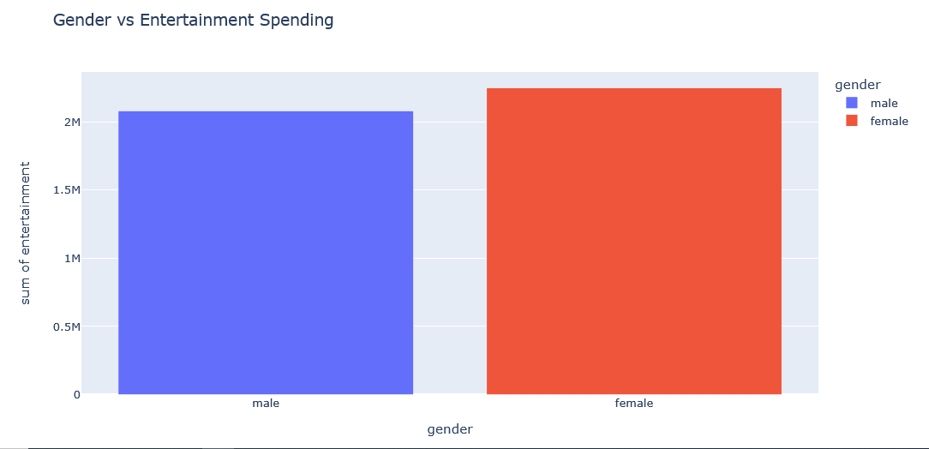
Entertainment Spending according to Gender

Slide 5

School Fees Spending according to Gender

Slide 6
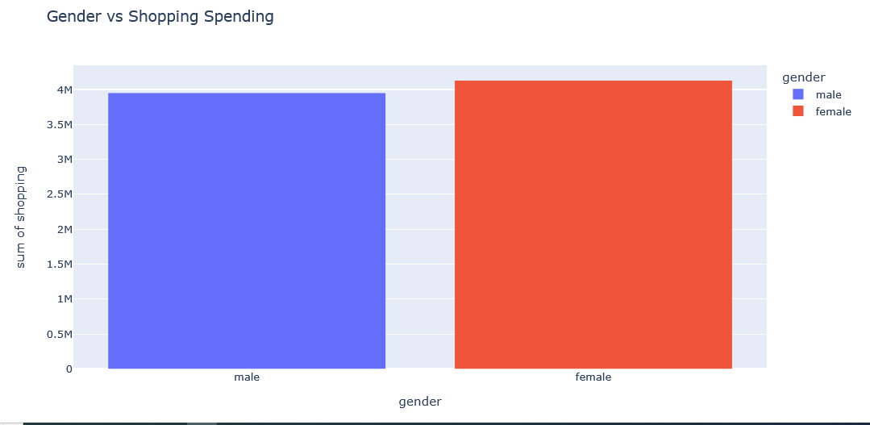
Shopping Spending according to Gender

Slide 7
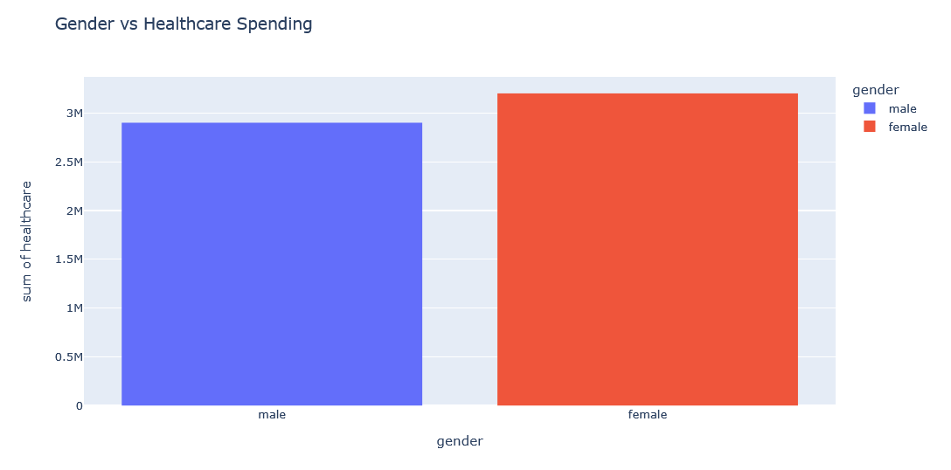
Healthcare Spending according to Gender

