Slide 1

Project Topic: Predicting Customer Churn in Telecom
Telco Churn Retention Targeting
Author: Olatunji Bilikisu
Date: January 2026
1

Slide 2
Problem Statement
Customer churn is a critical issue in telecom.
Churn reduces revenue and increases acquisition costs; targeting high-risk customers improves retention ROI.
Nigeria’s telecom market worth $9.5B (2025), projected to grow to $12B by 2030.
Example: MTN reduced churn from 26% → 5%, Airtel from 15% → 3%.
2/13
Notes:
[
Script]
In five minutes I will show: (1) how we engineered features safely, (2) how we trained models, (3) how we evaluated using Lift@k, (4) how we selected a champion using min–max weighted scoring, and (5) what the Streamlit app delivers operationally.
[Sources]
- Internal project file: model_comparison_results.csv

Slide 3
Predicting Customer Churn in Telecom
Predicting Customer Churn in Telecom -> Churn Retention Targeting
Baseline churn ≈ 26.5%
Best Lift@10% ≈ 2.89×
Champion (weighted): LR (bal)
Challenger: HGB
What this project delivers
A model that assigns each customer a churn probability (a “risk score”).
A Streamlit app that ranks customers and produces Top 10% / Top 20% outreach lists.
3/13
Notes:
[
Script]
In five minutes I will show: (1) how we engineered features safely, (2) how we trained models, (3) how we evaluated using Lift@k, (4) how we selected a champion using min–max weighted scoring, and (5) what the Streamlit app delivers operationally.
[Sources]
- Internal project file: model_comparison_results.csv

Slide 4
Methodology
Dataset
data/processed/
telco_churn_processed.csv
(or uploaded CSV)
Model
joblib load
logistic_regression_balanced.pkl
logistic_regression.pkl
hist_gradient_boosting.pkl
Streamlit app
Align schema → score
Compute Lift@k
Export targeting list
4/13
Notes:
[
Script]
In five minutes I will show: (1) how we engineered features safely, (2) how we trained models, (3) how we evaluated using Lift@k, (4) how we selected a champion using min–max weighted scoring, and (5) what the Streamlit app delivers operationally.
[Sources]
- Internal project file: model_comparison_results.csv

Slide 5
Model Overview
About the models
Model outputs
The models:
label customers as “churn” or “no churn
assigns each customer a churn probability (risk score)
The models, Logistic Regression, Random Forest, HistGradientBoosting, each produces a churn probability (risk score)
Output: a number between 0 and 1 for each customer
Our understanding:
How likely this customer is to churn?
We use the scores to rank customers and target the Top 10% or 20% for retention outreach
proba = model.predict_proba(X)[:, 1]
5/13
Notes:
[
Script]
In five minutes I will show: (1) how we engineered features safely, (2) how we trained models, (3) how we evaluated using Lift@k, (4) how we selected a champion using min–max weighted scoring, and (5) what the Streamlit app delivers operationally.
[Sources]
- Internal project file: model_comparison_results.csv

Slide 6
1) Feature engineering
Goal: give the model clean, consistent inputs without leaking the answer
Data quality & outliers
Data quality: missing values handled (e.g., TotalCharges)
Encoding + engineered features (e.g., charges_ratio, HighSpender, HighChurnRisk)
Leakage controls
Churn_Yes is never in X.
Train-fitted thresholds (quantiles learned on train only)
6/13
Notes:
[
Script]
Feature engineering is where most churn projects accidentally “cheat”. If we accidentally include the label or compute thresholds on the full dataset, evaluation looks better than reality. We fix TotalCharges NaNs, use safe ratios, and treat the trained feature list as the contract.
[Sources]
- Internal project file: feature_engineering.py

Slide 7
2) Model training (simple models, strong ranking)
Train multiple candidates; keep the process reproducible
What we trained
Logistic Regression (standard) and Logistic Regression (class_weight=balanced).
Random Forest (standard) and Random Forest (balanced).
HistGradientBoosting for non-linear ranking improvements.
How we split
Why this matters
Use a stratified holdout split so churn/non-churn proportions are preserved.
Train on train split; report Lift@k on held-out test split.
Save models to disk for the Streamlit app to load (joblib).
Retention is a “top-of-the-list” problem: ranking matters more than accuracy.
Balanced training can improve recall (finding more churners) but may trade precision.
We keep both a champion and a challenger to validate in a pilot.
7/13

Slide 8
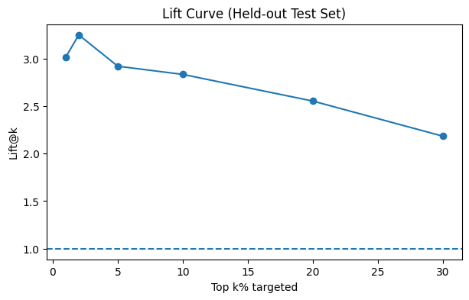
3) Model evaluation: Lift@k is the targeting KPI
Lift@k answers: “Is Top 10% / Top 20% targeting better than random selection?”
Definitions
• Baseline churn rate: average churn in the evaluation set
• Precision@k: churn rate inside the Top k% targeted list
• Lift@k = Precision@k ÷ Baseline (how many times better than random)
• Recall@k: % of all churners captured in the Top k% list
Example
If baseline = 0.265 and Precision@10% = 0.773,
Lift@10% = 0.773 / 0.265 ≈ 2.91×.
Meaning: Top 10% is ~3× more churn-heavy than average.
Lift curve behavior
Lift is highest at very small k (top 1–5%) and decreases as we target more customers.
This is normal because we include more lower-risk customers as k grows.
8/13
Notes:
[
Script]
We train several model families. The main point is not complexity; it is reliable ranking at the top of the list. We use a stratified holdout and report top‑k metrics because that matches how retention teams operate.
[Sources]
- Internal project file: model_comparison_results.csv

Slide 9
4) Weighted model scoring: why min–max normalization
We need one score that reflects business priorities across multiple metrics.
Problem: metrics are on different numeric scales
We rank models by weighted objective:
60% Lift@10%
30% Lift@20%
10% PR-AUC
Solution: normalize each metric to 0–1 scale and apply weights
Normalization ensures each metric contributes fairly; the weights reflect business priority (Top 10% matters most).
Min–max normalization
Weighted score
norm(x) = (x − min) / (max − min)
0 = worst model on that metric, 1 = best model on that metric.
Score = 0.60·norm(Lift@10%) + 0.30·norm(Lift@20%) + 0.10·norm(PR-AUC)
9/13

Slide 10
4) Weighted model scoring: why min–max normalization
Lift@k tells us how much better we are than random selection
model | weighted_score | lift@10% | lift@20% | pr_auc
logistic_regression_balanced | 0.850000 | 2.858934 | 2.565024 | 0.654469
hist_gradient_boosting | 0.715092 | 2.885653 | 2.444789 | 0.640127
logistic_regression | 0.663915 | 2.832215 | 2.551665 | 0.652185
10/13
Notes:
[
Script]
We train several model families. The main point is not complexity; it is reliable ranking at the top of the list. We use a stratified holdout and report top‑k metrics because that matches how retention teams operate.
[Sources]
- Internal project file: model_comparison_results.csv

Slide 11
4) Production/Pilot decision
Production default
Logistic Regression (balanced)
Why: best overall weighted score (strong Lift@20% + strong PR-AUC + high Lift@10%).
Best all-round choice for Top 10% and Top 20% targeting.
Pilot comparison
HistGradientBoosting
Why: best Lift@10% (“Top 10% sniper”).
Test head-to-head vs Champion in pilot for incremental ROI.
11/13

Slide 12
5) Deployment & readiness (app)
Turn scores into action, then prove ROI with a controlled pilot
Streamlit app components
Controls: model choice, Top 10%/20%, minimum threshold, holdout metrics toggle.
Scoring: align input features to the model’s expected schema and compute probabilities.
Outputs: prioritized table + CSV export for operations.
Metrics: fixed churn label (Churn_Yes) to prevent invalid evaluation.
12/13
Notes:
[
Script]
The app is the operational layer: it turns a trained model into a weekly action list. The next step is not more modeling; it is a controlled pilot to quantify ROI, plus basic monitoring to ensure performance does not drift.
[Sources]
- Internal project file: app_retention_targeting_v2_clean.py

Slide 13
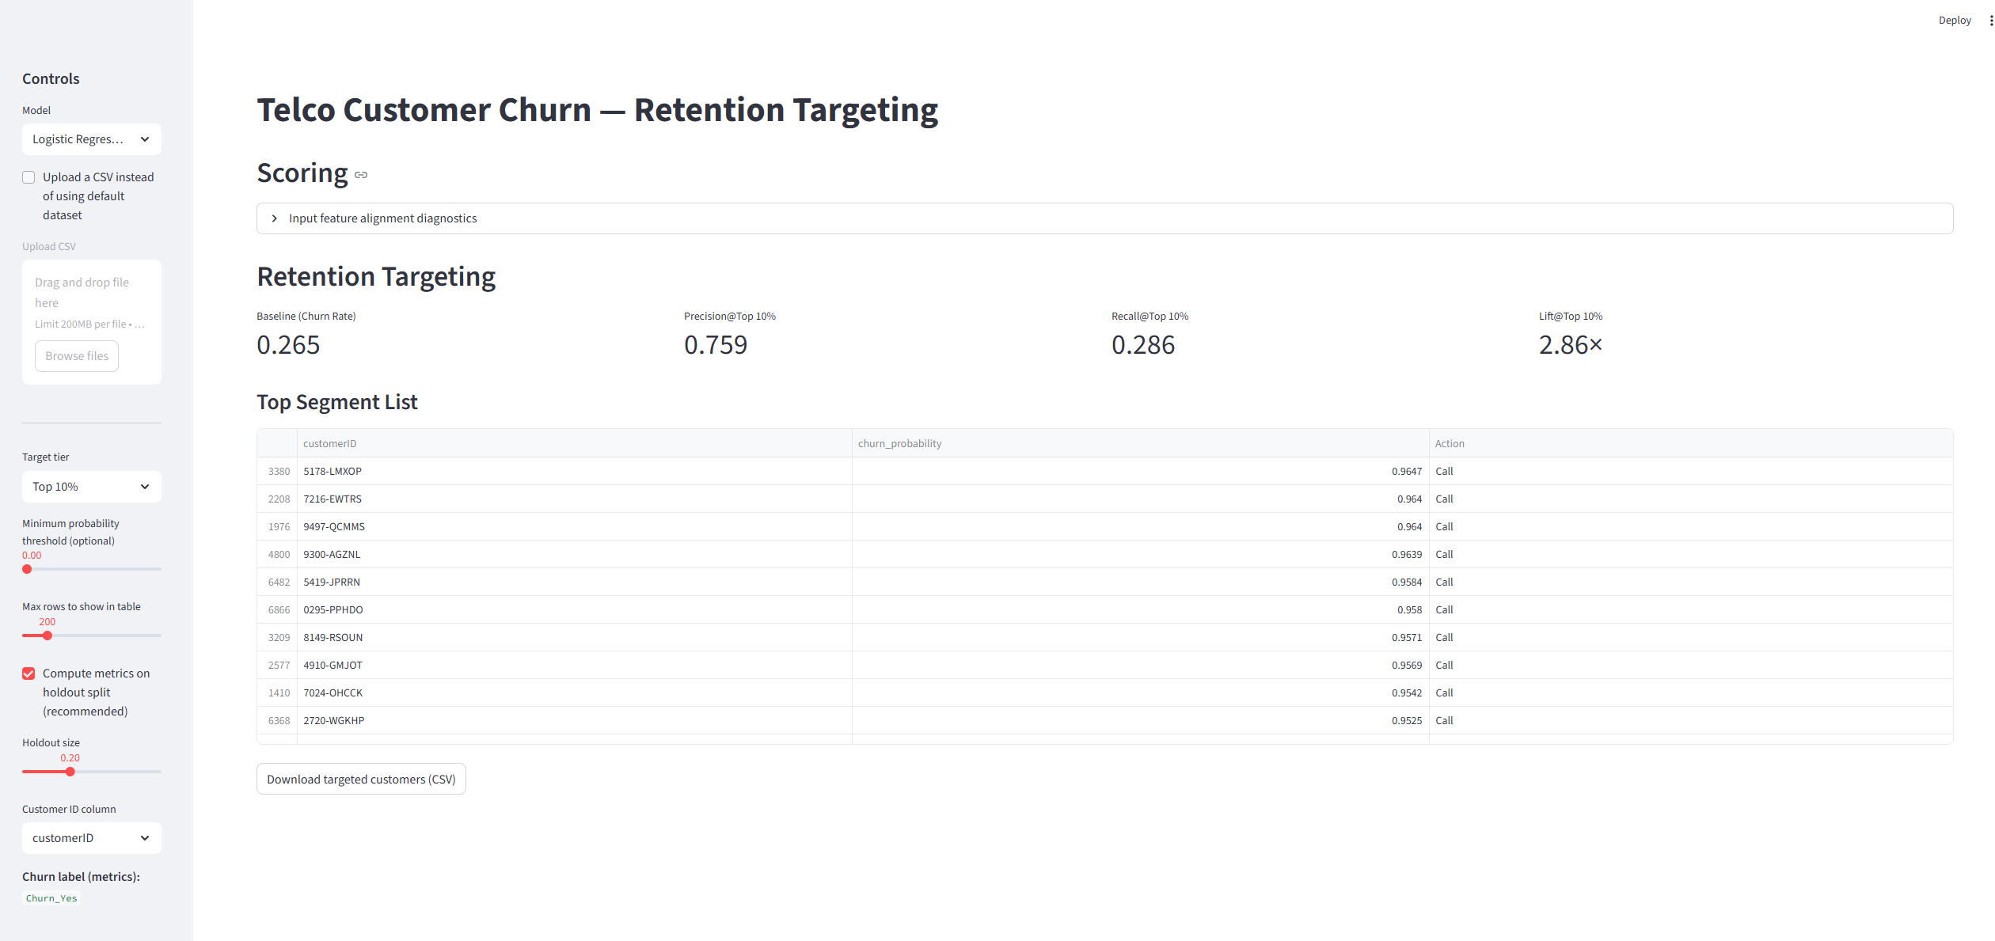
Streamlit App
13/13
Notes:
[
Script]
In five minutes I will show: (1) how we engineered features safely, (2) how we trained models, (3) how we evaluated using Lift@k, (4) how we selected a champion using min–max weighted scoring, and (5) what the Streamlit app delivers operationally.
[Sources]
- Internal project file: model_comparison_results.csv

