Slide 1
PRIMO CHURN RADAR
Oberry is losing members quietly.
~19%
2,260
฿5.4M/yr
of members go silent for 60+ days, unnoticed
members already flagged high-risk today
in spend riding on reaching them in time
No cancellation, no complaint — a member just stops coming back, and nothing in a typical POS report flags it until they're already gone.
Illustrative figures · synthetic data
Notes:
Open with the number, not the model. Almost one in five Oberry members go quiet for two straight months before anyone notices — that's the definition of churn we used throughout. Right now, 2,260 members are already flagged as high-risk by the system, and between them they represent about 5.4 million baht a year in spend. This talk is about how we found them in time to do something about it.

Slide 2
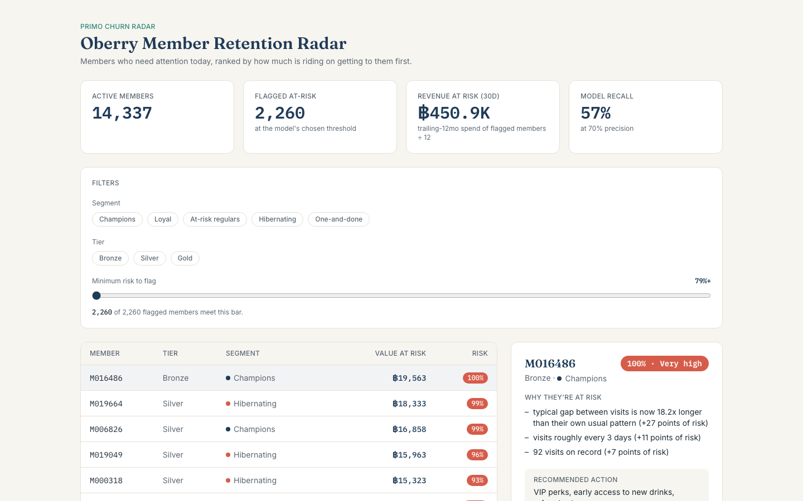
One pipeline: data → segments → risk score → action
1
2
3
4
Data
Segments
Risk score
Action
Two years of transaction history becomes five member segments, a trained risk score for every member, and a specific recommended action — not a hunch.
Illustrative figures · synthetic data
Notes:
This is the whole system in one line, and this screenshot is the actual live dashboard, not a mockup — the Oberry Member Retention Radar. Every number on it reads straight from the same database this pipeline writes to. The operator sees who's flagged, why, and what to do about it, sorted by how much value is on the line.

Slide 3
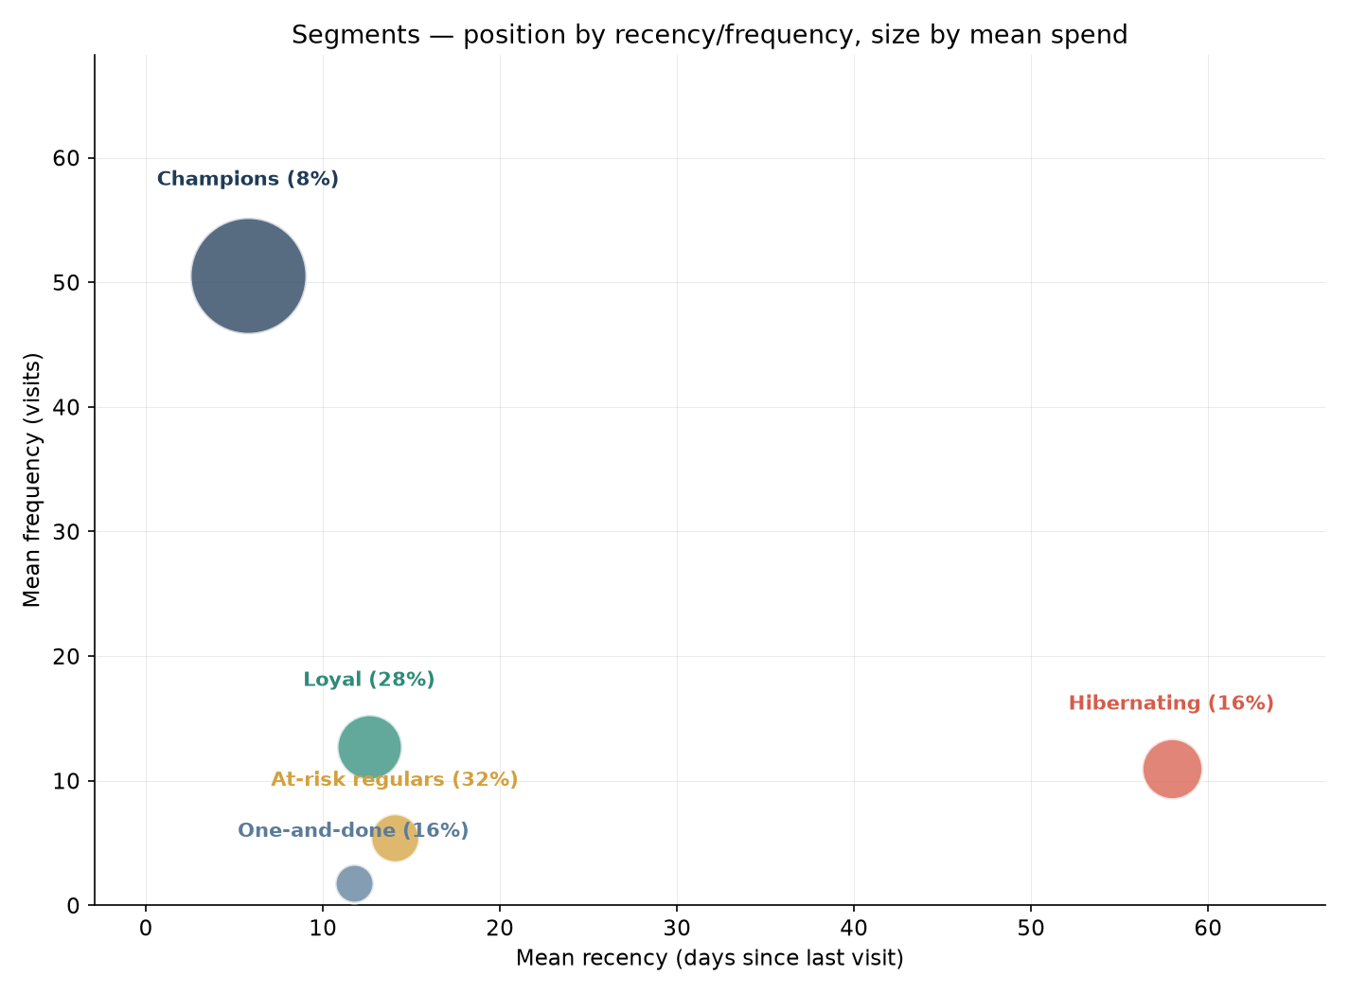
Five kinds of member, not one undifferentiated list
Champions — 8%
Loyal — 28%
At-risk regulars — 32%
Hibernating — 16%
One-and-done — 16%
Illustrative figures · synthetic data
Notes:
This split wasn't hand-picked — it's k-means clustering on recency, frequency, and spend, and the model chose five groups on its own. Position on the chart is recency and visit frequency; bubble size is how much each group spends. Champions are small in number but huge in value. At-risk regulars are the biggest group of all, at 32 percent — that's the group where a small improvement in retention pays for the whole project.

Slide 4
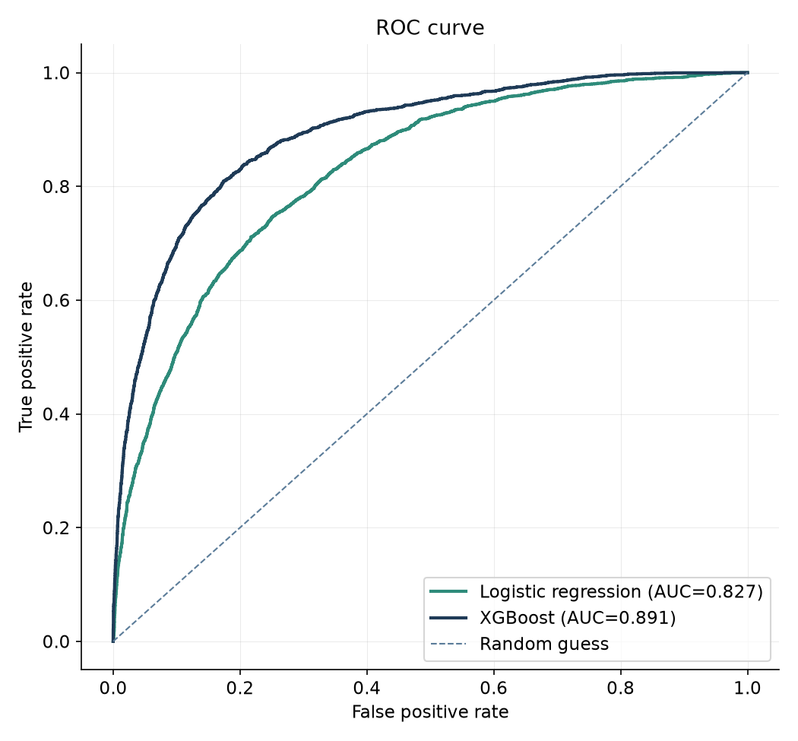
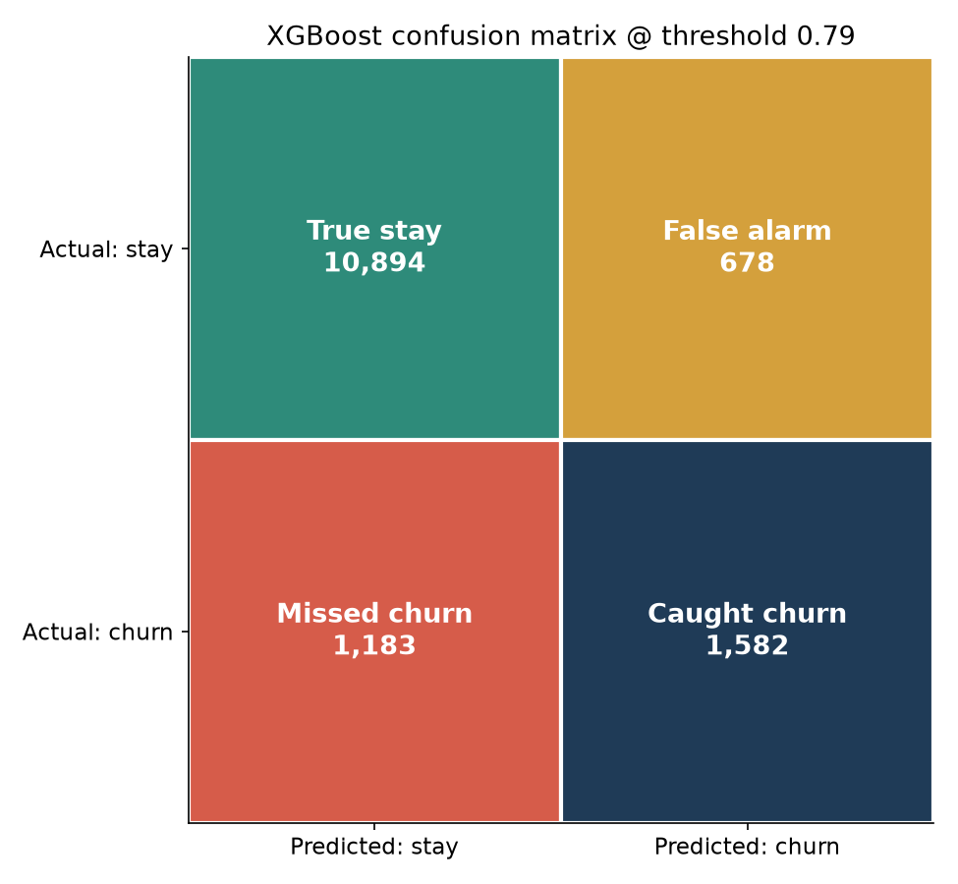
Does it work? Yes — with honest, stated limits
At the chosen threshold, the model catches 57% of members who actually leave, at 70% precision on every alarm it raises — no model catches everyone, and this one doesn't pretend to.
Illustrative figures · synthetic data
Notes:
Two models, tested the honest way: trained on an earlier three-month window, tested on a later one the model never saw, not a random shuffle that would leak the answer. XGBoost beats plain logistic regression, but the logistic regression is respectably close — that's a good sign the signal is real, not an artifact of a complex model overfitting. The confusion matrix uses plain labels on purpose: caught churn, missed churn, false alarm, true stay. We chose the threshold to maximize how many leavers we catch, while keeping false alarms low enough that the win-back coupon stays a genuine signal instead of spam.

Slide 5
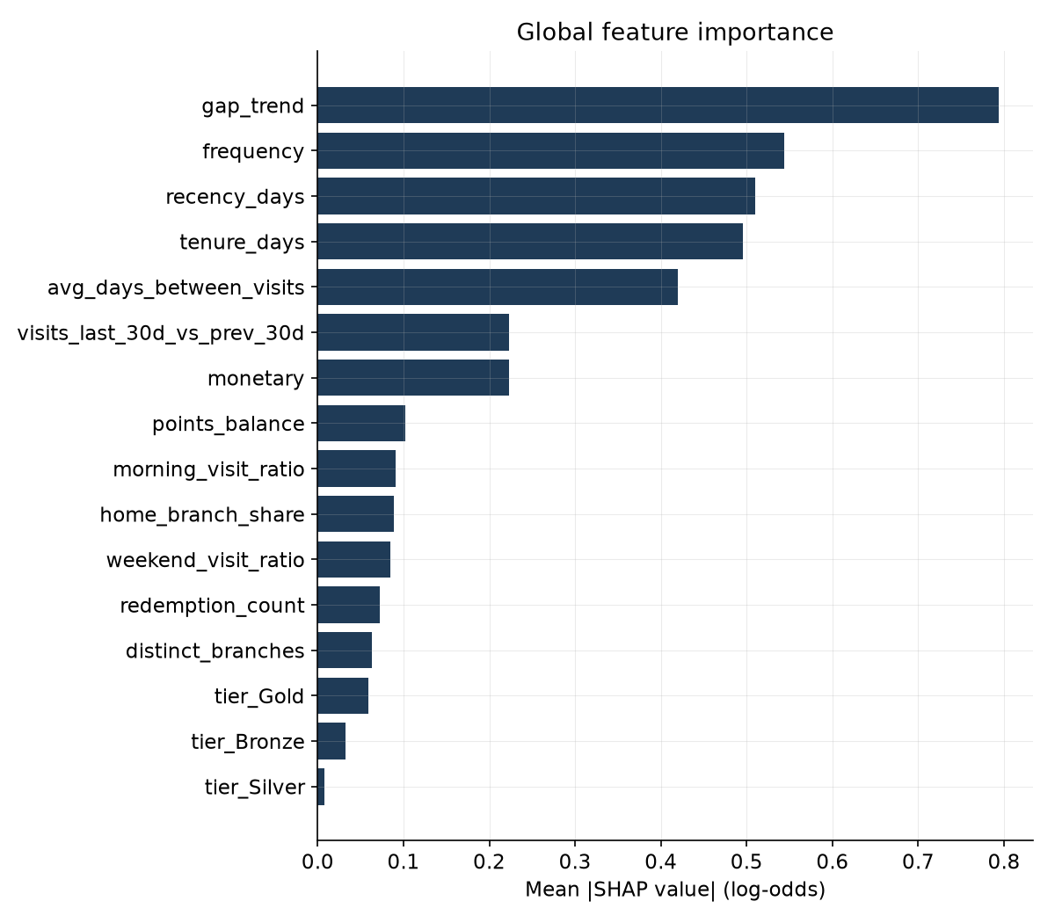
The strongest warning isn't spend — it's silence
– A widening gap between visits predicts departure weeks before the last one.
– Members who never redeem a point churn noticeably more often.
– Recency and visit-gap trend dominate — spend alone barely registers.
Illustrative figures · synthetic data
Notes:
This chart ranks features by how much they actually move the model's prediction, averaged across every member. The two at the top — recency and gap trend — are exactly what the café-specific design of this project was built to catch: not just 'when did they last visit,' but 'has their rhythm already started to change.' The redemption finding is the actionable one for marketing: a member who's never redeemed a point never felt the loyalty program actually reward them, and they leave for it.

Slide 6
A specific action for every flagged member
Segment
Risk
Recommended action
Champions
low
VIP perks, early access to new drinks, referral ask
Loyal
low–med
Tier-up nudge, personalized bundle
At-risk regulars
high
15%-off win-back coupon + “we miss you” LINE mission
Hibernating
very high
Bounce-back free drink + one-question why-survey
One-and-done
high
Onboarding mission, second-visit nudge
Worked example — member M016486
Bronze tier, Champions segment, ฿19,563/year in spend. Typical gap between visits is now 18.2x longer than their own usual pattern (+27 points of risk). Risk: 99.6%. Action: VIP perks, early access to new drinks, referral ask.
Illustrative figures · synthetic data
Notes:
The action table is deliberately not one-size-fits-all: a Champion at risk gets recognition, not a discount, because they don't need convincing to spend — they need to feel seen. Hibernating members get the biggest incentive because they're the hardest and most expensive to win back once fully gone. The example at the bottom is a real flagged member from the current run — the highest-value one — with the actual reasons the model gave and the exact action it recommends.

Slide 7
What it's worth, and what's next
20,000
→
14,337
→
2,260
→
฿5.4M/yr
total members
scored by the model
flagged high-risk
in spend on the line
To productionize, this needs:
This is a working prototype, validated on synthetic data end to end — the architecture is real and the pipeline runs today. What's unproven is whether these exact patterns hold in Oberry's real transaction history, and that's the next step, not a leap of faith.
– Oberry's real transaction data, not synthetic
– A scheduled batch-scoring run, not a one-off
– Instrumented campaigns with measured lift
– Ongoing monitoring for model drift
Illustrative figures · synthetic data
Notes:
This is the slide to slow down on. The funnel shows the honest scope: twenty thousand members, fourteen thousand three hundred of them scored by the model, twenty-two sixty flagged today, representing about 5.4 million baht a year in spend. We have not measured what fraction of those we'd actually retain with these campaigns — that requires running them against real members and measuring what happens, which is exactly the next phase. Everything up to this point is a working prototype on synthetic data. The architecture, the leak-free evaluation, the explainability — that's all real and reusable. What's left is proving it on Oberry's actual data.

