Slide 1
Jumping for JS

Slide 2
Today’s Class

Slide 3
Objectives
In today’s class we’ll be covering:
The Art of Pseudo-Coding
Building Rock-Paper Scissors
JavaScript Functions

Slide 4
Basics Recap

Slide 5
Deep Philosophy
What is JavaScript?
(And what is it used for?)

Slide 6

JavaScript Definitions
JavaScript is the third of the three fundamental programming languages of the modern web (along with HTML, CSS)
JavaScript allows developers to create dynamic web applications capable of taking in user inputs, changing what’s displayed to users, animating elements, and much more.

Slide 7
Please… Don’t Pick Me.
What is a Variable?
(And how do we declare one?)

Slide 8
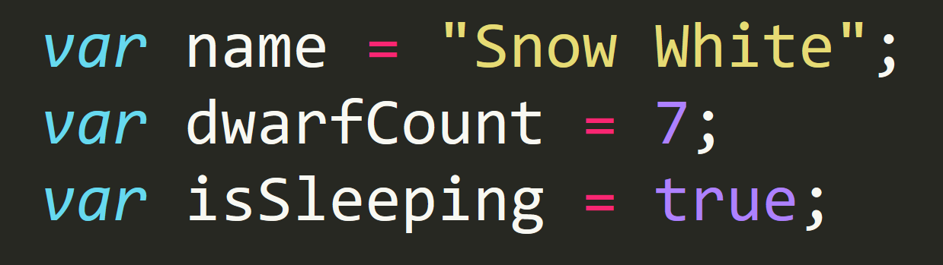
Basic Variables
Variables are the nouns of programming.
They are “things” (Numbers, Strings, Booleans, etc.)
They are composed of variable names and values

Slide 9
Please… Don’t Pick Me.
What is meant by console.log?
(And how does it differ from an alert, prompt, or confirm?)

Slide 10
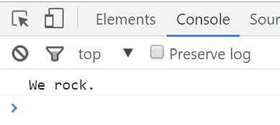
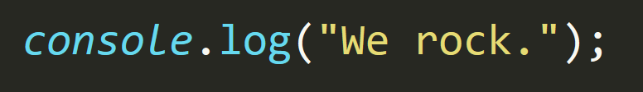
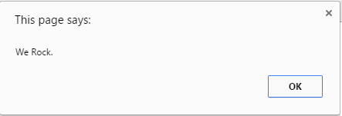
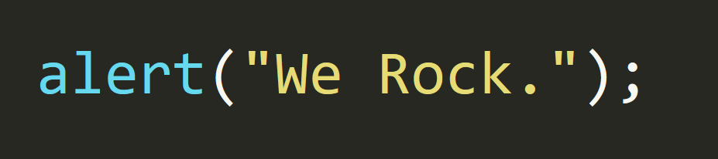
Basic Variables
Console.log displays discreetly to the debugger.
Alert displays a pop-up message to the user.

Slide 11
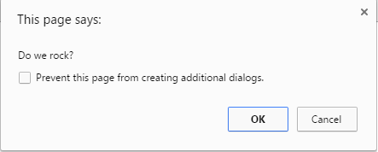
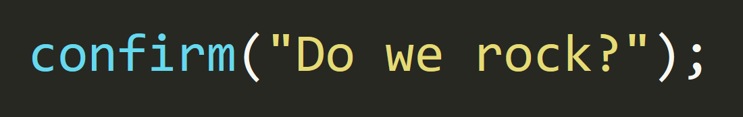
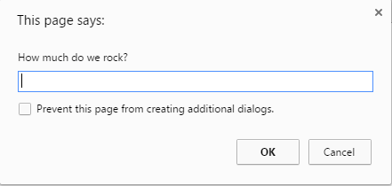
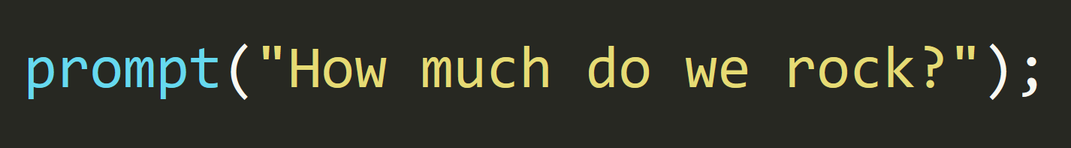
Basic Variables
Confirm displays a True/False popup.
Alert displays a prompt with a text-box input.

Slide 12
Please… Don’t Pick Me.
How do we “write” text to the HTML itself?

Slide 13
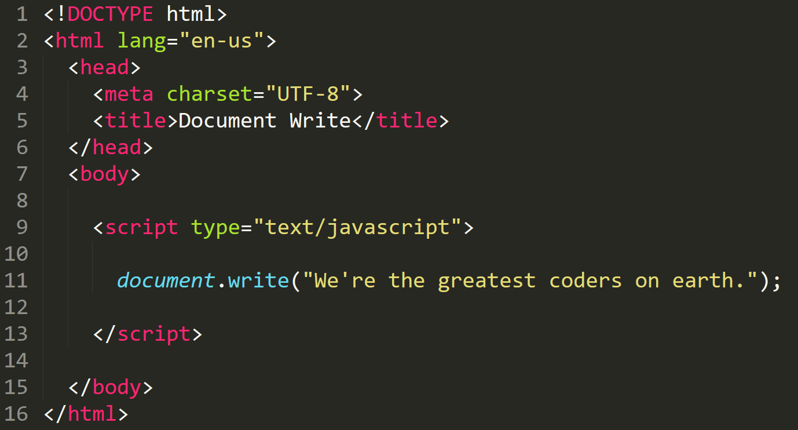

Writing to HTML
We can use JavaScript to directly write to the HTML page itself using document.write( ).
Later we will go over much more advanced approaches for writing HTML using JavaScript and jQuery.
Test.html (chrome)
Test.html
(sublime)

Slide 14
Please… Don’t Pick Me.
How do we check conditions?

Slide 15
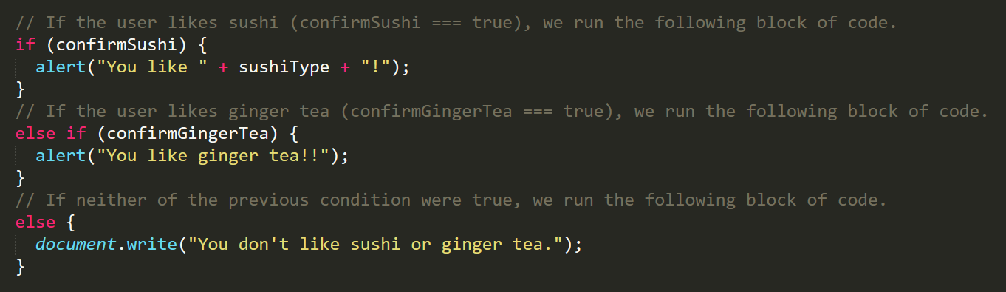
If/Else Statements
If/Else statements are critical.
Each statement is composed of an if, else-if, or else (keyword), a condition, and the resulting code in { } curly brackets.

Slide 16
Please… Don’t Pick Me.
What is an array?

Slide 17
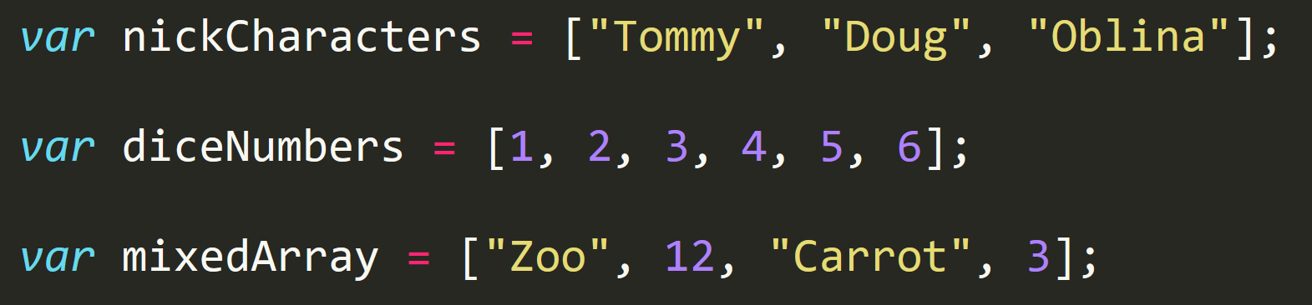
Basic Arrays
Arrays are a type of variable that are collections.
These collections can be made up of strings, numbers, booleans, other arrays, objects, anything.
Each element of the array is marked by an index. Indexes always start with 0.

Slide 18
PAUSE

Slide 19
Functions

Slide 20
> YOUR TURN!!
Activity: 25-LoopTV | Suggested Time: 10 min
Code Dissection: Array Building
Run the program sent to you via slack.
Then, with a partner, fill in the missing comments for each line of code.
Make sure both of you can fully explain what each line means.
Be prepared to share with the class.

Slide 21
Demo Time
Instructor: Demo
(SuperHeroLogging_NoFunctions.html | 26-SuperHeroLogging)

Slide 22
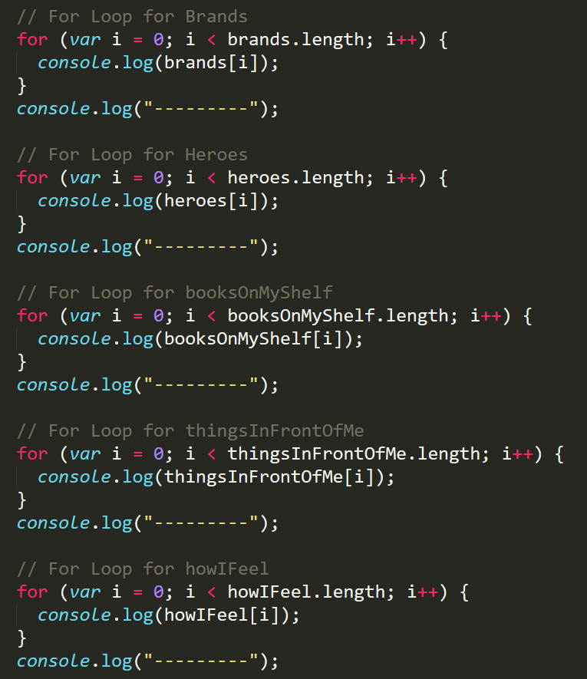
Mondo Repetitive…
Who wants to maintain this??
Hint: No one.

Slide 23
Demo Time
Instructor: Demo
(SuperHeroLogging_withFunctions.html | 26-SuperHeroLogging)

Slide 24
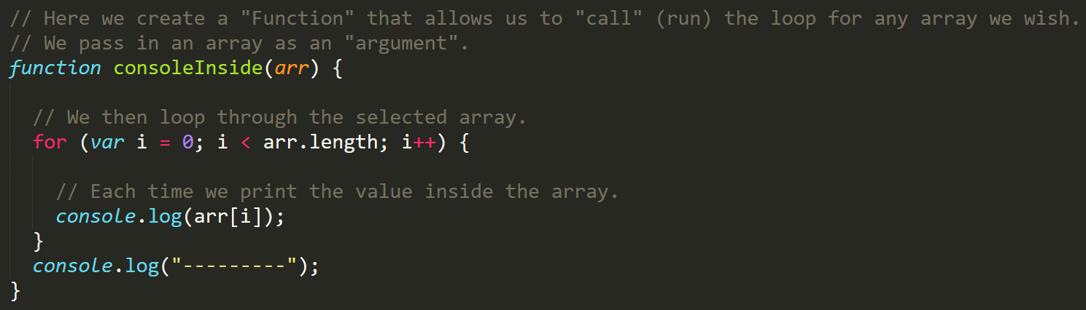
Much Better with Functions!
Squeaky Clean Code.
Minimal repetition

Slide 25
> YOUR TURN!!
Activity: 27-MyFirstFunctions | Suggested Time: 20 min
Code Creation: Function Building
Working in pairs and using the starter file sent to you via slack–fill in the missing functions and function calls.
Note: Try to finish all four functions if you can, but don’t be distressed if you only get 1 or 2. The important thing is that you get at least one function fully done.
HINT: Look back to the previous example if you need help.

Slide 26
Recap Activity
Time Permitting

Slide 27
Questions

