Slide 1
TuneFull

Slide 2
The Team Roster
Laura Steiner – Team Leader
Robert Dominguez – Team Member
Roderick Frechette – Team Member

Slide 3
Project Summary
The TuneFull music network bundles together fun and discovery to provide its users with a positive and friendly music sharing experience. Tune in to share 20-30 second clips of music that match your mood, and see what music clips your friends are sharing. You can also listen to clips posted by people outside your friend circle to discover new music, or follow those with similar taste.

Slide 4
Technical Inventory
Android platforms
Hibernate
Spotify API
JUnit 5
Stetho

Slide 5
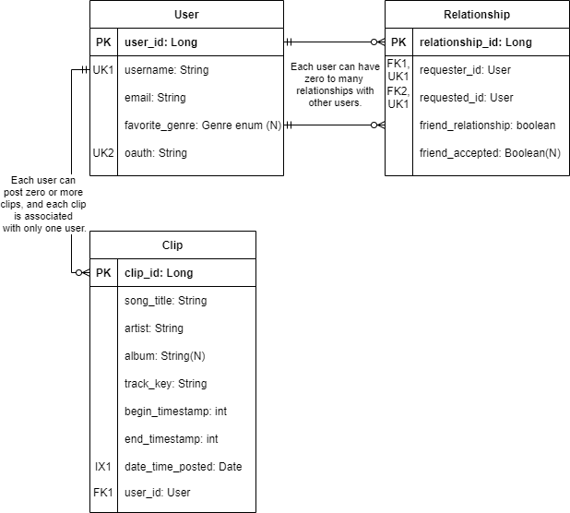
ERD: Server Side
User
Etc.
Relationship
Etc.
Clip
Etc.

Slide 6
Security Considerations
Spotify API
Used to login in.
HTTPS

Slide 7
Key Obstacles Encountered/Overcome
We did stuff.

Slide 8
Current State and Possible Future Direction.
CNM App Contest.

Slide 9
PDF

Slide 10
Thank you for your time.

