Slide 1

TuneFull
The Musical Social Network

Slide 2
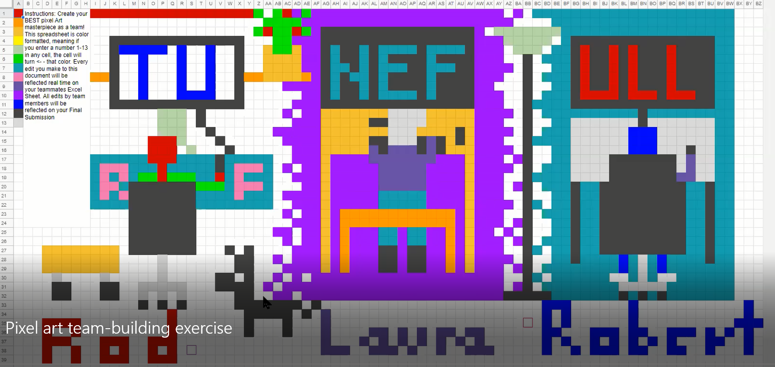
The TuneFull Team
Robert Dominguez – Team Member
Website: https://dominguez1st.github.io/
Personal Project: Card Combat
Roderick Frechette – Team Member
Website: https://rfrech.github.io/
Personal Project: Battle of Midway
Laura Steiner – Team Leader
Website: https://lsteiner9.github.io/
Personal Project: ScaleScroller

Slide 3
Project Summary
The TuneFull music network bundles together fun and discovery to provide its users with a positive and friendly music sharing experience. Tune in to share 30 second clips of music that match your mood, and see what music clips your friends are sharing. You can also listen to clips posted by people outside your friend circle to discover new music, or follow those with similar taste.

Slide 4
Technical Inventory for Server and Client
Server:
Ubuntu Linux OS
Apache HTTPS server configured as reverse proxy
JRE 8
Apache Tomcat Java application server
Web service application, incorporating
Data model
Custom entity classes
Hibernate ORM
Embedded Apache Derby database
Spring Boot Data
Custom data repository interfaces
Service Controllers
Spring MVC
Custom Controllers
View Composition & Serialization
Jackson JSON
Custom View Classes & Interfaces
Authentication
Spring Security
Google Sign In
Client:
Android OS
Remote service interfaces
Retrofit
Gson
ReactiveX
View Model Components
Android Lifecycle framework (ViewModel & LiveData)
Custom View Model Classes
View
Custom RecyclerView.Adapter and RecyclerView.Holder classes
Custom Layouts
Custom Dialogs
Custom Drawables and Vector Assets
Controller
Custom activity, fragment, dialog classes
Authentication
Google Sign In
Spotify Sign In (OpenID)
Other Libraries/Services
Stetho
OkHttp Logging
Spotify SDK
Spotify API

Slide 5
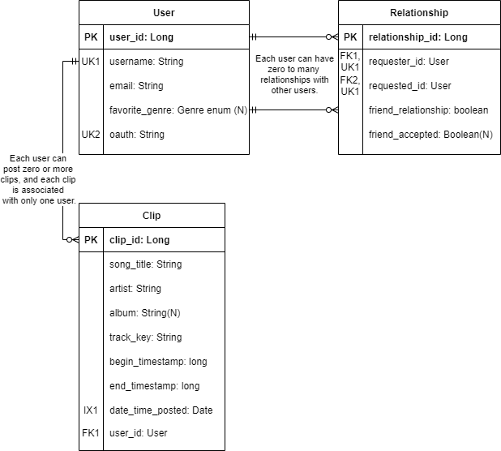
Entity-Relationship Diagram

Slide 6
TuneFull Demo

Slide 7
Obstacles Overcome and Lessons Learned
Navigation
Being willing to change our ideas from original wireframes
Being Persistent
Things take longer than expected

Slide 8
Current State and Future Directions
Some issues/bugs to work on
Future Directions:
UNM App Contest
Google Play Store

Slide 9
Thank you for your time! Check it out at: tunefull.github.io

