Slide 1
TuneFull

Slide 2
The Team Roster
Laura Steiner – Team Leader
Contact Info
Robert Dominguez – Team Member
Roderick Frechette – Team Member

Slide 3
Project Summary
The TuneFull music network bundles together fun and discovery to provide its users with a positive and friendly music sharing experience. Tune in to share 20-30 second clips of music that match your mood, and see what music clips your friends are sharing. You can also listen to clips posted by people outside your friend circle to discover new music, or follow those with similar taste.

Slide 4
Technical Inventory - Server
Android platforms
Hibernate
Spotify API
Stetho
Spring Framework
OkHttp Logging Dependency
ReactiveX
Gson

Slide 5
Technical Inventory - Client
Android platforms
Hibernate
Spotify API
Stetho
Spring Framework
OkHttp Logging Dependency
ReactiveX
Gson

Slide 6
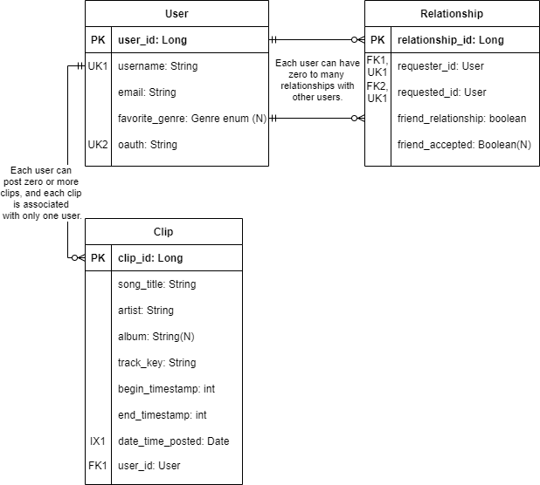
ERD: Server Side
User
Etc.
Relationship
Etc.
Clip
Etc.

Slide 7
Security Considerations
Spotify API
Used to login in.
HTTPS

Slide 8
Key Obstacles Encountered/Overcome
We did stuf
Spotify API
User to User
Relationship – Friends to Following
Navigation
Learned how find info

Slide 9
Demo

Slide 10
Current State and Possible Future Direction.
UNM App Contest
Google Play
Future colaberation with Spotify

Slide 11
Thank you for your time.

