Slide 1

TuneFull
The Musical Social Network

Slide 2
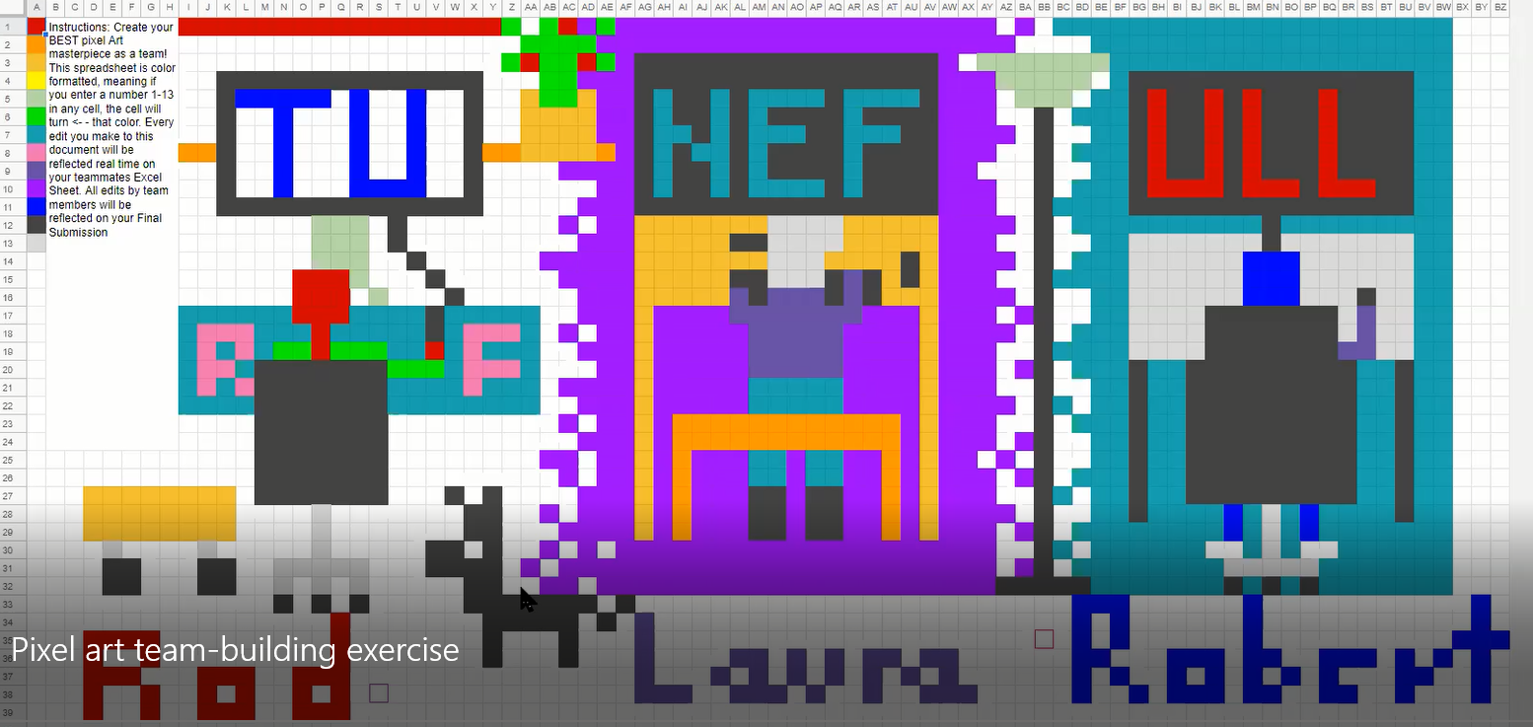
The TuneFull Team
Robert Dominguez – Team Member
Website: https://dominguez1st.github.io/
Roderick Frechette – Team Member
Website: https://rfrech.github.io/
Laura Steiner – Team Leader
Website: https://lsteiner9.github.io/

Slide 3
Project Summary
The TuneFull music network bundles together fun and discovery to provide its users with a positive and friendly music sharing experience. Tune in to share 30 second clips of music that match your mood, and see what music clips your friends are sharing. You can also listen to clips posted by people outside your friend circle to discover new music, or follow those with similar taste.
Goals
Motivation

Slide 4
Technical Inventory – Server Side
Technology stack:
Ubuntu Linux OS
Apache HTTPS server configured as reverse proxy
JRE 8
Apache Tomcat Java application server
Web service application, incorporating
Data model
Hibernate ORM
Spring Boot Data
Custom data repository interfaces
Service Controllers
Spring MVC
Custom Controllers
View Composition & Serialization
Jackson JSON
Custom View Classes & Interfaces
Authentication
Spring Security
Google Sign In
Custom entity classes
Embedded Apache Derby database

Slide 5
Technical Inventory – Client Side
Technology stack:
Android OS
Remote service interfaces
Retrofit
Gson
View Model Components
Android Lifecycle framework (ViewModel & LiveData)
Custom View Model Classes
View
Custom RecyclerView.Adapter and RecyclerView.Holder classes
Custom Layouts
Custom Dialogs
Custom Drawables and Vector Assets
Controller
Custom activity, fragment, dialog classes
Authentication
Google Sign In
Spotify Sign In (OpenID)
Other Libraries/Services
Spotify SDK
Spotify API
Stetho
OkHttp Logging
ReactiveX

Slide 6
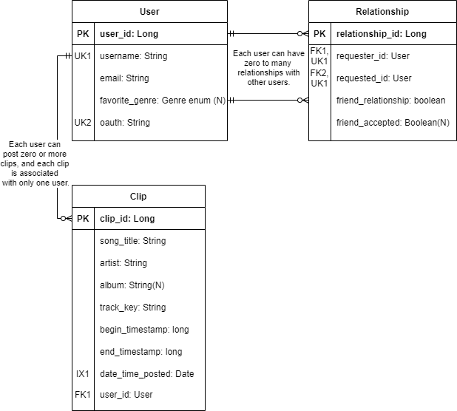
Entity-Relationship Diagram

Slide 7
Security Considerations
Authentication and authorization through Google Sign In
No user credentials stored in our database
OpenID authorization with Spotify
HTTPS
Prepared SQL statements to avoid SQL injection

Slide 8
TuneFull Demo

Slide 9
Obstacles Overcome and Lessons Learned
Data model: Relationship entity
How to connect User to User
Friends vs. following
Spotify SDK and Authentication
Research info online
Thinking out-of-the-box
Navigation
Being willing to change our ideas from original wireframes
Being Persistent
Things take longer than expected

Slide 10
Current State and Future Directions
Some issues/bugs to work on:
Spotify App Remote
Unimplemented screens
Some client-server communication is not yet working.
Future Directions:
Fix issues/bugs
UNM App Contest
Continue customizing the look and feel of our app
Google Play Store

Slide 11
Thank you for your time! Check it out at: tunefull.github.io
Questions?

