Slide 1
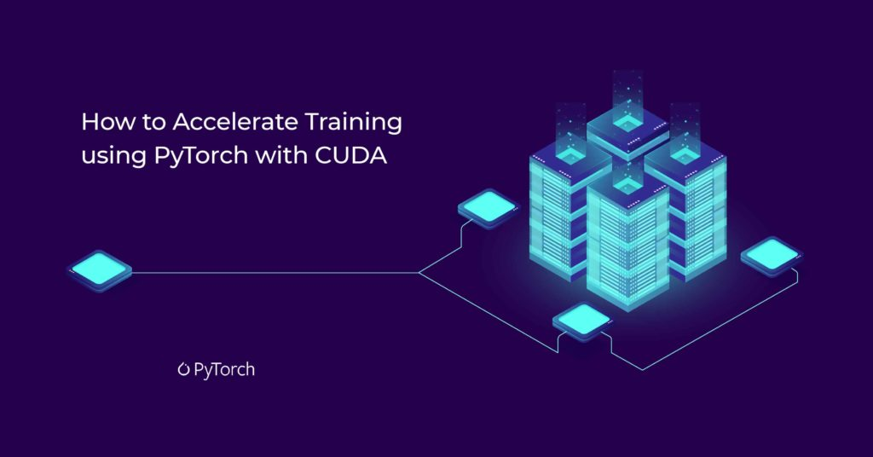
17 Minutes or 7 Hours? Train ML Model Using GPU vs CPU https://github.com/tuneman7/cuda_work/blob/main/README.md
Prepared For:
Data Science and Machine Learning Students and Practitioners
Prepared By:
Don Irwin
W255 Summer 2022
August 6 2022

Slide 2
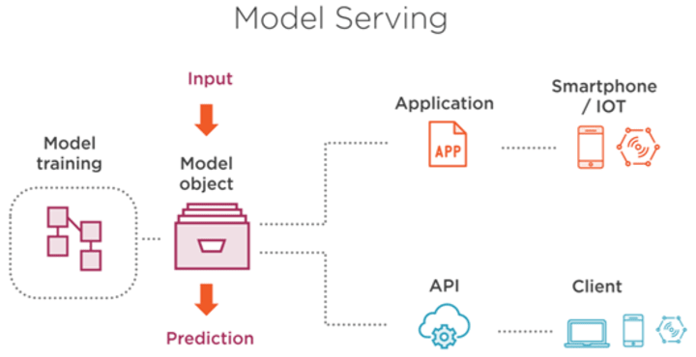
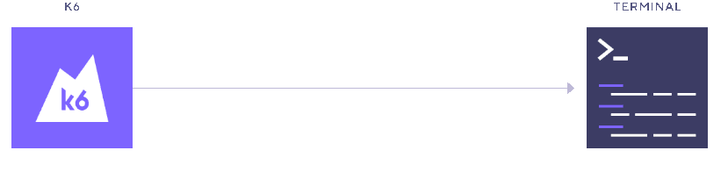
Background:
Background:
This project utilizes the DistilBertForSequenceClassification sentiment analysis model which is inside of the "glue" dataset.
It downloads, or trains the model then serves it within a FASAPI container and runs K6 load testing against a minikube instance.
K6 Load Testing
MIDS 2022 Summer, W255 Project Don Irwin

Slide 3
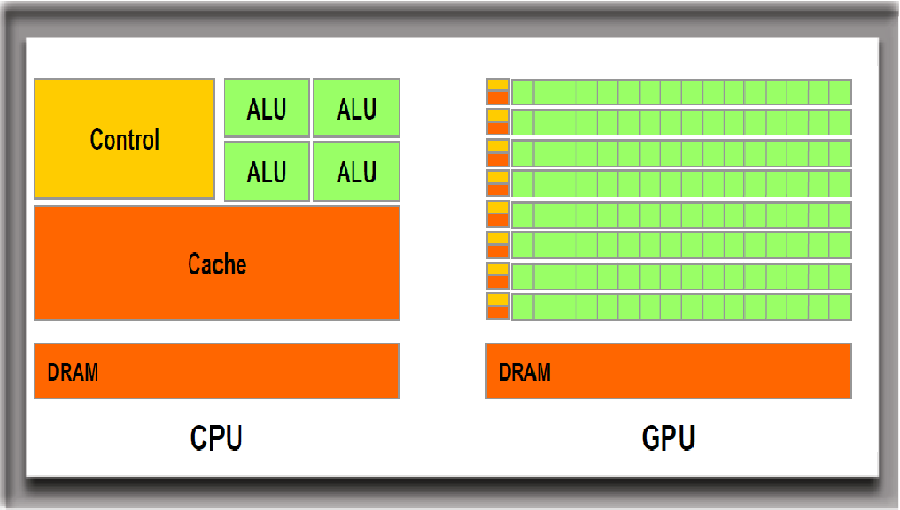
CPU and GPU working together in AI frameworks:
CPUs have larger instruction sets, allowing them to “do more things” than a GPU. However, GPUs generally contain thousands of cores, achieve higher parallelism, and are very good with matrix multiplication, utilized by machine learning, and neural net frameworks. Often times the CPU acts as the “controller” off-loading tasks to the GPU then persisting or evaluating the results.
MIDS 2022 Summer, W255 Project Don Irwin

Slide 4
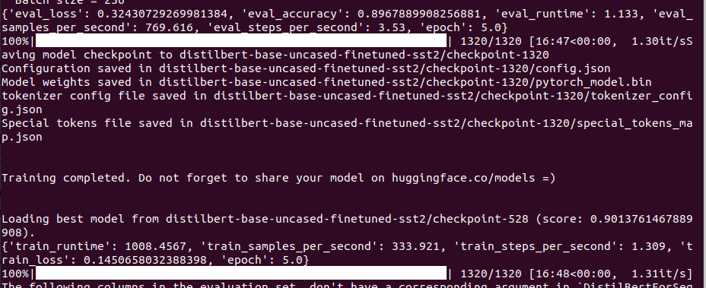
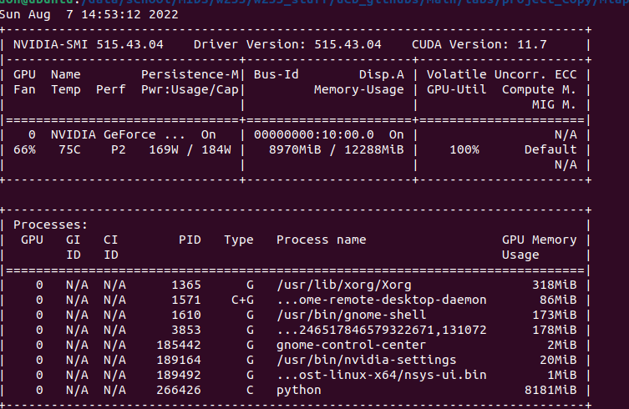
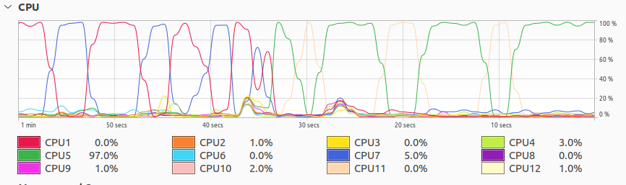
Results: CUDA – GPU train time and CPU/GPU use profile
Train time @ 17 minutes 334 train samples per second.
GPU use at 100%, Python Using 8 Gigs of memory
Most CPU cores Unused
MIDS 2022 Summer, W255 Project Don Irwin

Slide 5
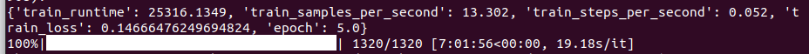
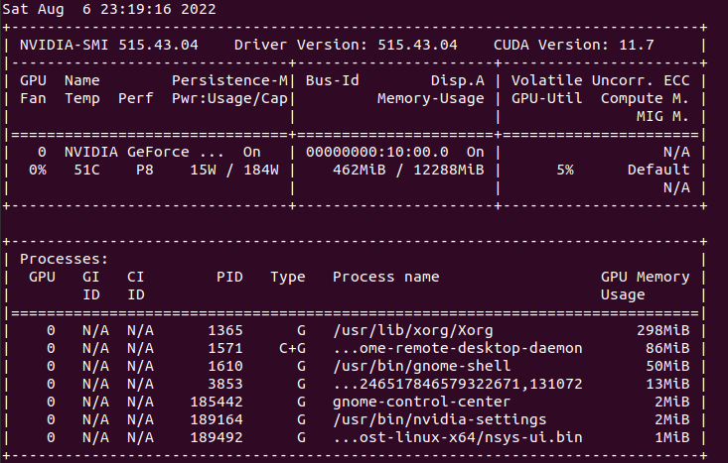
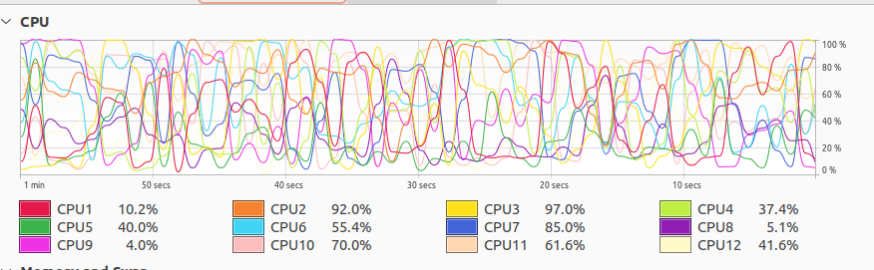
Results: CPU train time and CPU/GPU use profile
Train time @ 7 hours 13.3 train samples per second
GPU-based training can train the model 24 times in, the amount of time it took the CPU to train the model a single time.
GPU use at 5%, Python using no memory.
Very High CPU Activity
MIDS 2022 Summer, W255 Project Don Irwin

Slide 6
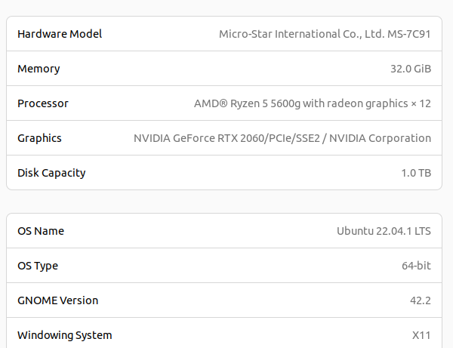
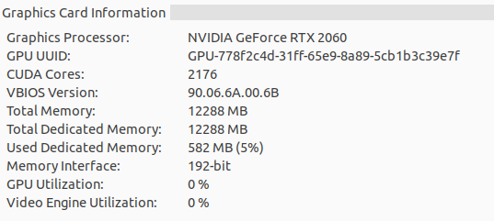
System Specifications:
The system is good, but not ultra high-end. I parted this system together to avoid having to use my MAC M1 given the complications associated with getting packages to run on the M1 architecture. For servers, Linux, the x64 architecture, and the NVIDIA cuda frameworks are widely used. I still use my M1 to terminal into this machine while travelling. It’s an uncomplicated way of doing development since many of the packages just work. Also, getting R Studio distributions to work well on an M1 machine can be quite a headache.
MIDS 2022 Summer, W255 Project Don Irwin

Slide 7
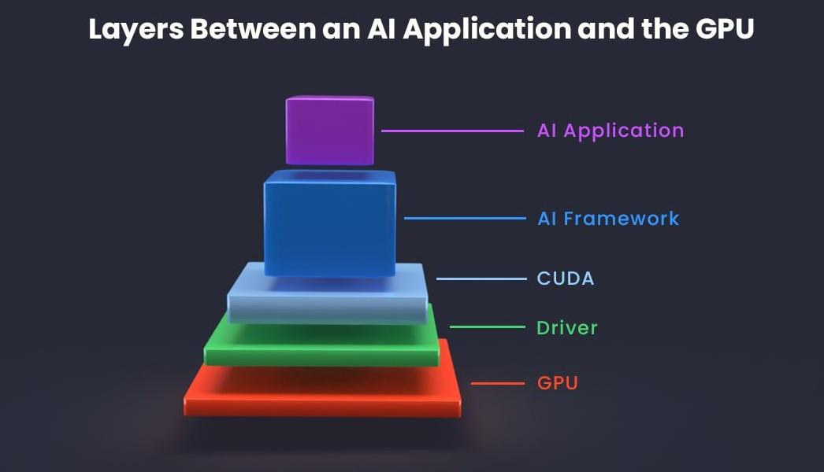
Getting it to work: Be prepared to spend some hours on this.
Have an NVIDIA graphics card or device which is compatible with NVIDIA’s CUDA package.
Install NVIDA drivers.
Install the CUDA packages / tools.
Test that pytorch can “see” the graphics card and do its work on it: git clone https://github.com/tuneman7/cuda_work && . ./cuda_work/test_python_cuda.sh
Some resources on this: https://tuneman7.github.io/cuda_notes.html We are also able to access the GPU from within docker images, but that is beyond the scope of this demonstration.
MIDS 2022 Summer, W255 Project Don Irwin

Slide 8
Sample Application:
https://github.com/tuneman7/cuda_work
NOTES: I could not get cuda / torch to play well under poetry. For training, this project uses python3 virtual environments. For the docker build it still uses poetry. when the model is trained, the prediction scores will be slightly different after each training so the “assert_almost_equal” statements within the test harness are necessarily removed. You can re-add them after testing it once or twice. The run.sh script checks for environmental variables, as needed. ENVIRONMENTAL DEPENDENCIES – in addition to Cuda from previous slide: Docker, Minikube, K6, Poetry, python3.10-venv RUNNING: git clone https://github.com/tuneman7/cuda_work cd cuda_work
. run.sh OR: git clone https://github.com/tuneman7/cuda_work && cd cuda_work && . run.sh
MIDS 2022 Summer, W255 Project Don Irwin

Slide 9
Thank You!

