Slide 1

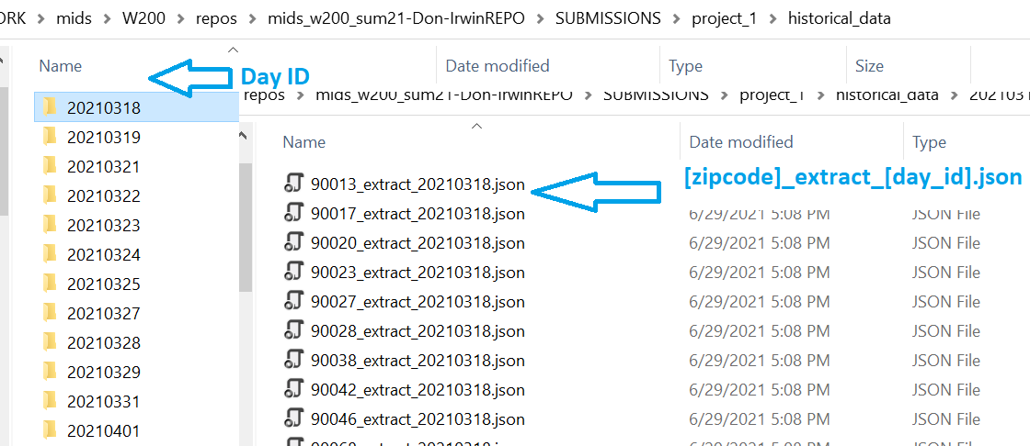
MIDS Summer 2021 w200 Project 1 Presentation Don Irwin: 06/24/2021
{
"active_listings": "79",
"active_listings_up_down": "down",
"analytics_uri": "https://www.realtor.com/realestateandhomes-search/90017",
"average_days_on_market": "123",
"average_days_on_market_up_down": "down",
"description": "Downtown Los Angeles",
"extract_day_id": "20210318",
"extract_dt": "03/18/2021, 09:15:16",
"median_list_price": "599,000",
"median_list_price_up_down": "down",
"median_price_per_sqft": "707",
"median_price_per_sqft_up_down": "up",
"price_reduced_status": "https://www.redfin.com/zipcode/90017/filter/max-price-reduced=1d",
"price_reduced_today": 2,
"search_uri": "https://www.redfin.com/zipcode/90017",
"zipcode": "90017"
}
Background: I collected summary Real Estate data for approximately three months. There is too little data to garner any information about market trends, and the data is imperfect. But it was / is enough to use for a simple project utilizing object oriented design.
Persistent data store: I’m using my file system as the persistent data store. Let’s look at the data.

Slide 2
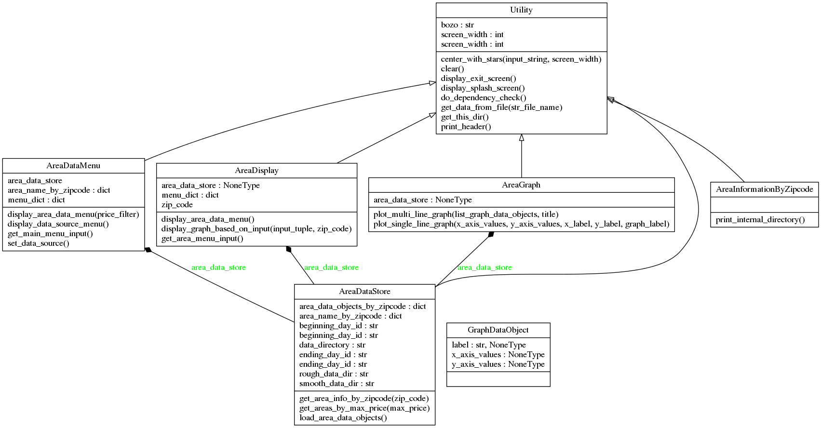
MIDS Summer 2021 w200 Project 1 Presentation Don Irwin: 06/24/2021
Class Diagram

Slide 3
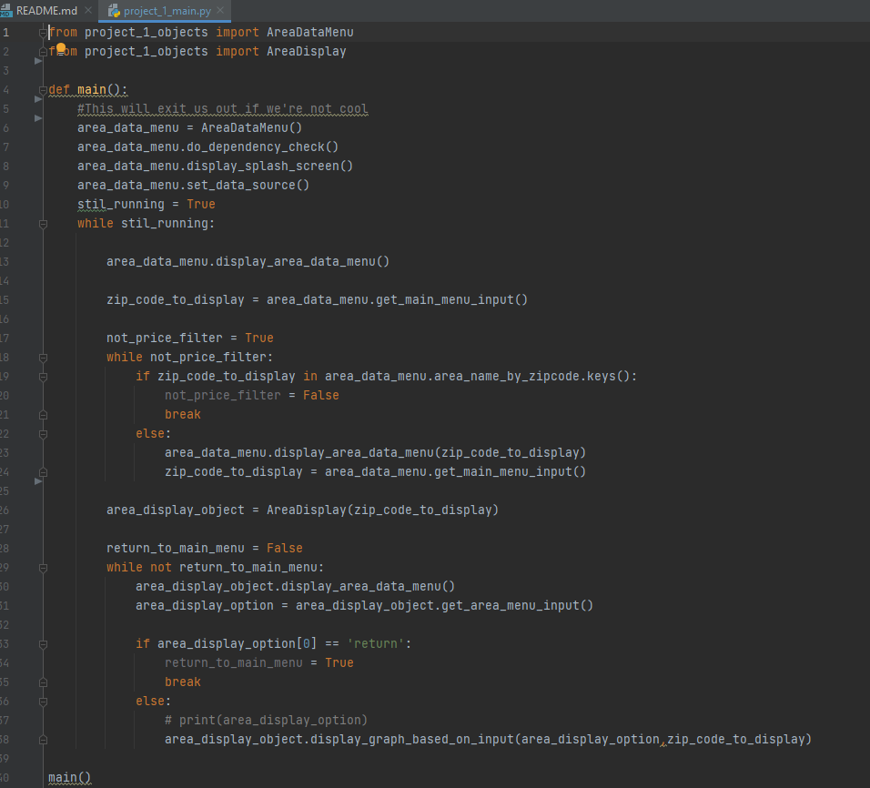
MIDS Summer 2021 w200 Project 1 Presentation Don Irwin: 06/24/2021
Flow Control
Look at Project_1_main.py:
Note on Dependency Checking: We need to alert a user if something is missing on their system. Additionally we need to be portable I.E. it will run on OSX / Linux and Windows. -- Look at utility class.

Slide 4
MIDS Summer 2021 w200 Project 1 Presentation Don Irwin: 06/24/2021
Run Demo:
Look at class files:

