Slide 1
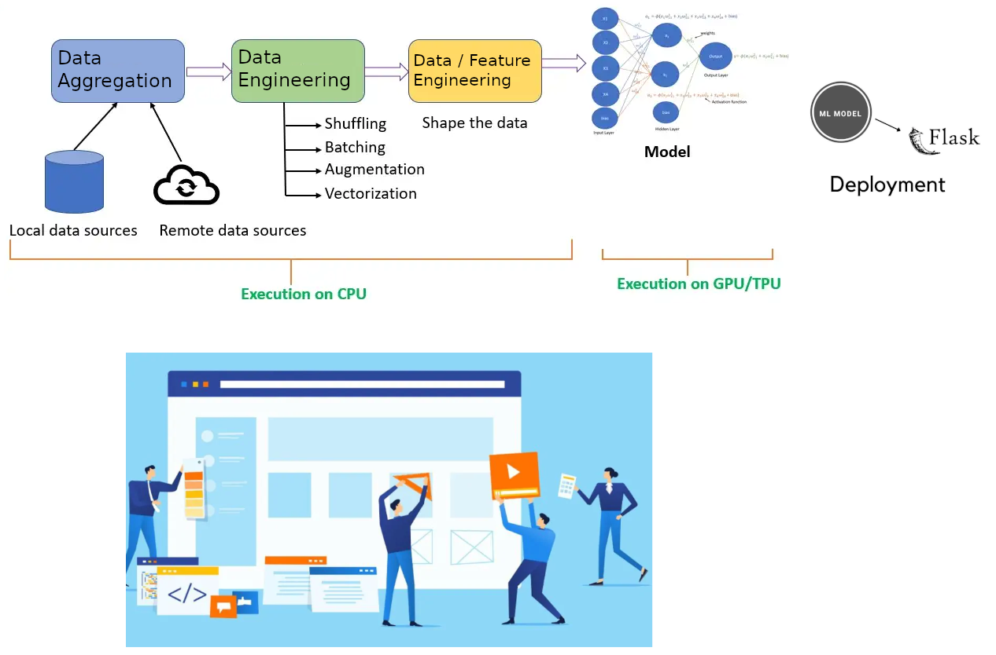
Sequence for being able to create a ML web application
After all of the above is done you can build your app
At week 10 (Presentation 2) none of the above was done. At week 7 and 8, I requested help with data aggregation / feature engineering. -- None was provided. Yet I had made a commitment to the team to build a website. I had to do the data aggregation. I had to do the data / feature engineering I had to identify a model. I had to train a model. I had to tune a model. I had to deploy the model. I had to code a composite multi-signal analysis model. Then I had to build the site.

Slide 2
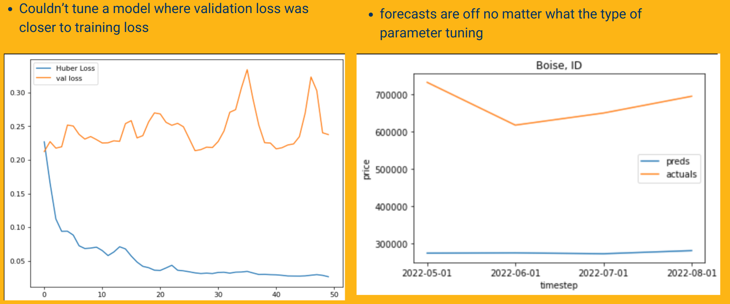
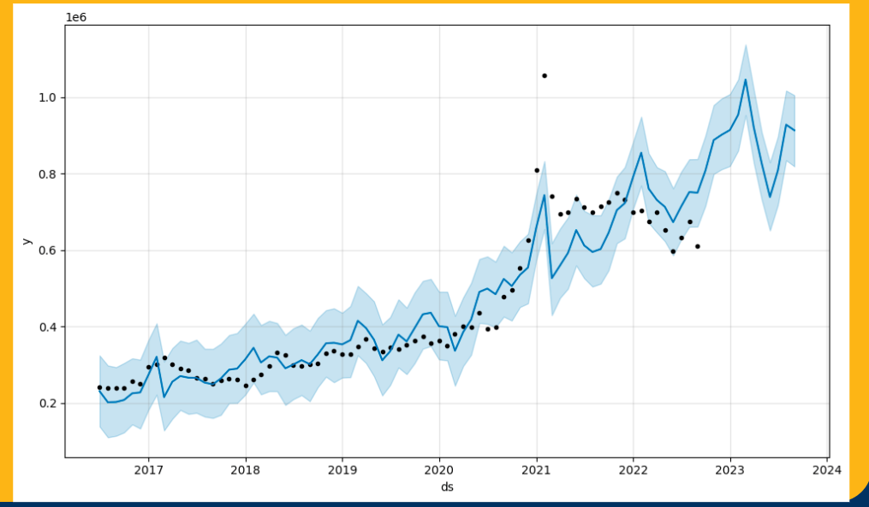
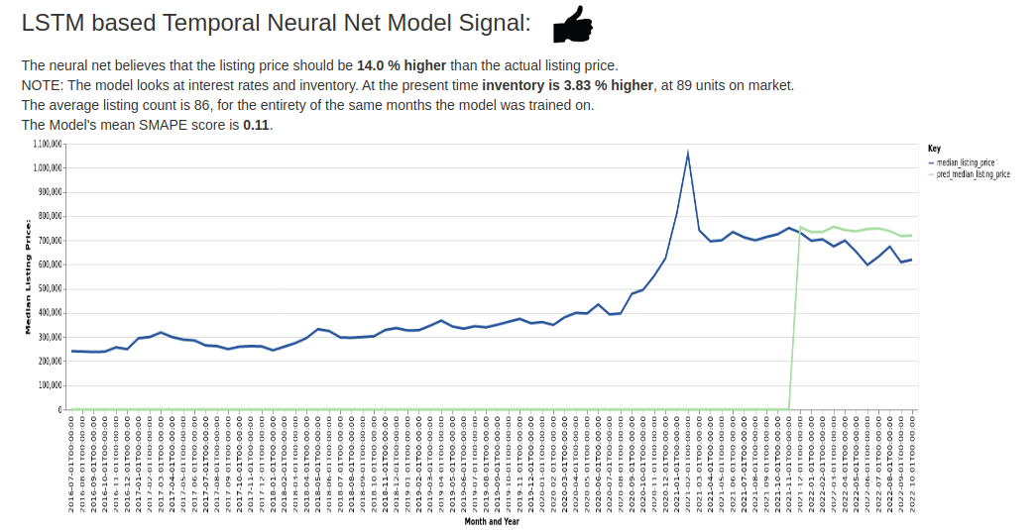
Models Before and After – Boise ID

Slide 3
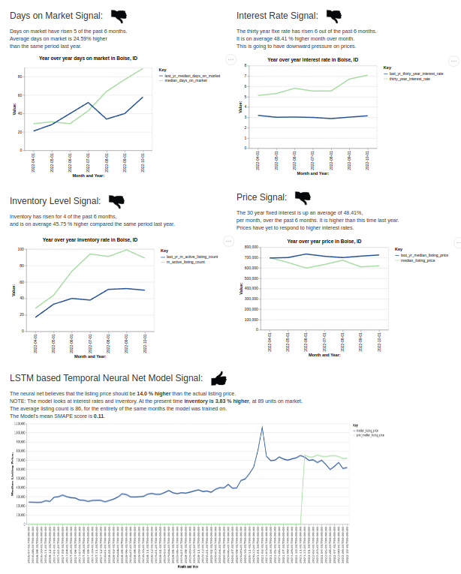
Composite Multi Signal Analysis Model – the pictures are pretty, but the code behind is beautiful – and probably still wrong.

Slide 4
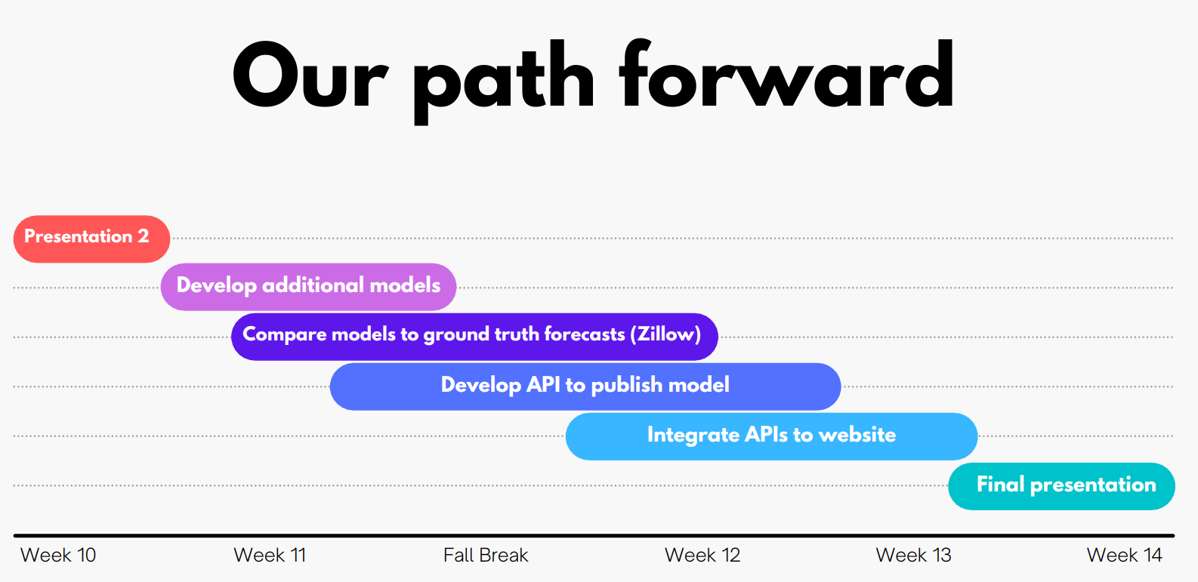
None of the below was done, it could not occur, because upstream tasks were not completed, or resource scarcity. I had to improvise, nothing was provided to me by team members, despite requests.

