Slide 1
Monkey Meykon
Nguyễn Sơn Tùng

Slide 7
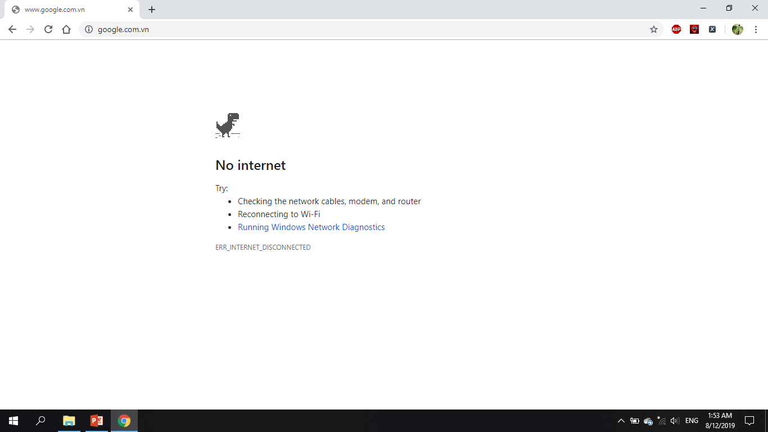

Slide 8
Thanks to listening!

