Slide 1
Solution Architect 1
TungNQ4

Slide 2
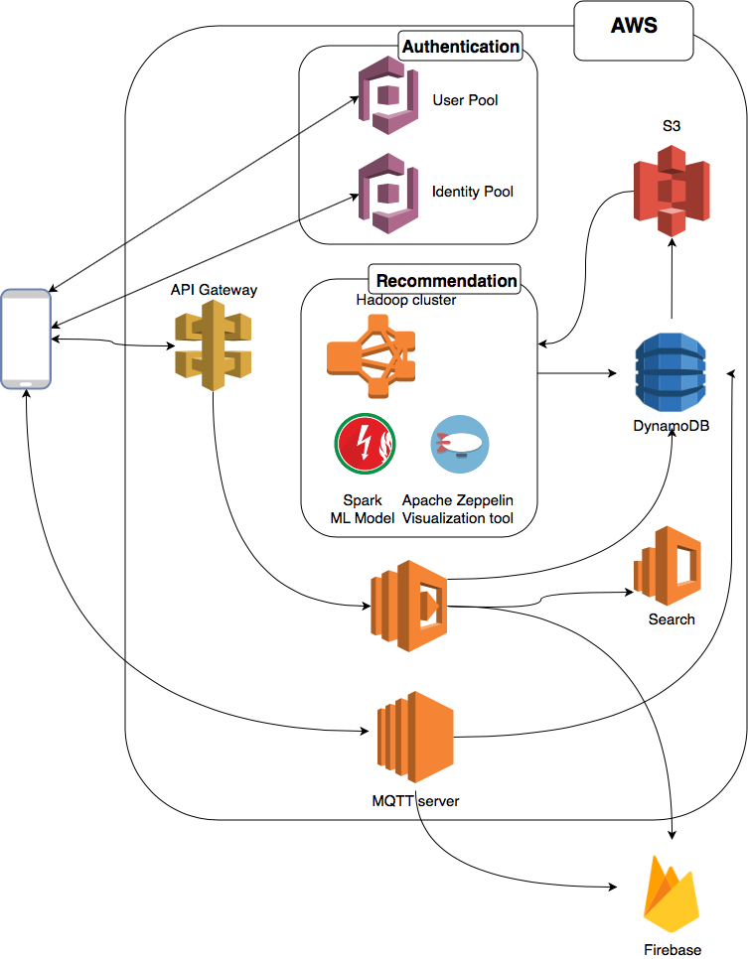

Slide 3
