Slide 1
AWS EKS Kubernetes - Masterclass | DevOps, Microservices
Kalyan Reddy Daida

Slide 2
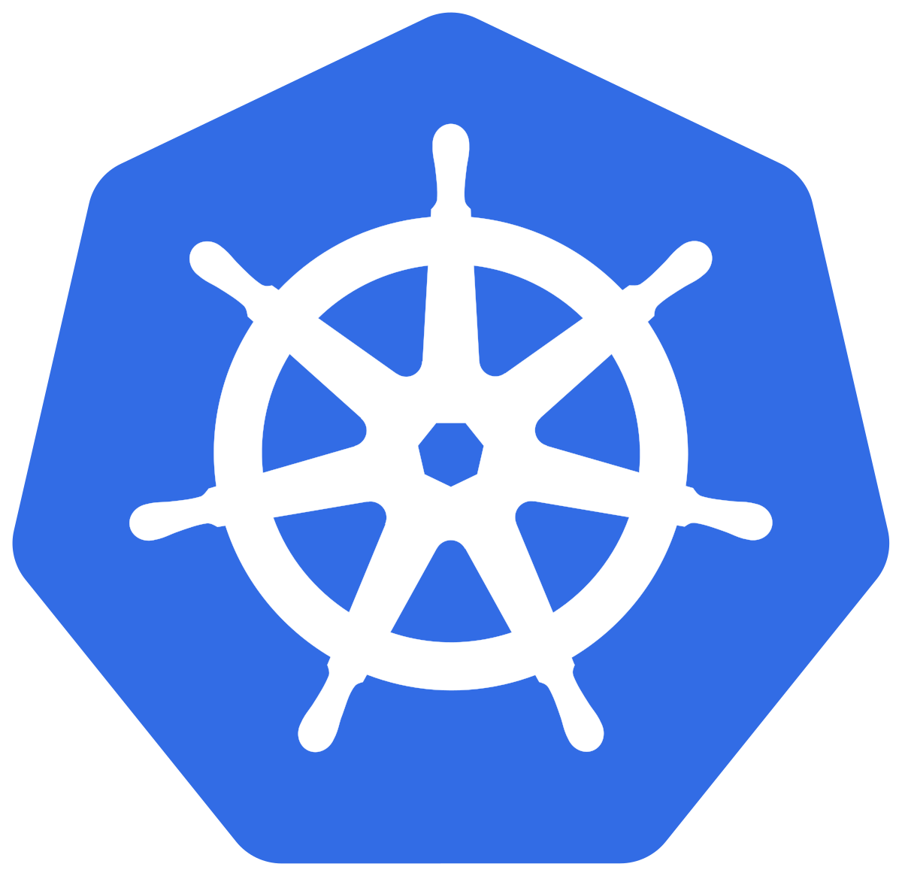

AWS EKS
Course Outline

Slide 3
Kubernetes for Beginners On Cloud
AWS EKS Kubernetes - Masterclass | DevOps, Microservices
STACKSIMPLIFY
Azure AKS Kubernetes - Masterclass | DevOps, Microservices
Kubernetes
On
Cloud
Roadmap
Google GKE Kubernetes - Masterclass | DevOps, Microservices
Docker & Kubernetes for Java Spring Boot Developers on AWS
Master HELM3 with Kubernetes on AWS & Azure

Slide 4
Kubernetes Concepts
AWS Services Integration with EKS
DevOps
Microservices

Slide 5



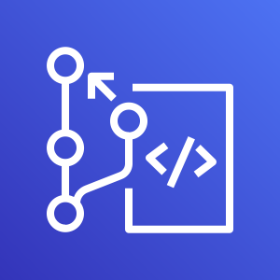

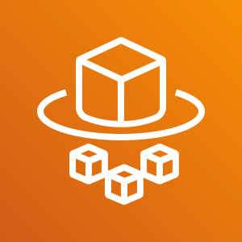

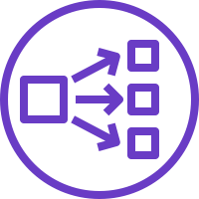
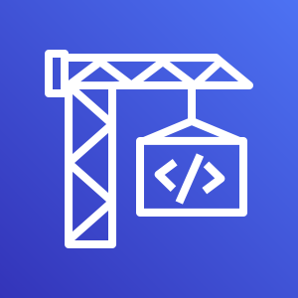




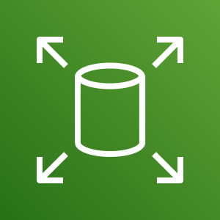



Architecture
kubectl - Imperative
Persistent Volumes
K
U
B
E
R
N
E
T
E
S
A
W
S
S
E
R
V
I
C
E
S
Pods
Declarative with YAML
PVC
ReplicaSets
Secrets
Load Balancers
Deployments
Init Containers
Annotations
Node Port Service
Probes
Canary Deployments
Cluster IP Service
Requests & Limits
HPA
External Name Service
Namespaces
VPA
Ingress Service
Limit Range
DaemonSets
Ingress SSL
Resource Quota
Fluentd for logs
Ingress & External DNS
Storage Classes
ConfigMaps
DevOps
Microservices
AWS Developer Tools
Service Discovery
Distributed Tracing
Canary Deployments
AWS CodeCommit
AWS CodeBuild
AWS CodePipeline

Slide 6
Docker - Fundamentals
nginxdemos/hello
Docker Daemon
Docker Registry
(Docker Hub)
nginxdemos/hello
Container-11
Images
Containers
Docker Host
docker pull nginxdemos/hello
Docker Registry or Docker Hub
A Docker registry stores Docker images.
Docker Hub is a public registry that anyone can use, and Docker is configured to look for images on Docker Hub by default.
We can even run our own private registry.
When we use the docker pull or docker run commands, the required images are pulled from our configured registry.
When we use the docker push command, our image is pushed to our configured registry.
docker run -p 82:80 -d nginxdemos/hello
Docker Client (My Desktop or Docker Host)

Slide 7
Kubernetes - Imperative & Declarative
Kubernetes Fundamentals
Imperative
Declarative
kubectl
YAML & kubectl
Pod
Pod
ReplicaSet
ReplicaSet
Deployment
Deployment
Service
Service

Slide 8

EKS Cluster
http://<workernode-public-ip>:<NodePort>/usermgmt/<apis>
UserMgmt – NodePort Service
Users
NodePort Service
EKS Storage EBS CSI Driver
REST API
Deployment
POD
Environment Variables
ReplicaSet
Drawbacks of EBS CSI for MySQL DB
Deployment (UserMgmt)
Complex setup to achieve HA
MySQL – ClusterIP Service
StatefulSets
AWS Elastic Block Store - EBS
Complex Multi-Az support for EBS
Storage Class
Environment Variables
Complex Master-Master MySQL setup
Persistent Volume Claim
Volumes
Complex Master-Slave MySQL setup
MySql
No Automatic Backup & Recovery
Config Map
Volume Mounts
POD
No Auto-Upgrade MySQL
ReplicaSet
Deployment
Deployment (mysql)
ClusterIP Service

Slide 9
http://<workernode-public-ip>:<NodePort>/usermgmt/<apis>
EKS Cluster
UserMgmt – NodePort Service
Users
NoePort Service
REST API
Deployment
AWS
RDS Database
POD
Environment Variables
ReplicaSet
Deployment (UserMgmt)
ExternalName Service
MySQL – ExternalName Service
High Availability
Metrics & Monitoring
Backup & Recovery
Automatic Upgrades
Read Replicas
Amazon RDS
Multi-AZ Support

Slide 10





AWS Cloud
EKS Cluster Control Plane
VPC
Availability Zone: us-east-1a
Availability Zone: us-east-1b
Public subnet
Public subnet
http://<workernode-public-ip>:<NodePort>/usermgmt/<apis>
EC2 Worker Node-1
EC2 Worker Node-2
User Management – Node Port Service
Users
U
U
ReplicaSet
U
U
Pod
Pod
Pod
Pod
Deployment
MySQL – External Name Service
Private subnet
Private subnet
AWS EKS
Network Design
With
EKS Workload
&
RDS Database
Amazon RDS
Amazon RDS

Slide 11

AWS Cloud
VPC
EKS Cluster Control Plane
Availability Zone: us-east-1a
Availability Zone: us-east-1b
Users
Public subnet
Public subnet
Classic CLB DNS URL
Classic Load Balancer
User Management – Classic Load Balancer Service
NAT gateway
NAT gateway
Private subnet
Private subnet
EC2 Worker Node-1
EC2 Worker Node-2
U
U
ReplicaSet
U
U
Pod
Pod
Pod
Pod
Deployment
MySQL – External Name Service
AWS EKS
Network Design
With
EKS Workload
RDS & ELB
Classic Load Balancer
EKS Private NodeGroup
Amazon RDS DB
Amazon RDS DB

Slide 12
AWS Cloud
VPC
EKS Cluster Control Plane
Availability Zone: us-east-1a
Availability Zone: us-east-1b
Users
Public subnet
Public subnet
NLB DNS URL
Network Load Balancer
User Management – Network Load Balancer Service
NAT gateway
NAT gateway
Private subnet
Private subnet
EC2 Worker Node-1
EC2 Worker Node-2
U
U
ReplicaSet
U
U
Pod
Pod
Pod
Pod
Deployment
MySQL – External Name Service
AWS EKS
Network Design
With
EKS Workload
RDS & ELB
Network Load Balancer
EKS Private NodeGroup
Amazon RDS DB
Amazon RDS DB

Slide 13
AWS Cloud
VPC
EKS Cluster Control Plane
Availability Zone: us-east-1a
Availability Zone: us-east-1b
Users
Amazon Route 53
Public subnet
Public subnet
SSL
Application Load Balancer
HTTP → HTTPS
SSL Redirect
external-dns
User Management – Application Load Balancer Service (Ingress)
apps.kubeoncloud.com
NAT gateway
NAT gateway
/app1/*
/app2/*
Ingress
/*
HTTPS URLS
https://apps.kubeoncloud.com/usermgmt/users
Private subnet
Private subnet
EC2 Worker Node-1
EC2 Worker Node-2
app1- NodePort SVC
app2 -NodePort SVC
User Management – Node Port Service
N
N
U
AWS Certificate Manager
Pod
Pod
Pod
ReplicaSet
ReplicaSet
ReplicaSet
Deployment: app1
Deployment: app2
Deployment: UMS
MySQL – External Name Service
AWS EKS
Network Design
With
EKS Workload
RDS & ELB
Application
Load Balancer & Route53
Ingress & External-DNS
EKS Private NodeGroup
Amazon RDS DB
Amazon RDS DB

Slide 14


EKS Deployment Options - Mixed
EKS Cluster
AWS Cloud
VPC
Availability Zone: us-east-1a
Availability Zone: us-east-1b
Availability Zone: us-east-1a
Availability Zone: us-east-1b
Public subnet
Public subnet
Public subnet
Public subnet
Auto Scaling group
EC2 Instance
EKS Public Managed Node Group
EC 2Instance
Private subnet
Private subnet
Private subnet
EKS Fargate
Private subnet
Auto Scaling group
Fargate Profile
EC2 Instance
EKS Private Managed Node Group
EC 2Instance
Fargate EC2 Instance
Fargate EC2 Instance
EKS Managed Node Groups
EKS Fargate Profiles

Slide 15



EKS Deployment Options – Mixed Mode - 3 Apps
Users
AWS Cloud
app1. kubeoncloud.com
app2.kubeoncloud.com
ums.kubeoncloud,com
Amazon RDS DB
app1.kubeoncloud.com
app2.kubeoncloud.com
ums.kubeoncloud.com
Amazon Route 53
VPC
Availability Zone: us-east-1a
Availability Zone: us-east-1b
Availability Zone: us-east-1a
EKS Fargate
Availability Zone: us-east-1b
Public subnet
Public subnet
Private subnet
Private subnet
App1 - Ingress
UMS - Ingress
NS: ns-ums
MySQL – ExternalName Service
Fargate Profile: UMS
Ingress
App2 - Ingress
U
U
UMS Pod
UMS Pod
Private subnet
Private subnet
UMS - NodePort Service
NS: ns-app1
App1 - NodePort Service
NS: ns-app2
App2 - NodePort Service
Auto Scaling group
Fargate Profile: App2
N
N
N
N
App1 Pod
EKS Private Managed Node Group
App1 Pod
App2 Pod
App2 Pod
EKS Managed Node Groups
EKS Fargate Profiles
AWS Certificate Manager
EKS Cluster

Slide 16



EKS & ECR
Developer
Users
http://ecrdemo.kubeoncloud.com
AWS Cloud
ecrdemo.kubeoncloud.com
Push Images
EKS Cluster
Amazon Route 53
AWS Certificate Manager
VPC
Docker Image
Pull Docker Image from ECR
Availability Zone: us-east-1a
Availability Zone: us-east-1b
Public subnet
Public subnet
Ingress
Elastic Container Registry - ECR
NAT gateway
ECR Demo - ALB Ingress Service
NAT gateway
Private subnet
Private subnet
EC2 Worker Node-1
EC2 Worker Node-2
ECR Demo App - NodePort Service
N
N
Pod
Pod
EKS Private Managed Node Group

Slide 17


Stages in Release Process
Source
Build
Test
Production

Slide 18



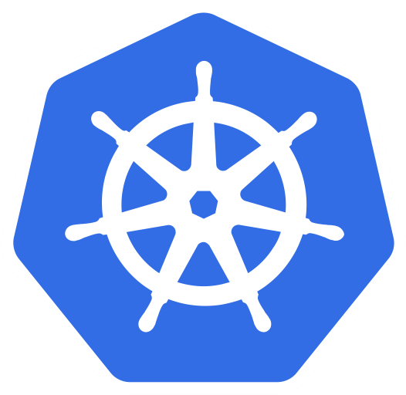


AWS Developer Tools or Code Services
Source
Build
Test
Deploy
Monitor
AWS CodeCommit
AWS CodeBuild
AWS CodeBuild + Third Party
CodeBuild
kubectl
AWS CloudWatch
Container Insights
AWS CodePipeline

Slide 19
AWS Developer Tools or Code Services
Source
Build
Test
Deploy
Monitor
AWS CodeCommit
AWS CodeBuild
AWS CodeBuild + Third Party
CodeBuild
kubectl
AWS CloudWatch
Container Insights
AWS CodePipeline

Slide 20

Microservices
Postman
Client
Create User API
Send Notification API
List Users API
Health Status API
Email
End User
Delete User API
Health Status API
User Management Microservice
Notification Microservice
API Developer
Or
API User
Users DB
SMTP Server

Slide 21


Microservices Deployment on AWS EKS
Users
https://ums.kubeoncloud.com/usermgmt/user
AWS Cloud
ums.kubeoncloud.com
services.kubeoncloud.com
EKS Cluster
VPC
Amazon Route 53
Availability Zone: us-east-1a
Availability Zone: us-east-1a
Public subnet
Public subnet
Ingress
Application Load Balancer
AWS Certificate
Manager
UMS – Ingress Service
NAT gateway
NAT gateway
Private subnet
Private subnet
End User
EC2 Worker Node-1
UMS – NodePort Service
EC2 Worker Node-2
Usermgmt Microservice Deployment
U
U
UMS Pod
UMS Pod
MySQL – External Name Service
Email
Notification – ClusterIP Service
Notification Microservice Deployment
N
N
Amazon RDS DB
NS Pod
NS Pod
Amazon RDS DB
SMTP – External Name Service
Simple Email
Service (SES)
EKS Managed Node Groups

Slide 22
Kubernetes – DaemonSets
UMS LoadBalancer Service
U
U
ReplicaSet
U
U
AWS X-Ray
UMS POD
UMS POD
UMS POD
UMS POD
UMS Deployment
XRay ClusterIP Service
X
DaemonSet
X
XRay pod
XRay pod
Worker Node - 1
Worker Node - 2
Kubernetes Cluster

Slide 23
Microservices Distributed Tracing with AWS X-Ray
Users
AWS Cloud
https:// xraydemo.kubeoncloud.com/usermgmt/notification-xray
xraydemo.kubeoncloud.com
services-xray.kubeoncloud.com
VPC
Amazon Route 53
End User
Availability Zone: us-east-1a
Public subnet
Private subnet
EC2 Worker Node-1
Ingress
Application Load Balancer
UMS – NodePort Service
AWS Certificate
Manager
Email
UMS – Ingress Service
U
Amazon RDS DB
UMS Pod
UMS Deployment
MySQL – External Name Service
Notification – ClusterIP Service
Simple Email
Service (SES)
N
NS Pod
NS Deployment
NAT gateway
SMTP – External Name Service
EKS Cluster
X-Ray – ClusterIP Service
X
X-Ray Pod
XRay DaemonSet
EKS Managed Node Groups
AWS X-Ray

Slide 24
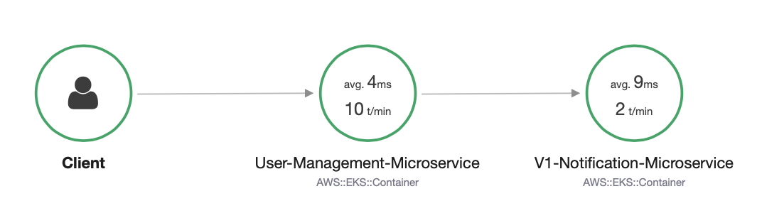
AWS X-Ray – Service Map

Slide 25
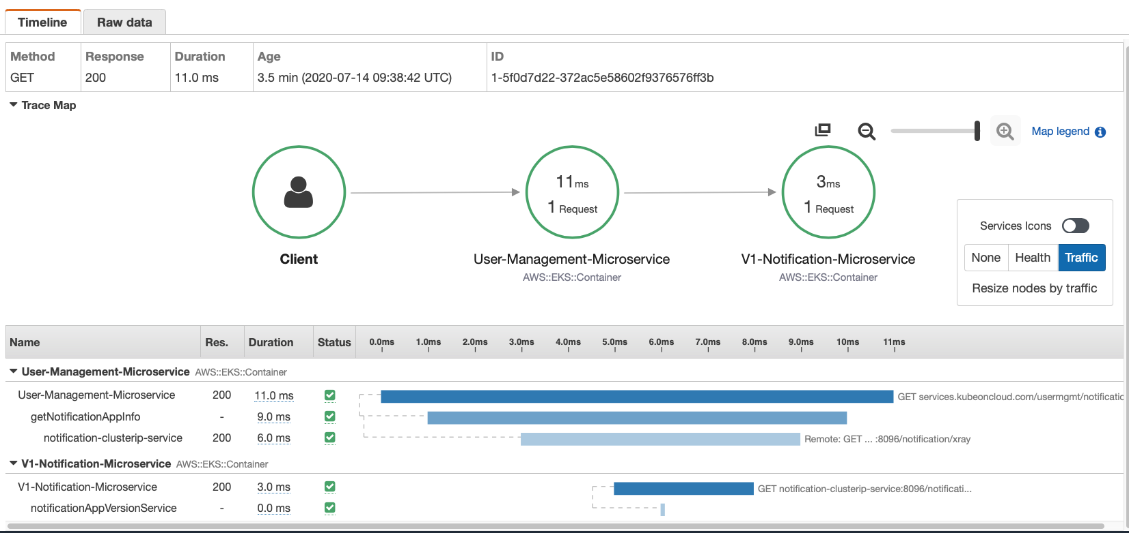
AWS X-Ray - Traces

Slide 26
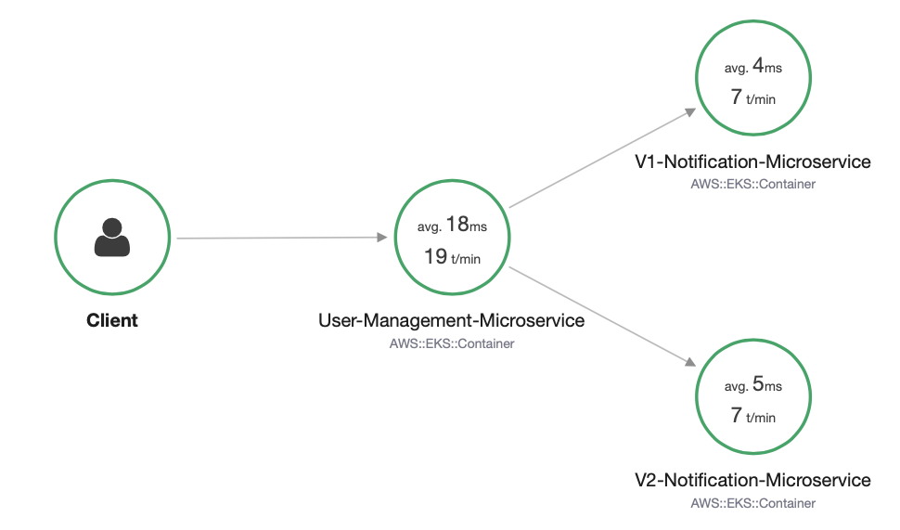
Microservices – Canary Deployments

Slide 27
How HPA works?
Metrics Server
Pod - 1
Pod - 2
Pod - N
2. Calculate the Replica’s
.
.
.
This control loop is executed every 15 seconds
15 secs
Horizontal Pod Autoscaler
1. Query for Metrics
Deployment
ReplicaSet
3. Scale the app to desired replicas
Scale
Replication Controller
StatefulSet
Application
Kubernetes Cluster

Slide 28
Container Insights
Container Map
Container Resources
Load Balancer Service
Performance Dashboards
Log Groups
Log Insights
Alarms
N
N
ReplicaSet
App Pod
App pod
NGINX Deployment
Developer or Operations User
C
CloudWatch Agent
DaemonSet
C
CW pod
CW pod
CloudWatch
Fluentd
DaemonSet
F
F
Fluentd pod
Fluentd pod
Worker Node - 1
Worker Node - 2
Kubernetes Cluster

Slide 29
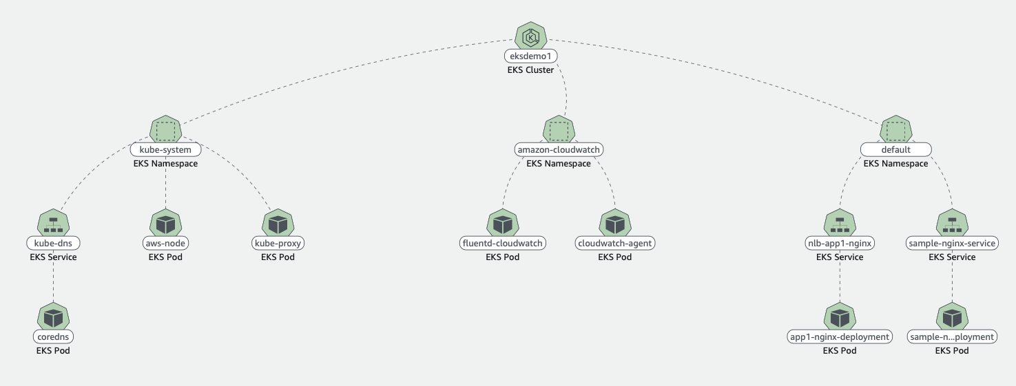
CloudWatch Container Insights Map

Slide 30
AWS EKS
CLIs

Slide 31
AWS EKS Cluster - CLIs
AWS CLI
We can control multiple AWS services from the command line and automate them through scripts.
CLIs
kubectl
We can control Kubernetes clusters and objects using kubectl
eksctl
eksctl is used for creating & deleting clusters on AWS EKS.
We can even create, autoscale and delete node groups.
We can even create fargate profiles using eksctl
In short, it is VERY VERY POWERFUL tool for managing EKS clusters on AWS.

Slide 32
AWS EKS
Cluster

Slide 33
AWS EKS – Core Objects
EKS Cluster
EKS Control Plane
Worker Nodes & Node Groups
Fargate Profiles
(Serverless)
VPC
Contains Kubernetes Master components like etcd, kube-apiserver, kube-controller.
It’s a managed service by AWS
Group of EC2 Instances where we run our Application workloads
Instead of EC2 Instances, we run our Application workloads on Serverless Fargate profiles
With AWS VPC we follow secure networking standards which will allow us to run production workloads on EKS.

Slide 34
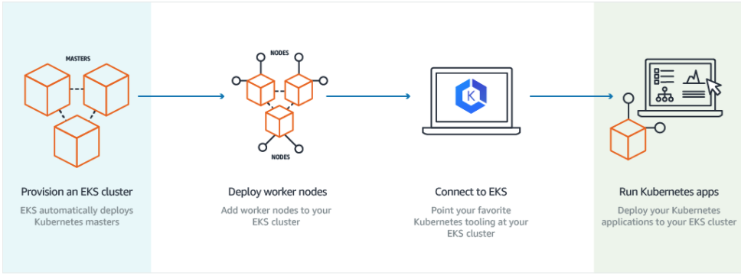
How does EKS work?
© Amazon

Slide 35
EKS Cluster – Core Objects Detailed
EKS Control Plane
EKS runs a single tenant Kubernetes control plane for each cluster, and control plane infrastructure is not shared across clusters or AWS accounts.
This control plane consists of at least two API server nodes and three etcd nodes that run across three Availability Zones within a Region
EKS automatically detects and replaces unhealthy control plane instances, restarting them across the Availability Zones within the Region as needed.
Worker Nodes
&
Node Groups
Worker machines in Kubernetes are called nodes. These are EC2 Instances
EKS worker nodes run in our AWS account and connect to our cluster's control plane via the cluster API server endpoint.
A node group is one or more EC2 instances that are deployed in an EC2 Autoscaling group.
All instances in a node group must
Be the same instance type
Be running the same AMI
Use the same EKS worker node IAM role

Slide 36
EKS Cluster – Core Objects Detailed
Fargate Profiles
AWS Fargate is a technology that provides on-demand, right-sized compute capacity for containers
With Fargate, we no longer have to provision, configure, or scale groups of virtual machines to run containers.
Each pod running on Fargate has its own isolation boundary and does not share the underlying kernel, CPU resources, memory resources, or elastic network interface with another pod.
AWS specially built Fargate controllers that recognizes the pods belonging to fargate and schedules them on Fargate profiles.
We will see more in our Fargate learning section.
VPC
EKS uses AWS VPC network policies to restrict traffic between control plane components to within a single cluster.
Control plane components for a EKS cluster cannot view or receive communication from other clusters or other AWS accounts, except as authorized with Kubernetes RBAC policies.
This secure and highly-available configuration makes EKS reliable and recommended for production workloads.

Slide 37
Kubernetes
Architecture

Slide 38
Kubernetes
Architecture

Slide 39
Kubernetes - Architecture
Master
Worker Node
Kube Controller Manager
Cloud Controller Manager
Kubelet
Kube-Proxy
Container Runtime (Docker)
kube-apiserver
Worker Node
etcd
kube-scheduler
Kubelet
Kube-Proxy
Container Runtime (Docker)
Container Runtime (Docker)

Slide 40
Kubernetes Architecture - Master
Master
kube-apiserver
It acts as front end for the Kubernetes control plane. It exposes the Kubernetes API
Command line tools (like kubectl), Users and even Master components (scheduler, controller manager, etcd) and Worker node components like (Kubelet) everything talk with API Server.
etcd
Consistent and highly-available key value store used as Kubernetes’ backing store for all cluster data.
It stores all the masters and worker node information.
kube-scheduler
Scheduler is responsible for distributing containers across multiple nodes.
It watches for newly created Pods with no assigned node, and selects a node for them to run on.
Kube Controller Manager
Cloud Controller Manager
kube-apiserver
etcd
kube-scheduler
Container Runtime (Docker)

Slide 41
Kubernetes Architecture - Master
Master
kube-controller-manager
Controllers are responsible for noticing and responding when nodes, containers or endpoints go down. They make decisions to bring up new containers in such cases.
Node Controller: Responsible for noticing and responding when nodes go down.
Replication Controller: Responsible for maintaining the correct number of pods for every replication controller object in the system.
Endpoints Controller: Populates the Endpoints object (that is, joins Services & Pods)
Service Account & Token Controller: Creates default accounts and API Access for new namespaces.
Kube Controller Manager
Cloud Controller Manager
kube-apiserver
etcd
kube-scheduler
Container Runtime (Docker)

Slide 42
Kubernetes Architecture - Master
Master
cloud-controller-manager
A Kubernetes control plane component that embeds cloud-specific control logic.
It only runs controllers that are specific to your cloud provider.
On-Premise Kubernetes clusters will not have this component.
Node controller: For checking the cloud provider to determine if a node has been deleted in the cloud after it stops responding
Route controller: For setting up routes in the underlying cloud infrastructure
Service controller: For creating, updating and deleting cloud provider load balancer
Kube Controller Manager
Cloud Controller Manager
kube-apiserver
etcd
kube-scheduler
Container Runtime (Docker)

Slide 43
Kubernetes Architecture – Worker Nodes
Worker Node
Kubelet
Kubelet is the agent that runs on every node in the cluster
This agent is responsible for making sure that containers are running in a Pod on a node.
Kube-Proxy
It is a network proxy that runs on each node in your cluster.
It maintains network rules on nodes
In short, these network rules allow network communication to your Pods from network sessions inside or outside of your cluster.
Kubelet
Kube-Proxy
Container Runtime (Docker)
Container Runtime
Container Runtime is the underlying software where we run all these Kubernetes components.
We are using Docker, but we have other runtime options like rkt, container-d etc.

Slide 44
Kubernetes - Architecture
Master
Worker Node
Kube Controller Manager
Cloud Controller Manager
Kubelet
Kube-Proxy
Container Runtime (Docker)
kube-apiserver
Worker Node
etcd
kube-scheduler
Kubelet
Kube-Proxy
Container Runtime (Docker)
Container Runtime (Docker)

Slide 45
AWS EKS
Cluster

Slide 46
EKS Kubernetes - Architecture
Master
Worker Node -1
EKS Controller Manager
Fargate Controller Manager
Kubelet
Kube-Proxy
Container Runtime (Docker)
kube-apiserver
Worker Node - 2
etcd
kube-scheduler
Kubelet
Kube-Proxy
Container Runtime (Docker)
Container Runtime (Docker)
EKS Control Plane
EKS Node Group

Slide 47
Kubernetes
Fundamentals
Pod, ReplicaSet, Deployment & Service

Slide 48
Kubernetes - Fundamentals
Pod
A POD is a single instance of an Application.
A POD is the smallest object, that you can create in Kubernetes.
ReplicaSet
A ReplicaSet will maintain a stable set of replica Pods running at any given time.
In short, it is often used to guarantee the availability of a specified number of identical Pods
k8s Fundamentals
Deployment
A Deployment runs multiple replicas of your application and automatically replaces any instances that fail or become unresponsive.
Rollout & rollback changes to applications. Deployments are well-suited for stateless applications.
Service
A service is an abstraction for pods, providing a stable, so called virtual IP (VIP) address.
In simple terms, service sits Infront of a POD and acts as a load balancer.

Slide 49
Kubernetes - Imperative & Declarative
Kubernetes Fundamentals
Imperative
Declarative
kubectl
YAML & kubectl
Pod
Pod
ReplicaSet
ReplicaSet
Deployment
Deployment
Service
Service

Slide 50
Kubernetes
POD

Slide 51
Kubernetes - POD
With Kubernetes our core goal will be to deploy our applications in the form of containers on worker nodes in a k8s cluster.
Kubernetes does not deploy containers directly on the worker nodes.
Container is encapsulated in to a Kubernetes Object named POD.
A POD is a single instance of an application.
A POD is the smallest object that we can create in Kubernetes.
N
Nginx Container
Image
N
N
POD
POD
Worker Node
Worker Node
Node
Worker Node
Kubernetes Cluster

Slide 52

Kubernetes - POD
PODs generally have one to one relationship with containers.
To scale up we create new POD and to scale down we delete the POD.
N
N
N
N
POD
POD
POD
POD
Worker Node - 1
Worker Node - 2
Kubernetes Cluster

Slide 53
Kubernetes – PODs
We cannot have multiple containers of same kind in a single POD.
Example: Two NGINX containers in single POD serving same purpose is not recommended.
N
N
N
N
N
POD
POD
POD
POD
Worker Node - 1
Worker Node - 2
Kubernetes Cluster

Slide 54
Kubernetes – Multi-Container Pods
We can have multiple containers in a single POD, provided they are not of same kind.
Helper Containers (Side-car)
Data Pullers: Pull data required by Main Container
Data pushers: Push data by collecting from main container (logs)
Proxies: Writes static data to html files using Helper container and Reads using Main Container.
Communication
The two containers can easily communicate with each other easily as they share same network space.
They can also easily share same storage space.
Multi-Container Pods is a rare use-case and we will try to focus on core fundamentals.
N
H
POD
Worker Node
Kubernetes Cluster
Helper
Containers
Node

Slide 55
Kubernetes
PODs
Demo

Slide 56
Kubernetes
Services - NodePort

Slide 57
Kubernetes – Service - NodePort
We can expose an application running on a set of PODs using different types of Services available in k8s.
ClusterIP
NodePort
LoadBalancer
NodePort Service
To access our application outside of k8s cluster, we can use NodePort service.
Exposes the Service on each Worker Node's IP at a static port (nothing but NodePort).
A ClusterIP Service, to which the NodePort Service routes, is automatically created.
Port Range 30000-32767
http://<Worker-Node-IP>:<NodePort>
NodePort: 3xxx
User
Worker NodePort
Port: 80
Service
ClusterIP Service Port
targetPort: 80
Container Port in a POD
Node
N
POD
Worker Node
Worker Node
Worker Node
Node
Kubernetes Cluster

Slide 58
Kubernetes
POD & NodePort Service
Demo

Slide 59
Kubernetes
ReplicaSets

Slide 60
Kubernetes - ReplicaSets
High Availability or Reliability
Scaling
ReplicaSets
Load Balancing
Labels & Selectors

Slide 61
Kubernetes – ReplicaSet
A ReplicaSet’s purpose is to maintain a stable set of replica Pods running at any given time.
If our application crashes (any pod dies), replicaset will recreate the pod immediately to ensure the configured number of pods running at any given time.
Reliability
Or
High Availability
N
N
N
POD
POD
POD
ReplicaSet
Worker Node
Kubernetes Cluster

Slide 62

Kubernetes – ReplicaSet
Load Balancing
To avoid overloading of traffic to single pod we can use load balancing.
Kubernetes provides pod load balancing out of the box using Services for the pods which are part of a ReplicaSet
Labels & Selectors are the key items which ties all 3 together (Pod, ReplicaSet & Service), we will know in detail when we are writing YAML manifests for these objects
Service
N
N
N
N
POD
POD
POD
POD
ReplicaSet
Worker Node
Worker Node
Kubernetes Cluster

Slide 63
Kubernetes – ReplicaSet
Scaling
When load become too much for the number of existing pods, Kubernetes enables us to easily scale up our application, adding additional pods as needed.
This is going to be seamless and super quick.
Service
N
N
N
N
POD
POD
POD
POD
ReplicaSet
Worker Node
Worker Node
Kubernetes Cluster

Slide 64
Kubernetes
ReplicaSets
Demo

Slide 65
Kubernetes
Deployments

Slide 66
Kubernetes – Deployments
Service
N
N
N
N
POD
POD
POD
POD
ReplicaSet
Deployment
Worker Node - 1
Worker Node - 2
Kubernetes Cluster

Slide 67
Kubernetes - Deployment
Create a Deployment to rollout a ReplicaSet
Updating the Deployment
Rolling Back a Deployment
Deployments
Scaling a Deployment
Pausing and Resuming a Deployment
Deployment Status
Clean up Policy
Canary Deployments

Slide 68
Kubernetes
Deployments
Demo

Slide 69
Kubernetes
Services

Slide 70
Kubernetes - Services
ClusterIP
Used for communication between applications inside k8s cluster (Example: Frontend application accessing backend application)
NodePort
Used for accessing applications outside of of k8s cluster using Worker Node Ports (Example: Accessing Frontend application on browser)
Services
LoadBalancer
Primarily for Cloud Providers to integrate with their Load Balancer services (Example: AWS Elastic Load Balancer)
Ingress
Ingress is an advanced load balancer which provides Context path based routing, SSL, SSL Redirect and many more (Example: AWS ALB)
externalName
To access externally hosted apps in k8s cluster (Example: Access AWS RDS Database endpoint by application present inside k8s cluster)

Slide 71
Services
Kubernetes Cluster
Frontend App – NodePort or LoadBalancer or Ingress Service
Users
N
N
N
POD
POD
POD
ReplicaSet
Deployment (app=frontend)
Backend App - ClusterIP Service
AWS Cloud
B
B
B
DB – ExternalName Service
POD
POD
POD
AWS RDS Database
ReplicaSet
Deployment (app=Backend)

Slide 72
Kubernetes
Services
Demo

Slide 73
Services Demo
Kubernetes Cluster
Frontend App – NodePort Service
Users
http://<workernode-public-ip>:<NodePort>/hello
N
POD
ReplicaSet
Deployment (app=frontend)
Backend App - ClusterIP Service
B
POD
ReplicaSet
Deployment (app=Backend)

Slide 74
Kubernetes
YAML Basics

Slide 75
YAML Basics
YAML is not a Markup Language
YAML is used to store information about different things
We can use YAML to define key, Value pairs like variables, lists and objects
YAML is very similar to JSON (Javascript Object Notation)
YAML primarily focuses on readability and user friendliness
YAML is designed to be clean and easy to read
We can define YAML files with two different extensions
abc.yml
abc.yaml

Slide 76
YAML Basics
YAML Comments
YAML Key Value Pairs
YAML Dictionary or Map
YAML Array / Lists
YAML Spaces
YAML Document Separator

Slide 77
AWS EKS
Storage

Slide 78
EKS Storage
In-Tree EBS Provisioner
EBS CSI Driver
EFS CSI Driver
FSx for Luster CSI
Legacy
CSI means Container Storage Interface
Will be deprecated soon
Latest & Greatest available today & in Beta release & ready for production use
As on today, not supported on AWS EKS Fargate (Serverless)
Allows EKS Clusters to manage lifecycle of EBS Volumes for persistent storage, EFS File systems & FSx for Luster File systems
Supported for k8s 1.14 & later
Supported for k8s 1.16 & later

Slide 79
AWS EKS Storage
EBS CSI Driver

Slide 80
AWS Elastic Block Store - Introduction
EBS provides block level storage volumes for use with EC2 & Container instances.
We can mount these volumes as devices on our EC2 & Container instances.
EBS volumes that are attached to an instance are exposed as storage volumes that persist independently from the life of the EC2 or Container instance.
We can dynamically change the configuration of a volume attached to an instance.
AWS recommends EBS for data that must be quickly accessible and requires long-term persistence.
EBS is well suited to both database-style applications that rely on random reads and writes, and to throughput-intensive applications that perform long, continuous reads and writes.

Slide 81
EKS Storage EBS CSI Driver
EKS Cluster
MySQL – ClusterIP Service
AWS Elastic Block Store - EBS
Storage Class
Environment Variables
Persistent Volume Claim
Volumes
MySql
Config Map
Volume Mounts
POD
ReplicaSet
Deployment
Deployment (mysql)
ClusterIP Service

Slide 82
EKS Cluster
http://<workernode-public-ip>:<NodePort>/usermgmt/<apis>
UserMgmt – NodePort Service
Users
NodePort Service
REST API
Deployment
EKS Storage EBS CSI Driver
POD
Environment Variables
ReplicaSet
Deployment (UserMgmt)
MySQL – ClusterIP Service
AWS Elastic Block Store - EBS
Storage Class
Environment Variables
Persistent Volume Claim
Volumes
MySql
Config Map
Volume Mounts
POD
ReplicaSet
Deployment
Deployment (mysql)
ClusterIP Service

Slide 83
Elastic Block Store
AWS EKS Storage
EBS CSI Driver
Important k8s Concepts
for Application Deployments

Slide 84
EKS Cluster
http://<workernode-public-ip>:<NodePort>/usermgmt/<apis>
UserMgmt – NodePort Service
Secrets
Namespaces
Users
Init Containers
NodePort Service
Liveness & Readiness Probes
REST API
Deployment
EKS Storage EBS CSI Driver
Requests & Limits
POD
Environment Variables
ReplicaSet
Deployment (UserMgmt)
MySQL – ClusterIP Service
AWS Elastic Block Store - EBS
Storage Class
Environment Variables
Persistent Volume Claim
Volumes
MySql
Config Map
Volume Mounts
POD
ReplicaSet
Deployment
Deployment (mysql)
ClusterIP Service

Slide 85
Probes
Probes
Liveness Probe
Readiness Probe
Startup Probe
Kubelet uses liveness probes to know when to restart a container
Kubelet uses readiness probes to know when a container is ready to accept traffic
Kubelet uses startup probes to know when a container application has started
Liveness probes could catch a deadlock, where an application is running, but unable to make progress and restarting container helps in such state
When a Pod is not ready, it is removed from Service load balancers based on this readiness probe signal.
Firstly this proble disables liveness & readiness checks until it succeeds ensuring those pods don’t interfere with app startup.
This can be used to adopt liveness checks on slow starting containers, avoiding them getting killed by the kubelet before they are up and running.
Options to define Probes
Check using Commands
/bin/sh –c nc -z localhost 8095
Check using HTTP GET Request
httpget path:/health-status
Check using TCP
tcpSocket Port: 8095

Slide 86
Kubernetes
Namespaces

Slide 87
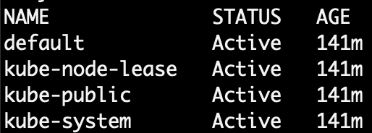
Namespaces - Introduction
Namespaces are also called Virtual clusters in our physical k8s cluster
We use this in environments where we have many users spread across multiple teams or projects
Clusters with tens of users ideally don’t need to use namespaces
Benefits
Creates isolation boundary from other k8s objects
We can limit the resources like CPU, Memory on per namespace basis (Resource Quota).

Slide 88
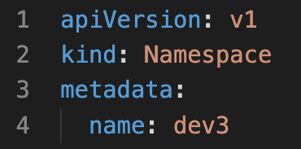
Namespaces
LoadBalancer Service
LoadBalancer Service
LoadBalancer Service
F
F
F
Pod
Pod
Pod
Namespace Manifest - Declarative
ReplicaSet
ReplicaSet
ReplicaSet
Deployment
Deployment
Deployment
ClusterIP Service
ClusterIP Service
ClusterIP Service
B
B
B
Pod
Pod
Pod
ReplicaSet
ReplicaSet
ReplicaSet
Deployment
Deployment
Deployment
Namespace: dev
Namespace: qa
Namespace: staging
Namespace Manifest - Imperative
Deployment

Slide 89
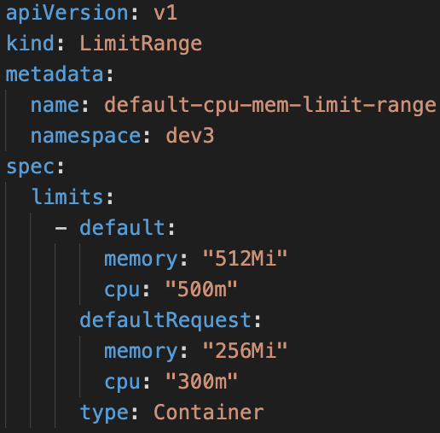
Limit Range
LoadBalancer Service
LoadBalancer Service
LoadBalancer Service
F
F
F
Pod
Pod
Pod
Limit Range Manifest
ReplicaSet
ReplicaSet
ReplicaSet
Deployment
Deployment
Deployment
ClusterIP Service
ClusterIP Service
ClusterIP Service
B
B
B
Pod
Pod
Pod
ReplicaSet
ReplicaSet
ReplicaSet
Deployment
Deployment
Deployment
Deployment
CPU
Memory
CPU
Memory
CPU
Memory
default
Min/Max
default
Min/Max
default
Min/Max
Limit Range (Per Container)
Limit Range (Per Container)
Limit Range (Per Container)
Namespace: dev
Namespace: qa
Namespace: staging

Slide 90
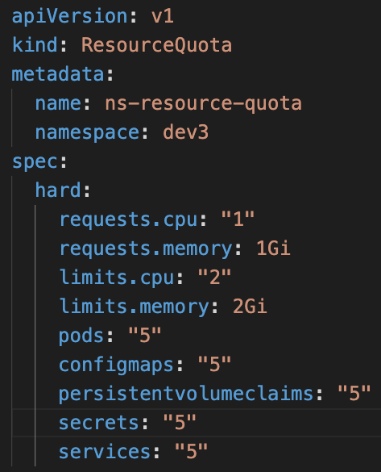
Resource Quota
LoadBalancer Service
LoadBalancer Service
LoadBalancer Service
F
F
F
Resource Quota Manifest
Pod
Pod
Pod
ReplicaSet
ReplicaSet
ReplicaSet
Deployment
Deployment
Deployment
ClusterIP Service
ClusterIP Service
ClusterIP Service
B
B
B
Pod
Pod
Pod
ReplicaSet
ReplicaSet
ReplicaSet
Deployment
Deployment
Deployment
Deployment
CPU
Memory
CPU
Memory
CPU
Memory
Pods
Services
Pods
Services
Pods
Services
Resource Quota
Resource Quota
Resource Quota
Namespace: dev
Namespace: qa
Namespace: staging

Slide 91
Amazon RDS
AWS EKS
&
RDS Database

Slide 92
EKS Cluster
http://<workernode-public-ip>:<NodePort>/usermgmt/<apis>
UserMgmt – NodePort Service
Users
NodePort Service
EKS Storage EBS CSI Driver
REST API
Deployment
POD
Environment Variables
ReplicaSet
Drawbacks of EBS CSI for MySQL DB
Deployment (UserMgmt)
Complex setup to achieve HA
MySQL – ClusterIP Service
StatefulSets
AWS Elastic Block Store - EBS
Complex Multi-Az support for EBS
Storage Class
Environment Variables
Complex Master-Master MySQL setup
Persistent Volume Claim
Volumes
Complex Master-Slave MySQL setup
MySql
No Automatic Backup & Recovery
Config Map
Volume Mounts
POD
No Auto-Upgrade MySQL
ReplicaSet
Deployment
Deployment (mysql)
ClusterIP Service

Slide 93
http://<workernode-public-ip>:<NodePort>/usermgmt/<apis>
EKS Cluster
UserMgmt – NodePort Service
Users
NoePort Service
REST API
Deployment
AWS
RDS Database
POD
Environment Variables
ReplicaSet
Deployment (UserMgmt)
ExternalName Service
MySQL – ExternalName Service
High Availability
Metrics & Monitoring
Backup & Recovery
Automatic Upgrades
Read Replicas
Amazon RDS
Multi-AZ Support

Slide 94
AWS Cloud
EKS Cluster Control Plane
VPC
Availability Zone: us-east-1a
Availability Zone: us-east-1b
Public subnet
Public subnet
http://<workernode-public-ip>:<NodePort>/usermgmt/<apis>
EC2 Worker Node-1
EC2 Worker Node-2
User Management – Node Port Service
Users
U
U
ReplicaSet
U
U
Pod
Pod
Pod
Pod
Deployment
MySQL – External Name Service
Private subnet
Private subnet
AWS EKS
Network Design
With
EKS Workload
&
RDS Database
Amazon RDS
Amazon RDS

Slide 95
Classic
Load Balancer
Network
Load Balancer
Application
Load Balancer
AWS
Elastic Load Balancing
Overview

Slide 96
Elastic Load Balancing
Classic Load Balancer
Network Load Balancer
Application Load Balancer
https://aws.amazon.com/elasticloadbalancing/features/#compare

Slide 97
Elastic Load
Balancing
Classic
Load Balancer
Network
Load Balancer
Application
Load Balancer
Amazon RDS
AWS EKS
&
RDS & ELB
Classic Load Balancer

Slide 98
AWS Cloud
EKS Cluster Control Plane
VPC
Availability Zone: us-east-1a
Availability Zone: us-east-1b
Public subnet
Public subnet
http://<workernode-public-ip>:<NodePort>/usermgmt/<apis>
EC2 Worker Node-1
EC2 Worker Node-2
User Management – Node Port Service
Users
U
U
ReplicaSet
U
U
Pod
Pod
Pod
Pod
Deployment
MySQL – External Name Service
Private subnet
Private subnet
AWS EKS
Network Design
With
EKS Workload
&
RDS Database
Amazon RDS
Amazon RDS

Slide 99
AWS Cloud
VPC
EKS Cluster Control Plane
Availability Zone: us-east-1a
Availability Zone: us-east-1b
Users
Public subnet
Public subnet
Classic CLB DNS URL
Classic Load Balancer
User Management – Classic Load Balancer Service
NAT gateway
NAT gateway
Private subnet
Private subnet
EC2 Worker Node-1
EC2 Worker Node-2
U
U
ReplicaSet
U
U
Pod
Pod
Pod
Pod
Deployment
MySQL – External Name Service
AWS EKS
Network Design
With
EKS Workload
RDS & ELB
Classic Load Balancer
EKS Private NodeGroup
Amazon RDS DB
Amazon RDS DB

Slide 100
Elastic Load
Balancing
Classic
Load Balancer
Network
Load Balancer
Application
Load Balancer
Amazon RDS
AWS EKS
&
RDS & ELB
Network Load Balancer

Slide 101
AWS Cloud
VPC
EKS Cluster Control Plane
Availability Zone: us-east-1a
Availability Zone: us-east-1b
Users
Public subnet
Public subnet
NLB DNS URL
Network Load Balancer
User Management – Network Load Balancer Service
NAT gateway
NAT gateway
Private subnet
Private subnet
EC2 Worker Node-1
EC2 Worker Node-2
U
U
ReplicaSet
U
U
Pod
Pod
Pod
Pod
Deployment
MySQL – External Name Service
AWS EKS
Network Design
With
EKS Workload
RDS & ELB
Network Load Balancer
EKS Private NodeGroup
Amazon RDS DB
Amazon RDS DB

Slide 102
AWS Load Balancer Controller Updates - Start

Slide 103

Elastic Load
Balancing
Application
Load Balancer
Network
Load Balancer
Kubernetes
Ingress
AWS EKS
Load Balancer Controller
Kubernetes Ingress
Application Load Balancer
14 Demos

Slide 104
AWS Load Balancer Controller Install
D1
D8
k8s Service + External DNS
Ingress Basics
D2
D9
Ingress Name based Virtual Host Routing
Ingress Context Path Routing
D3
D10
SSL Discovery - Host
EKS
ALB
Ingress
Ingress SSL
D4
D11
SSL Discovery - TLS
Ingress SSL Redirect
D5
D12
Ingress Groups
External DNS Install
D6
D13
Ingress Target Type - IP
Ingress + External DNS
D7
D14
Ingress Internal ALB

Slide 105
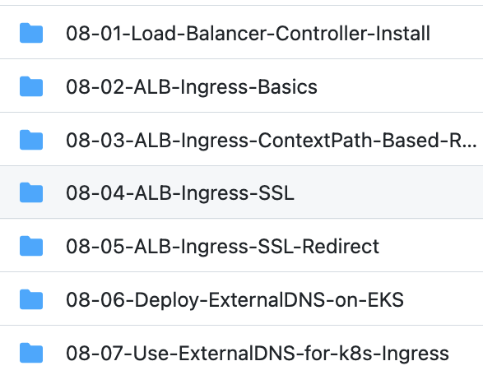
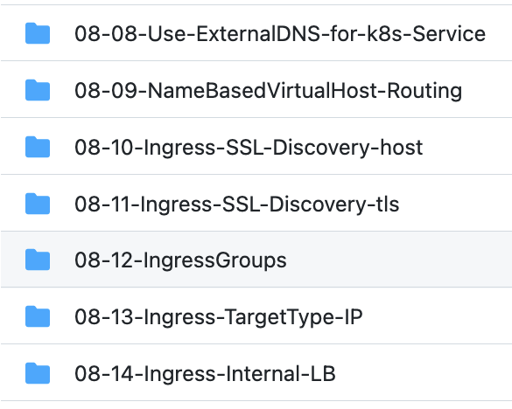
Git Repo: https://github.com/stacksimplify/aws-eks-kubernetes-masterclass/tree/master/08-NEW-ELB-Application-LoadBalancers

Slide 106
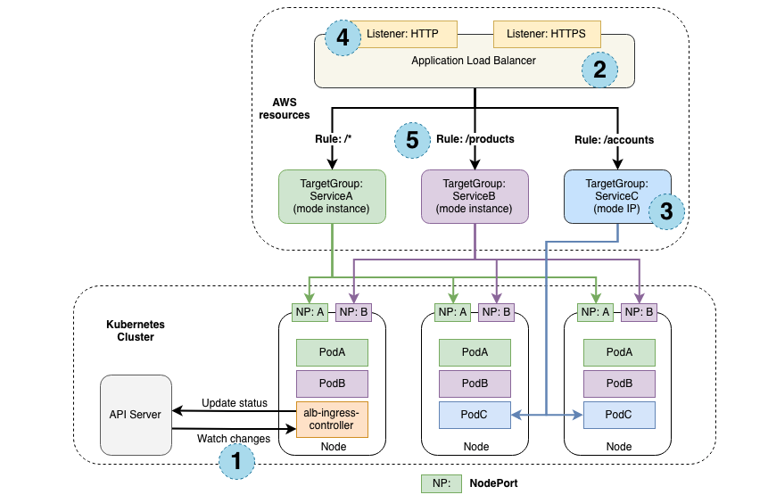
How Ingress Works?

Slide 107
Elastic Load
Balancing
Application
Load Balancer
Network
Load Balancer
Kubernetes
Ingress
AWS EKS
Load Balancer Controller
Install

Slide 108
Kubernetes Ingress
AWS ALB Ingress Controller
AWS Load Balancer Controller
Renamed & Redesigned
AWS Application Load Balancer Only
AWS Application and Network Load Balancers
Doesn’t support latest Ingress API Version (apiVersion: networking.k8s.io/v1) from Kubernetes Version 1.22 onwards
K8s Ingress Resource
AWS Application Load Balancer
K8s Service Resource
AWS Network Load Balancer
No Development releases, Soon it will be deprecated
Supports latest and greatest from Ingress perspective

Slide 109



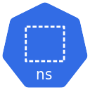





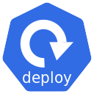
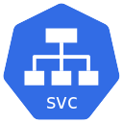

AWS Load Balancer Controller
kubectl
cli
Deploy Ingress k8s
manifest
AWS Cloud
EKS Cluster
kube-system namespace
K8s API Server
IAM
IAM Policy
IAM Role
Annotated with IAM Role
Watch for
Ingress Events
AWS Load Balancer Controller
Service Account
Can Create / Update / Delete AWS Application Load Balancers
AWS Load Balancer Controller
Deployment
AWS Load Balancer Controller
WebHook ClusterIP Service
AWS ELB
AWS Application Load Balancer
Ingress Resource
aws-load-balancer-tls
Other AWS Services

Slide 110
Elastic Load
Balancing
Application
Load Balancer
Network
Load Balancer
Kubernetes
Ingress
AWS EKS
Load Balancer Controller
Kubernetes Ingress Class

Slide 111
Kubernetes Ingress Class
AWS EKS ALB Ingress
Controller
If we have multiple Ingress Controllers running in our Kubernetes cluster, how to identify to which Ingress Controller our Ingress Resource/Service should be associated to ?
NGINX Ingress Controller
AKS Application Gateway Ingress Controller
Kubernetes Object
Kind: IngressClass
More Ingress Controllers: https://kubernetes.io/docs/concepts/services-networking/ingress-controllers/

Slide 112
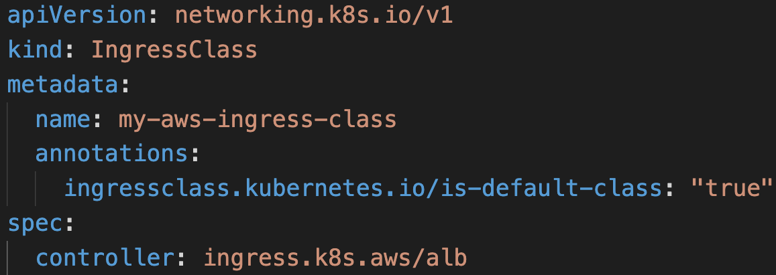
Kubernetes Ingress Class

Slide 113
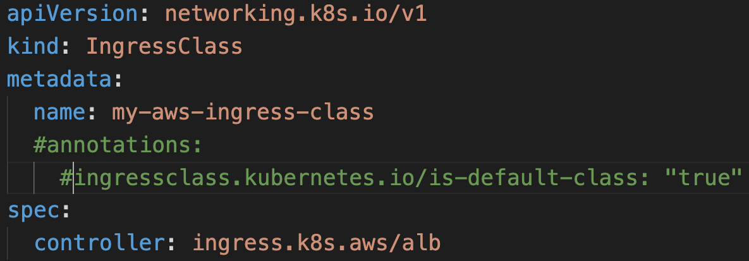
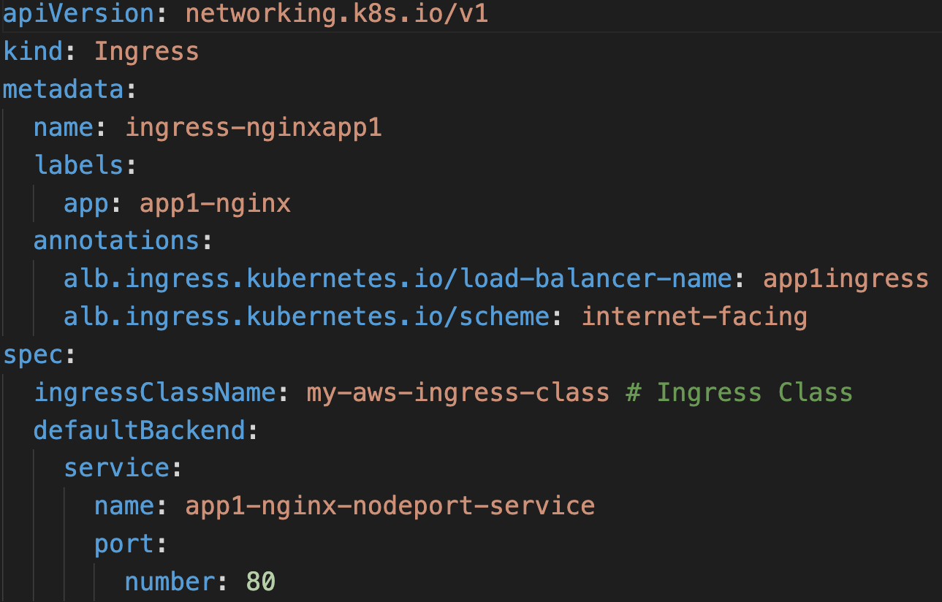
Ingress Class
Ingress Resource
If IngressClass is not defined as is-default-class:true then in Ingress Resource we need to define the spec.ingressClassName in Ingress Resource

Slide 114
Elastic Load
Balancing
Application
Load Balancer
Network
Load Balancer
Kubernetes
Ingress
AWS EKS
Load Balancer Controller
Kubernetes Ingress Basics

Slide 115
Ingress Manifest – Key Items
Ingress Annotations
(Load Balancer Settings)
Ingress Spec
Ingress Class Name
(Which Ingress Controller to use)
Ingress Spec
(Define Ingress Routing Rules, Default Backend)
Annotations Reference: https://kubernetes-sigs.github.io/aws-load-balancer-controller/v2.3/guide/ingress/annotations/#annotations

Slide 116
Two Ingress Basic Demos
Demo-1
Demo-2
Ingress Service with
Default Backend
Ingress Service with
Ingress Rules

Slide 117
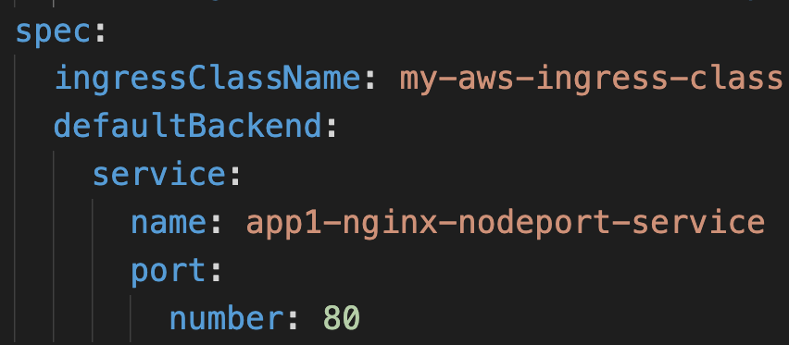
AWS Cloud
VPC
EKS Cluster Control Plane
Availability Zone: us-east-1a
Availability Zone: us-east-1b
Users
Public subnet
Public subnet
http://ALB-DNS-URL/app1/index.html
Application Load Balancer
Application Load Balancer Service (Ingress)
NAT gateway
Default Backend
NAT gateway
AWS EKS
Network Design
With
EKS Workload
Application
Load Balancer
Ingress
Private subnet
Private subnet
EC2 Worker Node-1
EC2 Worker Node-2
NGINX App1 – Node Port Service
Default
Backend
U
Pod
EKS Private NodeGroup
ReplicaSet
Deployment: App1

Slide 118
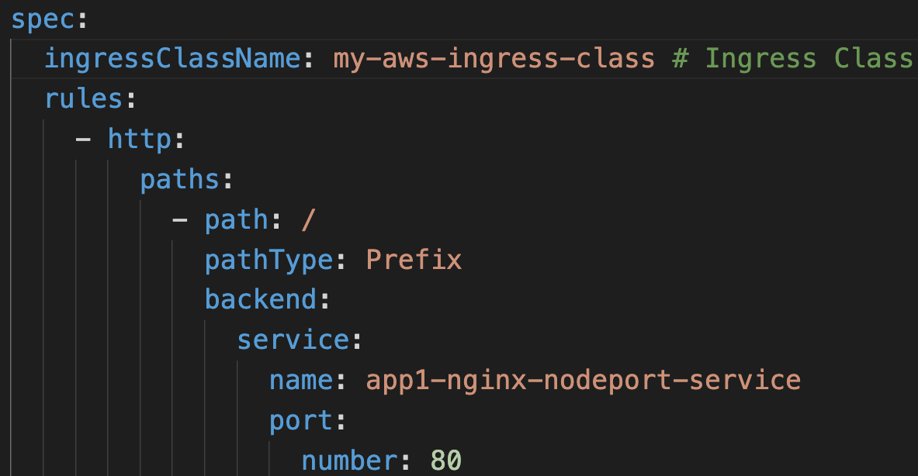
AWS Cloud
VPC
EKS Cluster Control Plane
Availability Zone: us-east-1a
Availability Zone: us-east-1b
Users
Public subnet
Public subnet
http://ALB-DNS-URL/app1/index.html
Application Load Balancer
Application Load Balancer Service (Ingress)
AWS EKS
Network Design
With
EKS Workload
Application
Load Balancer
NAT gateway
/*
NAT gateway
Ingress
Private subnet
Private subnet
EC2 Worker Node-1
EC2 Worker Node-2
NGINX App1 – Node Port Service
Ingress Rules
U
Pod
EKS Private NodeGroup
ReplicaSet
Deployment: App1

Slide 119
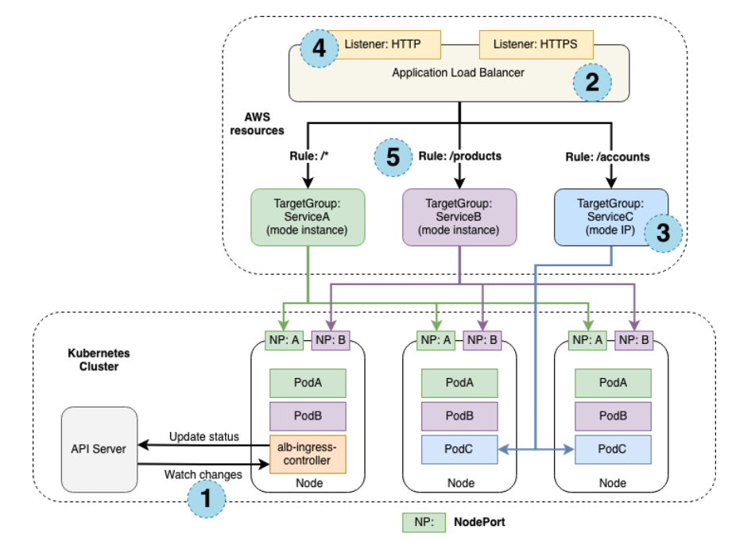
How AWS Load Balancer controller works?
Three Apps: A, B, C
3 Worker Nodes, 3 Pods per App
ALB Context Path Routing
Node Port Service
Traffic Mode: Instance, IP
ALB Ingress Controller watch for Events from k8s API Server
Reference: https://kubernetes-sigs.github.io/aws-load-balancer-controller/v2.3/how-it-works/

Slide 120
Elastic Load
Balancing
Application
Load Balancer
Network
Load Balancer
Kubernetes
Ingress
AWS EKS
Load Balancer Controller
Kubernetes Ingress
Context Path based Routing

Slide 121
AWS Cloud
VPC
EKS Cluster Control Plane
Availability Zone: us-east-1a
Availability Zone: us-east-1b
Users
Public subnet
Public subnet
http://ALB-DNS-URL/
Application Load Balancer
http://ALB-DNS-URL/app1/index.html
http://ALB-DNS-URL/app2/index.html
Application Load Balancer Service (Ingress)
NAT gateway
/app1/*
/app2/*
/*
NAT gateway
Ingress
Private subnet
Private subnet
EC2 Worker Node-1
EC2 Worker Node-2
app1- NodePort SVC
app2 -NodePort SVC
app3 – Node Port Service
AWS EKS
Network Design
Application
Load Balancer
Ingress
Context Path based Routing
N
N
U
Pod
Pod
Pod
ReplicaSet
ReplicaSet
ReplicaSet
Deployment: app1
Deployment: app2
Deployment: app3
EKS Private NodeGroup

Slide 122



AWS EKS ALB Ingress – Context Path Based Routing
AWS Cloud
AWS EKS Cluster
Nginx App1
/app1/
/app2/
Users
/
AWS Application
Load Balancer
Ingress Service
Nginx App2
k8s admin
using kubectl
client
k8s api
server
Ingress Controller
Nginx App3

Slide 123
Elastic Load
Balancing
Application
Load Balancer
Network
Load Balancer
Kubernetes
Ingress
AWS EKS
Load Balancer Controller
Kubernetes Ingress
SSL

Slide 124
ALB Ingress SSL
Task-1: Register AWS Route53 DNS Domain
Task-2: Create SSL Certificate in AWS Certificate Manager
AWS
Route 53
AWS
Certificate Manager
Task-3: Update SSL Annotations in Ingress Service
Task-4: Deploy k8s manifests and Test

Slide 125
AWS Cloud
VPC
EKS Cluster Control Plane
Availability Zone: us-east-1a
Availability Zone: us-east-1b
Users
Amazon Route 53
Public subnet
Public subnet
SSL
Application Load Balancer
HTTP URLS
http://ssldemo.stacksimplify.com/ http://ssldemo. stacksimplify.com/app1/index.html http://ssldemo. stacksimplify.com/app2/index.html
Application Load Balancer Service (Ingress)
NAT gateway
/app1/*
/app2/*
/*
NAT gateway
Ingress
Private subnet
Private subnet
HTTPS URLS
https://ssldemo.stacksimplify.com/ https://ssldemo. stacksimplify.com/app1/index.html https://ssldemo. stacksimplify.com/app2/index.html
EC2 Worker Node-1
EC2 Worker Node-2
app1- NodePort SVC
app2 -NodePort SVC
app3 – Node Port Service
N
N
U
AWS Certificate Manager
Pod
Pod
Pod
ReplicaSet
ReplicaSet
ReplicaSet
Deployment: app1
Deployment: app2
Deployment: app3
AWS EKS
Network Design
With
Application
Load Balancer
Ingress SSL
EKS Private NodeGroup

Slide 126
Register a Domain using AWS Route53
stacksimplify.com is already a registered domain used for our websites
We are going to use Domain named kubeoncloud.com to register a new domain using AWS Route53

Slide 127
Elastic Load
Balancing
Application
Load Balancer
Network
Load Balancer
Kubernetes
Ingress
AWS EKS
Load Balancer Controller
Kubernetes Ingress
SSL Redirect

Slide 128
AWS Cloud
VPC
EKS Cluster Control Plane
Availability Zone: us-east-1a
Availability Zone: us-east-1b
Users
Amazon Route 53
Public subnet
Public subnet
SSL
Application Load Balancer
HTTP → HTTPS
SSL Redirect
Application Load Balancer Service (Ingress)
HTTPS URLS
https://ssldemo.stacksimplify.com/ https://ssldemo. stacksimplify.com/app1/index.html https://ssldemo. stacksimplify.com/app2/index.html
NAT gateway
NAT gateway
/app1/*
/app2/*
Ingress
/*
Private subnet
Private subnet
EC2 Worker Node-1
EC2 Worker Node-2
app1- NodePort SVC
app2 -NodePort SVC
app3 – Node Port Service
N
N
U
AWS Certificate Manager
Pod
Pod
Pod
ReplicaSet
ReplicaSet
ReplicaSet
Deployment: app1
Deployment: app2
Deployment: app3
AWS EKS
Network Design
With
Application
Load Balancer
Ingress SSL Redirect
EKS Private NodeGroup

Slide 129
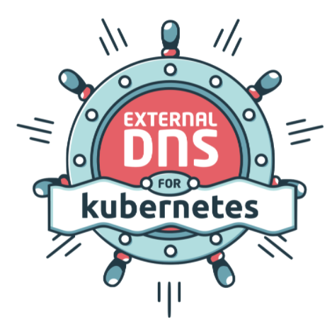
Elastic Load
Balancing
Application
Load Balancer
Network
Load Balancer
Kubernetes
Ingress
External
DNS
AWS EKS
Load Balancer Controller
External DNS Install

Slide 130

Kubernetes External DNS
In previous SSL Demos, we added AWS Route53 DNS Record manually (ssldemo101.stacksimplify.com)
AWS
Route 53
Route53
DNS Record
abc.stacksimplify.com
k8s Ingress
Service
With External DNS we can automatically add it for a Kubernetes Ingress Service or Kubernetes Service by defining it as Annotation
Route53
DNS Record
def.stacksimplify.com
k8s
Service

Slide 131

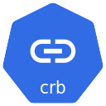

AWS EKS + External DNS
Deploy Ingress /service k8s
Manifest with external-dns
Annotations
AWS Cloud
EKS Cluster
default namespace
K8s API Server
IAM
IAM Policy
IAM Role
Annotate SA with IAM Role
external-dns
Service Account
Create / Update / Delete DNS Records in AWS Route53
external-dns
pod
external-dns
Deployment
external-dns
Cluster Role
external-dns
Cluster Role
Binding
AWS Route53
Route53
DNS Records
External-dns retrieves a list of resources (Services, Ingresses, etc.)
from the Kubernetes API Server to determine a desired list of DNS records that need to be created / updated / deleted from AWS Route53
Other AWS Services

Slide 132
Elastic Load
Balancing
Application
Load Balancer
Network
Load Balancer
Kubernetes
Ingress
External
DNS
AWS EKS
Load Balancer Controller
Kubernetes Ingress &
External DNS

Slide 133
AWS Cloud
VPC
EKS Cluster Control Plane
Availability Zone: us-east-1a
Availability Zone: us-east-1b
Users
Amazon Route 53
Public subnet
Public subnet
SSL
Application Load Balancer
HTTP → HTTPS
SSL Redirect
external-dns
Application Load Balancer Service (Ingress)
dnstest1.stacksimplify.com
dnstest2. stacksimplify.com
NAT gateway
NAT gateway
/app1/*
/app2/*
Ingress
/*
HTTPS URLS
https://dnstest1.stacksimplify.com/ https://dnstest1. stacksimplify.com/app1/index.html https://dnstest1. stacksimplify.com/app2/index.html
https://dnstest2. stacksimplify.com/ https://dnstest2. stacksimplify.com/app1/index.html https://dnstest2. stacksimplify.com/app2/index.html
Private subnet
Private subnet
EC2 Worker Node-1
EC2 Worker Node-2
app1- NodePort SVC
app2 -NodePort SVC
app3 – Node Port Service
N
N
U
AWS Certificate Manager
Pod
Pod
Pod
ReplicaSet
ReplicaSet
ReplicaSet
Deployment: app1
Deployment: app2
Deployment: app3
AWS EKS
Network Design
With
Application
Load Balancer & Route53
Ingress & External-DNS
EKS Private NodeGroup

Slide 134
Elastic Load
Balancing
Application
Load Balancer
Network
Load Balancer
Kubernetes
Ingress
External
DNS
AWS EKS
Load Balancer Controller
Kubernetes Service &
External DNS

Slide 135
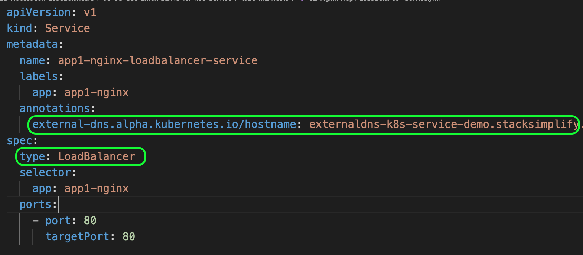
Kubernetes Service with External DNS

Slide 136
AWS Cloud
VPC
EKS Cluster Control Plane
Availability Zone: us-east-1a
Availability Zone: us-east-1b
Users
Amazon Route 53
Public subnet
Public subnet
Classic Load Balancer
http://externaldns-k8s-service-demo.
stacksimplify.com
Classic Load Balancer Service
NAT gateway
NAT gateway
Private subnet
Private subnet
EC2 Worker Node-1
EC2 Worker Node-2
N
N
ReplicaSet
N
N
Pod
Pod
Pod
Pod
Deployment
AWS EKS
Network Design
With
EKS Workload
Classic Load Balancer
External DNS
EKS Private NodeGroup

Slide 137
Elastic Load
Balancing
Application
Load Balancer
Network
Load Balancer
Kubernetes
Ingress
External
DNS
AWS EKS
Load Balancer Controller
Kubernetes Ingress
Name based Virtual Host / Host Header Routing

Slide 138
AWS Cloud
VPC
EKS Cluster Control Plane
Availability Zone: us-east-1a
Availability Zone: us-east-1b
Users
Amazon Route 53
Public subnet
Public subnet
SSL
Application Load Balancer
Ingress
HTTP → HTTPS
SSL Redirect
external-dns
Application Load Balancer Service (Ingress)
app1.stacksimplify.com
app2. stacksimplify.com
default.stacksimplify.com
NAT gateway
NAT gateway
app1.stacksimplify.com
app2.stacksimplify.com
default.stacksimplify.com
App URLs
https://app1. stacksimplify.com/app1/index.html https://app2. stacksimplify.com/app2/index.html
https://default.stacksimplify.com/
Private subnet
Private subnet
EC2 Worker Node-1
EC2 Worker Node-2
app1- NodePort SVC
app2 -NodePort SVC
app3 – Node Port Service
N
N
N
AWS Certificate Manager
Pod
Pod
Pod
ReplicaSet
ReplicaSet
ReplicaSet
Deployment: app1
Deployment: app2
Deployment: app3
AWS EKS
Network Design
With
Application
Load Balancer & Route53
Ingress & External-DNS
EKS Private NodeGroup

Slide 139
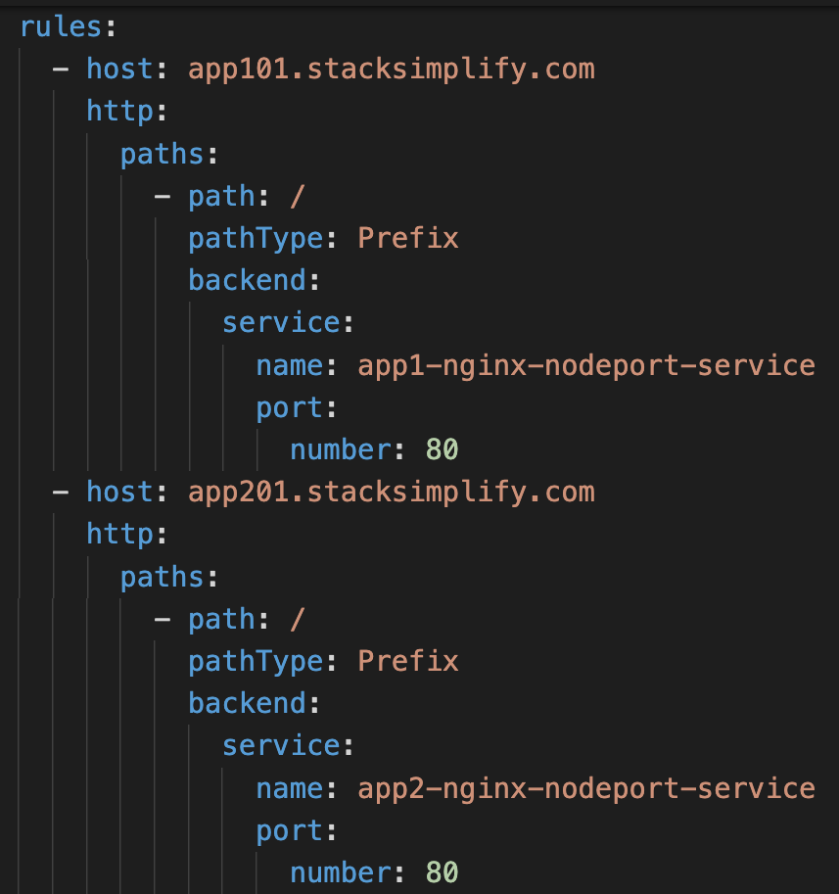
Name based Virtual Host Routing
Requests with app101.stacksimplify.com will go to App1 Node Port Service
Requests with app201.stacksimplify.com will go to App2 Node Port Service

Slide 140
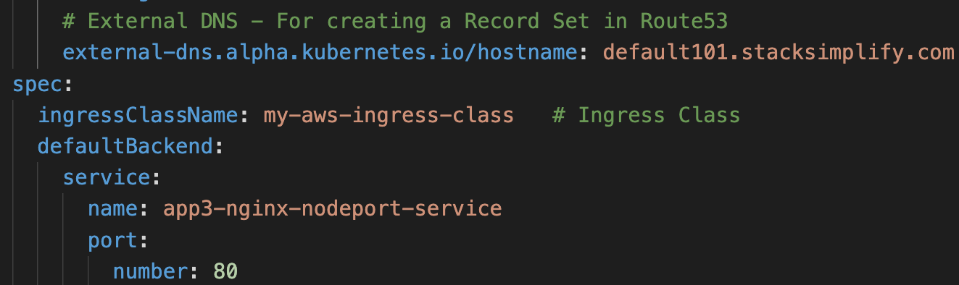
Named based Virtual Host Routing
Requests with default101.stacksimplify.com will go to App3 Node Port Service (Default Backend)

Slide 141
Elastic Load
Balancing
Application
Load Balancer
Network
Load Balancer
Kubernetes
Ingress
External
DNS
AWS EKS
Load Balancer Controller
Kubernetes Ingress
SSL Discovery – Host & TLS

Slide 142
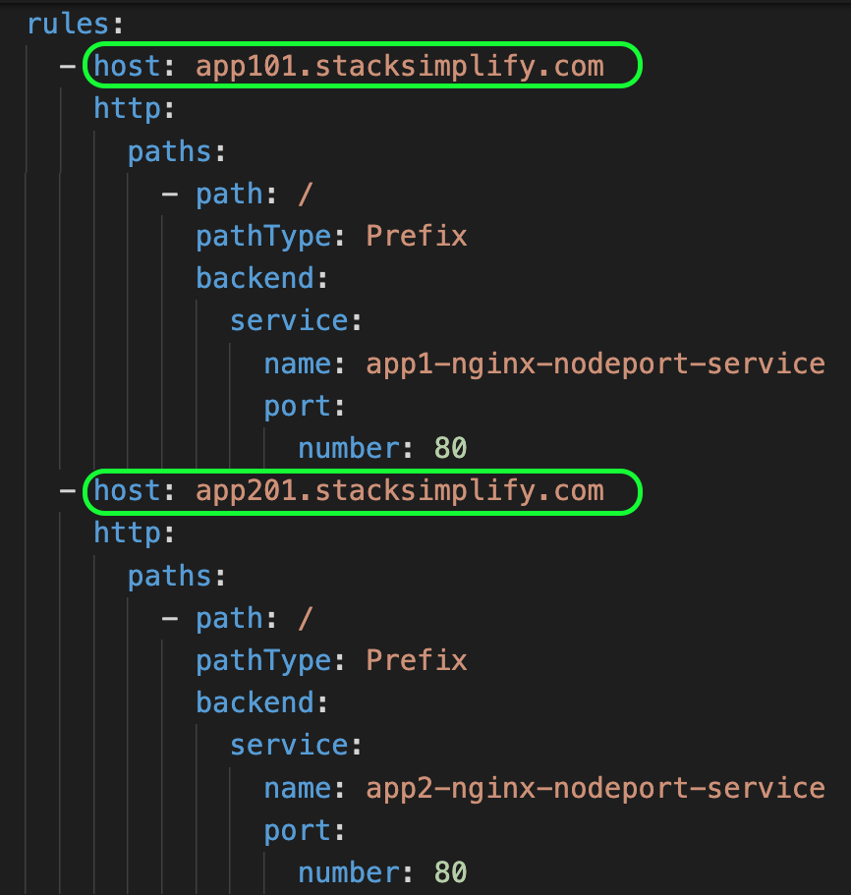
Ingress SSL Certificate Discovery using Host
Demo-1: SSL Discovery – Host
TLS certificates for ALB Listeners can be automatically discovered with hostnames from Ingress resources if the alb.ingress.kubernetes.io/certificate-arn annotation is not specified.
The controller will attempt to discover TLS certificates from the tls field in Ingress and host field in Ingress rules.
Important Note: You need to explicitly specify to use HTTPS listener with listen-ports annotation.
alb.ingress.kubernetes.io/listen-ports: '[{"HTTPS":443}]'

Slide 143
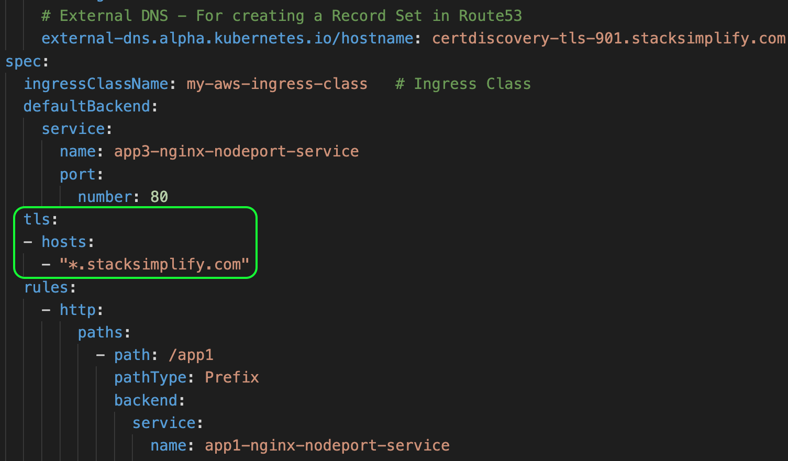
Ingress SSL Certificate Discovery using tls
Demo-2: SSL Discovery – tls

Slide 144
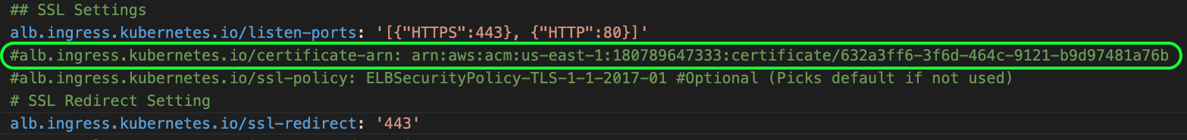
Comment certificate-arn Annotation
Comment alb.ingress.kubernetes.io/certificate-arn
Annotation when using host / tls options

Slide 145
Elastic Load
Balancing
Application
Load Balancer
Network
Load Balancer
Kubernetes
Ingress
External
DNS
AWS EKS
Load Balancer Controller
Kubernetes Ingress
Ingress Groups

Slide 146

Without Ingress Groups
Single Ingress Resource for all three Apps
Any changes to App3 we need to update the “my-apps” ingress resource
Example: If we have 50 apps which needs different rules in them and all should be part of single ALB, maintaining such huge k8s manifest file with configs becomes tedious and confusing.
Ingress Resource: my-apps
With Ingress Groups we can simplify our Kubernetes Ingress Manifest when dealing with multiple apps requiring single ALB
App1
App2
App3

Slide 147


With Ingress Groups
alb.ingress.kubernetes.io/load-balancer-name: ingress-groups-demo
Ingress Group: myapps.web
Priority: 10
Priority: 20
Priority: 30
Ingress Service: app1-ingress
Ingress Service: app2-ingress
Ingress Service: app3-ingress
App1
App2
App3

Slide 148
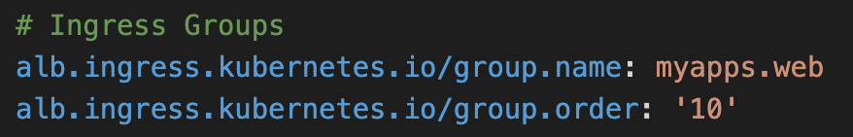
Ingress Groups
1
IngressGroup feature enables you to group multiple Ingress resources together.
2
The controller will automatically merge Ingress rules for all Ingresses within IngressGroup and support them with a single ALB.
3
VERY VERY IMPORTANT NOTE: In addition, most annotations defined on an Ingress only applies to the paths defined by that Ingress.
Sample

Slide 149
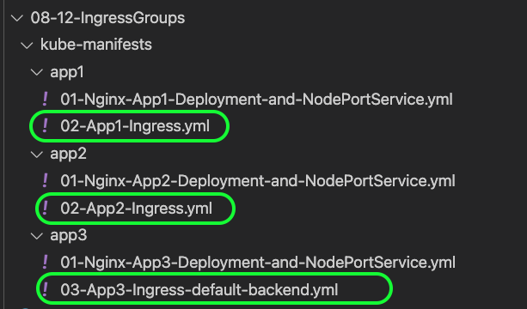
Ingress Groups
3 Ingress Kubernetes Manifests creates 3 Ingress Resources and merge to create a Single AWS ALB.

Slide 150
Elastic Load
Balancing
Application
Load Balancer
Network
Load Balancer
Kubernetes
Ingress
External
DNS
AWS EKS
Load Balancer Controller
Kubernetes Ingress
Target Type: IP

Slide 151
ALB Ingress Target Types
What is alb.ingress.kubernetes.io/target-type Annotation ?
target-type specifies how to route traffic to pods.
ALB Ingress Target Types
Instance
IP

Slide 152


ALB Ingress Target Types
Instance
IP
instance mode will route traffic to all ec2 instances within cluster on NodePort opened for your service.
ip mode will route traffic directly to the pod IP.
service must be of type "NodePort" or "LoadBalancer" to use instance mode
ip mode is required for sticky sessions to work with Application Load Balancers.
Default Target Type is Instance Mode which means no need to define this annotation in Ingress, by default it takes Instance Mode
Need to define the annotation explicitly as target-type: ip

Slide 153
Elastic Load
Balancing
Application
Load Balancer
Network
Load Balancer
Kubernetes
Ingress
External
DNS
AWS EKS
Load Balancer Controller
Kubernetes Ingress
Internal Application
Load Balancer

Slide 154
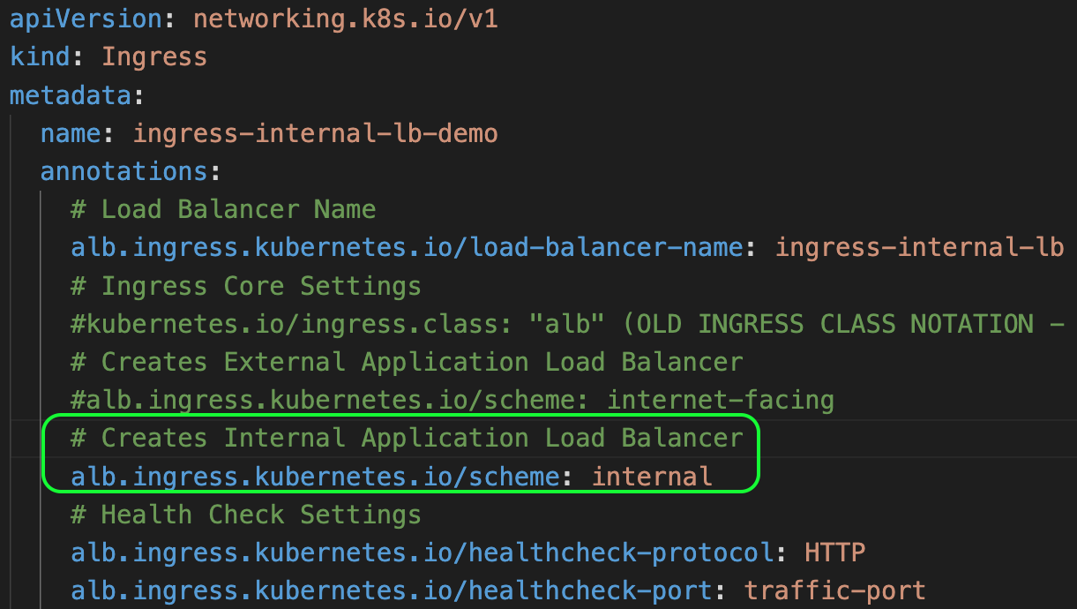
Ingress ALB Internal Load Balancer
Creates AWS ALB Internal Load Balancer

Slide 155
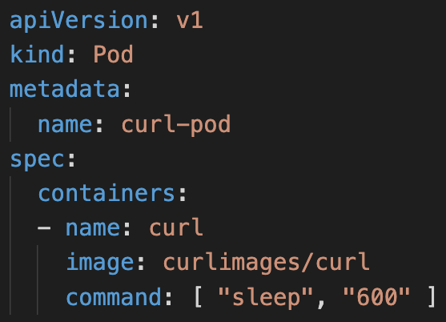
Curl Pod
We cannot connect to Internal LB directly from internet to test it.
We will deploy a curl pod in EKS Cluster so we can connect to curl pod in EKS Cluster and test the Internal LB Endpoint using curl command.

Slide 156
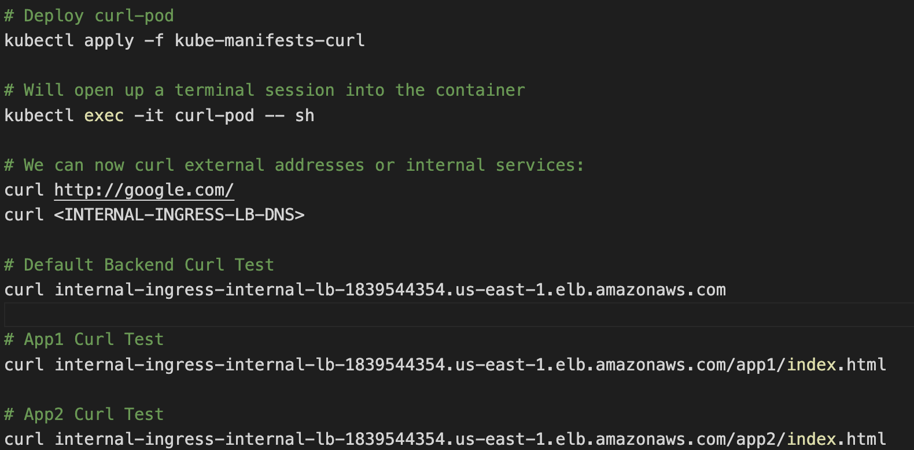
Command to Test Ingress AWS Internal ALB using curl pod

Slide 157
AWS Load Balancer Controller Updates - End

Slide 158
Elastic Load
Balancing
Classic
Load Balancer
Network
Load Balancer
Application
Load Balancer
Certificate
Manager
Route53
Elastic Block
Store
Amazon RDS
AWS EKS
Fargate Profiles
Serverless
Fargate
Profiles

Slide 159
What is Fargate?
Fargate is a Serverless compute platform for containers on AWS
Fargate provides on-demand, right-sized compute capacity for containers
EKS integrates Kubernetes with Fargate by using controllers that are built by AWS using the upstream, extensible model provided by Kubernetes.
These controllers run as part of the EKS managed Kubernetes control plane and are responsible for scheduling native Kubernetes pods onto Fargate.
The Fargate controllers include a new scheduler that runs alongside the default Kubernetes scheduler in addition to several mutating and validating admission controllers.
When we start a pod that meets the criteria for running on Fargate, the Fargate controllers running in the cluster recognize, update, and schedule the pod onto Fargate.

Slide 160
AWS EKS on Fargate
=
Bring existing pods
Production Ready
Rightsized and Integrated
We don’t need to change our existing pods
Fargate works with existing workflows and services that run on kubernetes
Launch pods easily.
Easily run pods across Azs for HA
Each pod runs in an isolated compute environment
Only pay for resources you need to run your pods
Includes native AWS integrations for networking and security

Slide 161
EKS Deployment Options
Managed EC2 Nodes
Only EC2 Node Groups
Unmanaged EC2 Nodes
Managed Nodes
EKS Deployment Options
Mixed
Unmanaged EC2 Nodes
Fargate Nodes
Only Fargate
Fargate Nodes

Slide 162
EKS Deployment Options – EC2 Node Groups
AWS Cloud
EKS Cluster
VPC
Availability Zone: us-east-1a
Availability Zone: us-east-1b
Public subnet
Public subnet
Auto Scaling group
We can deploy EC2 Managed Node Groups in both public and private subnets of a VPC
EC2 Instance
EKS Public Managed Node Group
EC 2Instance
Private subnet
Private subnet
Auto Scaling group
EC2 Instance
EKS Private Managed Node Group
EC 2Instance
EKS Managed Node Groups

Slide 163
EKS Deployment Options – Only Fargate
EKS Cluster
AWS Cloud
VPC
Availability Zone: us-east-1a
Availability Zone: us-east-1b
Public subnet
Public subnet
Pods running on Fargate are only supported on private subnets
Private subnet
EKS Fargate
Private subnet
Fargate Profile
Fargate EC2 Instance
Fargate EC2 Instance
EKS Fargate Profiles

Slide 164
EKS Deployment Options - Mixed
EKS Cluster
AWS Cloud
VPC
Availability Zone: us-east-1a
Availability Zone: us-east-1b
Availability Zone: us-east-1a
Availability Zone: us-east-1b
Public subnet
Public subnet
Public subnet
Public subnet
Auto Scaling group
EC2 Instance
EKS Public Managed Node Group
EC 2Instance
Private subnet
Private subnet
Private subnet
EKS Fargate
Private subnet
Auto Scaling group
Fargate Profile
EC2 Instance
EKS Private Managed Node Group
EC 2Instance
Fargate EC2 Instance
Fargate EC2 Instance
EKS Managed Node Groups
EKS Fargate Profiles

Slide 165
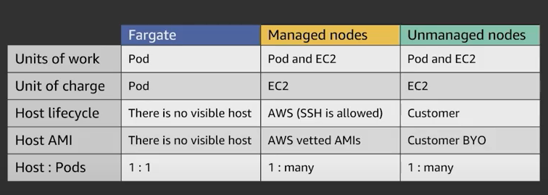
EKS Fargate vs Managed vs Unmanaged Nodes

Slide 166
EKS Fargate Considerations
There are many considerations we need to be aware of before we decide our Kubernetes workloads to run on Fargate.
Documentation Link
https://docs.aws.amazon.com/eks/latest/userguide/fargate.html

Slide 167
Elastic Load
Balancing
Classic
Load Balancer
Network
Load Balancer
Application
Load Balancer
Certificate
Manager
Route53
Elastic Block
Store
Amazon RDS
AWS EKS
Fargate Profiles
Basics
Fargate
Profiles

Slide 168
EKS Deployment Options - Mixed
EKS Cluster
AWS Cloud
VPC
Availability Zone: us-east-1a
Availability Zone: us-east-1b
Public subnet
Public subnet
Auto Scaling group
EC2 Instance
EKS Public Managed Node Group
EC 2Instance
Private subnet
Private subnet
EKS Fargate
Auto Scaling group
EC2 Instance
EKS Private Managed Node Group
EC 2Instance
EKS Managed Node Groups
EKS Fargate Profiles

Slide 169

EKS Deployment Options - Mixed
Fargate Profiles can be deployed to EKS Cluster only when we have at least one private subnet
EKS Cluster
AWS Cloud
VPC
Availability Zone: us-east-1a
Availability Zone: us-east-1b
Availability Zone: us-east-1a
Availability Zone: us-east-1b
Public subnet
Public subnet
Public subnet
Public subnet
Auto Scaling group
EC2 Instance
EKS Public Managed Node Group
EC 2Instance
Private subnet
Private subnet
Private subnet
EKS Fargate
Private subnet
Auto Scaling group
Fargate Profile
EC2 Instance
EKS Private Managed Node Group
EC2 Instance
Fargate EC2 Instance
Fargate EC2 Instance
EKS Managed Node Groups
EKS Fargate Profiles

Slide 170
AWS Cloud
EKS Cluster Control Plane
VPC
Availability Zone: us-east-1a
Availability Zone: us-east-1b
Users
Amazon Route 53
Public subnet
Public subnet
SSL
Application Load Balancer
SSL Redirect
external-dns
fpdev.kubeoncloud.com
User Management – Application Load Balancer Service (Ingress)
https://fpdev.kubeoncloud.com/app1/index.html
NAT gateway
/*
NAT gateway
Ingress
Private subnet
Private subnet
Fargate Node-1
Fargate Node-2
N
ReplicaSet
N
AWS Certificate Manager
Pod
Pod
Deployment: app1
app1- NodePort Service
AWS EKS
Fargate Profiles
Basics
Fargate Profile: fp-dev

Slide 171
Elastic Load
Balancing
Classic
Load Balancer
Network
Load Balancer
Application
Load Balancer
Certificate
Manager
Route53
Elastic Block
Store
Amazon RDS
AWS EKS
Fargate Profiles
Advanced with YAML
Fargate
Profiles

Slide 172
EKS Deployment Options – Mixed Mode - 3 Apps
Users
AWS Cloud
app1. kubeoncloud.com
app2.kubeoncloud.com
ums.kubeoncloud,com
Amazon RDS DB
app1.kubeoncloud.com
app2.kubeoncloud.com
ums.kubeoncloud.com
Amazon Route 53
VPC
Availability Zone: us-east-1a
Availability Zone: us-east-1b
Availability Zone: us-east-1a
EKS Fargate
Availability Zone: us-east-1b
Public subnet
Public subnet
Private subnet
Private subnet
App1 - Ingress
UMS - Ingress
NS: ns-ums
MySQL – ExternalName Service
Fargate Profile: UMS
Ingress
App2 - Ingress
U
U
UMS Pod
UMS Pod
Private subnet
Private subnet
UMS - NodePort Service
NS: ns-app1
App1 - NodePort Service
NS: ns-app2
App2 - NodePort Service
Auto Scaling group
Fargate Profile: App2
N
N
N
N
App1 Pod
EKS Private Managed Node Group
App1 Pod
App2 Pod
App2 Pod
EKS Managed Node Groups
EKS Fargate Profiles
AWS Certificate Manager
EKS Cluster

Slide 173
EKS Deployment – Mixed – Ingress with Cross Namespaces
Users
app1. kubeoncloud.com
app2.kubeoncloud.com
ums.kubeoncloud,com
AWS Cloud
app1. kubeoncloud.com
app2.kubeoncloud.com
ums.kubeoncloud,com
Amazon RDS DB
Ingress with Cross Namespaces is not supported as on today
Amazon Route 53
VPC
Availability Zone: us-east-1a
Availability Zone: us-east-1b
Availability Zone: us-east-1a
EKS Fargate
Availability Zone: us-east-1b
Public subnet
Public subnet
Private subnet
Private subnet
App1 - Ingress
NS: ns-ums
MySQL – ExternalName Service
/app1/*
/ums/*
Fargate Profile: UMS
Ingress
/app2/*
U
U
UMS Pod
UMS Pod
Private subnet
Private subnet
UMS - NodePort Service
NS: ns-app1
App1 - NodePort Service
NS: ns-app2
App2 - NodePort Service
Auto Scaling group
Fargate Profile: App2
N
N
N
N
App1 Pod
EKS Private Managed Node Group
App1 Pod
App2 Pod
App2 Pod
EKS Managed Node Groups
EKS Fargate Profiles
AWS Certificate Manager
EKS Cluster

Slide 174
AWS Load Balancer Controller & AWS Network Load Balancer – NEW TOPIC ADDITION - START

Slide 175
Elastic Load
Balancing
Network
Load Balancer
Kubernetes
Service
External
DNS
AWS EKS
Load Balancer Controller
Kubernetes Service
Network Load Balancer

Slide 176
6 Demos
Demo-1: NLB Basics
Demo-4: NLB & Elastic IP
AWS Load Balancer Controller
Demo-2: NLB TLS SSL
Demo-5: Internal NLB
AWS Network
Load Balancer
Kubernetes
Service
Demo-3: NLB & External DNS
Demo-6: NLB & Fargate

Slide 177
Elastic Load
Balancing
Network
Load Balancer
Kubernetes
Service
External
DNS
AWS EKS
Load Balancer Controller
Kubernetes Service
Network Load Balancer - Basics

Slide 178
Network Load Balancer
What is Network Load Balancer ?
Network traffic is load balanced at L4 of the OSI model.
Supports TCP, UDP and TLS Protocols
ELB Features Comparison for Additional Understanding: https://aws.amazon.com/elasticloadbalancing/features/

Slide 179
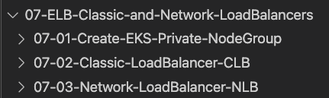
Options for creating Network Load Balancer using Kubernetes on EKS Cluster
AWS cloud provider load balancer controller
AWS Load Balancer Controller
Legacy Controller which can create AWS Classic LB and Network LB
Latest and greatest which can create AWS ALB and NLB
Creates very basic Network Load Balancer
Supports Protocols TCP, UDP & TLS (SSL) and for Health Check it supports TCP, HTTP & HTTPS
This controller will receive only critical bug fixes and in long run it will be deprecated
Supports Instance and IP Mode(For Fargate)
This controller will not have any new features added to it
Supports Internal, External NLB and Custom Subnet Discovery
Supports Static Elastic IP and Access Control
Supports 25+ new Annotations
https://kubernetes-sigs.github.io/aws-load-balancer-controller/v2.4/guide/service/annotations/

Slide 180
How to ensure our Network LB created using Kubernetes Service will be associated with only latest AWS Load Balancer Controller ?
AWS Cloud Provider Load Balancer Controller (Legacy)
service.beta.kubernetes.io/aws-load-balancer-type: nlb
service.beta.kubernetes.io/aws-load-balancer-type: nlb-ip
(Deprecated - Used just for backward compatability)
service.beta.kubernetes.io/aws-load-balancer-type: external
Kubernetes Service
Additional Note-1: If the values of aws-load-balancer-type annotation is nlb-ip or external legacy controller ignores that k8s service so that AWS Load Balancer Controller can take over.
AWS Load Balancer Controller (Latest)
Additional Note-2: EKS Cluster Versions v1.18.18+, v1.19.10+ and v1.20 and higher are supported

Slide 181
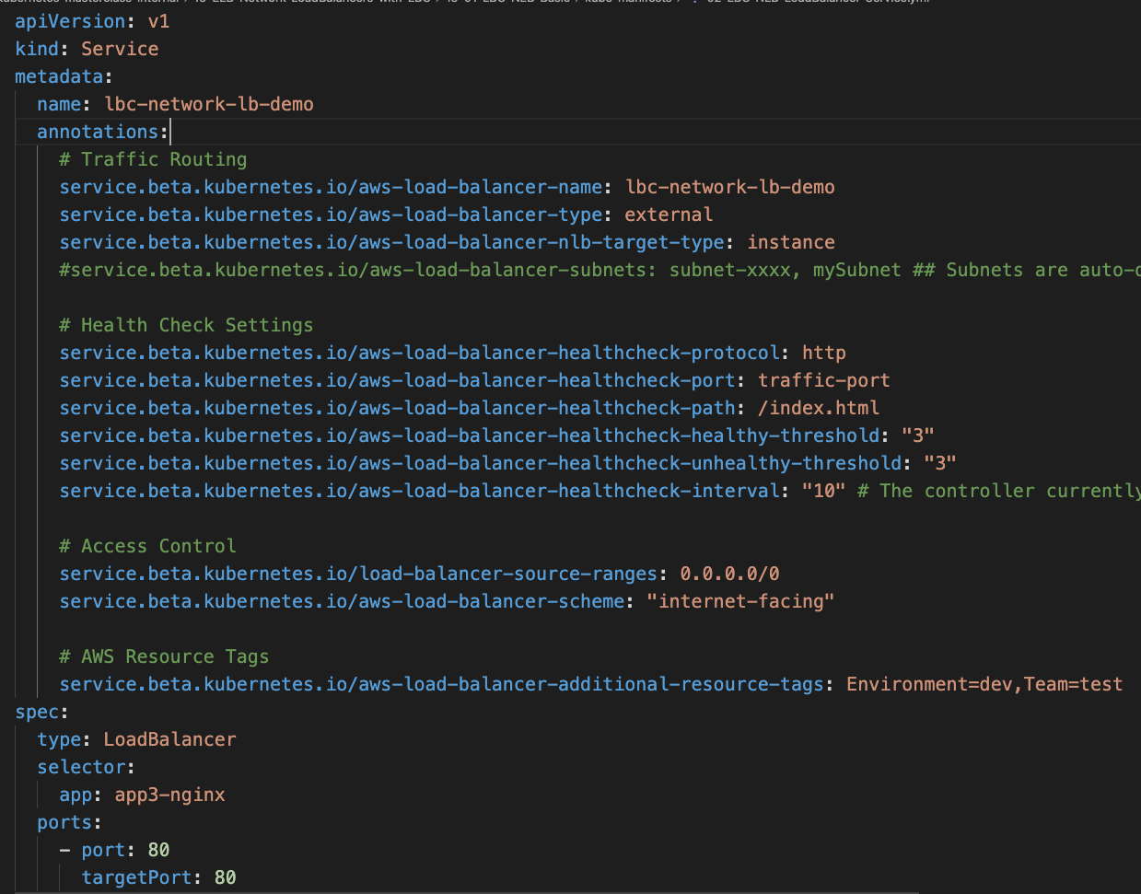
This Kubernetes Service creates Network Load Balancer which will be associated to latest AWS Load Balancer Controller

Slide 182
AWS EKS NLB – Basics
AWS Cloud
AWS EKS Cluster
Listener: 80
http://nlb-dns-url
LB Type: External
HTTP
Target-Type: Instance
Health Check Settings
Users
AWS Network
Load Balancer
Scheme: internet-facing
Nginx App3
Source Range: 0.0.0.0/0
Kubernetes Load Balancer Service
k8s admin
using kubectl
client
k8s api
server
AWS Load Balancer Controller

Slide 183
AWS Cloud
EKS Cluster Control Plane
HTTP
VPC
Availability Zone: us-east-1a
Availability Zone: us-east-1b
Users
http://NLB-DNS-URL
Public subnet
Public subnet
Network Load Balancer
NLB k8s Service
NAT gateway
Network Load Balancer
NAT gateway
Private subnet
Private subnet
EC2 Worker Node-1
EC2 Worker Node-2
N
ReplicaSet
N
Pod
Pod
Deployment: app3
AWS EKS
Network LB
Basics
EKS Private NodeGroup

Slide 184
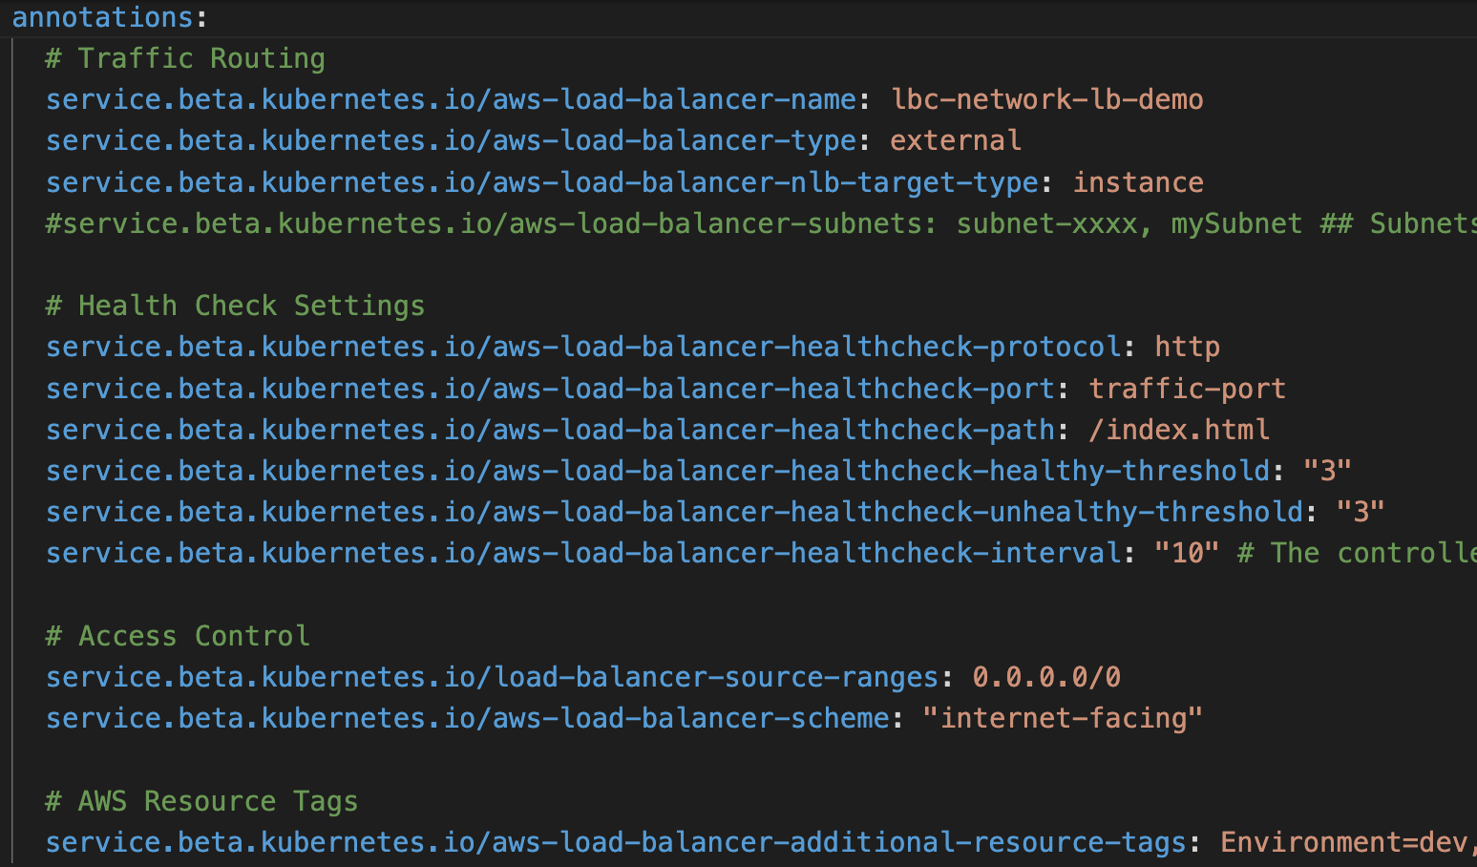
Kubernetes Service of Type NLB
Annotations

Slide 185
Elastic Load
Balancing
Network
Load Balancer
Kubernetes
Service
External
DNS
AWS EKS
Load Balancer Controller
Kubernetes Service
Network Load Balancer - TLS

Slide 186
AWS EKS NLB – TLS (HTTP + HTTPS)
AWS Cloud
AWS EKS Cluster
AWS Certificate Manager
Listener: 80
Listener, SSL-Ports: 443
http://nlb-dns-url
LB Type: External
SSL Cert: cert-arn
HTTP
Target-Type: Instance
SSL Negotiation Policy
HTTPS
Health Check Settings
Backend Protocol: tcp
Users
https://nlb-dns-url
AWS Network
Load Balancer
Scheme: internet-facing
Nginx App3
Source Range: 0.0.0.0/0
Kubernetes Load Balancer Service
k8s admin
using kubectl
client
k8s api
server
AWS Load Balancer Controller

Slide 187
AWS Cloud
EKS Cluster Control Plane
HTTP
HTTPS
VPC
Availability Zone: us-east-1a
Availability Zone: us-east-1b
Users
http://NLB-DNS-URL
https://NLB-DNS-URL
Public subnet
Public subnet
Network Load Balancer
NLB k8s Service
TLS
NAT gateway
Network Load Balancer
NAT gateway
Private subnet
Private subnet
EC2 Worker Node-1
EC2 Worker Node-2
N
ReplicaSet
N
AWS Certificate Manager
Pod
Pod
Deployment: app3
AWS EKS
Network LB
With
TLS
EKS Private NodeGroup

Slide 188
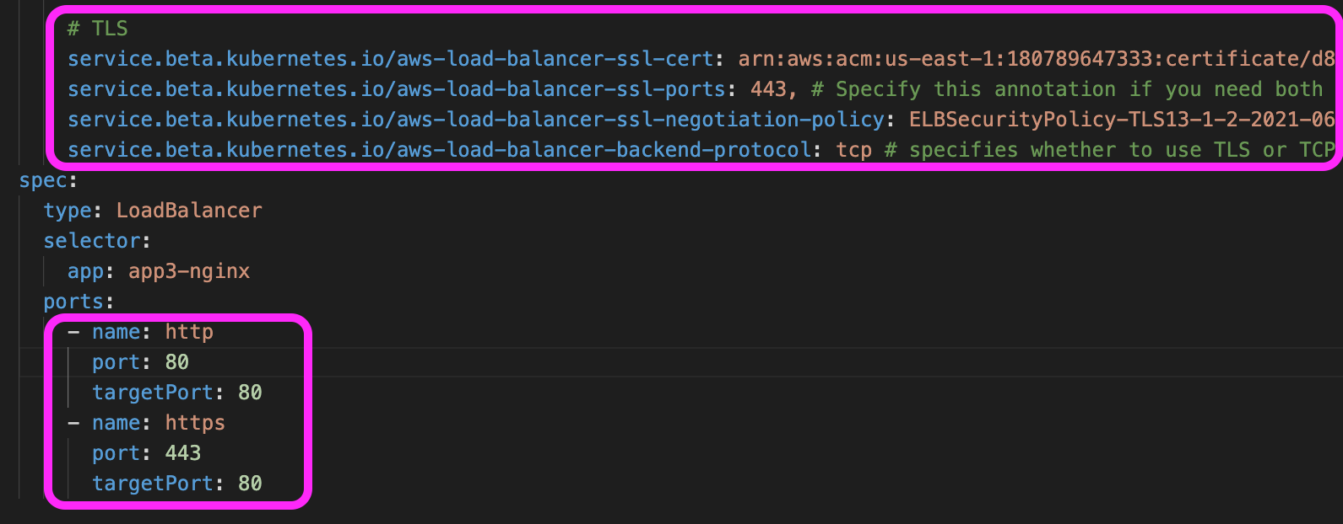
AWS EKS NLB -Annotations

Slide 189
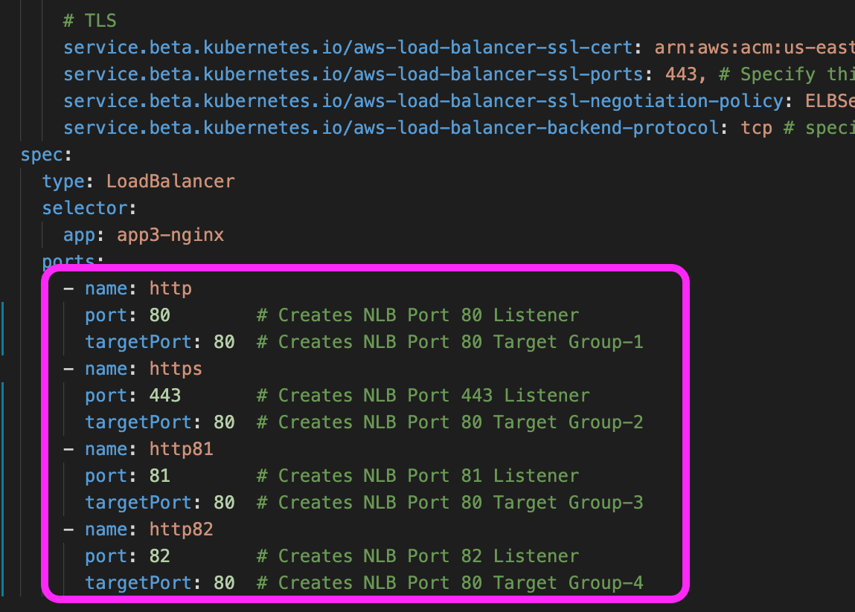
AWS EKS NLB -Annotations

Slide 190
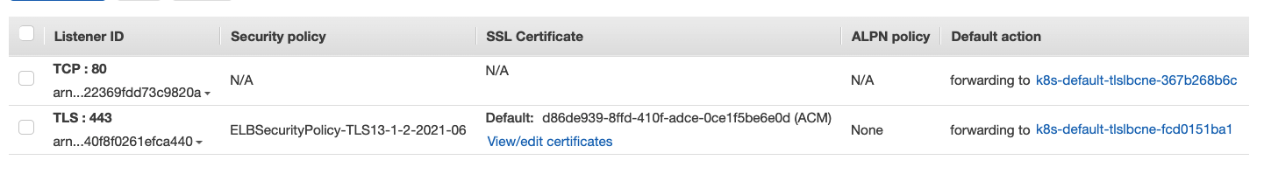
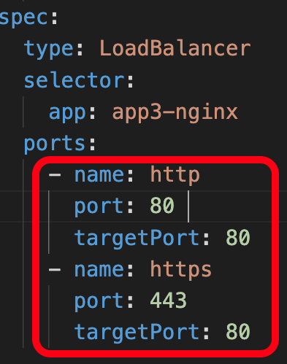
AWS EKS NLB –Load Balancer
It created two Target Groups one for 80 and for 443
TLS and Non-TLS two listeners created
LB SSL Negotiation Policy
SSL Certificate

Slide 191
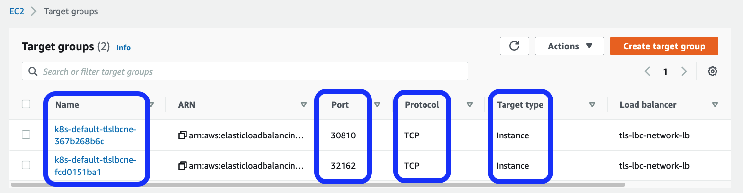
AWS EKS NLB -Target Groups

Slide 192

AWS EKS NLB -Target Groups

Slide 193

AWS EKS NLB -Target Groups

Slide 194
Elastic Load
Balancing
Network
Load Balancer
Kubernetes
Service
External
DNS
AWS EKS
Load Balancer Controller
Kubernetes Service
Network Load Balancer External DNS

Slide 195
AWS EKS NLB – External DNS
AWS Cloud
AWS EKS Cluster
AWS Certificate Manager
Listener: 80
Listener, SSL-Ports: 443
http://nlbextdns.stacksimplify.com
LB Type: External
SSL Cert: cert-arn
HTTP
Target-Type: Instance
SSL Negotiation Policy
HTTPS
Health Check Settings
Backend Protocol: tcp
Users
AWS Network
Load Balancer
Scheme: internet-facing
External DNS Hostname
Nginx App3
https://nlbextdns.stacksimplify.com
Source Range: 0.0.0.0/0
Kubernetes Load Balancer Service
k8s Api Server
AWS Load Balancer Controller
k8s admin
using kubectl
client
External DNS
AWS Route53
Create / Update / Delete DNS Record in Route53

Slide 196
AWS Cloud
EKS Cluster Control Plane
VPC
Availability Zone: us-east-1a
Availability Zone: us-east-1b
Users
Amazon Route 53
Public subnet
Public subnet
HTTP
Network Load Balancer
NLB k8s Service
HTTPS
TLS
external-dns
nlbextdns.stacksimplify.com
NAT gateway
Network Load Balancer
NAT gateway
http://nlbextdns.stacksimplify.com
https://nlbextdns.stacksimplify.com
Private subnet
Private subnet
EC2 Worker Node-1
EC2 Worker Node-2
N
ReplicaSet
N
AWS Certificate Manager
Pod
Pod
Deployment: app3
AWS EKS
Network LB
With
External DNS
EKS Private NodeGroup

Slide 197
AWS EKS NLB - External DNS Annotation

Slide 198
Elastic Load
Balancing
Network
Load Balancer
Kubernetes
Service
External
DNS
AWS EKS
Load Balancer Controller
Kubernetes Service
Network Load Balancer
Elastic IP

Slide 199

AWS EKS NLB – External DNS
AWS Cloud
AWS EKS Cluster
AWS Certificate Manager
Elastic IP
Listener: 80
Listener, SSL-Ports: 443
http://nlbeip.stacksimplify.com
LB Type: External
SSL Cert: cert-arn
HTTP
Target-Type: Instance
SSL Negotiation Policy
HTTPS
Health Check Settings
Backend Protocol: tcp
Users
AWS Network
Load Balancer
Scheme: internet-facing
External DNS Hostname
Nginx App3
https://nlbeip.stacksimplify.com
Source Range: 0.0.0.0/0
Elastic IP
Kubernetes Load Balancer Service
k8s admin
using kubectl
client
k8s Api Server
AWS Load Balancer Controller
External DNS
AWS Route53
Create / Update / Delete DNS Record in Route53

Slide 200
AWS Cloud
EKS Cluster Control Plane
VPC
Availability Zone: us-east-1a
Availability Zone: us-east-1b
Users
Amazon Route 53
Public subnet
Public subnet
HTTP
Network Load Balancer
NLB k8s Service
HTTPS
Elastic IP
Elastic IP
nlbeip.stacksimplify.com
NAT gateway
Network Load Balancer
NAT gateway
TLS
external-dns
http://nlbeip.stacksimplify.com
https://nlbeip.stacksimplify.com
Private subnet
Private subnet
EC2 Worker Node-1
EC2 Worker Node-2
N
ReplicaSet
N
AWS Certificate Manager
Pod
Pod
Deployment: app3
AWS EKS
Network LB
With
Elastic IPs
EKS Private NodeGroup

Slide 201
AWS EKS NLB - Elastic IP Annotation
Important Note-1:
You must specify the same number of eip allocations as load balancer subnets annotation
Important Note-2:
NLB must be internet-facing

Slide 202
Elastic Load
Balancing
Network
Load Balancer
Kubernetes
Service
External
DNS
AWS EKS
Load Balancer Controller
Kubernetes Service
Network Load Balancer
Internal LB

Slide 203
AWS EKS NLB – Internal LB
k8s admin using
kubectl client
AWS Cloud
AWS EKS Cluster
Listener: 80
LB Type: External
Target-Type: Instance
curl-pod
Health Check Settings
AWS Network
Load Balancer
Scheme: internal
Kubernetes Load Balancer Service
Nginx App3
k8s Api Server
AWS Load Balancer Controller
k8s admin
using kubectl
client

Slide 204
AWS Cloud
VPC
EKS Cluster Control Plane
AWS EKS
Network Design
With
Network
Load Balancer
Internal
Availability Zone: us-east-1a
Availability Zone: us-east-1b
Public subnet
Public subnet
NAT gateway
NAT gateway
Private subnet
Private subnet
NLB k8s Service
Network Load Balancer Service
EC2 Worker Node-1
EC2 Worker Node-2
N
Pod
curl-pod
ReplicaSet
EKS Private NodeGroup
Deployment: app3
k8s admin using
kubectl client

Slide 205
AWS EKS NLB - Internal

Slide 206
Curl Pod
We cannot connect to Internal LB directly from internet to test it.
We will deploy a curl pod in EKS Cluster so we can connect to curl pod in EKS Cluster and test the Internal LB Endpoint using curl command.

Slide 207

Command to Test AWS Internal NLB using curl pod

Slide 208
Elastic Load
Balancing
Network
Load Balancer
Kubernetes
Service
External
DNS
AWS EKS
Load Balancer Controller
Kubernetes Service
Network Load Balancer
with Workload running on Fargate

Slide 209
AWS EKS NLB – Fargate Workloads
AWS Cloud
AWS EKS Cluster
AWS Certificate Manager
Listener: 80
Liistener, SSL-Ports: 443
http://fargatenlb.stacksimplify.com
LB Type: External
SSL Cert: cert-arn
Fargate Node-1
HTTP
Target-Type: IP
SSL Negotiation Policy
HTTPS
Health Check Settings
Backend Protocol: tcp
Users
AWS Network
Load Balancer
Scheme: internet-facing
External DNS Hostname
Nginx App3
https://fargatenlb.stacksimplify.com
Source Range: 0.0.0.0/0
Kubernetes Load Balancer Service
k8s admin
using kubectl
client
k8s Api Server
AWS Load Balancer Controller
External DNS
AWS Route53
Create / Update / Delete DNS Record in Route53

Slide 210
AWS Cloud
EKS Cluster Control Plane
VPC
Availability Zone: us-east-1a
Availability Zone: us-east-1b
Users
Amazon Route 53
Public subnet
Public subnet
HTTP
Network Load Balancer
NLB k8s Service
HTTPS
nlbfargate.stacksimplify.com
TLS
external-dns
NAT gateway
Network Load Balancer
NAT gateway
http://nlbfargate.stacksimplify.com
https://nlbfargate.stacksimplify.com
Private subnet
Private subnet
Fargate Node-1
Fargate Node-2
N
ReplicaSet
N
AWS Certificate Manager
Pod
Pod
Deployment: app3
AWS EKS
Fargate Profiles
with
Network LB
Fargate Profile: fp-dev

Slide 211
AWS EKS NLB – Fargate Workloads
Pod IP Address will be directly registered as targets in NLB Load Balancer Target Groups when we use Target Type as IP Mode

Slide 212
AWS Load Balancer Controller & AWS Network Load Balancer – NEW TOPIC ADDITION - END

Slide 213
Elastic Load
Balancing
Classic
Load Balancer
Network
Load Balancer
Application
Load Balancer
Certificate
Manager
Route53
Elastic Block
Store
Amazon RDS
AWS EKS
ECR
Elastic Container Registry
Fargate
Profiles
Elastic Container
Registry

Slide 214
Elastic Container Registry - ECR
Elastic Container Registry (ECR) is a fully-managed Docker container registry that makes it easy for developers to store, manage, and deploy Docker container images.
ECR is integrated with Elastic Kubernetes Service (EKS), simplifying our development to production workflow.
ECR eliminates the need to operate our own container repositories or worry about scaling the underlying infrastructure.
ECR hosts our images in a highly available and scalable architecture, allowing us to reliably deploy containers for our applications.
Integration with AWS Identity and Access Management (IAM) provides resource-level control of each repository.
With Amazon ECR, there are no upfront fees or commitments. We pay only for the amount of data you store in your repositories and data transferred to the Internet.

Slide 215
Elastic Container Registry - ECR
Benefits
Full managed
Secure
Highly Available
Simplified Workflow

Slide 216


How ECR Works?
Developer
Docker Container
Push Images
Elastic Container Service - ECS
Pull Images and Run Containers
Docker Image
Docker Container
Pull Images
Elastic Container Registry - ECR
Elastic Kubernetes Service - EKS
Docker Container
On-Premise

Slide 217
EKS & ECR
Developer
Users
http://ecrdemo.kubeoncloud.com
AWS Cloud
ecrdemo.kubeoncloud.com
Push Images
EKS Cluster
Amazon Route 53
AWS Certificate Manager
VPC
Docker Image
Pull Docker Image from ECR
Availability Zone: us-east-1a
Availability Zone: us-east-1b
Public subnet
Public subnet
Ingress
Elastic Container Registry - ECR
NAT gateway
ECR Demo - ALB Ingress Service
NAT gateway
Private subnet
Private subnet
EC2 Worker Node-1
EC2 Worker Node-2
ECR Demo App - NodePort Service
N
N
Pod
Pod
EKS Private Managed Node Group

Slide 218
Elastic Load
Balancing
Classic
Load Balancer
Network
Load Balancer
Application
Load Balancer
Certificate
Manager
Route53
Elastic Block
Store
Amazon RDS
AWS EKS
&
AWS Developer Tools
Fargate
Profiles
Elastic Container
Registry
Code
Commit
Code
Build
Code
Pipeline

Slide 219
Stages in Release Process
Source
Build
Test
Production
Check-in source code
Peer review new code
Pull Request process
Compile Code & build artifacts (war ,jar, container images, Kubernetes manifest files)
Unit Tests
Integration tests with other systems.
Load Testing
UI Tests
Security Tests
Test Environments (Dev, QA and Staging)
Deployment to production environments
Monitor code in production to quickly detect errors
Deployment to production environments
Monitor code in production to quickly detect errors

Slide 220
Stages in Release Process
Source
Build
Test
Production

Slide 221
Continuous Integration
Source
Build
Test
Production
Automatically kick off a new release when new code is checked- in
Build and test code in a consistent, repeatable environment
Continually have an artifact ready for deployment

Slide 222
Continuous Delivery
Source
Build
Test
Production
Automatically deploy new changes to staging environments for testing
Deploy to production safely without affecting customers
Deliver to customers faster
Increase deployment frequency, and reduce change lead time and change failure rate

Slide 223
AWS Developer Tools or Code Services
Source
Build
Test
Deploy
Monitor
AWS CodeCommit
AWS CodeBuild
AWS CodeBuild + Third Party
CodeBuild
kubectl
AWS CloudWatch
Container Insights
AWS CodePipeline

Slide 224
AWS Developer Tools or Code Services
Source
Build
Test
Deploy
Monitor
AWS CodeCommit
AWS CodeBuild
AWS CodeBuild + Third Party
CodeBuild
kubectl
AWS CloudWatch
Container Insights
AWS CodePipeline

Slide 225

AWS CodeCommit

Slide 226
AWS CodeCommit - Introduction
Version Control Service hosted by AWS
We can privately store and manage documents, source code, and binary files
Secure & highly scalable
Supports standard functionality of Git (CodeCommit supports Git versions 1.7.9 and later.)
Uses a static user name and password in addition to standard SSH..

Slide 227








CodeCommit – Integration with AWS Services
AWS CodeStar
AWS CodeBuild
AWS CodePipeline
AWS Cloud9
AWS Amplify
AWS CloudFormation
AWS CodeCommit
Amazon Simple Notification Service
AWS Key Management Service
AWS Elastic Beanstalk
AWS CloudTrail
Amazon CloudWatch

Slide 228

CodeCommit - Steps
Developer
Local Git Repo
push
AWS Cloud
AWS CodeCommit

Slide 229
AWS CodeBuild

Slide 230
CodeBuild - Introduction
CodeBuild is a fully managed build service in the cloud.
Compiles our source code, runs unit tests, and produces artifacts that are ready to deploy.
Eliminates the need to provision, manage, and scale our own build servers.
It provides prepackaged build environments for the most popular programming languages and build tools such as Apache Maven, Gradle, and many more.
We can also customize build environments in CodeBuild to use our own build tools.
Scales automatically to meet peak build requests.

Slide 231


How to run CodeBuild?
How CodeBuild works?

Slide 232




Source
AWS CodeCommit
Amazon Simple Storage Service (S3)
GitHub
GitHub Enterprise
Bitbucket
AWS Managed Image
AWS CodeBuild
Amazon CloudWatch
Build Logs
Amazon EC2 Container Registry
Amazon Simple Notification Service
External Container Registry (Docker Hub)
Amazon Simple Storage Service (S3)
Build Notifications
Build Environment
Build Artifacts
AWS CodeBuild Architecture

Slide 233
CodeBuild - Steps
Developer
Commit code changes
Local Git Repo
push
AWS Cloud
AWS CodeCommit
AWS CodeBuild
Simple Storage
Service (S3)

Slide 234
AWS CodePipeline

Slide 235
CodePipeline - Introduction
AWS CodePipeline is a continuous delivery service to model, visualize, and automate the steps required to release your software.
Benefits
We can automate our release processes.
We can establish a consistent release process.
We can speed up delivery while improving quality.
Supports external tools integration for source, build and deploy.
View progress at a glance
View pipeline history details.

Slide 236



AWS CodePipeline Architecture
AWS CodePipeline
AWS CodeCommit
AWS CloudFormation
Amazon Elastic Container Service
AWS CodeBuild
Amazon CloudWatch
Amazon EC2 Container Registry
AWS CodeDeploy
Amazon Elastic Container Service (Blue/Green)
Simple Storage
Service (S3)
AWS Elastic Beanstalk
Jenkins
GitHub Webhooks
Simple Storage
Service (S3)
GitHub
AWS Service Catalog
Source
Build
Deploy
Monitor Source Changes

Slide 237

Continuous Delivery
©Amazon

Slide 238
AWS Cloud
CI CD Process
Developer
CloudWatch
CodePipeline
Commit code changes
Local Git Repo
push
S3
CodeCommit
CodeBuild
EKS Cluster
ECR
Worker Node-1
Worker Node -2
N
ReplicaSet
N
Pod
Pod
Deployment: app1
Elastic Kubernetes Service

Slide 239
Elastic Load
Balancing
Classic
Load Balancer
Network
Load Balancer
Application
Load Balancer
Certificate
Manager
Route53
Elastic Block
Store
Amazon RDS
AWS EKS
What are Microservices?
Fargate
Profiles
Elastic Container
Registry
Code
Commit
Code
Build
Code
Pipeline
Simple Email
Service

Slide 240
What are Microservices?
Microservices - also known as the microservice architecture - is an architectural style that structures an application as a collection of services that are
Highly maintainable and testable
Loosely coupled
Independently deployable
Organized around business capabilities
Owned by a small team

Slide 241
Microservices - Benefits
Developer independence: Small teams work in parallel and can iterate faster than large teams.
Isolation and resilience: If a component dies, you spin up another while and the rest of the application continues to function.
Scalability: Smaller components take up fewer resources and can be scaled to meet increasing demand of that component only.
Lifecycle automation: Individual components are easier to fit into continuous delivery pipelines and complex deployment scenarios not possible with monoliths.
Relationship to the business: Microservice architectures are split along business domain boundaries, increasing independence and understanding across the organization.

Slide 242
Elastic Load
Balancing
Classic
Load Balancer
Network
Load Balancer
Application
Load Balancer
Certificate
Manager
Route53
Elastic Block
Store
Amazon RDS
AWS EKS
Microservices Deployment
Fargate
Profiles
Elastic Container
Registry
Code
Commit
Code
Build
Code
Pipeline
Simple Email
Service

Slide 243
Microservices
Postman
Client
Create User API
Send Notification API
List Users API
Health Status API
Email
End User
Delete User API
Health Status API
User Management Microservice
Notification Microservice
API Developer
Or
API User
Users DB
SMTP Server

Slide 244
Microservices Deployment on AWS EKS
Users
https://ums.kubeoncloud.com/usermgmt/user
AWS Cloud
ums.kubeoncloud.com
services.kubeoncloud.com
EKS Cluster
VPC
Amazon Route 53
Availability Zone: us-east-1a
Availability Zone: us-east-1a
Public subnet
Public subnet
Ingress
Application Load Balancer
AWS Certificate
Manager
UMS – Ingress Service
NAT gateway
NAT gateway
Private subnet
Private subnet
End User
EC2 Worker Node-1
UMS – NodePort Service
EC2 Worker Node-2
Usermgmt Microservice Deployment
U
U
UMS Pod
UMS Pod
MySQL – External Name Service
Email
Notification – ClusterIP Service
Notification Microservice Deployment
N
N
Amazon RDS DB
NS Pod
NS Pod
Amazon RDS DB
SMTP – External Name Service
Simple Email
Service (SES)
EKS Managed Node Groups

Slide 245
Elastic Load
Balancing
Classic
Load Balancer
Network
Load Balancer
Application
Load Balancer
Certificate
Manager
Route53
Elastic Block
Store
Amazon RDS
AWS EKS
Microservices Distributed Tracing
AWS X-Ray
Fargate
Profiles
Elastic Container
Registry
Code
Commit
Code
Build
Code
Pipeline
Simple Email
Service
X-Ray

Slide 246
AWS X-Ray Introduction
AWS X-Ray helps analyse and debug distributed applications built using microservices architecture.
With X-Ray, we can understand how our application and its underlying services are performing to identify and troubleshoot the root cause of performance issues and errors.
X-Ray provides an end-to-end view of requests as they travel through our application and shows a map of our application’s underlying components.
We can also use X-Ray to analyse applications in development and in production, from simple three-tier applications to complex microservices applications consisting of thousands of services.

Slide 247
AWS X-Ray - Benefits
Review request behavior
Discover application issues
Improve application performance
Ready to use with AWS
Designed for a variety of applications

Slide 248

AWS X-Ray – How it works?
© Amazon

Slide 249
Kubernetes DaemonSets - Introduction
A DaemonSet ensures that all (or some) Nodes run a copy of a Pod.
As nodes are added to the cluster, Pods are added to them.
As nodes are removed from the cluster, those Pods are garbage collected.
Deleting a DaemonSet will clean up the Pods it created.
Some typical uses of a DaemonSet are:
running a logs collection daemon on every node (Example: fluentd)
running a node monitoring daemon on every node (Example: cloudwatchagent)
running an application trace collection daemon on every node (Example: AWS X-Ray)
In a simple case, one DaemonSet, covering all nodes, would be used for each type of daemon.
A more complex setup might use multiple DaemonSets for a single type of daemon, but with different flags and/or different memory and cpu requests for different hardware types

Slide 250
Kubernetes – DaemonSets
UMS LoadBalancer Service
U
U
ReplicaSet
U
U
AWS X-Ray
UMS POD
UMS POD
UMS POD
UMS POD
UMS Deployment
XRay ClusterIP Service
X
DaemonSet
X
XRay pod
XRay pod
Worker Node - 1
Worker Node - 2
Kubernetes Cluster

Slide 251
Microservices Distributed Tracing with AWS X-Ray
Users
AWS Cloud
https:// xraydemo.kubeoncloud.com/usermgmt/notification-xray
xraydemo.kubeoncloud.com
services-xray.kubeoncloud.com
VPC
Amazon Route 53
End User
Availability Zone: us-east-1a
Public subnet
Private subnet
EC2 Worker Node-1
Ingress
Application Load Balancer
UMS – NodePort Service
AWS Certificate
Manager
Email
UMS – Ingress Service
U
Amazon RDS DB
UMS Pod
UMS Deployment
MySQL – External Name Service
Notification – ClusterIP Service
Simple Email
Service (SES)
N
NS Pod
NS Deployment
NAT gateway
SMTP – External Name Service
EKS Cluster
X-Ray – ClusterIP Service
X
X-Ray Pod
XRay DaemonSet
EKS Managed Node Groups
AWS X-Ray

Slide 252
AWS X-Ray – Service Map

Slide 253
AWS X-Ray - Traces

Slide 254


AWS X-Ray - Traces

Slide 255
Elastic Load
Balancing
Classic
Load Balancer
Network
Load Balancer
Application
Load Balancer
Certificate
Manager
Route53
Elastic Block
Store
Amazon RDS
AWS EKS
Microservices
Canary Deployments
Fargate
Profiles
Elastic Container
Registry
Code
Commit
Code
Build
Code
Pipeline
Simple Email
Service
X-Ray

Slide 256
What are Canary Deployments?
Canaries means incremental rollouts
With canaries, the new version of the application is slowly deployed to the Kubernetes cluster while getting a very small amount of live traffic
In short, a subset of live users are connecting to the new version while the rest are still using the previous version
Using canaries, we can detect deployment issues very early while they effect only a small subset of users
If we encounter any issues with a canary, the production version is still present, and all traffic can simply be reverted to it.
User Management Microservice
75%
25%
100%
Notification Microservice - V1
Notification Microservice – V2

Slide 257
Microservices – Canary Deployments

Slide 258
Canary Deployments out of box on Kubernetes
Pods
Pods
Pods
Prod – 75%
Prod – 90%
Prod – 50%
Canary – 50%
Downside
We need to incrementally increase
pods based on percentage distribution
we need for canary
Canary – 25%
Canary – 10%

Slide 259
Canary Deployments on Kubernetes with AWS App Mesh
Pods
Pods
Pods
Prod – 70%
Prod – 20%
Prod – 95%
Canary – 5%
Canary – 30%
Canary – 80%

Slide 260
AWS EKS
Autoscaling
Horizontal Pod Autoscaler

Slide 261
Horizontal Pod Autoscaler – HPA - Intoduction
In a very simple note Horizontal Scaling means increasing and decreasing the number of Replicas (Pods)
HPA automatically scales the number of pods in a deployment, replication controller, or replica set, stateful set based on that resource's CPU utilization.
This can help our applications scale out to meet increased demand or scale in when resources are not needed, thus freeing up your worker nodes for other applications.
When we set a target CPU utilization percentage, the HPA scales our application in or out to try to meet that target.
HPA needs Kubernetes metrics server to verify CPU metrics of a pod.
We do not need to deploy or install the HPA on our cluster to begin scaling our applications, its out of the box available as a default Kubernetes API resource.

Slide 262
How HPA works?
Metrics Server
Pod - 1
Pod - 2
Pod - N
2. Calculate the Replica’s
.
.
.
This control loop is executed every 15 seconds
15 secs
Horizontal Pod Autoscaler
1. Query for Metrics
Deployment
ReplicaSet
3. Scale the app to desired replicas
Scale
Replication Controller
StatefulSet
Application
Kubernetes Cluster

Slide 263
How is HPA configured?
Scaling Metric: CPU Utilization
Target Value - CPU = 50%
HPA requires
Min Replicas = 2
Max Replicas = 10
kubectl autoscale deployment demo-deployment --cpu-percent=50 --min=1 --max=10

Slide 264
AWS EKS
Autoscaling
Vertical Pod Autoscaler

Slide 265
Vertical Pod Autoscaler – VPA - Introduction
VPA automatically adjusts the CPU and memory reservations for our pods to help "right size" our applications.
This adjustment can improve cluster resource utilization and free up CPU and memory for other pods.
Benefits
Cluster nodes are used efficiently, because Pods use exactly what they need.
Pods are scheduled onto nodes that have the appropriate resources available.
We don't have to run time-consuming benchmarking tasks to determine the correct values for CPU and memory requests.
Maintenance time is reduced, because the autoscaler can adjust CPU and memory requests over time without any action on your part.

Slide 266
VPA Components
VPA Admission Hook
VPA Recommender
VPA Updater
Every pod submitted to the k8s cluster goes through this webhook automatically which checks whether a VerticalPodAutoscaler object is referencing this pod or one of its parents (a ReplicaSet, a Deployment, etc.
Connects to the metrics-server in the cluster, fetches historical and current usage data (CPU and memory) for each VPA-enabled pod and generates recommendations for scaling up or down the requests and limits of these pods.
Runs every 1 minute. If a pod is not running in the calculated recommendation range, it evicts the currently running version of this pod, so it can restart and go through the VPA admission webhook which will change the CPU and memory settings for it, before it can start.

Slide 267
AWS EKS
Autoscaling
Cluster Autoscaler

Slide 268
Cluster Autoscaler - Introduction
Cluster Autoscaler is a tool that automatically adjusts the size of a Kubernetes cluster when one of the following conditions is true:
There are pods that failed to run in the cluster due to insufficient resources.
There are nodes in the cluster that have been underutilized for an extended period of time and their pods can be placed on other existing nodes.
The Cluster Autoscaler modifies our worker node groups so that they scale out when we need more resources and scale in when we have underutilized resources.

Slide 269
Elastic Load
Balancing
Classic
Load Balancer
Network
Load Balancer
Application
Load Balancer
Certificate
Manager
Route53
Elastic Block
Store
Amazon RDS
AWS EKS
CloudWatch
Container Insights
Fargate
Profiles
Elastic Container
Registry
Code
Commit
Code
Build
Code
Pipeline
Simple Email
Service
X-Ray
CloudWatch
Simple
Notification Service

Slide 270
Container Insights
A fully managed observability service for monitoring, troubleshooting and alarming on our containerized applications.
Container Insights to collect, aggregate, and summarize metrics and logs from our containerized applications and microservices.
The metrics include utilization for resources such as CPU, memory, disk, and network.
It also provides diagnostic information, such as container restart failures, to help us isolate issues and resolve them quickly.
We can also set CloudWatch alarms on metrics that Container Insights collects.
The metrics that Container Insights collects are available in CloudWatch automatic dashboards.
We can analyze and troubleshoot container performance and logs data with CloudWatch Logs Insights.

Slide 271
Container Insights
Container Map
Container Resources
Load Balancer Service
Performance Dashboards
Log Groups
Log Insights
Alarms
N
N
ReplicaSet
App Pod
App pod
NGINX Deployment
Developer or Operations User
C
CloudWatch Agent
DaemonSet
C
CW pod
CW pod
CloudWatch
Fluentd
DaemonSet
F
F
Fluentd pod
Fluentd pod
Worker Node - 1
Worker Node - 2
Kubernetes Cluster

Slide 272
CloudWatch Container Insights Map

Slide 273


Automatic Performance Dashboard

Slide 274
THANK YOU

Slide 275
ALB Ingress Controller v1.x DEPRECATED Slides Continues

Slide 276
Elastic Load
Balancing
Classic
Load Balancer
Network
Load Balancer
Application
Load Balancer
Amazon RDS
AWS EKS
&
RDS & ELB
Application Load Balancer

Slide 277
How Ingress Works?

Slide 278



k8s ClusterRole
k8s ServiceAccount
k8s ClusterRoleBinding
AWS IAM Policy
https://raw.githubusercontent.com/kubernetes-sigs/aws-alb-ingress-controller/master/docs/examples/iam-policy.json

Slide 279
AWS Cloud
VPC
EKS Cluster Control Plane
Availability Zone: us-east-1a
Availability Zone: us-east-1b
Users
Amazon Route 53
Public subnet
Public subnet
SSL
Application Load Balancer
HTTP → HTTPS
SSL Redirect
external-dns
User Management – Application Load Balancer Service (Ingress)
apps.kubeoncloud.com
NAT gateway
NAT gateway
/app1/*
/app2/*
Ingress
/*
HTTPS URLS
https://apps.kubeoncloud.com/usermgmt/users
Private subnet
Private subnet
EC2 Worker Node-1
EC2 Worker Node-2
app1- NodePort SVC
app2 -NodePort SVC
User Management – Node Port Service
N
N
U
AWS Certificate Manager
Pod
Pod
Pod
ReplicaSet
ReplicaSet
ReplicaSet
Deployment: app1
Deployment: app2
Deployment: UMS
MySQL – External Name Service
AWS EKS
Network Design
With
EKS Workload
RDS & ELB
Application
Load Balancer & Route53
Ingress & External-DNS
EKS Private NodeGroup
Amazon RDS DB
Amazon RDS DB

Slide 280
Elastic Load
Balancing
Classic
Load Balancer
Network
Load Balancer
Application
Load Balancer
Amazon RDS
AWS EKS
RDS & ELB
Application Load Balancer
Ingress Controller Basics

Slide 281
AWS Cloud
VPC
EKS Cluster Control Plane
Availability Zone: us-east-1a
Availability Zone: us-east-1b
Users
Public subnet
Public subnet
http://ALB-DNS-URL/usermgmt/users
Application Load Balancer
User Management – Application Load Balancer Service (Ingress)
NAT gateway
/*
NAT gateway
Ingress
Private subnet
Private subnet
EC2 Worker Node-1
EC2 Worker Node-2
User Management – Node Port Service
U
Pod
ReplicaSet
Deployment: UMS
AWS EKS
Network Design
With
EKS Workload
RDS & ELB
Application
Load Balancer
MySQL – External Name Service
EKS Private NodeGroup
Amazon RDS DB
Amazon RDS DB

Slide 282
Elastic Load
Balancing
Classic
Load Balancer
Network
Load Balancer
Application
Load Balancer
Amazon RDS
AWS EKS
RDS & ELB
Application Load Balancer
Ingress Context Path based Routing

Slide 283
AWS Cloud
VPC
EKS Cluster Control Plane
Availability Zone: us-east-1a
Availability Zone: us-east-1b
Users
Public subnet
Public subnet
http://ALB-DNS-URL/usermgmt/users
Application Load Balancer
http://ALB-DNS-URL/app1/index.html
http://ALB-DNS-URL/app2/index.html
User Management – Application Load Balancer Service (Ingress)
NAT gateway
/app1/*
/app2/*
/*
NAT gateway
Ingress
Private subnet
Private subnet
EC2 Worker Node-1
EC2 Worker Node-2
app1- NodePort SVC
app2 -NodePort SVC
User Management – Node Port Service
N
N
U
Pod
Pod
Pod
ReplicaSet
ReplicaSet
ReplicaSet
Deployment: app1
Deployment: app2
Deployment: UMS
AWS EKS
Network Design
With
EKS Workload
RDS & ELB
Application
Load Balancer
Context path based Routing
MySQL – External Name Service
EKS Private NodeGroup
Amazon RDS DB
Amazon RDS DB

Slide 284
Elastic Load
Balancing
Classic
Load Balancer
Network
Load Balancer
Application
Load Balancer
Amazon RDS
AWS EKS
RDS & ELB
Application Load Balancer
Ingress SSL

Slide 285
AWS Cloud
VPC
EKS Cluster Control Plane
Availability Zone: us-east-1a
Availability Zone: us-east-1b
Users
Amazon Route 53
Public subnet
Public subnet
SSL
Application Load Balancer
HTTP URLS
http://ssldemo.kubeoncloud.com/usermgmt/users http://ssldemo.kubeoncloud.com/app1/index.html http://ssldemo.kubeoncloud.com/app2/index.html
User Management – Application Load Balancer Service (Ingress)
NAT gateway
/app1/*
/app2/*
/*
NAT gateway
Ingress
Private subnet
Private subnet
HTTPS URLS
https://ssldemo.kubeoncloud.com/usermgmt/users https://ssldemo.kubeoncloud.com/app1/index.html https://ssldemo.kubeoncloud.com/app2/index.html
EC2 Worker Node-1
EC2 Worker Node-2
app1- NodePort SVC
app2 -NodePort SVC
User Management – Node Port Service
N
N
U
AWS Certificate Manager
Pod
Pod
Pod
ReplicaSet
ReplicaSet
ReplicaSet
Deployment: app1
Deployment: app2
Deployment: UMS
AWS EKS
Network Design
With
EKS Workload
RDS & ELB
Application
Load Balancer
Ingress SSL
MySQL – External Name Service
EKS Private NodeGroup
Amazon RDS DB
Amazon RDS DB

Slide 286
Elastic Load
Balancing
Classic
Load Balancer
Network
Load Balancer
Application
Load Balancer
Amazon RDS
AWS EKS
RDS & ELB
Application Load Balancer
Ingress SSL Redirect

Slide 287
AWS Cloud
VPC
EKS Cluster Control Plane
Availability Zone: us-east-1a
Availability Zone: us-east-1b
Users
Amazon Route 53
Public subnet
Public subnet
SSL
Application Load Balancer
HTTP → HTTPS
SSL Redirect
User Management – Application Load Balancer Service (Ingress)
HTTPS URLS
https://ssldemo.kubeoncloud.com/usermgmt/users https://ssldemo.kubeoncloud.com/app1/index.html https://ssldemo.kubeoncloud.com/app2/index.html
NAT gateway
NAT gateway
/app1/*
/app2/*
Ingress
/*
Private subnet
Private subnet
EC2 Worker Node-1
EC2 Worker Node-2
app1- NodePort SVC
app2 -NodePort SVC
User Management – Node Port Service
N
N
U
AWS Certificate Manager
Pod
Pod
Pod
ReplicaSet
ReplicaSet
ReplicaSet
Deployment: app1
Deployment: app2
Deployment: UMS
AWS EKS
Network Design
With
EKS Workload
RDS & ELB
Application
Load Balancer
Ingress SSL Redirect
MySQL – External Name Service
EKS Private NodeGroup
Amazon RDS DB
Amazon RDS DB

Slide 288
Elastic Load
Balancing
Classic
Load Balancer
Network
Load Balancer
Application
Load Balancer
Amazon RDS
AWS EKS
RDS & ELB
Application Load Balancer & Route53
Ingress & External-DNS

Slide 289
AWS Cloud
VPC
EKS Cluster Control Plane
Availability Zone: us-east-1a
Availability Zone: us-east-1b
Users
Amazon Route 53
Public subnet
Public subnet
SSL
Application Load Balancer
HTTP → HTTPS
SSL Redirect
external-dns
User Management – Application Load Balancer Service (Ingress)
dnstest1.kubeoncloud.com
dnstest2.kubeoncloud.com
NAT gateway
NAT gateway
/app1/*
/app2/*
Ingress
/*
HTTPS URLS
https://dnstest1.kubeoncloud.com/usermgmt/users https://dnstest1.kubeoncloud.com/app1/index.html https://dnstest1.kubeoncloud.com/app2/index.html
https://dnstest2.kubeoncloud.com/usermgmt/users https://dnstest2.kubeoncloud.com/app1/index.html https://dnstest2.kubeoncloud.com/app2/index.html
Private subnet
Private subnet
EC2 Worker Node-1
EC2 Worker Node-2
app1- NodePort SVC
app2 -NodePort SVC
User Management – Node Port Service
N
N
U
AWS Certificate Manager
Pod
Pod
Pod
ReplicaSet
ReplicaSet
ReplicaSet
Deployment: app1
Deployment: app2
Deployment: UMS
MySQL – External Name Service
AWS EKS
Network Design
With
EKS Workload
RDS & ELB
Application
Load Balancer & Route53
Ingress & External-DNS
EKS Private NodeGroup
Amazon RDS DB
Amazon RDS DB

